Slide 1


SMART INDIA HACKATHON 2026
TITLE PAGE
pramaan
Proof from any DVR.
Problem Statement ID – 26150
Problem Statement Title- Development of a Multi-Vendor DVR/NVR Forensic Analysis Tool for Standardized Acquisition, Recovery, and Analysis of Surveillance Evidence
Theme- Blockchain & Cybersecurity
PS Category- Software
Team ID- <TEAM_ID>
Team Name (Registered on portal) <TEAM_NAME>

Slide 2
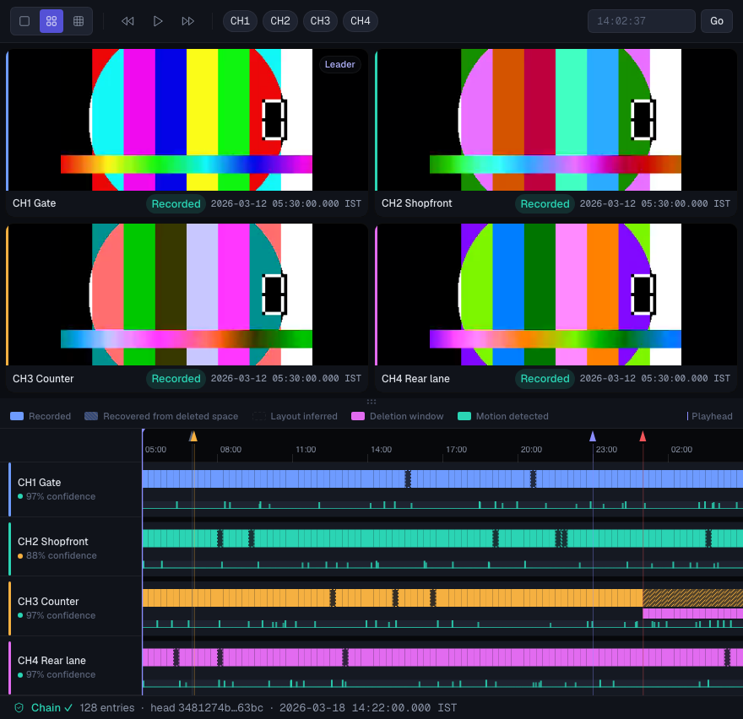
Pramaan — one workflow from any DVR disk to a Section 63-ready evidence package
<TEAM_NAME>
Any DVR/NVR disk in; a signed, independently verifiable evidence package out. Fully offline.
❖ Proposed Solution — what it does
1 Image
read-only E01 / raw
2 Hash
SHA-256 + MD5
3 Identify OEM
→ tier A / B / C
4 Parse + recover
incl. deleted footage
5 Normalise time
four clocks → IST
6 Sign
report + s.63 cert
❖ How it addresses the problem
Vendor-agnostic tiers: A parse · B infer layout · C carve
No vendor player: footage from every OEM in one workspace
Offline: air-gapped workstation, no telemetry
Evidence read-only: originals never re-encoded (stream copy)
Traceable: every finding links back to disk bytes
❖ Innovation and uniqueness
Format inference: undocumented vendors, proven on an unknown synthetic vendor
Four-clock time: header, index, on-screen OCR, log clock changes
Deletion verdict: method + actor from device logs
Custody: Ed25519 hash chain + Merkle-anchored case root
Prove it: any frame → its disk sectors + live SHA-256
Review workspace (synthetic case)

Slide 3
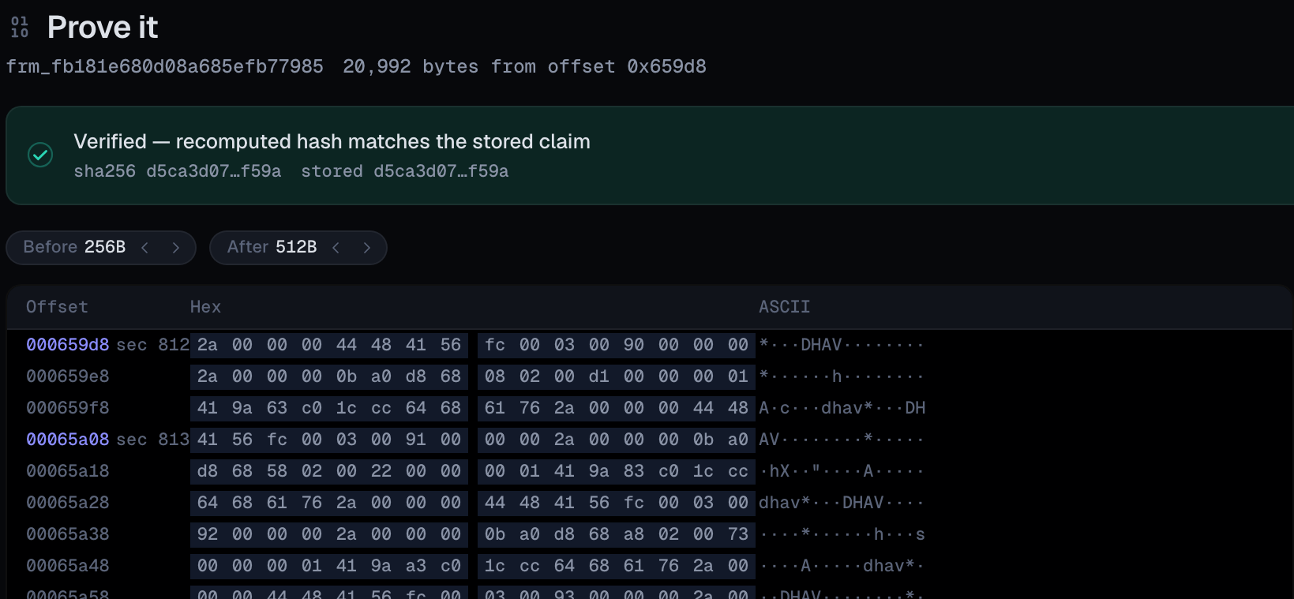
TECHNICAL APPROACH
<TEAM_NAME>
A deterministic Rust + Python forensic core; the LLM stays outside the evidence path.
❖ Technologies to be used
❖ Methodology and process for implementation
Rust scanner PyO3
Python 3.11 core
Evidence path: one-way, read-only, deterministic
DVR/NVR disk
Write-blocker
E01 / raw
Sources
Read-only
SHA-256
+ MD5
Re-verify
Acquire
Identify OEM
A: parse
B: infer
C: carve
Device logs
Core
Four-clock time
Deletion verdict
Motion triage
Analyse
Signed PDF
s.63 certificate
Signed MP4
Prove-it hex
Kaitai .ksy specs
FFmpeg stream copy
Output
DuckDB + Parquet
FastAPI + workers
React + TypeScript
PaddleOCR / ONNX
Ed25519 + Merkle
Claude API drafts only
Custody, alongside every hop: Ed25519-signed, hash-chained audit log → case Merkle root anchor (local ledger today; Fabric next)
LLM never sees frames or disk bytes
Same input + version → identical outputs
Every artefact records its provenance
Claude API (optional, off by default)
Structured metadata only; output is a labelled draft, never a finding
Prove it: a recovered frame's exact disk bytes, rehashed live

Slide 4
FEASIBILITY AND VIABILITY
<TEAM_NAME>
Working prototype today: all 10 validation targets met on our synthetic corpus.
❖ Validation vs PRD targets (synthetic)
❖ Analysis of the feasibility of the idea
Metric | Target | Result | Scored
Deleted-frame recovery | ≥ 95% | 100% | 5/10
Recovery precision | ≥ 99% | 100% | 7/10
Recording parse | 100% | 100% | 7/10
Timestamp error ≤ 1 s | ≥ 99% | 100% | 9/10
Deletion method | 100% | 100% | 6/10
Actor attribution | 100% | 100% | 3/10
Tier B inference fields | 100% | 100% | 2/10
Motion F1 | ≥ 80% | 100% | 6/10
Report determinism | yes | yes | 10/10
Read-only guarantee | yes | yes | 10/10
✓ Tier A parsers for 3 synthetic families
✓ Deleted footage recovered as playable, stream-copied clips
✓ Unknown-vendor layout inferred blind, then examiner-confirmed
✓ Signed PDF + BSA s.63 certificate, deterministic manifest
✓ Ed25519 custody chain + Merkle anchor, verified in UI
✓ E2E green at last run: 7/7 API, 7/7 browser
❖ Potential challenges and risks
❖ Strategies for overcoming these challenges
Encrypted disks on new STQC-era firmware
Logical acquisition fallback (ONVIF / RTSP); limitation stated in the report
Real disks differ from published layouts
Real-disk corpus next: 5–6 used recorders, same validation harness
Inferred layout mislabels a field
Confidence scores, examiner confirmation, tier labels A · B · C
Poor on-screen clock OCR
Four clocks cross-checked; per-channel offset with confidence
Synthetic corpus: 10 images modelled on published layouts (just validate). Real vendor disks not yet tested.
LLM invents a claim in a draft
Evidence-ID validator rejects unbacked sentences; draft label

Slide 5
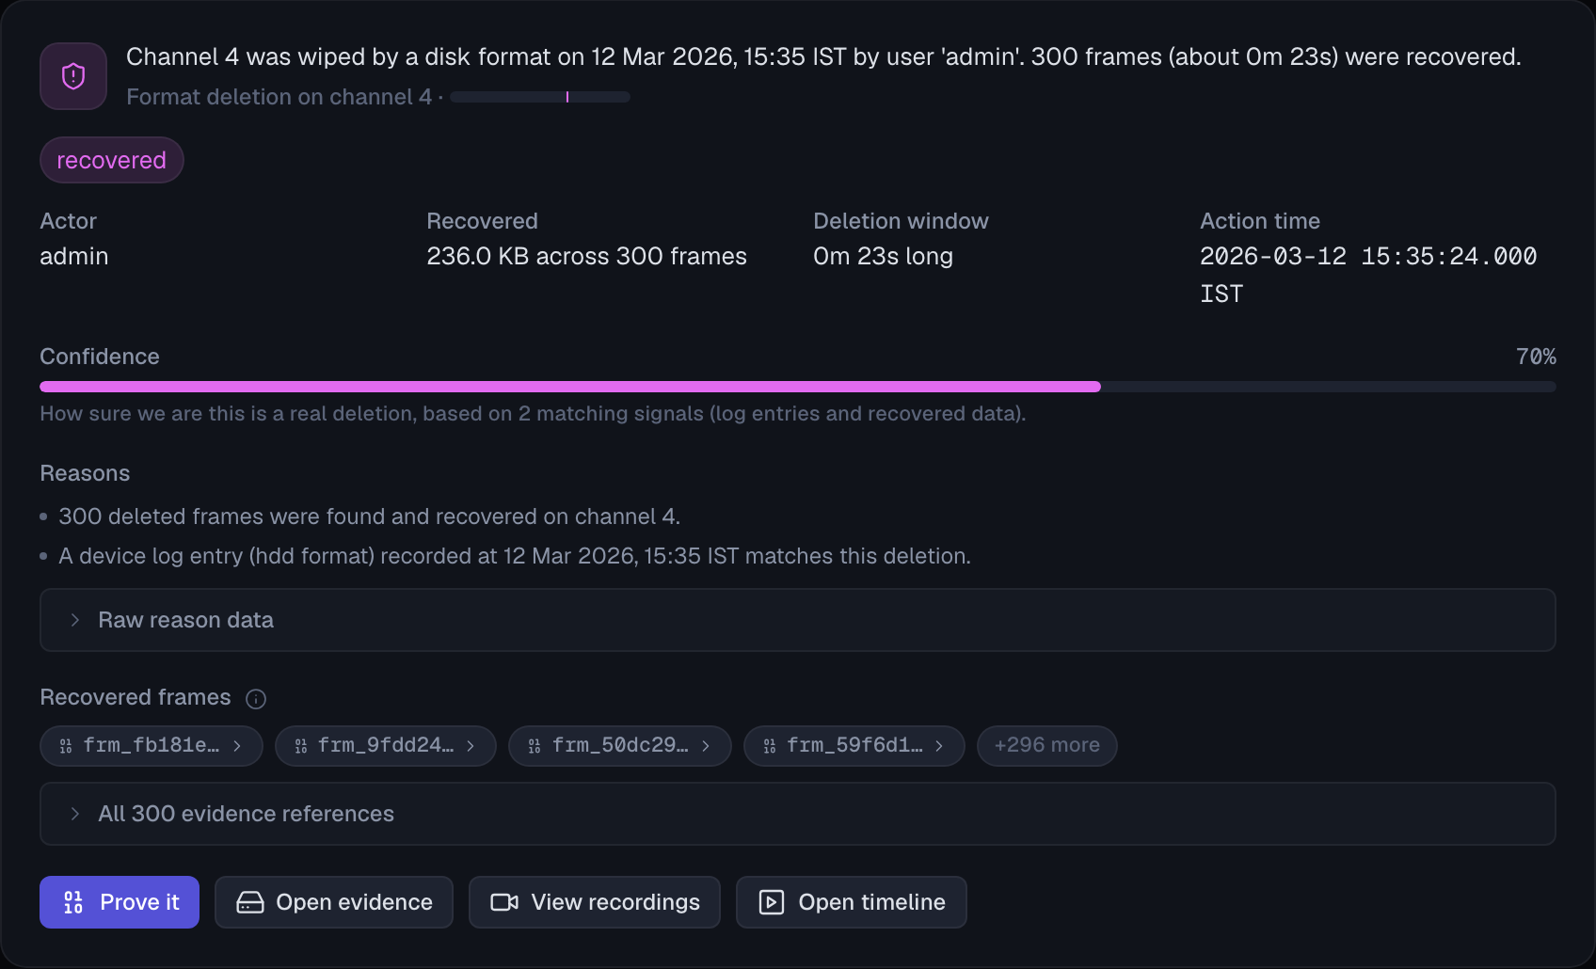
IMPACT AND BENEFITS
<TEAM_NAME>
One offline, court-ready workflow instead of vendor players and foreign suites.
❖ Potential impact on the target audience
Forensic labs
one SOP
Cyber cells
fast triage
Courts
verifiable hashes
NTRO
unknown OEMs
Single tool: one workflow in place of vendor players and foreign suites
Legal-ready: auto-filled BSA s.63 certificate; fits BNSS s.176(3) video workflows
Recovery: deleted footage, with method and actor from device logs
Triage: synced multi-camera timeline, jump straight to incident time
Deletion verdict from the device log (synthetic case)
❖ Benefits of the solution
Social
Faster justice: footage without vendor dependency
Reproducible method that courts can verify
Economic
No per-seat foreign licences; Make-in-India stack
Open, reviewable format specs per vendor
Security
Air-gapped: evidence never leaves the lab
LLM off by default, metadata only

Slide 6

RESEARCH AND REFERENCES
<TEAM_NAME>
Grounded in published DVR forensics research, open standards and Indian evidence law.
❖ Details / Links of the reference and research work
Han, Jeong & Lee · ICDF2C · 2015
Hikvision DVR file system → HIKSIM parser model
ONVIF Export File Format · IEC 62676-2-32
Signed export design (not yet conformance-tested)
1
6
Dragonas et al. · J. Forensic Sci. · 2023 / 2024
Hikvision and Dahua log records → actor attribution
NIST · NISTIR 8161 Rev. 1
CCTV digital video export profile → export design
2
7
Source code
github.com/MuaazSM/pramaan
Rzayeva et al. · Information · 2025
DVR recovery benchmark → our recovery target
BSA 2023 s.63 · Pune Bar Assn. v. UoI (2026)
Certificate format → auto-filled s.63 template
3
8
Demo video
<DEMO_VIDEO_URL>
Yoon & Hwang · DFRWS USA · 2026
Honeywell DVR file system → HWSIM parser model
NIST CFReDS · HeimVision DVR image
Public DVR image → planned smoke test
4
9
All results so far are on our synthetic corpus; real-disk validation is the next milestone.
SWGDE · DVR acquisition best practices · 2025
Seizure-clock SOP → intake fields, clock offset
MeitY / STQC · CCTV Essential Requirements
Firmware security shift → encrypted-disk risk
5
10

