Slide 1

Welcome

Slide 2
PROJECT 203 – GROUP 2
Project Guide
Ms. Neha Gupta
Project Co-Ordinator
Ms. Deepika
Team Members
Abhishek Tawale
Rajeshwari Pilankar
Ankita Tarkase
Payal Aher
Manihar Muajjam
T.Siva Chaitanya

Slide 3
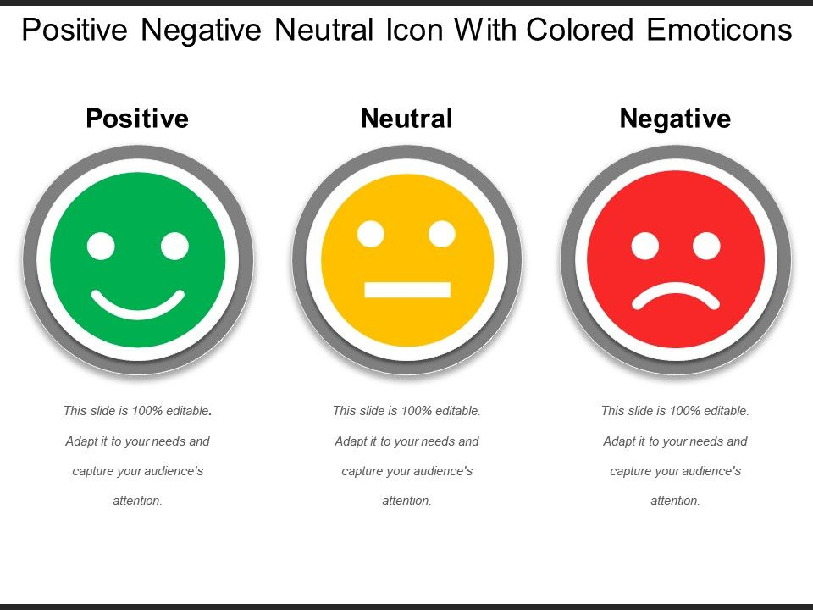
Business Objective
Need to Perform Sentimental Analysis of Financial Statements and Guage it's impact i.e,
Positive , Negative or Neutral.

Slide 4
Inroduction
Sentiment analysis in finance involves applying natural language processing (NLP) techniques to automatically categorize the sentiment of financial news articles, tweets, and other data sources as either positive, negative, or neutral.
It is used to gain insights into the market sentiment about a particular company or financial asset, which can be useful in making investment decisions.
The output of sentiment analysis can be used to determine market sentiment about a particular asset or company, and can be used to predict future price movements

Slide 5
Dataset
Financial sentiment analysis datasets contain a collection of financial news articles, social media posts and other textual data related to the financial industry .
The dataset contains labeled data, which is classified as positive, negative, or neutral sentiment, allowing for the training of machine learning models.

Slide 6
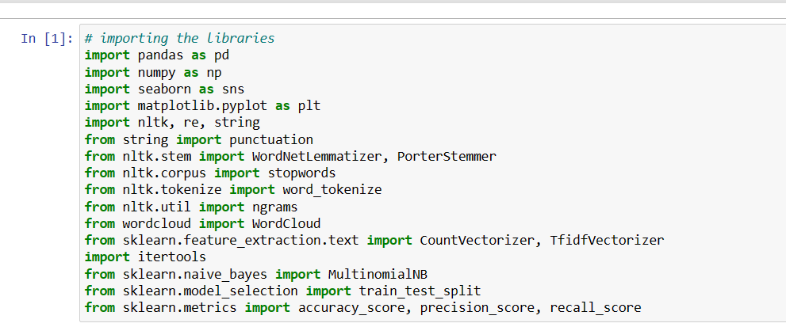
# Importing the libraries

Slide 7
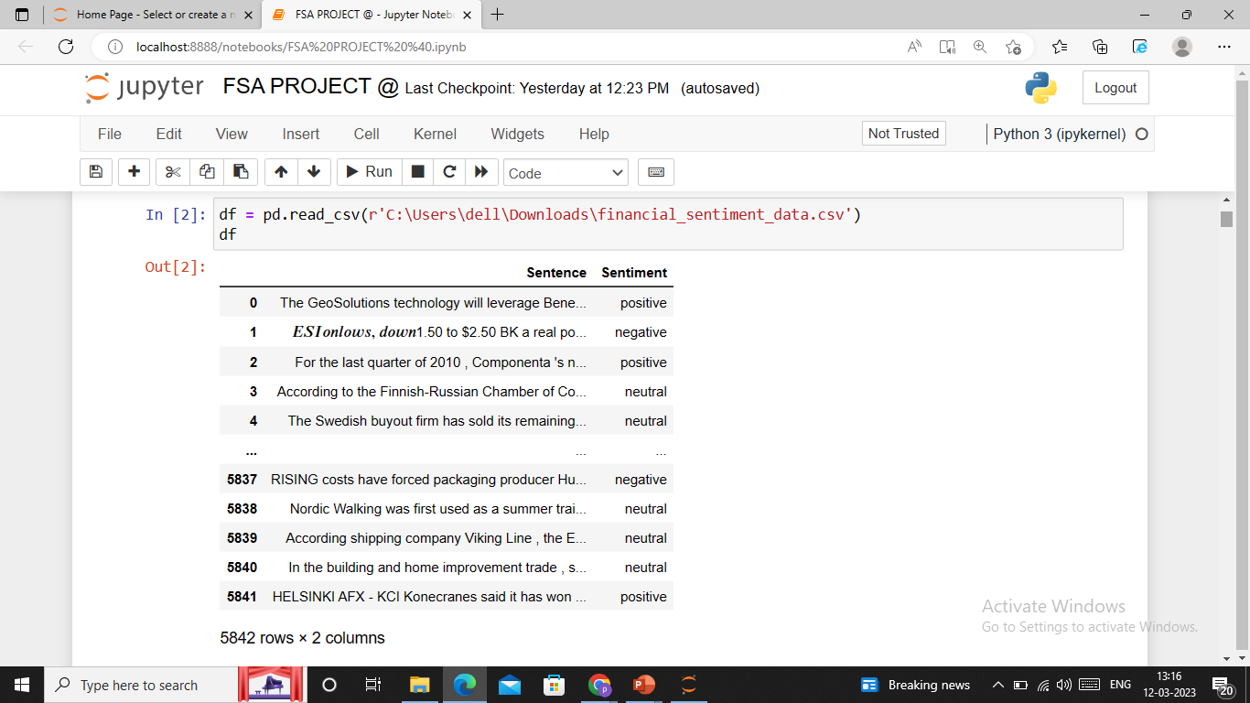
One dataset are being provided:
It consists of 5842 rows and 2 columns.
Dataset consists of two features Sentence and Sentiment

Slide 8
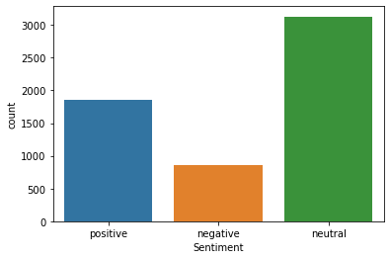
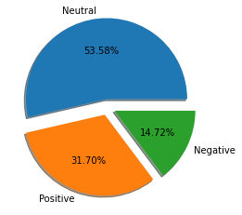
Distribution of the Dataset
It is obvious that the Sentiment “Neutral” is the dominant one. Having an unbalanced dataset may lead us to
classifiers/models that can not identify and classify cases that belong to positive or negative Sentiments and they may misclassify them.

Slide 9
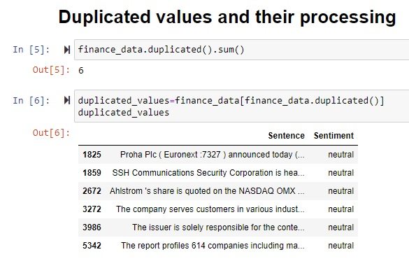
Pre Proccessing
6 duplicated rows are removed.
Checking for the duplicated rows
The actual emotion from the duplicated data are found for best dataset.

Slide 10
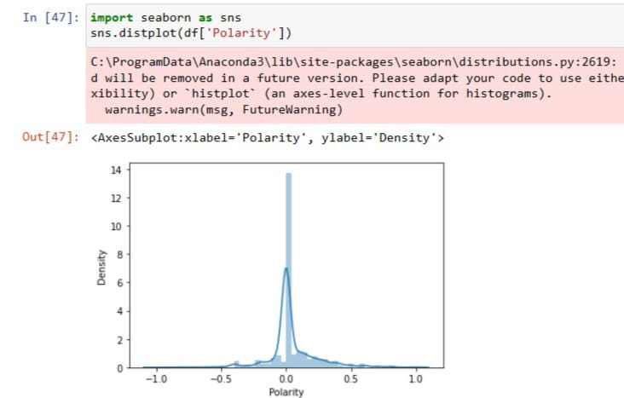
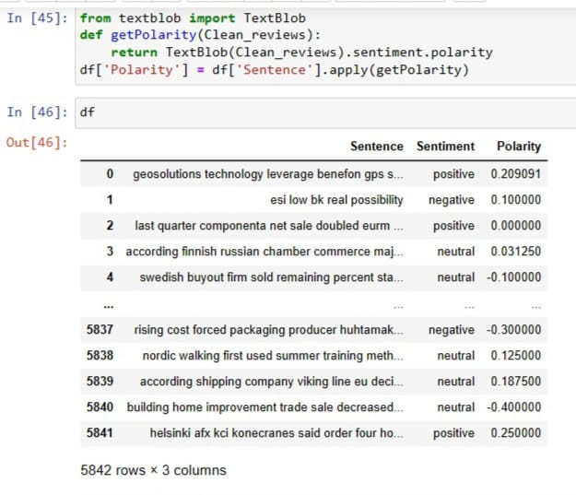
Polarity
Polarity score has been checked against each sentiment
From the description we cannot make the abrupt threshold function since it is mixed up in the dataset

Slide 11
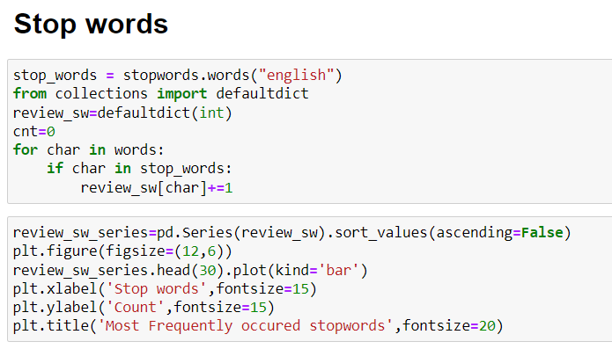
Stop Words
After analyzing the text data, it was observed that certain words appeared more commonly than others. These included common stopwords like "the", "of", "an", "to", "and", "a", "for", "from", "is", "will", "on", and "by“ etc….

Slide 12
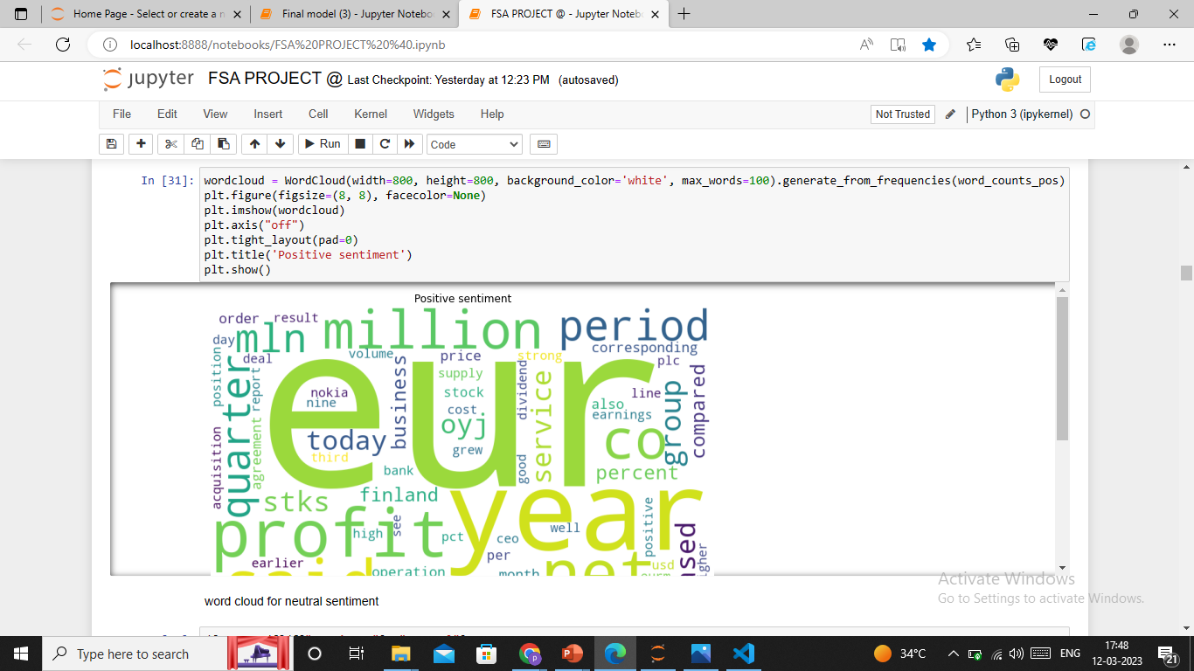
Positive Words

Slide 13
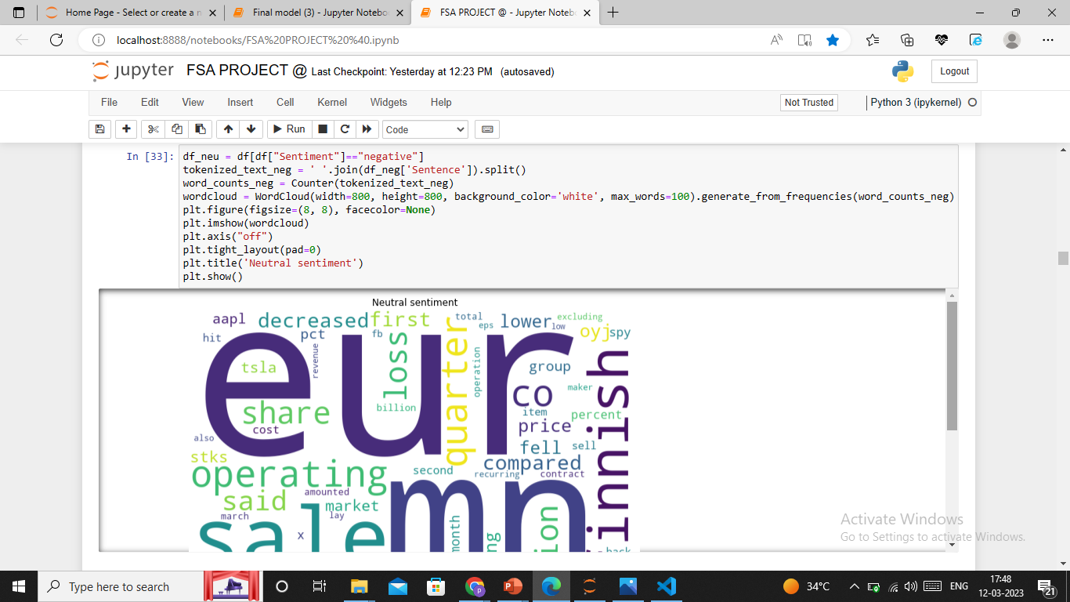
Negative word

Slide 14
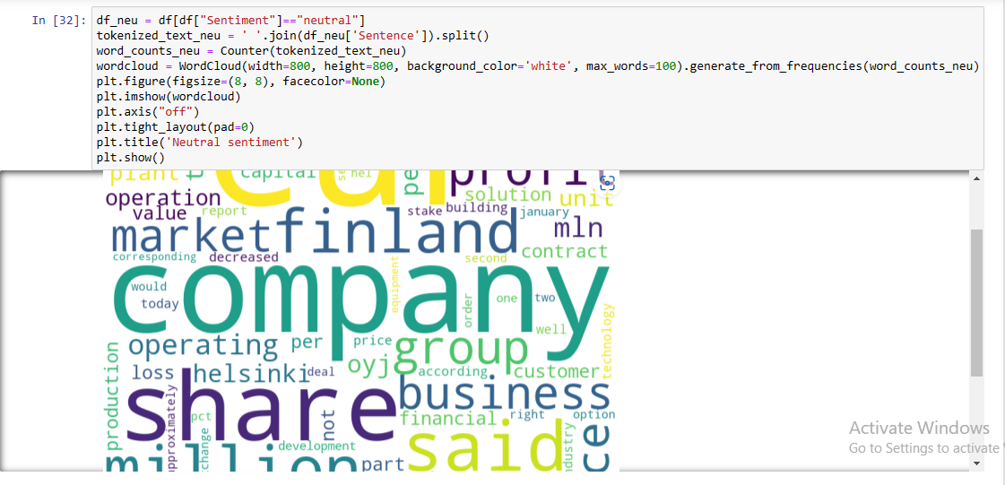
Neutral Words

Slide 15
Model Building

Slide 16
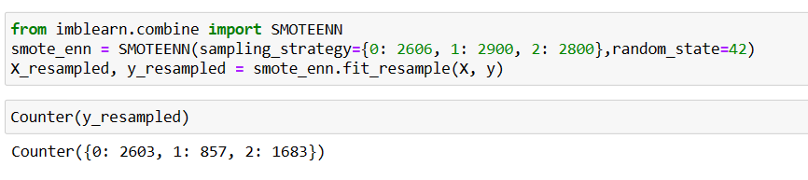
SMOTEENN combination of up and down sampling

Slide 17
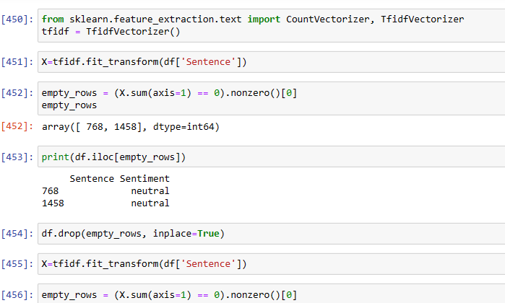
TF – IDF

Slide 18
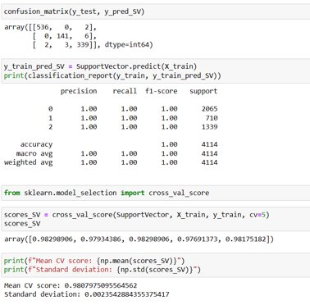
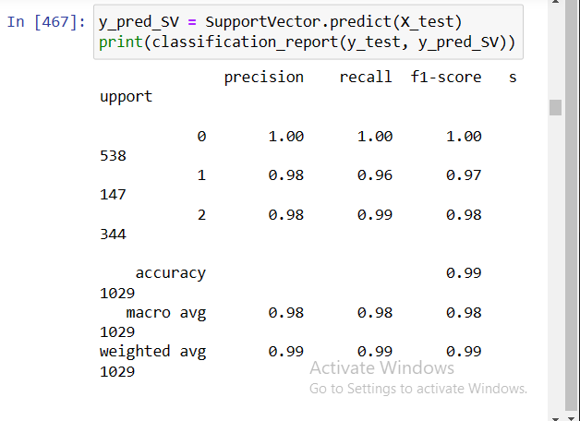
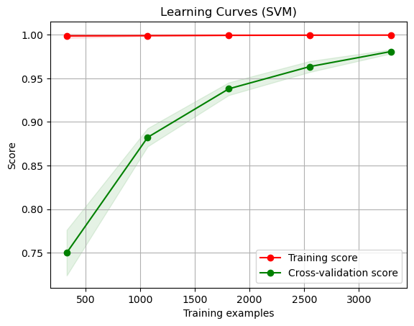
Support Vector Machine

Slide 19
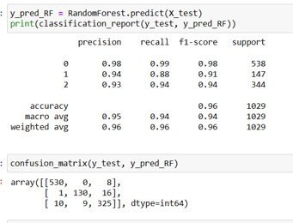
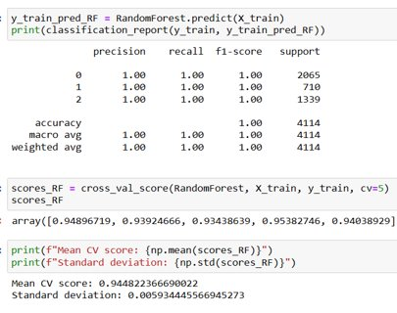
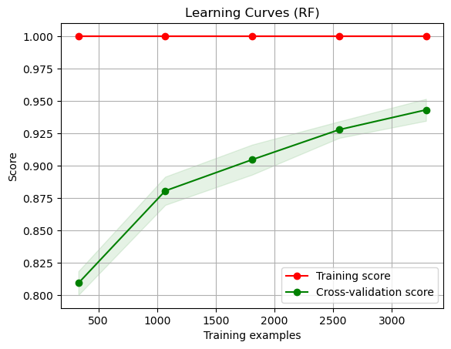
Random Forest

Slide 20
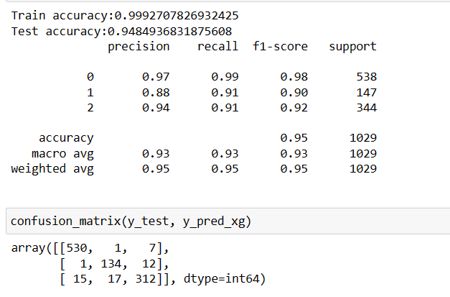
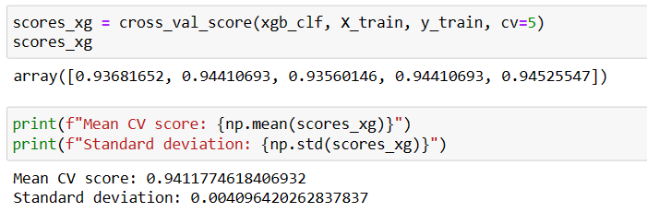
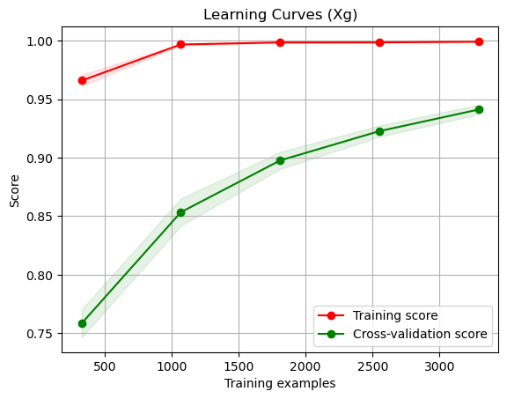
XGBoost

Slide 21
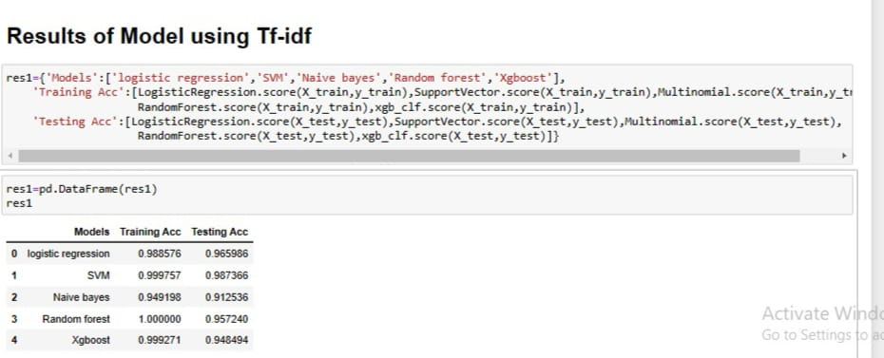
Results of Model using Tf-idf
conclusions:
SVM outperformed the other models on both the train and test sets, achieving an accuracy of 99.98% on the train set and 98.74% on the test set.
Logistic regression also performed well, achieving an accuracy of 98.86% on the train set and 96.60% on the test set.
Naive Bayes had the lowest performance of the models evaluated, achieving an accuracy of 94.92% on the train set and 91.25% on the test set.
Random forest and XGBoost both achieved perfect accuracy on the train set, but their test set performances were not as high as the other models.

Slide 22
Word 2 Vector

Slide 23
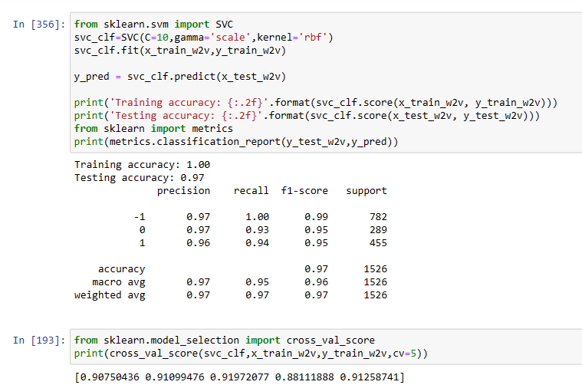
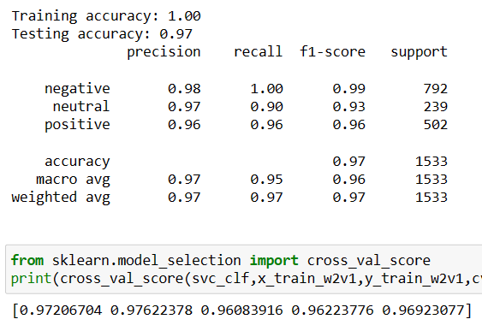
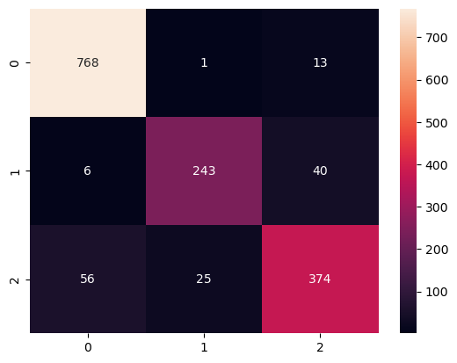
SVM

Slide 24
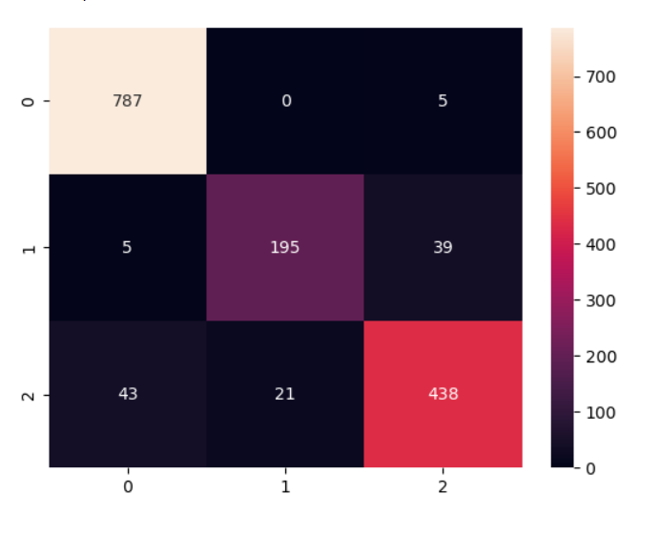
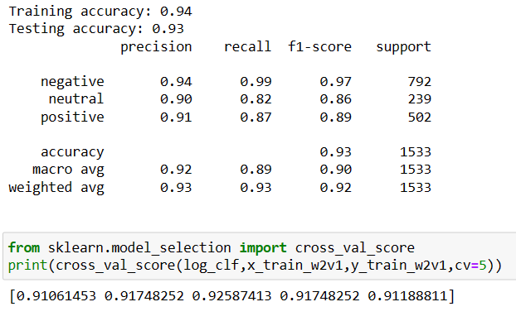
Logistic Regression

Slide 25
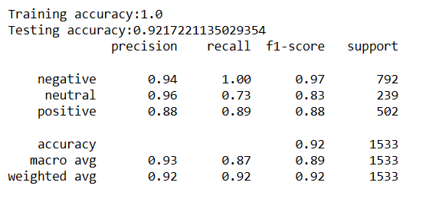
Random Forest

Slide 26
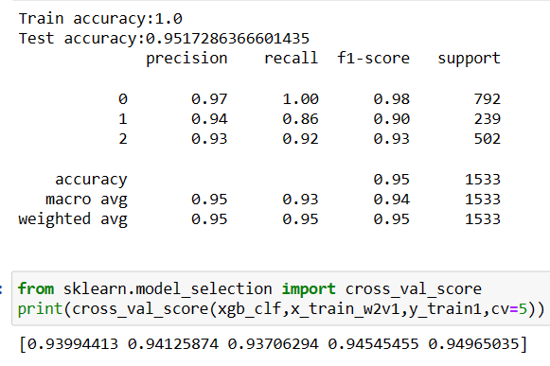
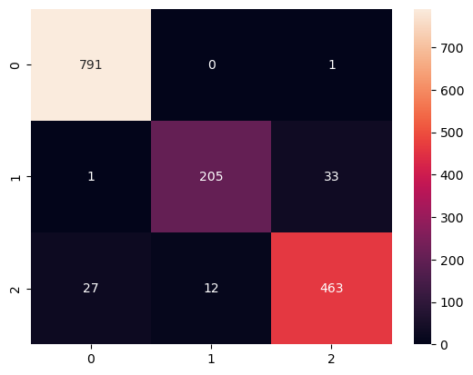
XGBoost

Slide 27
It can be concluded that
Logistic Regression achieved a train accuracy of 0.919101 and a test accuracy of 0.907602.
SVM achieved a train accuracy of 0.995506 and a test accuracy of 0.967235.
Random Forest achieved a train accuracy of 1.000000 and a test accuracy of 0.954128.
Xgboost achieved a train accuracy of 1.000000 and a test accuracy of 0.962647

Slide 28
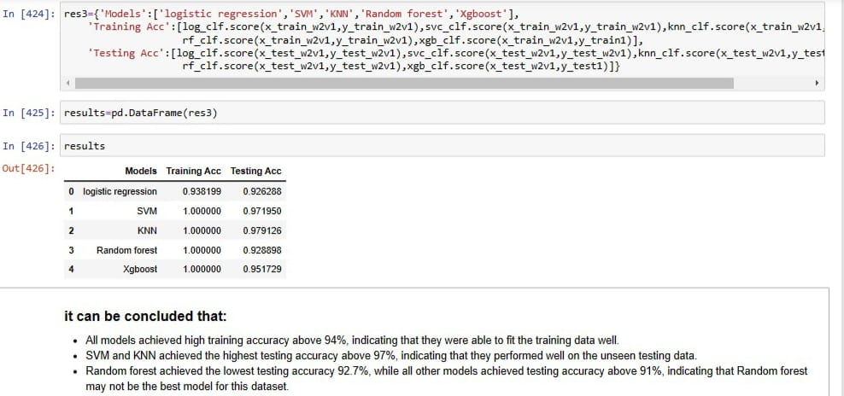
Results of Pretrained Word2vec model
All models achieved high training accuracy above 94%, indicating that they were able to fit the training data well.
SVM and KNN achieved the highest testing accuracy above 97%, indicating that they performed well on the unseen testing data.
Random forest achieved the lowest testing accuracy 92.7%, while all other models achieved testing accuracy above 91%, indicating that Random forest may not be the best model for this dataset.

Slide 29
Model Deployment

Slide 30
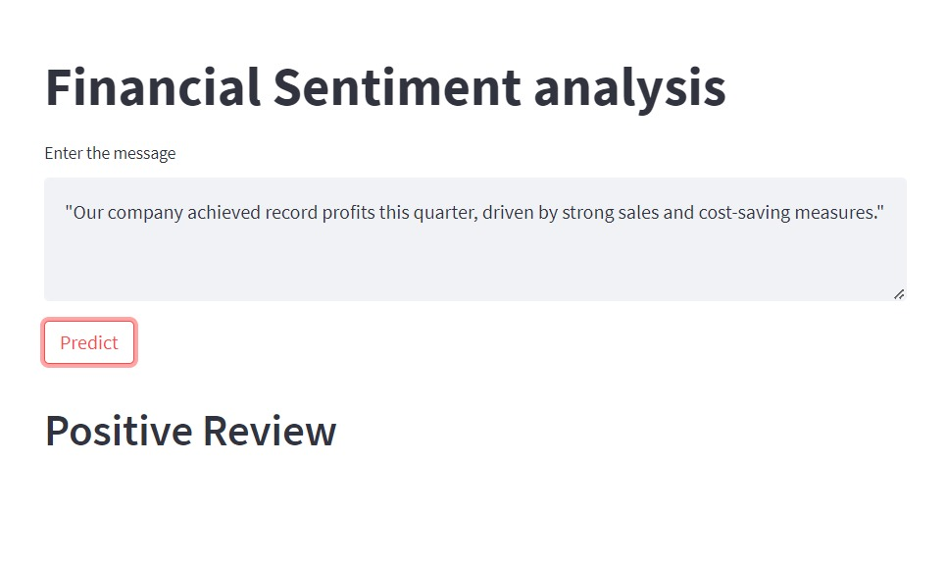
Positive Review

Slide 31
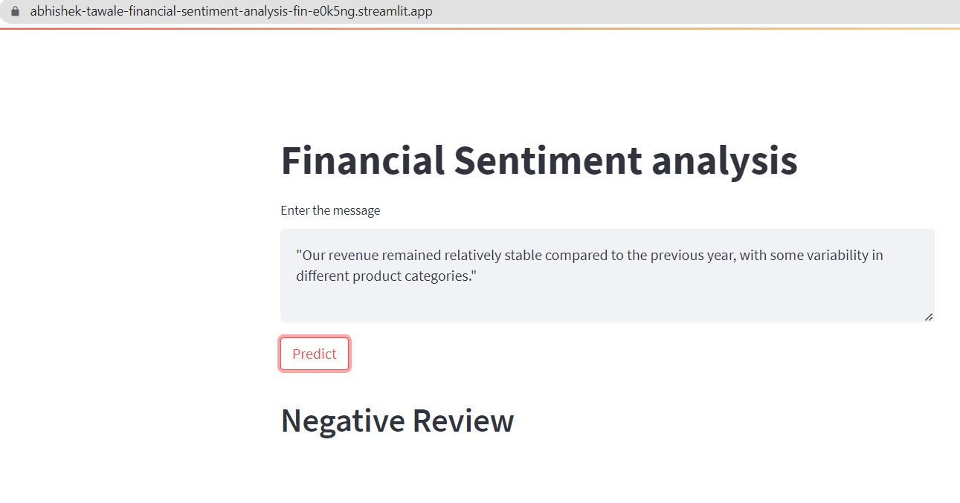
Negative Review

Slide 32
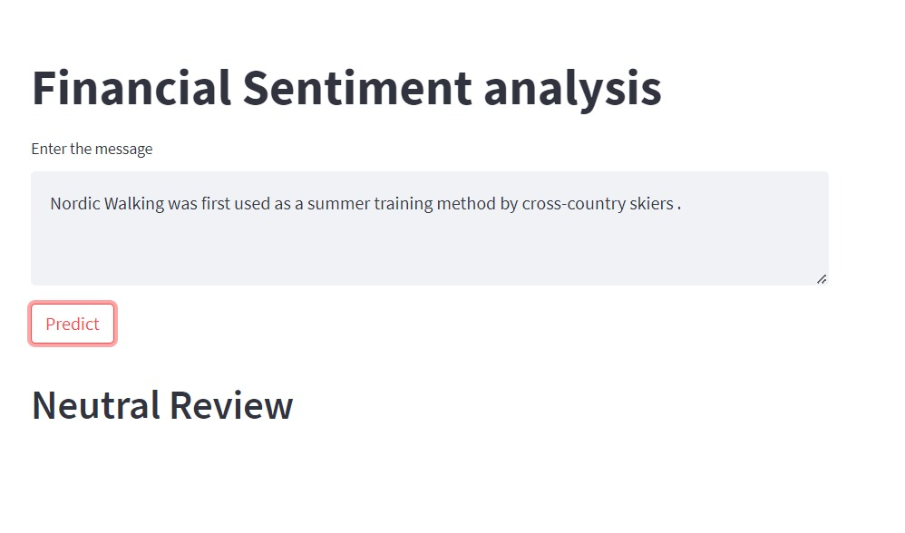
Neutral Review

Slide 33
Thank You

