Slide 1

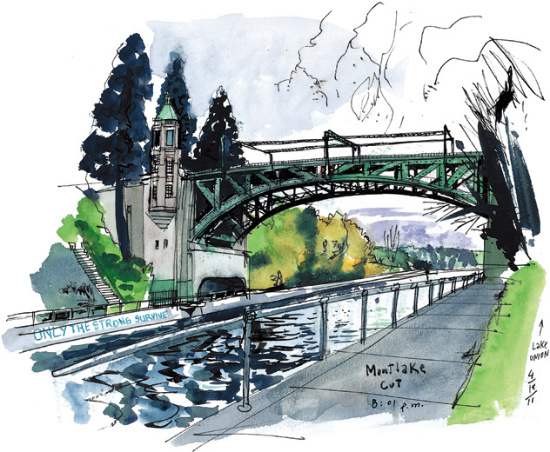
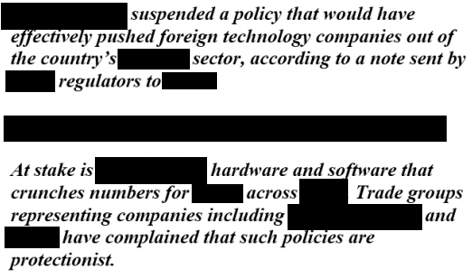


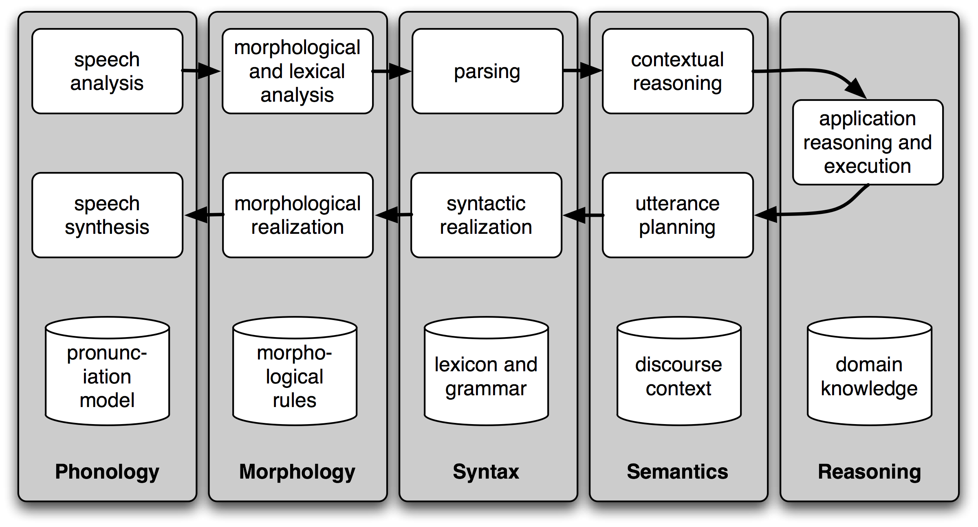
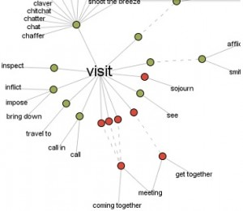


Emoveo: A Declassification Solution
Jackie Li
Readability
Balance & Flexibility
Solution
At the end, the text maintains the same formatting and ensures enough information is retained but sensitive information is removed.
Sufficient user control in addition to targeted, and automated redaction of sections of texts to specific topics and content.
Issue 3: NLP
Reliability of NLP as a consistent solution.
Strong Word-Relation
Issue 2: Time
Using online sources such as Wikipedia to build relevant keyword relations for better context and targeted search.
Issue 1: Volume
Time-Cost Trade affects quality: 2 full time employees per 1 GB of documents,
The amount of information that needs to be processed is large. at certain agencies, classified records have increased by 1 million gigabytes every 18 months
Scope
Emoveo means “to cut” or “to remove” in latin. Declassification is an important process in information protection and access today. The need to provide a strong balance between the two have not been easy. Traditional redaction, used to sanitize documents, have removed too much or too little from documents. The goal of Emoveo is to allow agencies and users to provide a balance between the two.

