Slide 1
RootIQ — Find the cause before it becomes an outage
Alert storm → one incident → evidence-backed RCA → approve-only remediation
Venture X · Infrastructure & Cloud
Source of numbers: docs/RESULTS.md · Architecture: docs/ARCHITECTURE.md

Slide 2
The NOC problem
Dozens of alerts across router, DNS, and app — engineer correlating by hand
Black-box tools hide why; auto-remediation without approval is a non-starter
RootIQ: one correlated incident, ranked cause with evidence, human gate

Slide 3
Promise
Under 60 seconds from inject to clear root cause
Every remediation requires engineer approve/reject (audit logged)
Works sim-first; live EVE-NG lab when venue network is ready

Slide 4
Lab topology
R1 · SW1/SW2 · APP-01 (DNS+Web) · COLLECTOR-01
SNMP / ICMP / DNS / HTTP / Syslog → normalized events

Slide 5
How it works
Detect → Correlate → Rank (graph) → Explain (grounded) → Act (whitelist)

Slide 6
Modes
sim = in-process simulator (default / backup)
live = EVE + collector + lab agent

Slide 7
Security
Read-oriented collect · fixed action whitelist · audit log · private deploy

Slide 8
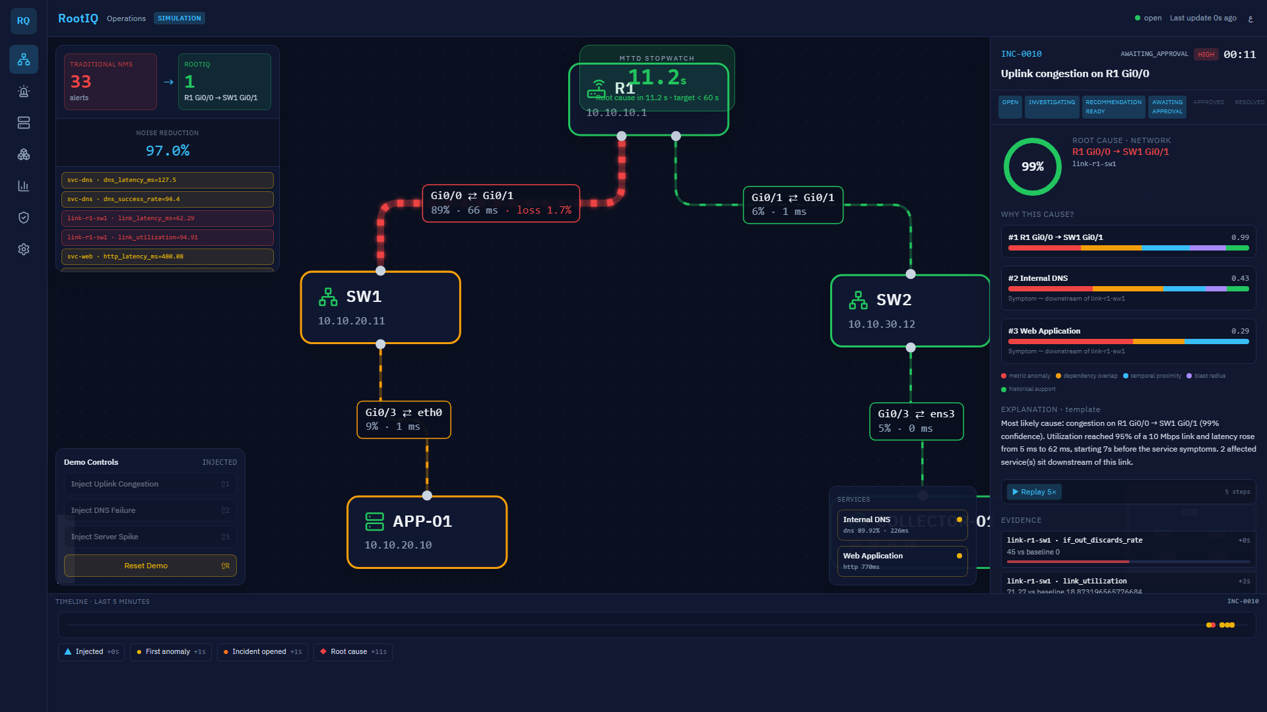
Demo — live map during incident

Slide 9
Measured in our lab (not pilot targets)
Time to correlated RCA: target < 60 s → measured 12.3 s (avg of 9 runs)
Root ranking: target Top 3 → Top-1 correct 9/9
Alert noise reduction: target 30% → measured 96.3%
Human approval before remediation: 100% → 100% (Audit)
Source: GET /api/runs after backend/scripts/day12_measure.py → docs/RESULTS.md

Slide 10

Why RootIQ is explainable
CandidateRanking with score components · EvidenceList of measured metrics
Grounded explanation: numbers must exist in evidence (LLM optional, never invents)

Slide 11
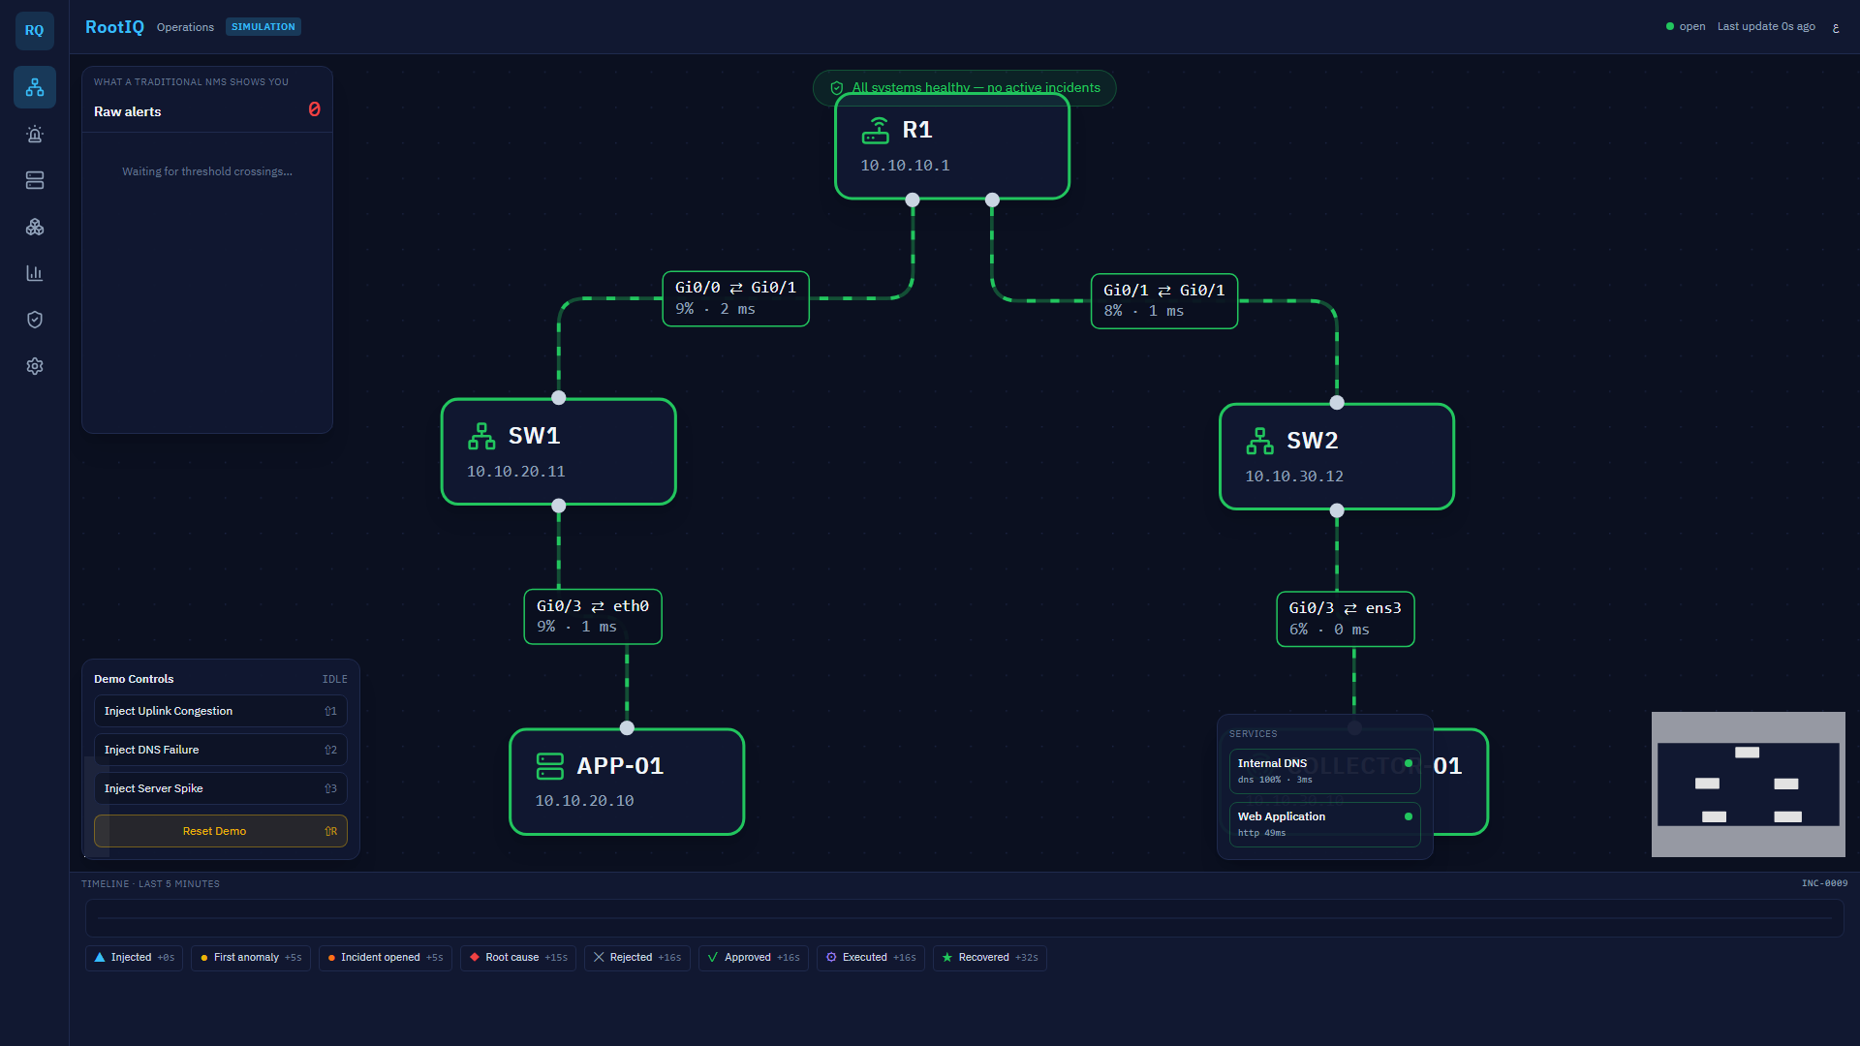
Architecture
EVE lab → Collector → FastAPI ingest → State/Detector → Correlator → RCA+Graph → Explanation
→ WebSocket → React dashboard → approve/reject → Action service → Lab agent → R1
PostgreSQL when Docker is up · Full Mermaid: docs/ARCHITECTURE.md

Slide 12
RootIQ
Find the cause before it becomes an outage.
Measured: 12.3 s RCA · 9/9 top-1 · 96.3% noise ↓ · 100% approval

