Slide 1

Departmental Store Business Analysis
This presentation explores the analysis of sales performance data for a departmental store.
The goal is to understand factors influencing sales and revenue, identify improvement areas, and optimize sales strategies.
By:
Hadia Amir (FA23-BBA-049)
Mustafa Mairaj (FA23-BBA-098)
Amina Zahid (FA23-BBA-019)
Daniyal Nadeem (FA23-BBA-040)
Khawaja Muhammad Muaz (FA23-BBA-065)

Slide 2
Dataset Overview
Key Columns
Additional Data
Customer Insights
Branch
Product Line
Tax 5%
City
Unit Price
Date
Customer Type
Quantity
Time
Gender
Total Sale
Payment
Rating

Slide 3
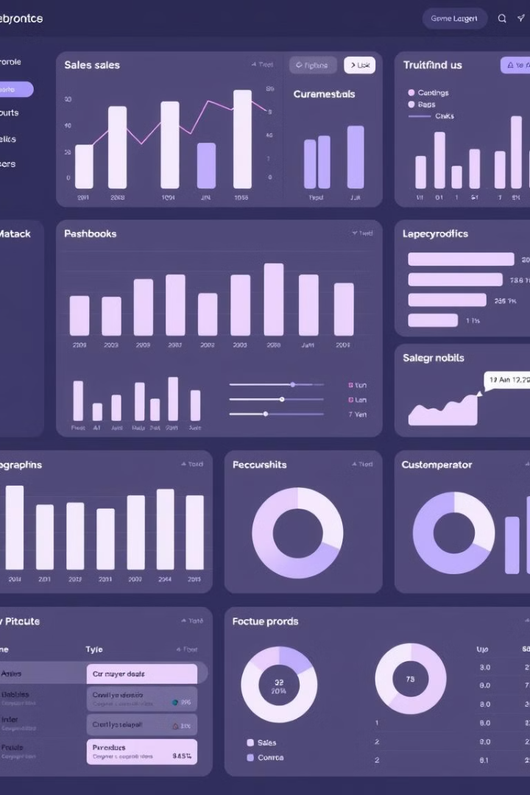
Key Findings
1
Branch C Dominates
2
Health and Beauty Leads
Branch C had the highest total sales, followed by Branch A and Branch B.
Health and Beauty was the top product line in terms of revenue.
3
Gender Revenue Gap
4
E-Wallet Preference
E-Wallet was the most frequently used payment method.
Male customers contributed slightly more to revenue than female customers.

Slide 4
Data Analysis & Visualization
Line Graph
Bar Graph
Total Sales by Branch: Visualizes sales performance for each branch over time.
Average Quantity Sold by Product Line: Shows the average number of units sold for each product line.

Slide 5

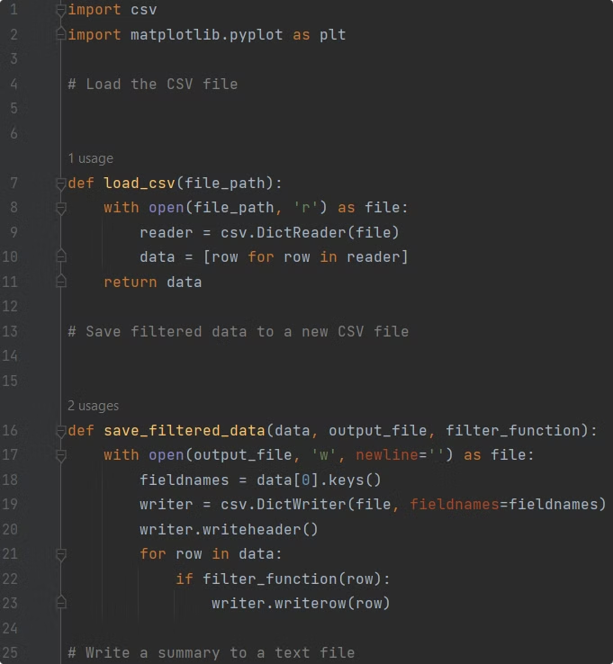
Code Structure
Data Loading
Data Analysis
load\_csv() function reads data from a CSV file into the program.
Functions perform calculations for key insights like total sales, branch rankings, etc.
Data Visualization
Functions create graphs using Matplotlib library, e.g., plot\_branch\_sales(), plot\_gender\_revenue()

Slide 6
User Input & Filtering
Dynamic Filtering
Data Saving
The program allows dynamic filtering based on user input, such as sales with unit prices above a threshold.
Filtered data is saved into a new CSV file (filtered\_data.csv) for further analysis.

Slide 7

Conclusion
1
Actionable Insights
2
Data-Driven Decisions
The project delivered actionable insights into branch performance, customer preferences, and product trends.
The results can guide future sales strategies, marketing campaigns, and product development initiatives.

Slide 8
Future Improvements
1
Enhance Data Manipulation
Use of pandas for more efficient data manipulation.
2
Advanced Visualizations
Incorporation of advanced visualizations (e.g., heatmaps, pie charts).
3
Automated Reporting
Automation of user report generation in PDF format.

