Slide 1
Doubt Resolution
Module - 1

Slide 2
Sreekumar MS
We have learned a few of the Supervised and Unsupervised learning algorithms. I see a lot of others listed in the ML books. Can we quickly brief upon others that we have not discussed, why they are relevant or not relevant, so that we have a complete intuition of the ML learning landscape and can refer and learn those at our own pace later. On a separate note we have discussed academic datasets and problems during our review. Can Professors at IIT share one of their real life projects(image processing, geo/climate informatics.. etc), the challenges they faced and walk us through the scenarios so that we can see how theory was put into practice.?

Slide 3
Week 1
Data analysis, pre-processing and visualization, ML workflow, cross-validation, error types and performance metrics

Slide 4
Amol Shrikrishna Tathe
1. Need to understand with simple real example once again
Manoj Majumdar
2. Please provide practical use cases, taking a problem scenario faced in large industries with huge data, and how that gets solved using
ML libraries. Also discuss when to use which library.

Slide 5
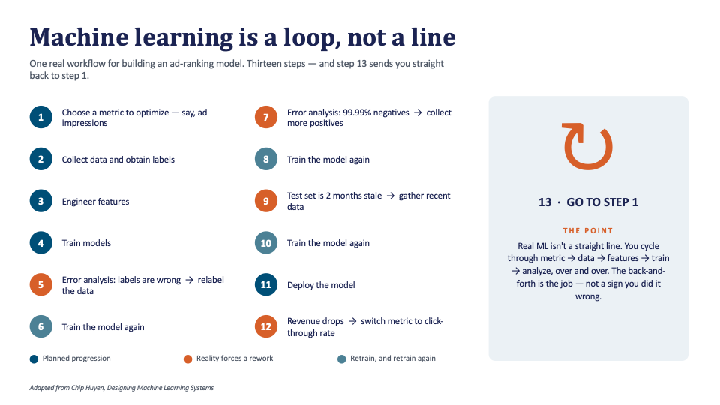

Slide 6
Libraries:
Numpy
Pandas
MatplotLib
Scikit Learn

Slide 7
Ramkumar Pitchai
3. Lot of concepts were taught, however, the big picture was missing. I want to understand the sequence of steps such as EDA, Pre-Processing, De-duplicating and so on and how they fit together when we come up with a solution. What are the standard pre-requisite steps along with their sample implementation.
Aruna dubey
What is ML workflow, cross validation,error types and performance metrics?
Ajit Kumar Polai
4. 1. As we have followed one type of dataset and we did same kind of data analysis and preprocessing. Overally considering real time projects, What analysis and activity should be done before train test split and what all after split and also what can be done before or after split. 2. We have different imputing, scaling, etc techniques. Can you explain different techniques and which techniques is best suitable for which type of dataset. 3. We covered many concepts related to model and optimization techniques. So I want to understand the thought process we should have to develop the model for the given dataset. Like after getting dataset first we have to indentify the problem type whether it is regression or classification. If it is regression what things should be considered like that.
Akshay Ranga H
5. There are n number of preprocessing techniques and the lecture was good enough. But what i fail to under is the intuition of what to do and what type of pre-processing techniques to apply for various kind of numerical and text like data and for multi variate analysis is missed!

Slide 8
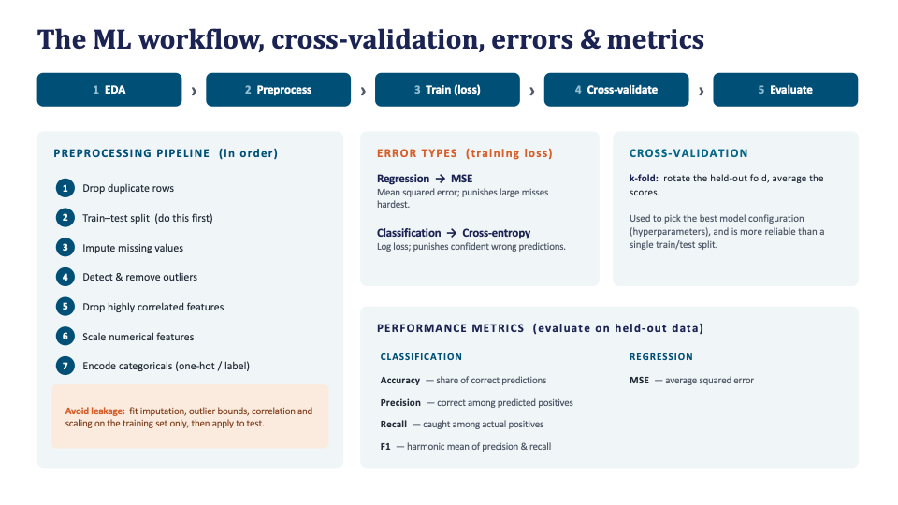

Slide 9
Ashok Kakade
6. Why is k-fold cross-validation more expensive but more reliable. What exactly does it protect against that a single train/test split doesn't?
Train-validation-test
Trains the model K times
Fortunate/Unfortunate split

Slide 10
Week 2
Supervised learning: linear and logistic regression

Slide 11
Aruna dubey
1. Please explain supervised learning why need linear and logistic regression also explain linear and logistic regression in real world
Akshay Ranga H
2. Is there any ideal process in training a model using linear and logistic regression? I fail to make an intution of When to use what. Is there a good way to correlate the concept to a problem statement

Slide 12
Madhumitha Prabakar
3. How to choose a model? Should we try with different models and chose the one with better accuracy?
Evaluation Metric
Interpretability
Training time
Inference latency
Memory usage

Slide 13
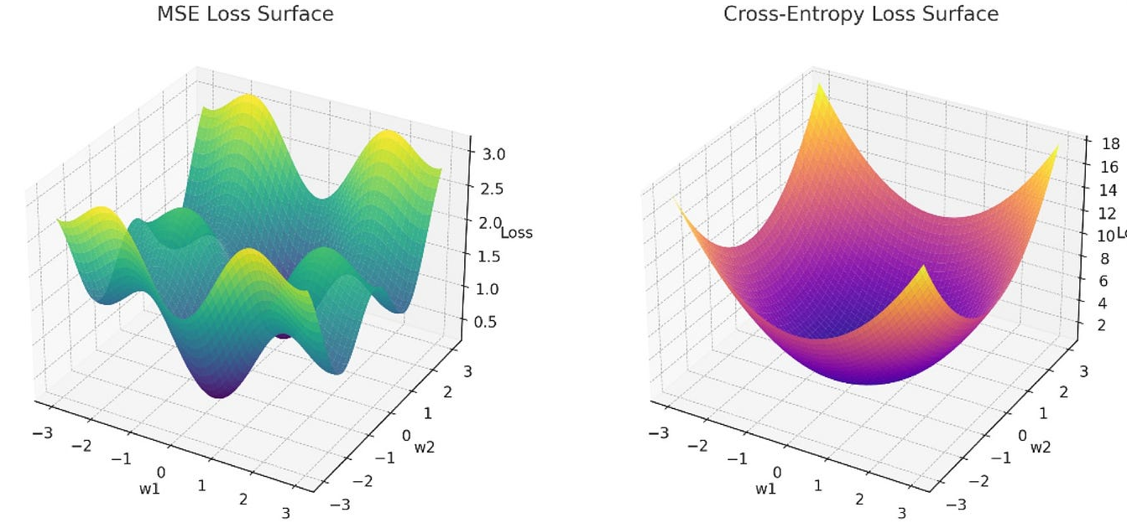
Ashok Kakade
4. Linear Regression uses Mean Squared Error as its loss function, but Logistic Regression Log Loss, entropy. why MSE we can't use with both?

Slide 14
Week 3
Supervised Learning: Decision trees and support vector machines

Slide 15
Aruna dubey
1. What is decision trees explain I details and support vector machine with few example
Ashok Kakade
2. A Decision Tree and an SVM are both trained on the same 2D classification dataset with two overlapping classes After training, the Decision Tree gets almost 100% training accuracy but the SVM (with a soft margin) gets only nearby 92% training accuracy, yet the SVM generalizes better on the test set. What is the Decision Tree doing differently that lets it hit 100%, and why does the SVM deliberately accept some misclassified training points instead of also trying to fit them perfectly?

Slide 16
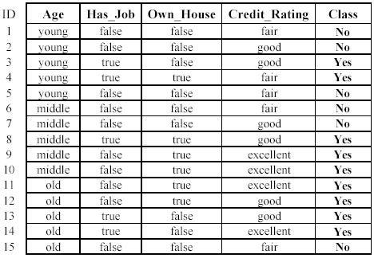
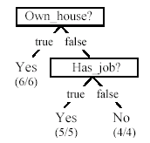
Decision Trees
Start with the entire training dataset as the root node.
Evaluate all possible splits for every feature.
Compute the weighted Gini impurity for each split.
Select the split with the lowest weighted Gini impurity.
Split the data into left and right child nodes.
Repeat recursively for each child node.
Stop when a stopping criterion is met (pure node, max depth, minimum samples, etc.).
Assign the majority class to each leaf node.

Slide 17
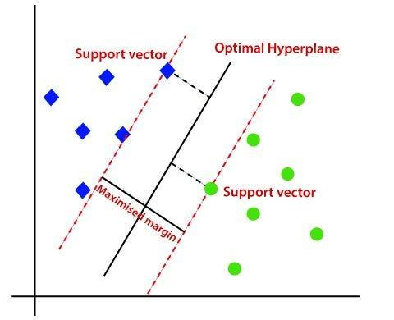

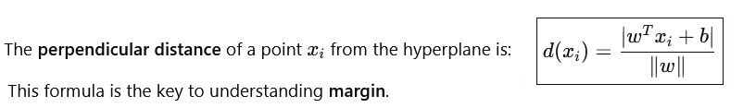
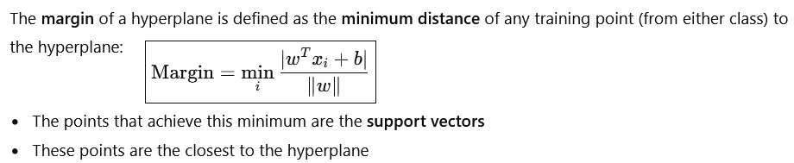



Support Vectors Machines

Slide 18




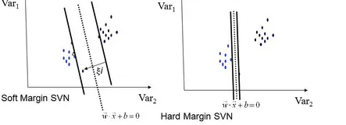

Hard-Margin vs Soft-Margin SVM
Hard-Margin SVM
Assumes perfect linear separability
No misclassification allowed
Soft-Margin SVM
Introduce slack variables ξi​≥0
Optimization problem:

Slide 19
Madhumitha Prabakar
3. Decision trees and SVM - are there any practical use cases in industries that you can give as example? Product rating was one. Can you give more? And when do we chose these models over the other ?
Choose a Decision Tree when:
Explainability is critical.
Business users need clear decision rules.
Choose an SVM when:
The number of features is very large.
High classification accuracy is more important than interpretability.

Slide 20
Week 4
Ensemble methods: Bagging and random forests, adaptive boosting and gradient boosting

Slide 21
G M Waseem
1. Need a full session on all the topics again from this session
Aruna dubey
2. What is bagging,boosting, Ada boosting and also explain gradient decent with example
Ashok Kakade
3. Random Forest reduces variance by averaging many trees trained on random subsets of data and features but if all the trees end up highly correlated, that averaging benefit weakens. What specifically does Random Forest do differently from plain Bagging to keep the trees less correlated?

Slide 22
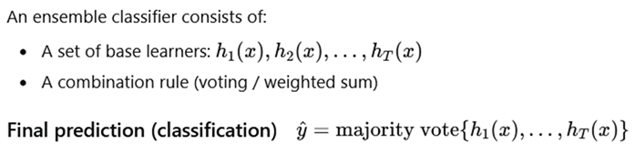
Why Ensemble Learning?
Instead of relying on a single classifier, combine multiple classifiers to obtain a stronger model.
Why single models fail?
High bias → underfitting (e.g., linear models)
High variance → overfitting (e.g., decision trees)
Sensitive to noise and sampling variation
📌 Ensemble methods aim to reduce error by aggregation.
What Is an Ensemble?

Slide 23
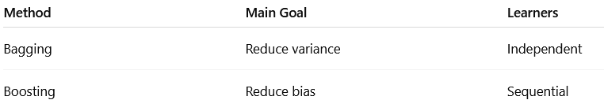
Types of Ensemble Methods
Notes:
‹#›

Slide 24
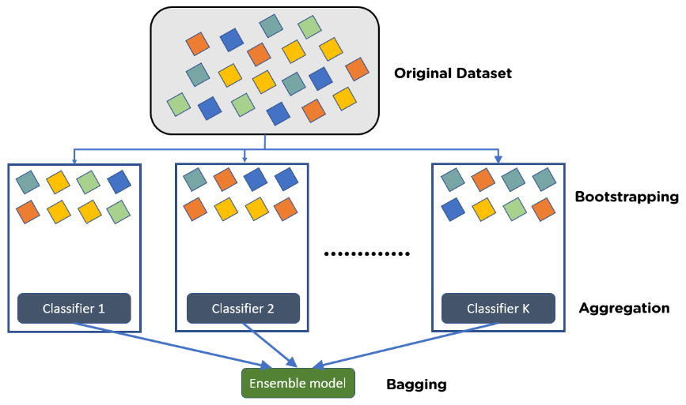

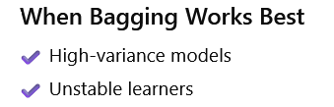
Bagging (Bootstrap Aggregating)
Bagging is an ensemble technique that reduces variance by training many models independently on different bootstrap samples of the same dataset and aggregating their predictions.
Core Idea (Intuition)
Resample the data many times (with replacement).
Train one model per sample (all in parallel).
Aggregate predictions (vote/average).
Why Bagging is Needed (Motivation)
Some learning algorithms (especially decision trees) are high-variance
Small changes in training data → very different models
Leads to overfitting
Goal of Bagging:

Slide 25
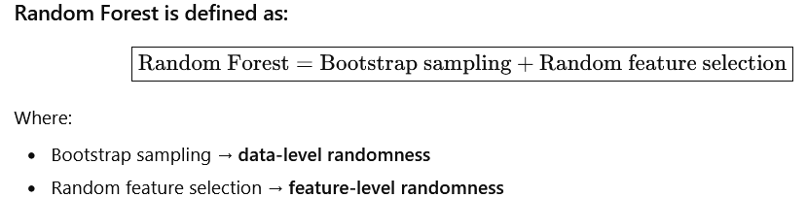
Random Forest = Bagging + Feature Randomness
What bagging does
Bagging uses bootstrap sampling
Each tree is trained on a different resampled version of the dataset
Sampling is with replacement
What feature randomness does
At each split:
Instead of considering all features
Random Forest considers only a random subset of features

Slide 26
Anurag Singh
4. Need a revision lecture on adaptive and gradient boosting with a use case
Namrata Modi
5. When dataset is complex and nonlinear how to choose suitable boosting method? If data contains more categorical features then how to decide method plz explain?
Ankita Roy
6. I need more clarification regarding some usecase of xgboosting that we can implement for real world ai/ml application.

Slide 27
Boosting
AdaBoost (Adaptive Boosting)
It is an ensemble learning technique that combines multiple weak classifiers to build a strong model. It works by sequentially focusing more on the misclassified data points from previous models.
Trains models sequentially, each correcting previous errors
Assigns higher weights to misclassified samples
Final prediction is made using weighted voting

Slide 28
Boosting
Gradient Boosting
Gradient Boosting is the boosting algorithm that works on the principle of the stagewise addition method, where multiple weak learning algorithms are trained and a strong learner algorithm is used as a final model from the addition of multiple weak learning algorithms trained on the same dataset.
In the gradient boosting algorithm, the first weak learner will not be trained on the dataset, it will simply return the mean of the particular column, and the residual for output of the first weak learner algorithm will be calculated which will be used as output or target column for next weak learning algorithm which is to be trained.
Following the same pattern, the second weak learner will be trained and the residuals will be calculated which will be used as an output column again for the next weak learner, this is how this process will continue until we reach zero residuals.

Slide 29
Ankit Verma
7. Please explain adaboosting replacement and weighed method?

Slide 30
Week 5
Unsupervised learning: K-means clustering and PCA

Slide 31
Amit Kumar
1. I need further more clarity on K mean and PCA concept with examples
Amol Shrikrishna Tathe
2. Need to understand with real examples
Amit Kumar
3. I need further more clarity on K mean and PCA concept with examples

Slide 32
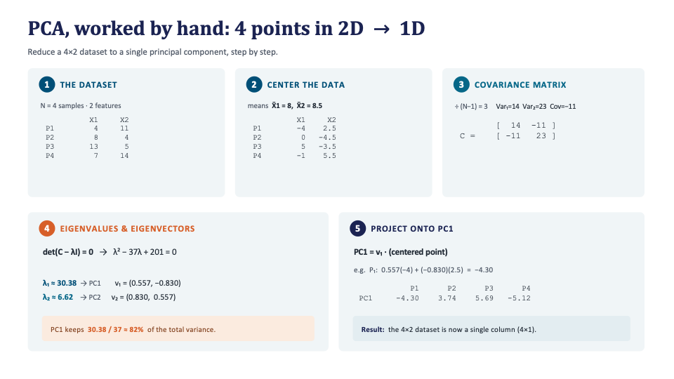

Slide 33
How does K-means work?
Initialize centroids: Randomly select K data points from the dataset to serve as the initial centroids.
E Step Assign data points to clusters: Calculate the distance between each data point and each centroid. Assign each data point to the cluster whose centroid is closest to it.
M Step Update centroids: Recalculate the centroids of the clusters based on the mean of the data points assigned to each cluster.
Repeat steps 2 and 3: Iterate the assignment and update steps until convergence. Convergence occurs when the centroids no longer change significantly or a maximum number of iterations is reached.
Finalize clusters: Once convergence is achieved, the algorithm stops, and the final clusters are determined.

Slide 34
Sreekumar MS
4.I am asking this question before attending Unsupervised learning. How can we handle a data which is a mixture of labelled and unlabeled data. Alternatively how can we take advantage of partially labelled data.
Weak Supervision
Leverages heuristics (labelling function) to generate labels
Small number of labels are recommended to guide heuristics
Semi Supervision
Leverages structural assumptions to generate labels
Two methods (not exhaustive):
Self-training
Add Perturbations

Slide 35
Ashok Kakade
5. what is the essence of Accuracy if accuracy score doesn't matter ?

