Slide 1
HospiBiz encrypt
Mubeena A
S6 MCA
TKM18MCA019

Slide 2
Introduction
Cloud computing is a rising computing technology. It permits users, store their data, knowledge or information remotely.
The purpose of this project is to secure access control scheme for public clouds.
For this such organizations uses cloud computing for secure data storage and retrieval with the help of encryption.
Here we use AES (Advanced Encryption Standard) for scalable and secure sharing of data in cloud computing.

Slide 3
Limitations of Existing System
As the data owner does not keep a copy of the data.
In order to issue the new keys to the users, the data owner needs to establish private communication channels with the users.
The privacy of the identity attributes of the users is not taken into account.

Slide 4
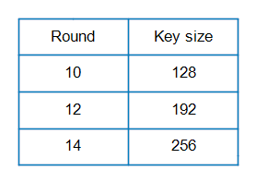
AES Algorithm
Is a symmetric-key computation which implies that same key is used for both encryption & decryption of data.
Key size are 128,192,256 bit.

Slide 5
Proposed system
In proposed system uses two layer encryption.
The hospital that decides to use the cloud to manage their electronic health record(EHR) system.
Here we use AES for scalable & secure sharing of health data in cloud computing.
The hospital admin encrypt and stores patient’s EHR into cloud and the employees download from cloud whenever they need and decrypt the EHR.
With this technique the security of patient’s information become more powerful than the existing system.
No data transmission is required between the data owner and the cloud.

Slide 6
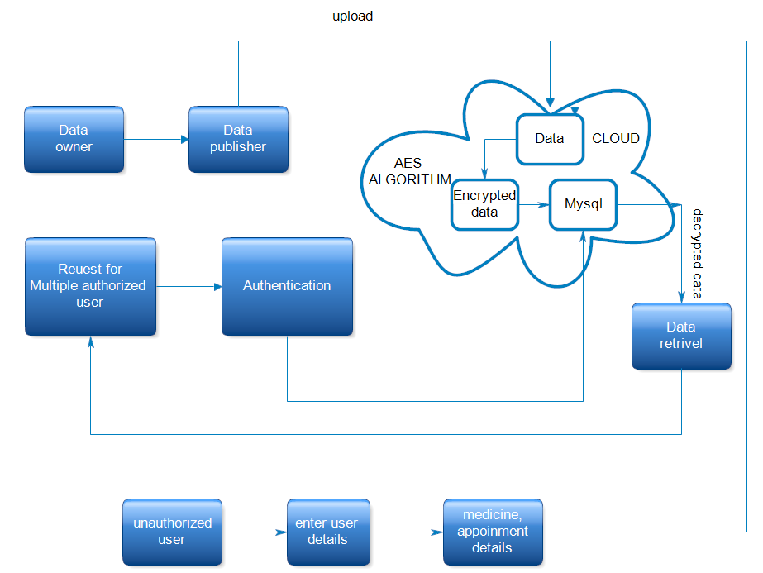
SYSTEM ARCHITECTURE

Slide 7

Results
Home page

Slide 8
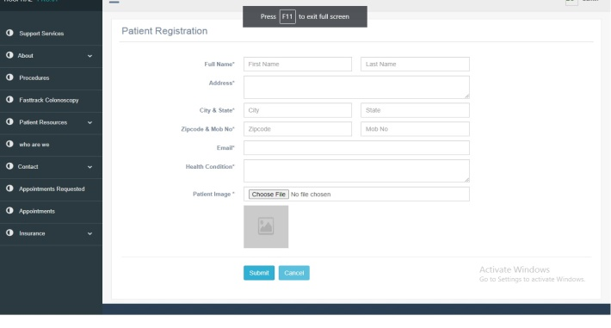
Patient Registration

Slide 9
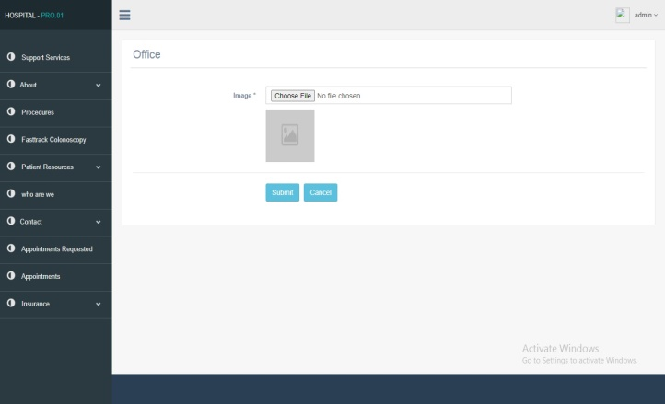
Add Files

Slide 10
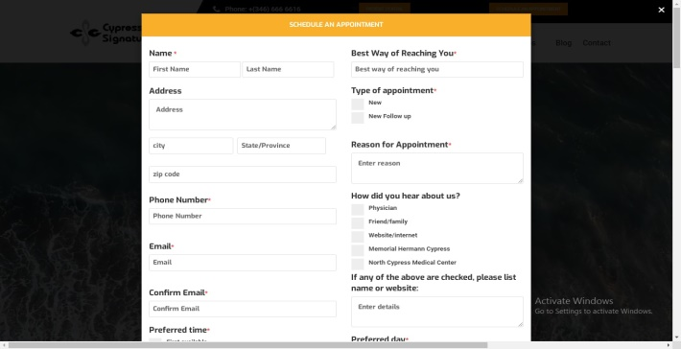
Patient online appointment

Slide 11
References
“Advanced Encryption Standard”, Douglas Selent, Rivier Academic Journal, Volume 6, Number 2, Fall 2010
Peter waher, “cloud computing bible", john Wiley & sons publishing ,2011
William Stallings, Cryptography and network security ,6th edition, Pearson education, March 2013

Slide 12
Thank you!...

