Slide 1

SAARTHI
The operating system for the trucking ecosystem.
Fleet management • marketplace • documents • live tracking • safety • AI
A local-first product designed to scale into a production-grade logistics platform.
PRODUCT PRESENTATION
SAARTHI / PRODUCT VISION 01

Slide 2
01 / THE OPPORTUNITY
One connected ecosystem — not another truck tracker
Saarthi connects the people, vehicles, orders and decisions around every trip.
TRUCK OWNER
CUSTOMER
Fleet, drivers, trips, documents, cost & performance.
Post demand, compare transport, track delivery.
SAARTHI
Shared operational layer
DRIVER
SUPPLIER
ADMIN / OPERATIONS
Trips, score, nearby services, safety & SOS.
Materials, pricing, orders & transport.
Verification • Audit • SOS oversight • subscriptions • platform control
SAARTHI / PRODUCT VISION 02

Slide 3
02 / CUSTOMER EXPERIENCE
A customer can post what they need
Saarthi turns a requirement into a trackable transport workflow.
01
02
03
04
05
06
POST
DISCOVER
COMPARE
CONFIRM
TRACK
DELIVER
Material, quantity, pickup, destination, capacity, timing.
Suppliers + suitable available trucks.
Price, ETA, capacity, verification, driver score.
Create order and assign transport.
Live location, route, ETA and status.
Proof, completion, history and rating.
Example
“Need 20 tons of sand from supplier A → construction site → today.”
SAARTHI / PRODUCT VISION 03

Slide 4
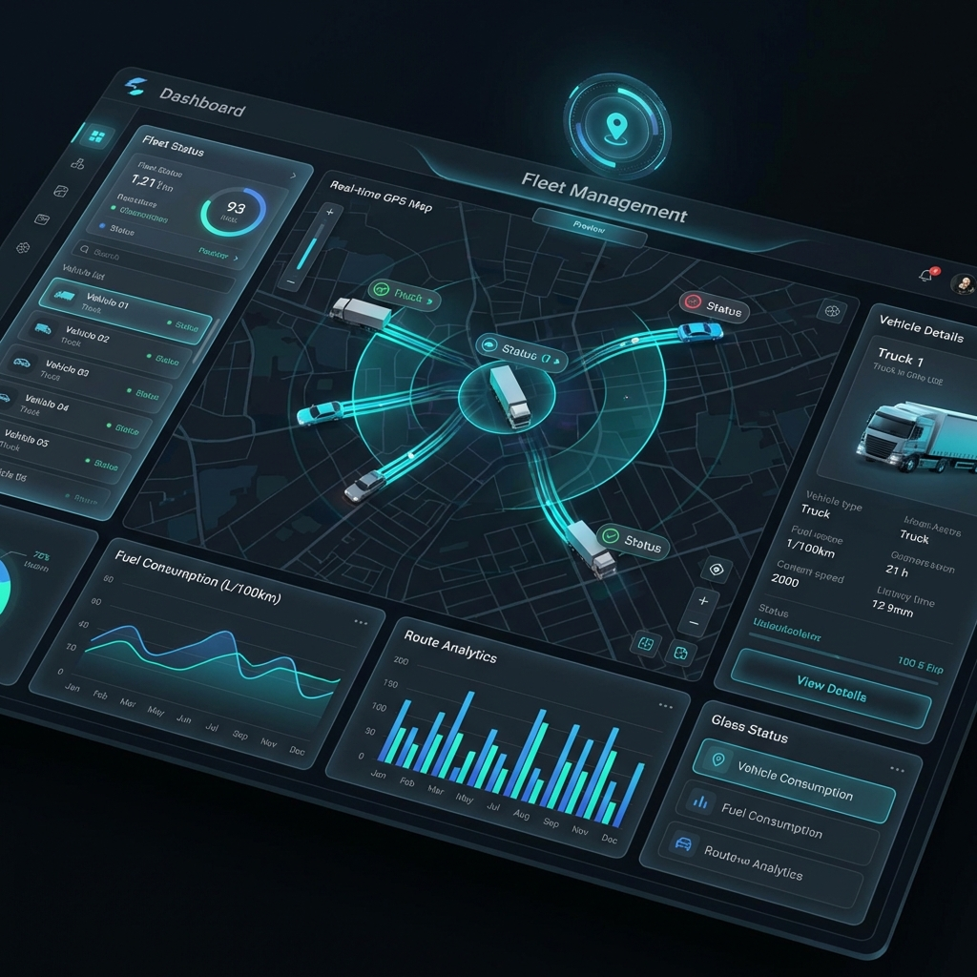
03 / FLEET COMMAND
Know what is happening across the entire fleet
One screen for live movement, exceptions, documents and business performance.
LIVE FLEET
Available • active • idle • maintenance • emergency
TRIPS
Orders • assignments • loading • delays • completion
DOCUMENTS
Verification • expiry • versions • audit
PERFORMANCE
Drivers • utilization • revenue • costs
AI ATTENTION
What needs action today — and why
SAARTHI / PRODUCT VISION 04

Slide 5
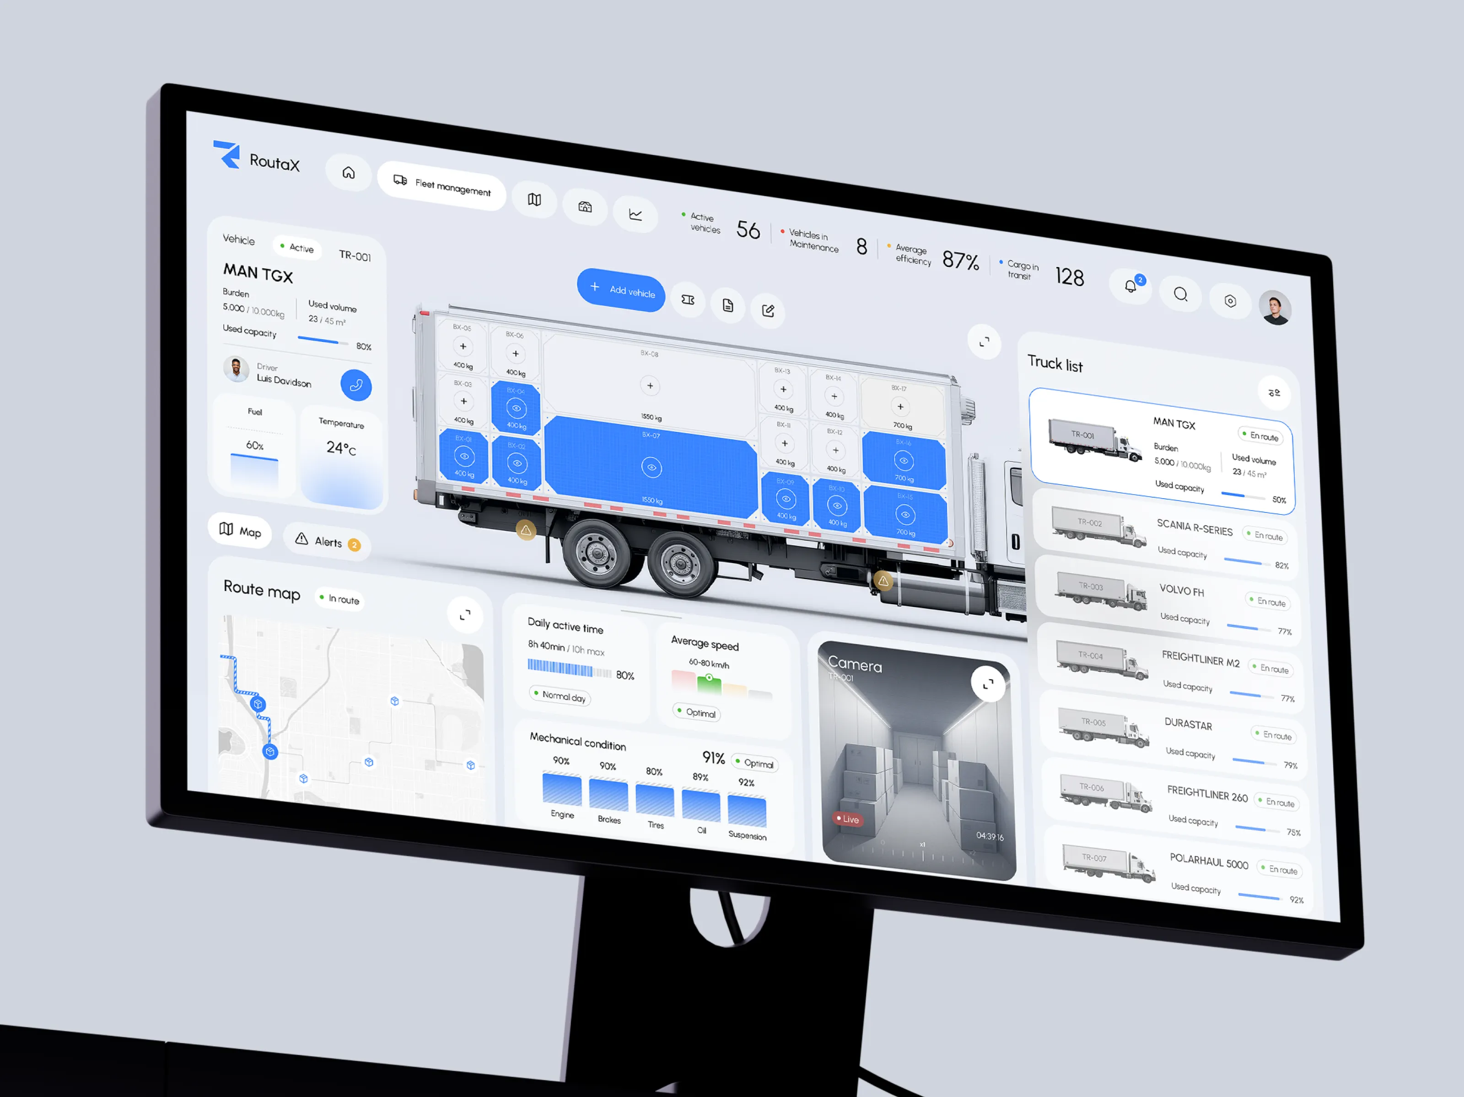
04 / LIVE TRACKING
Every truck becomes a digital twin
2D by default. 3D for premium tiers. The same tracking pipeline works locally and in production.
LIVE
ROUTE
Position • speed • heading • ETA
Stops • deviation • history
REPLAY
3D
Review the complete trip
Premium digital fleet view
Future hardware
Real GPS devices plug into the same normalized tracking pipeline.
SAARTHI / PRODUCT VISION 05

Slide 6
05 / DRIVER SAFETY NETWORK
A driver should never feel alone on the road
Saarthi combines practical road support with an in-network emergency response layer.
NEARBY SERVICES
Fuel • dhaba • workshop • tyre shop • hospital
NEARBY SAARTHI TRUCKS
Find eligible nearby trucks for assistance
ONE-TAP SOS
Medical • accident • breakdown • fuel • other
RESPONSE FLOW
Broadcast → acknowledge → help assigned → arrived
SAARTHI / PRODUCT VISION 06

Slide 7
06 / TRUST & COMPLIANCE
A digital document vault for every participant
Verification and document expiry become operational workflows instead of paperwork.
DRIVER
TRUCK
SUPPLIER
Licence • identity • supporting documents
RC • insurance • fitness • permits • PUC
Business verification • supporting records
CUSTOMER
ORDER / TRIP
AUDIT
Identity/business records where required
Delivery, invoice and operational documents
Versions • approvals • rejection reasons • history
Expiry engine
7 / 15 / 30-day configurable alerts • expired • expiring • verified • rejected
SAARTHI / PRODUCT VISION 07

Slide 8
07 / DRIVER INTELLIGENCE
Performance becomes a professional profile
Transparent scoring rewards reliability, safety and compliance.
91
WHAT CREATES THE SCORE
On-time trips • safety indicators • route compliance • documents • ratings • vehicle care
DRIVER SCORE
Safety
94
Reliability
92
CAREER PROFILE
Timeliness
88
Achievements can unlock recognition, visibility, training and future benefits.
Compliance
100
Safe Driver • 100 Trips • Zero Incident Streak • Emergency Helper
SAARTHI / PRODUCT VISION 08

Slide 9
08 / AI INTELLIGENCE
From dashboards to decisions
AI sits on top of trusted Saarthi data and explains what deserves attention.
ASK
PREDICT
“Which trucks need attention today?”
Maintenance and operational risk
AI
FLEET COPILOT
RECOMMEND
EXPLAIN
Best truck/driver for this order
Why did revenue or fuel cost change?
AI is an enhancement layer — core fleet operations remain fully functional without AI.
SAARTHI / PRODUCT VISION 09

Slide 10
09 / SUPPLIER + MATERIAL MARKETPLACE
Connect demand, supply and transport in one flow
Saarthi can become the shared operating layer between customers, material suppliers and fleets.
MATERIALS
PRICING
TRANSPORT
Sand • aggregate • gravel • bricks • configurable materials
Quantity • unit • price • availability
Required capacity • pickup • destination
ORDER
VISIBILITY
HISTORY
Requested → confirmed → assigned → delivered
Supplier sees delivery progress and truck status
Completed orders • documents • performance
SAARTHI / PRODUCT VISION 10

Slide 11
10 / BUSINESS MODEL
A clear upgrade path from visibility to intelligence
Feature entitlements are enforced by the backend, not just hidden in the UI.
BASIC
PRO
INTELLIGENCE
ENTERPRISE
2D maps Fleet + drivers Documents Trips + orders Basic reports
Everything in Basic 3D maps Driver scoring Advanced analytics Smart alerts Maintenance
Everything in Pro AI Copilot Predictions AI recommendations Business intelligence
Custom pricing Large fleets APIs SSO Advanced permissions Integrations
The commercial story is simple: start with control → upgrade for intelligence → scale for enterprise.
SAARTHI / PRODUCT VISION 11

Slide 12
11 / LOCAL-FIRST PRODUCT
The local version must be fully functional
No disposable prototype. Real database, APIs, workflows and a realistic GPS simulator.
1
2
3
4
5
SETUP
SEED
SIMULATE
OBSERVE
DEMO
→
→
→
→
React + TS Node + TS PostgreSQL
Users • trucks orders • trips suppliers
Mock GPS movement speed + route
Live map ETA • status trip replay
SOS • nearby score • analytics AI-ready data
SAARTHI / PRODUCT VISION 12

Slide 13
12 / TECHNICAL FOUNDATION
Mock today. Replace tomorrow.
The architecture isolates external providers so production does not require a rewrite.
REACT + TYPESCRIPT
Web dashboards • driver experience • customer marketplace
NODE.JS + TYPESCRIPT
Auth • RBAC • fleet • orders • trips • documents • SOS • AI
POSTGRESQL
Users • trucks • drivers • orders • trips • documents • analytics
REALTIME
WebSockets • fleet updates • trip updates • SOS events
PROVIDER ABSTRACTIONS
GPS • maps • storage • notifications • payments • AI
SAARTHI / PRODUCT VISION 13

Slide 14
13 / PRODUCTION EVOLUTION
From local machine to real-world fleet operations
Production replaces infrastructure and integrations — the core Saarthi workflows stay intact.
LOCAL
LOCAL
LOCAL
Mock GPS
→
Real GPS devices
PostgreSQL
→
Managed PostgreSQL
Local files
→
Object storage
LOCAL
LOCAL
LOCAL
Mock notifications
→
Email / SMS / Push
Mock payments
→
Production gateway
Development AI
→
Production AI provider
Production checklist: security • backups • monitoring • HTTPS • tenant isolation • integrations • smoke tests
SAARTHI / PRODUCT VISION 14

Slide 15
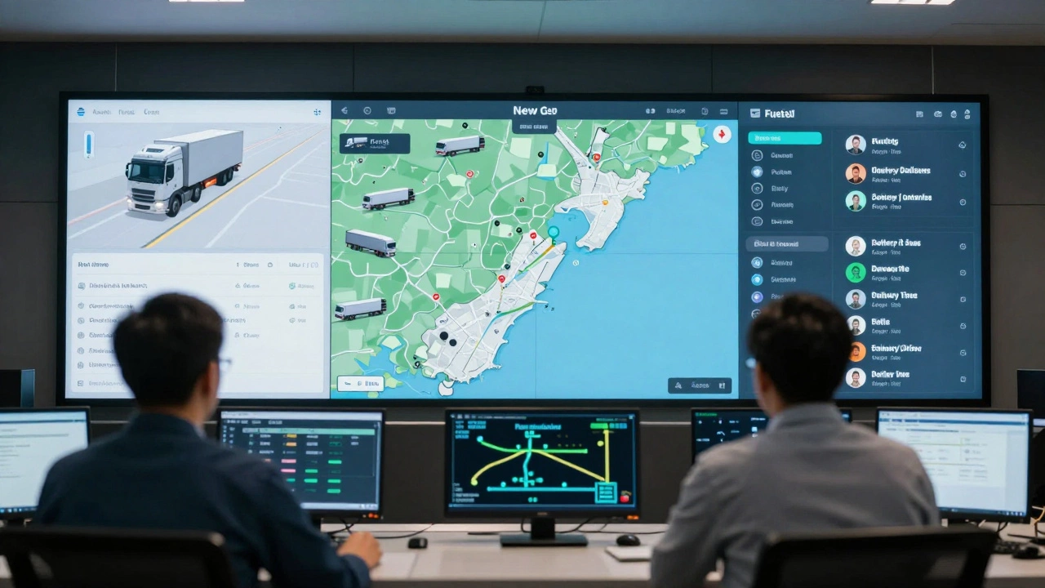
SAARTHI
Know your fleet. Support your drivers. Move smarter.
A connected logistics operating system built for the road — from local demonstration to production scale.
FLEET • MARKETPLACE • SAFETY • DOCUMENTS • TRACKING • AI
Thank you
SAARTHI / PRODUCT VISION 15

