Slide 1
Causal Inference Algorithms Evaluation
Project 4 Group 6 Report
Kristen Akey, Citina Liang, Rui Liang, Mubai Liu, Wen Yin
December 2, 2020

Slide 2
Outline
Overview
Inverse propensity weighting (IPW) + L1 penalized logistic regression
Regression estimate
Weighted regression + L1 penalized logistic regression.
Performance comparison
Conclusion

Slide 3
Overview
Evaluate three causal inference algorithms.
Build models on two distinct datasets
Compare their performance and computational efficiency.

Slide 4
Inverse propensity weighting (IPW) + L1 penalized logistic regression
L1 penalty
# Setting alpha = 1 implements lasso regression
set.seed(0)
lasso_hd <- cv.glmnet(hX, hA,family = "binomial", alpha = 1)
lasso_ld <- cv.glmnet(lX, lA, family = "binomial",alpha = 1)
IPW<-function(x,A,model,data){
start_time <- Sys.time()
# Calculate the propensity score
lasso_model <- glmnet(x, A, alpha = 1, family = "binomial",lambda = model$lambda.min)
propensity <- predict(lasso_model, x, type = "response")
# Calculate the weights
weight <- 1 / propensity * A + 1 / (1 - propensity) * (1 - A)
resampled_data <- data %>%
mutate(propensity = propensity,
weight = weight,
Y_Weight = Y*weight)
ATE<-1/nrow(resampled_data)*(sum(resampled_data[resampled_data$A==1,"Y_Weight"])
-sum(resampled_data[resampled_data$A==0,"Y_Weight"]))
end_time <- Sys.time()
return(list(ATE=ATE,running_time = end_time - start_time))
}
ATE_highDim<-IPW(hX,hA,lasso_hd,highDim) #ATE: -2.21809, runtime:0.02583098
ATE_lowDim<-IPW(lX,lA,lasso_ld,lowDim) #ATE: 2.21036, runtime:0.005035877
IPW

Slide 5
Regression estimate
# simple regression estimate
# separate X and Y, will be used in predict function
df_X <- df %>% select(-Y, -A)
start <- Sys.time()
# m0
m0 <- glm(Y ~ ., data = subset(df[df$A==0,], select = -A))
# m1
m1 <- glm(Y ~ ., data = subset(df[df$A==1,], select = -A))
# prediction using non-treatment model params
Y_pred_0 <- predict(m0, newdata = df_X)
# prediction using treatment model params
Y_pred_1 <- predict(m1, newdata = df_X)
# add predicted y to the dataframe
df <- df %>% mutate(Y_pred1 = Y_pred_1, Y_pred0 = Y_pred_0)
# calculate ATE
n <- nrow(df)
ATE = 1/n * sum(df$Y_pred1 - df$Y_pred0)
Build separate models for treatment and control groups
ATE is the average difference between predictions of the two models

Slide 6
Weighted regression + L1 penalized logistic regression.
L1 penalty
cv_l1 <- cv.glmnet(X_low, A_low, family = "binomial", alpha = 1)
l1_low <- glmnet(X_low, A_low, family = "binomial", alpha = 1, lambda = cv_l1$lambda.min)
propen_score_low <- predict(l1_low, X_low, type = "response")
# Finding weights
weight_low <- cbind(as.numeric(A_low), propen_score_low) %>%
as_tibble %>%
mutate(weights = (V1/s0 + (1-V1)/(1-s0))) %>%
select(weights)
# Linear regression for selecting covarites
filter_low <- summary(lm(Y~., data = df_ld))$coef[,4][3:24]<0.05
Z_low <- cbind(A_low, X_low[,filter_low])
Z_low <- Z_low %>% apply(2, as.numeric)
# Final Regression for ATE
Y_low <- df_ld$Y
weighted_low <- lm(Y_low ~ Z_low, weights = as.numeric(unlist(weight_low)))
ATE_low <- coef(weighted_low)[2]
IPTW

Slide 7
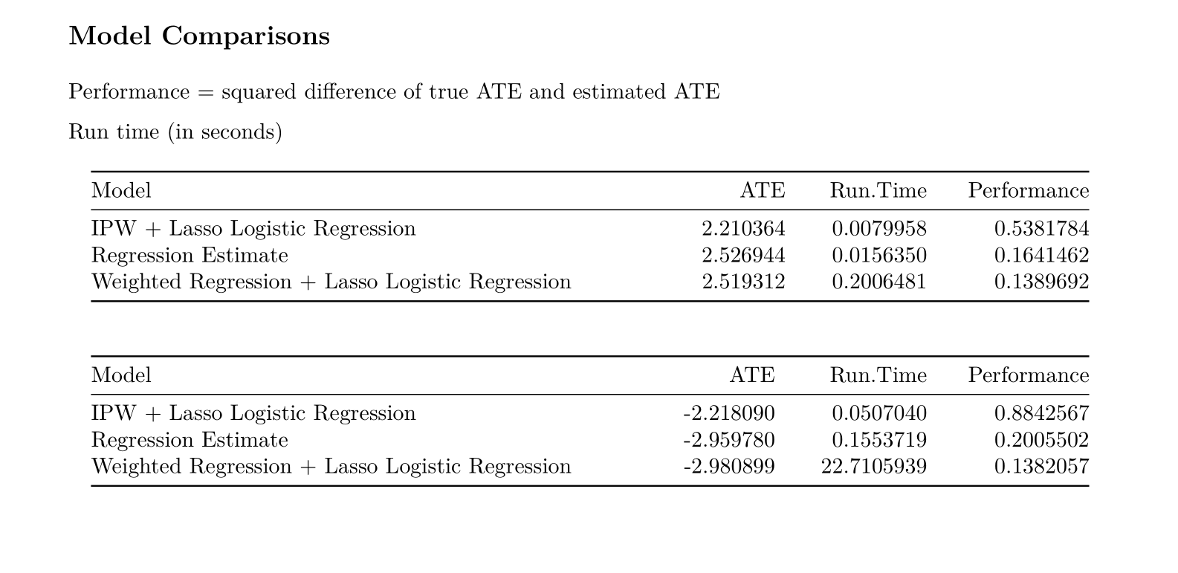

Slide 8
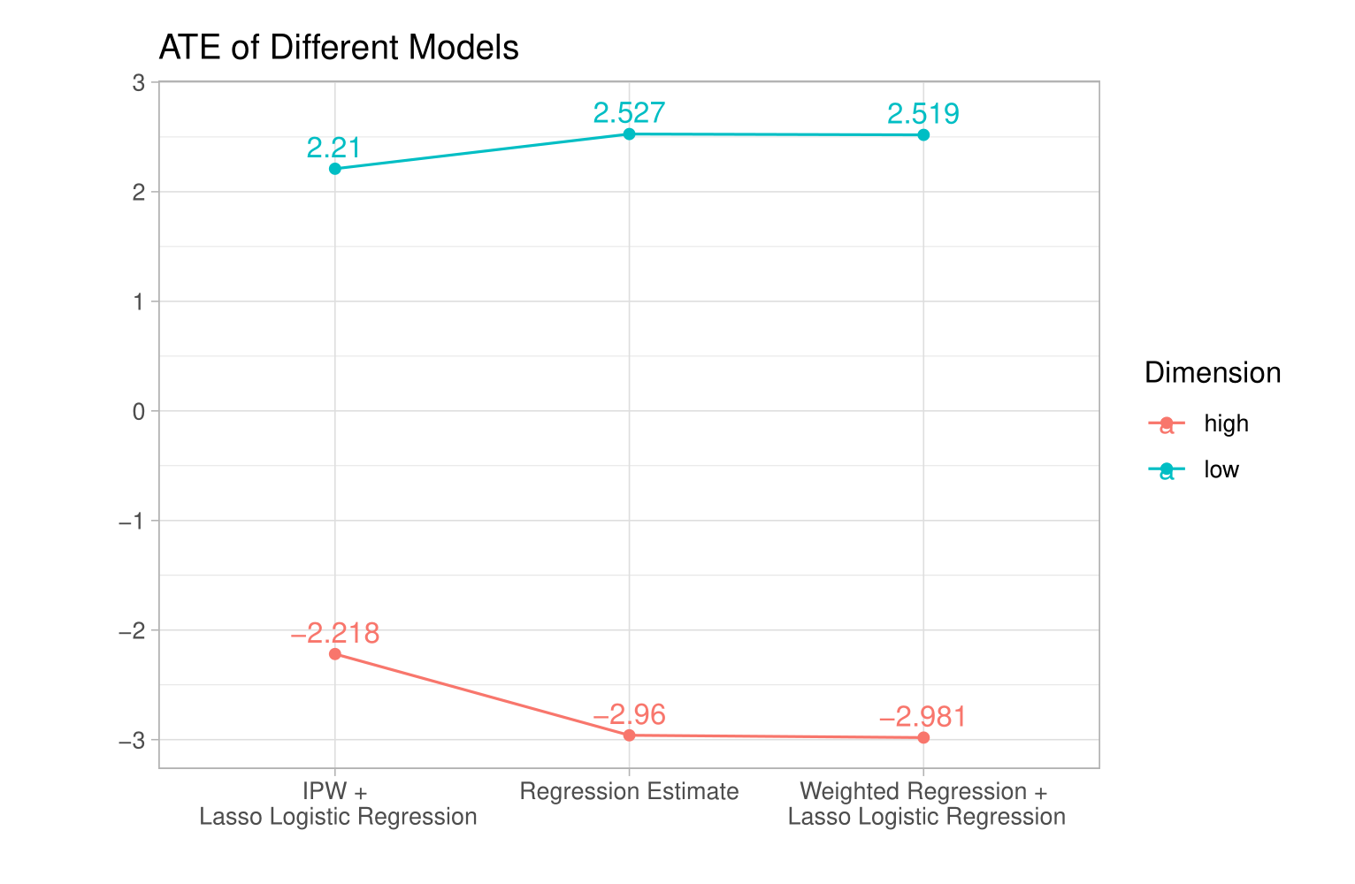

Slide 9
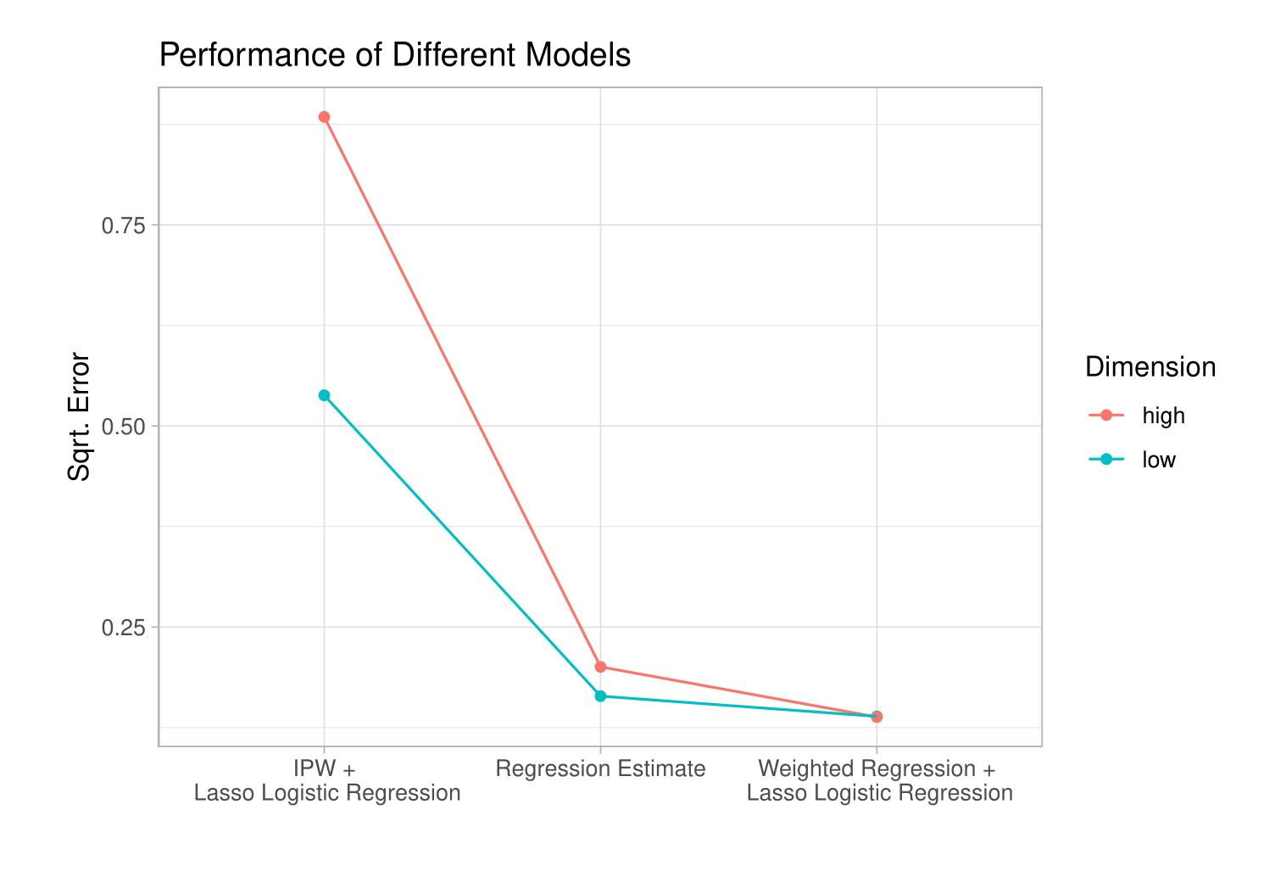

Slide 10
