Slide 1
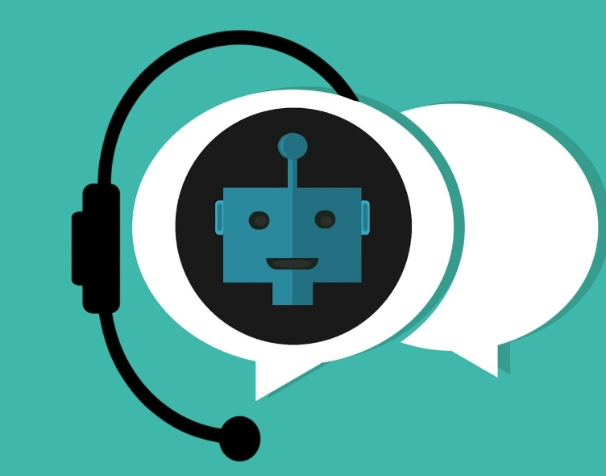
BUILDING CHATBOT USING WATSON
NAME : S.MUBARAK MOHAMED
REG : 912421104022

Slide 2
CHATBOT PERSONA & CONVERSATION FLOW
NAME : TOM
Our chat bot name is tom and every one can easily to remember and they can easily know the name
TONE AND STYLE:
The chatbot's tone can be friendly and the language should be common every one can be understandable
EMOTIONS:
chatbots are designed to express emotions like happiness, frustration, or empathy.

Slide 3
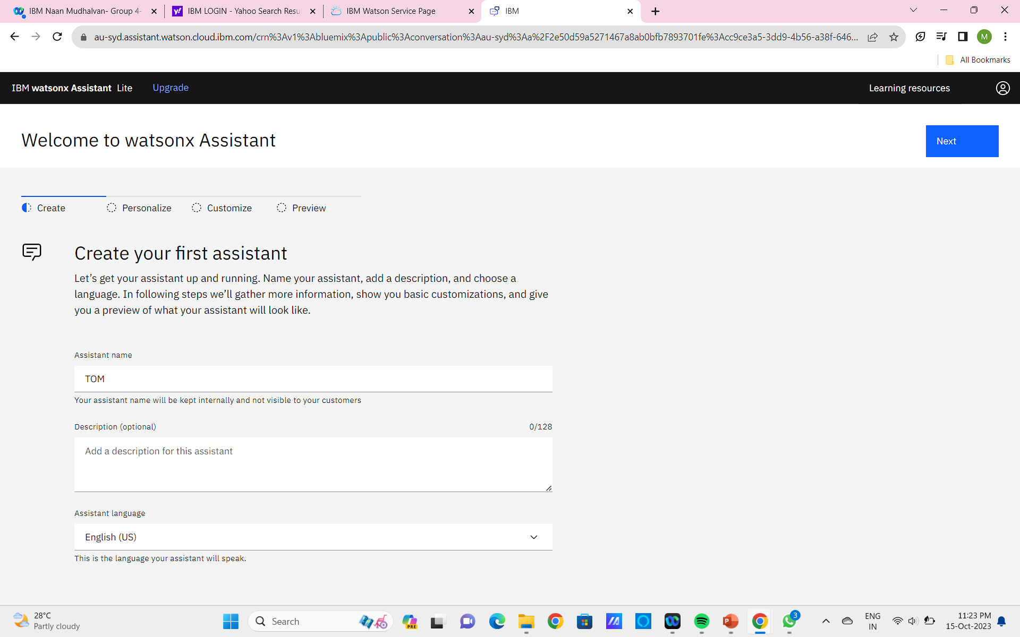

Slide 4
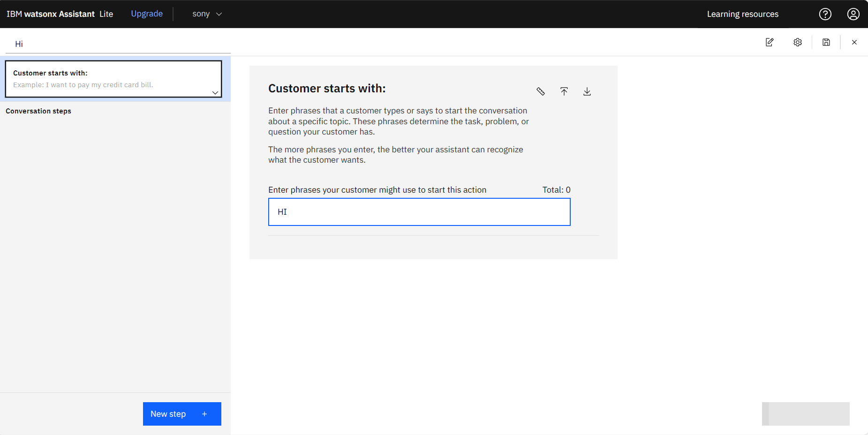

Slide 5
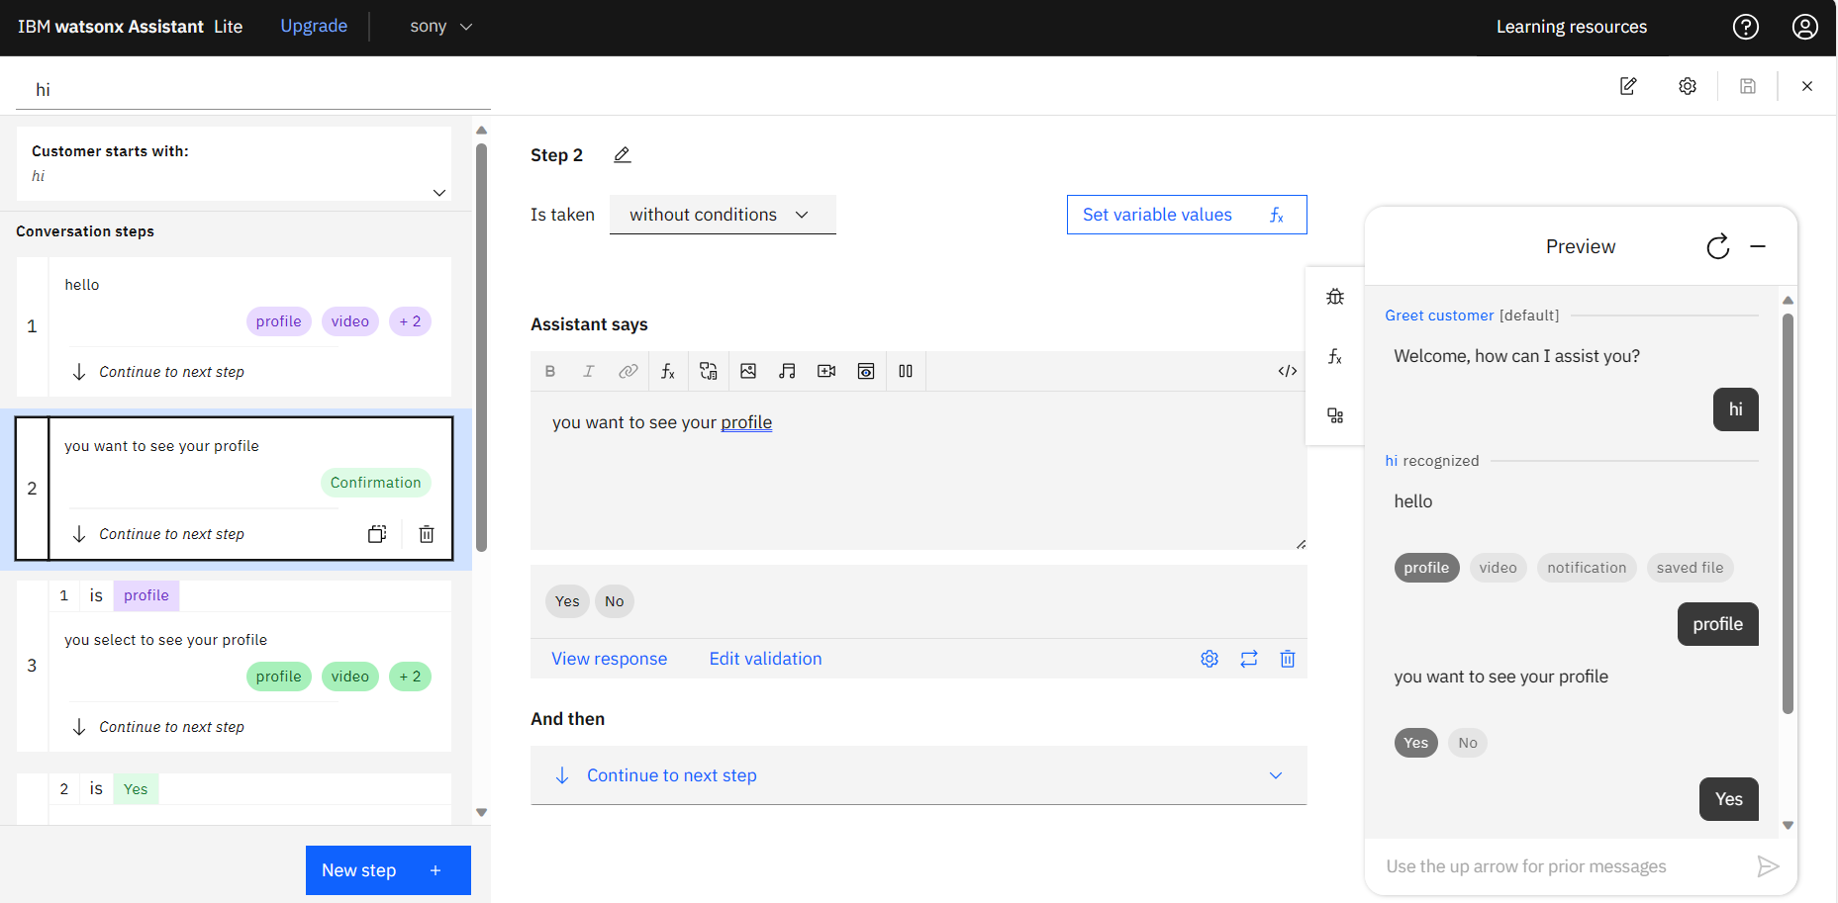

Slide 6
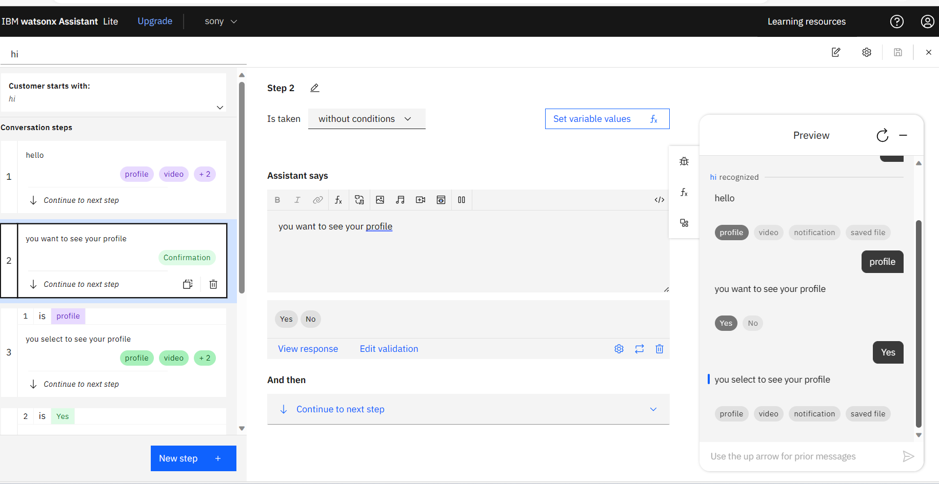

Slide 7
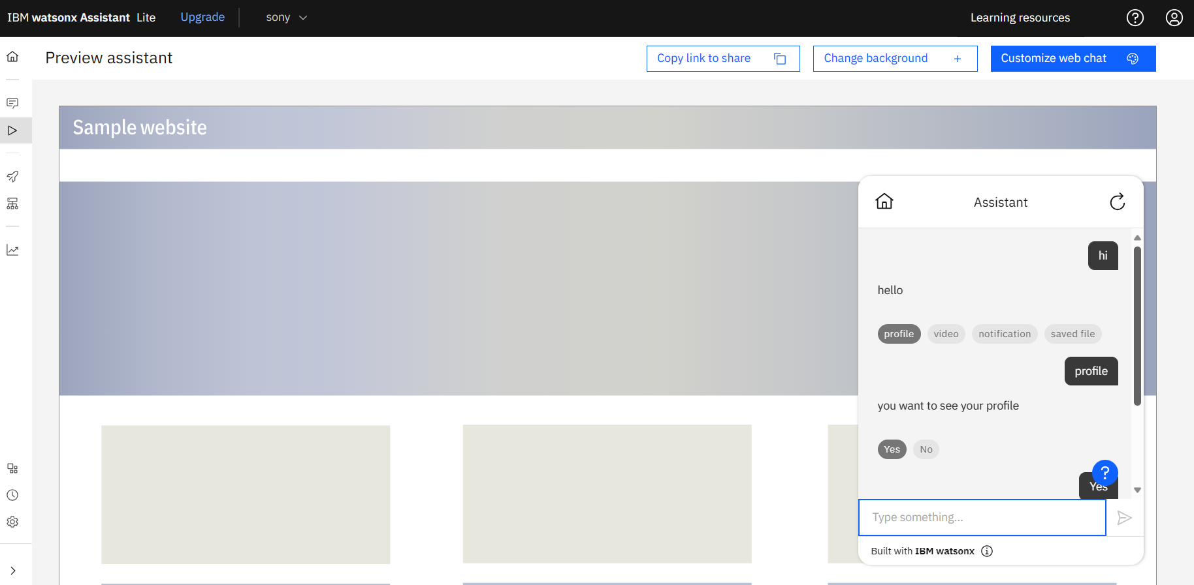

Slide 8
INTENTS, ENTITIES, AND DIALOG NODES IN WATSON ASSISTENT
To configure intents, entities, and dialog nodes in Watson Assistant to handle user queries, follow these steps:
CREATE INTENTS:
Intents represent the goals or actions that users want to achieve with your assistant. For each intent, provide at least five examples of utterances that users might say to express that intent.
CREATE ENTITIES:
Entities are specific pieces of information that are relevant to your assistant's domain. For each entity, define a name and a type. You can also provide a list of values for the entity.

Slide 9
CREATE DIALOG NODES
Dialog nodes represent the different paths that a conversation can take. Each dialog node has a condition and a response. The condition specifies what must be present in the user input for the node to be triggered. The response is the utterance that your assistant uses to respond to the user.
To create a dialog node that handles a user query, follow these steps:
Create a new dialog node.
Enter a name for the node.
In the Condition field, specify the intent and any entities that must be present in the user input for the node to be triggered.

Slide 10
Enter a response for the node. You can use text, images, and other multimedia elements in your response.
Click Create.
You can also use dialog nodes to collect information from the user, ask follow-up questions, and branch the conversation based on the user's input.

Slide 11
THANK YOU
PRESENTED BY,
NAME : S.MUBARAK MOHAMED
REG : 912421104022

