Slide 1

Predicting Hotel Reservation cancelations
Mubarik Ibrahim
Final Project Presentation
Data Analytics

Slide 2
Presentation outline
Business Questions
Data Exploration
Feature selection
Models used and score
Conclusion

Slide 3

Business Question
Using machine learning to understand the relationship between cancelations and features that are related to hotel reservations and predict the rate of cancelations.
To avoid investment risk.
Better customer understanding and high retention.
Facility improvement

Slide 4

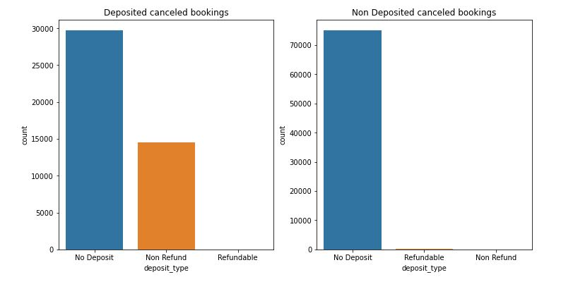
Overview of cancelations
Dataset of two hotels with similar facilities(features).
Add your second bullet point here
Add your third bullet point here

Slide 5
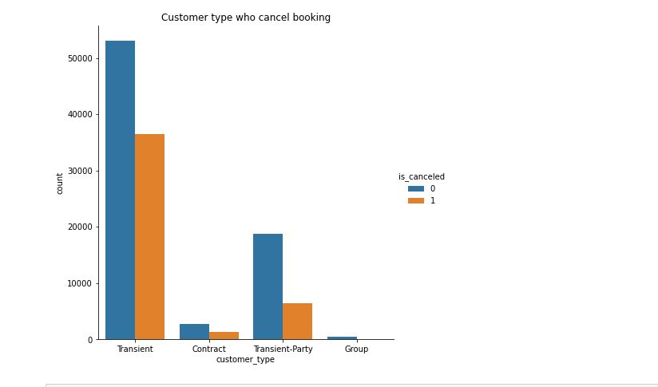
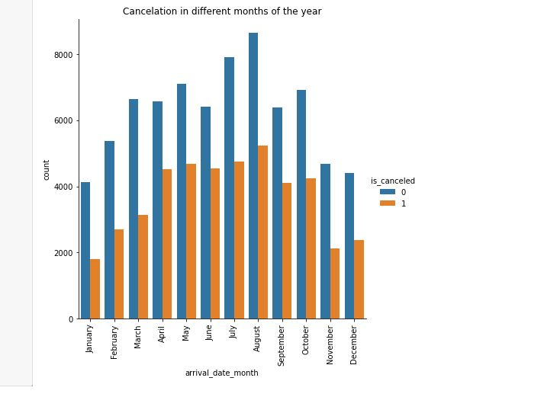
Customer Types and reservations

Slide 6
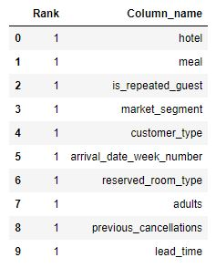
Feature Selection
RFE selected features

Slide 7

Models Used
Logistic regression with a score of 65%
Random Forest with a score of 79%
Decision Tree also recording a score of 77%

Slide 8
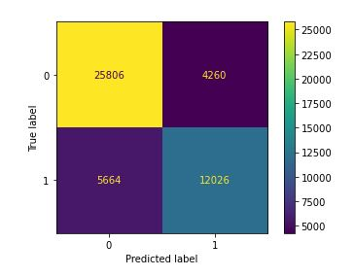
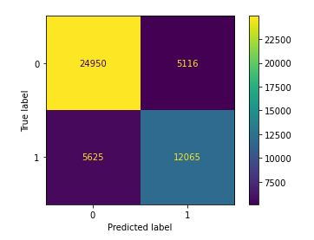
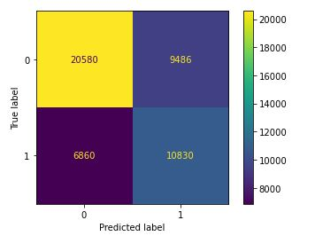
Confusion Matrix
Logistic regression
Random Forest
Decision Tree

Slide 9
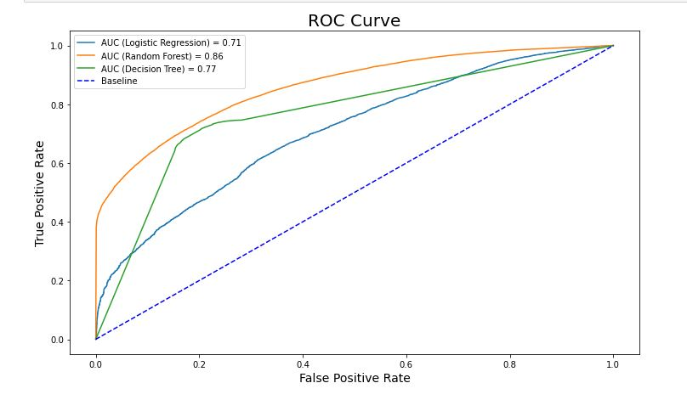

Slide 10
Conclusion
With the data set provided, all features seem to be somewhat correlated with cancelation. The prediction score is good but can be improved if more information to added to the dataset.

Slide 11
Thank You!

