Slide 1
Car Rental System
Group Members:
1) Muhammad Bahuddin Shakir - 24-SE-006
2) MUBASHAR MAQSOOD -24-SE-117
3) ZAIN UI ABIDEEN -24-SE-048
Course: Object-Oriented Programming (OOP
)

Slide 2
Project Objectives
Design a Car Rental System
Allow users to:
• View available cars
• Book cars
• View rented cars
Generate rental receipts in text format
Practice Object-Oriented Programming concepts

Slide 3
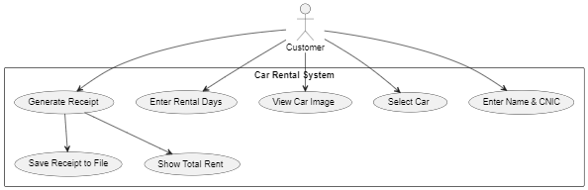
USE CASE DIAGRAM:

Slide 4
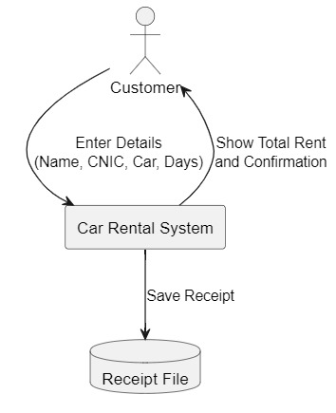
DATA FLOW DIGRAM:

Slide 5
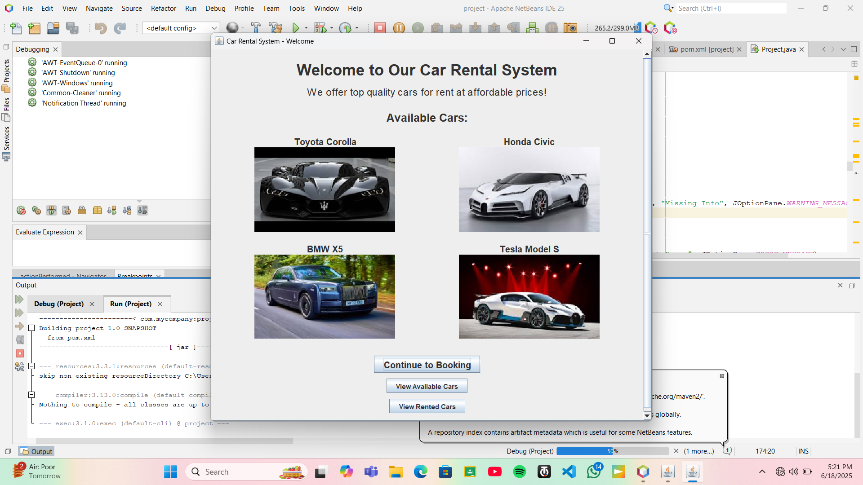
Home Screen:

Slide 6
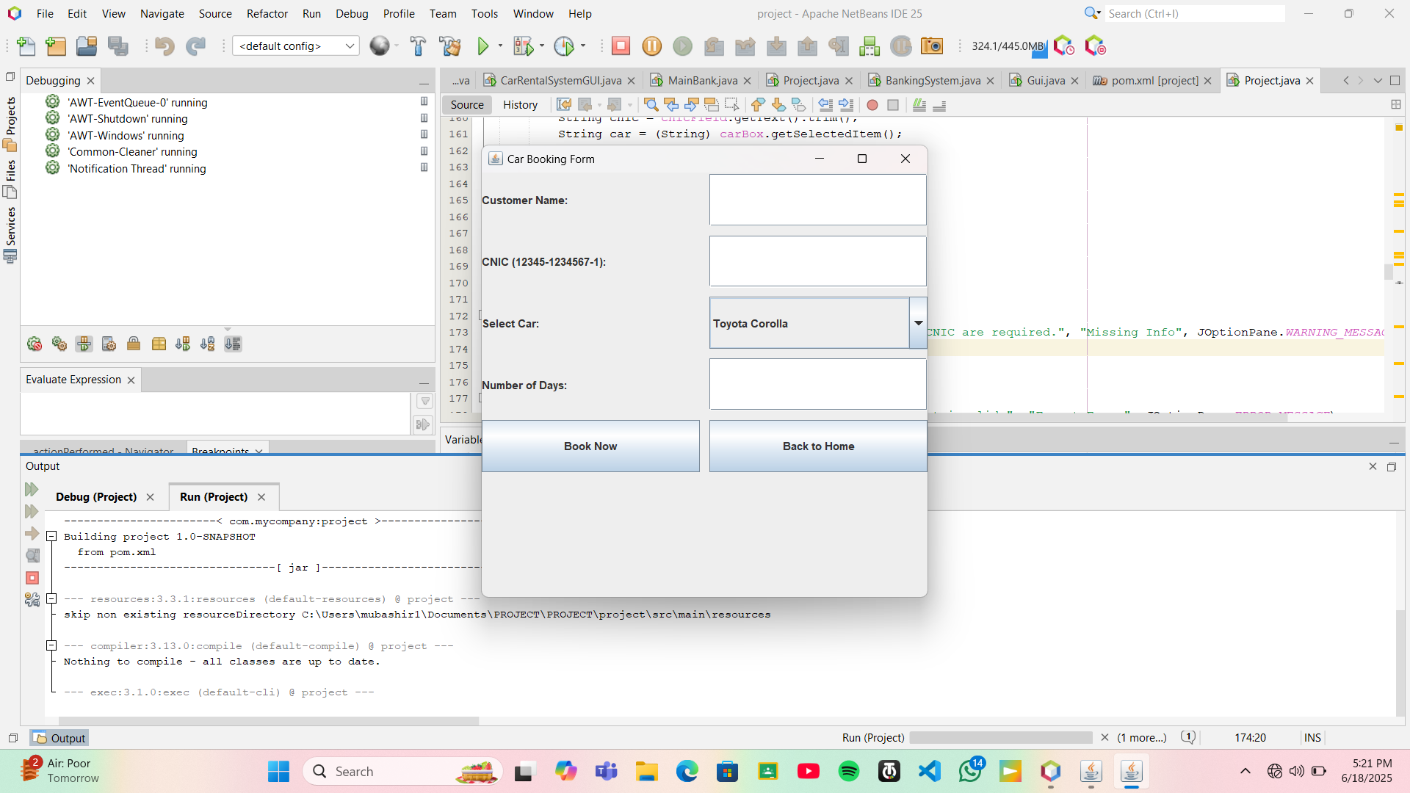
Booking Form:

Slide 7
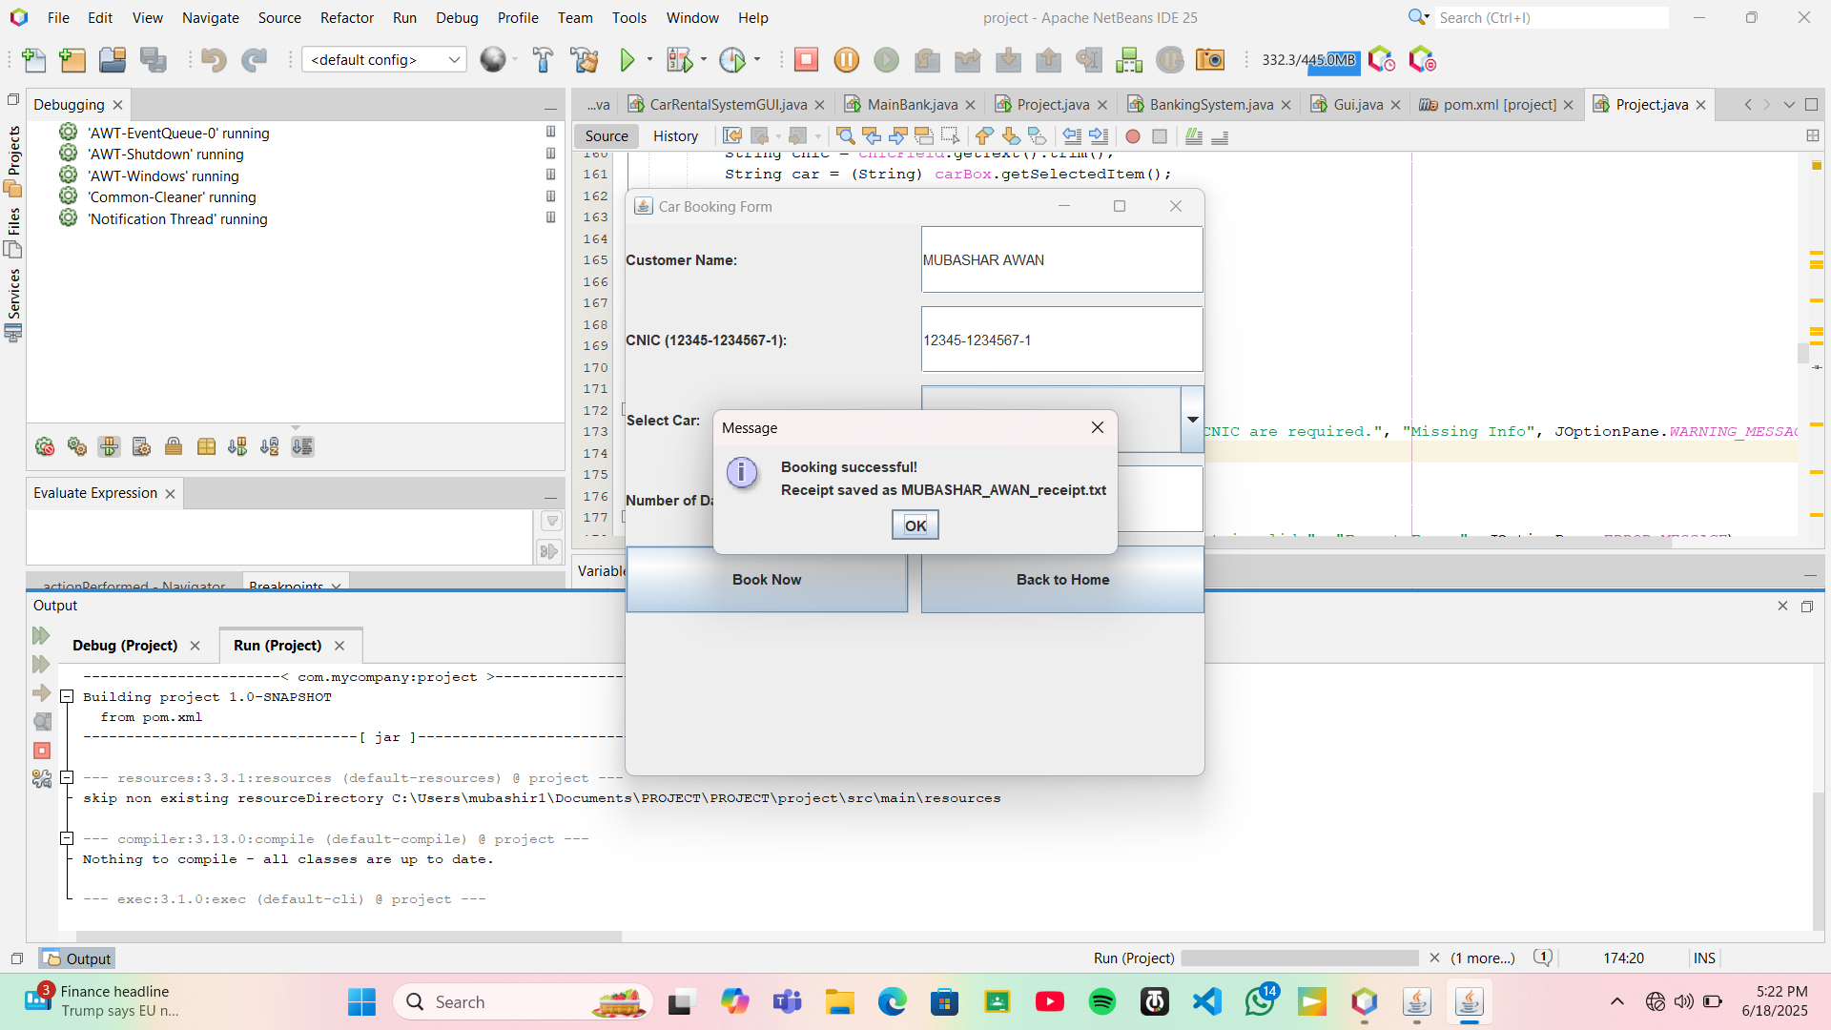
BOOKING CONFIRMATION:

Slide 8
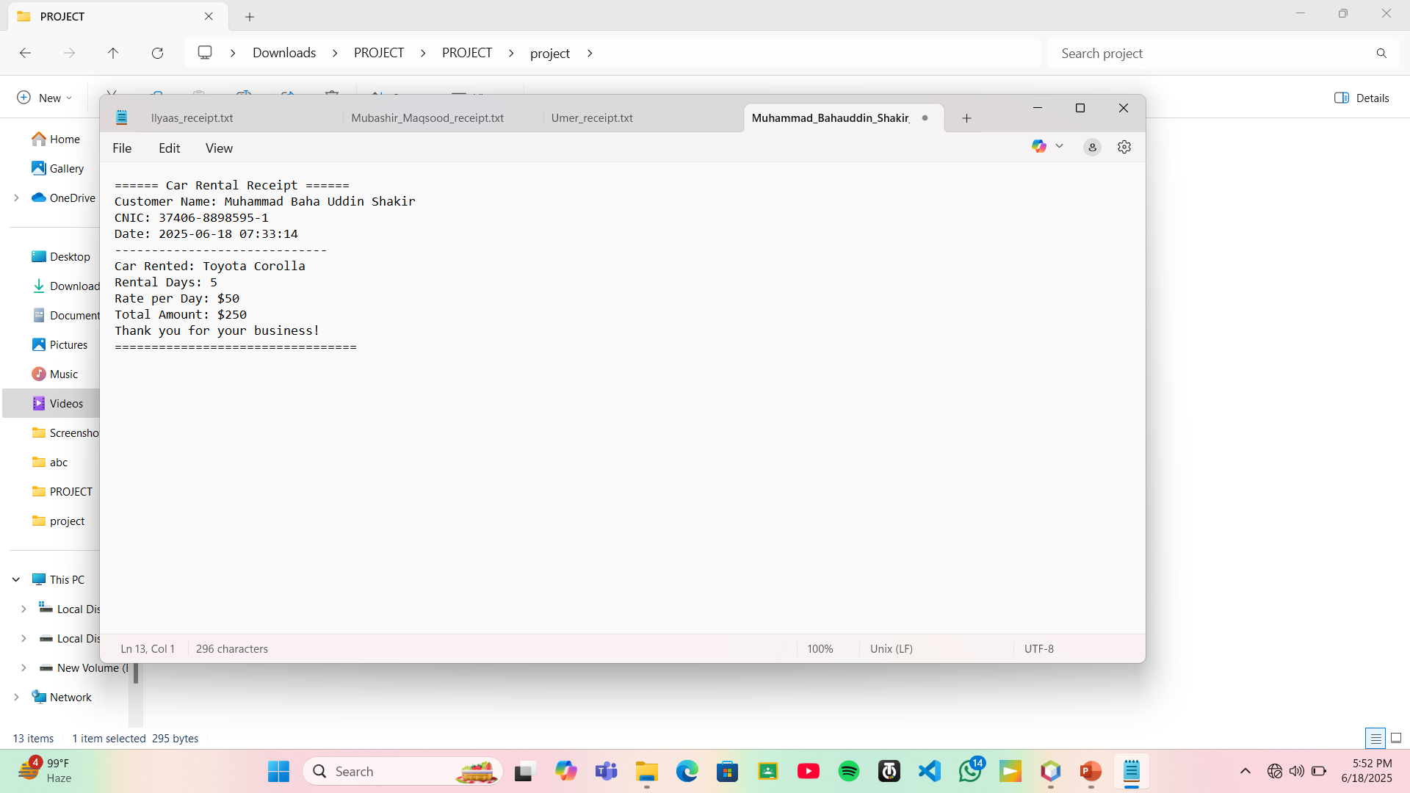
Receipt Output:
Generated and saved as .txt file after booking.

Slide 9
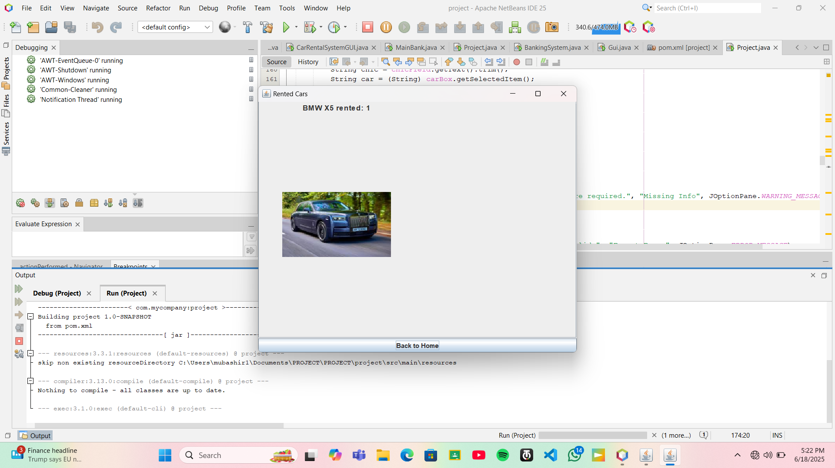
Rented CARS:
Display number of rented and available cars.

Slide 10
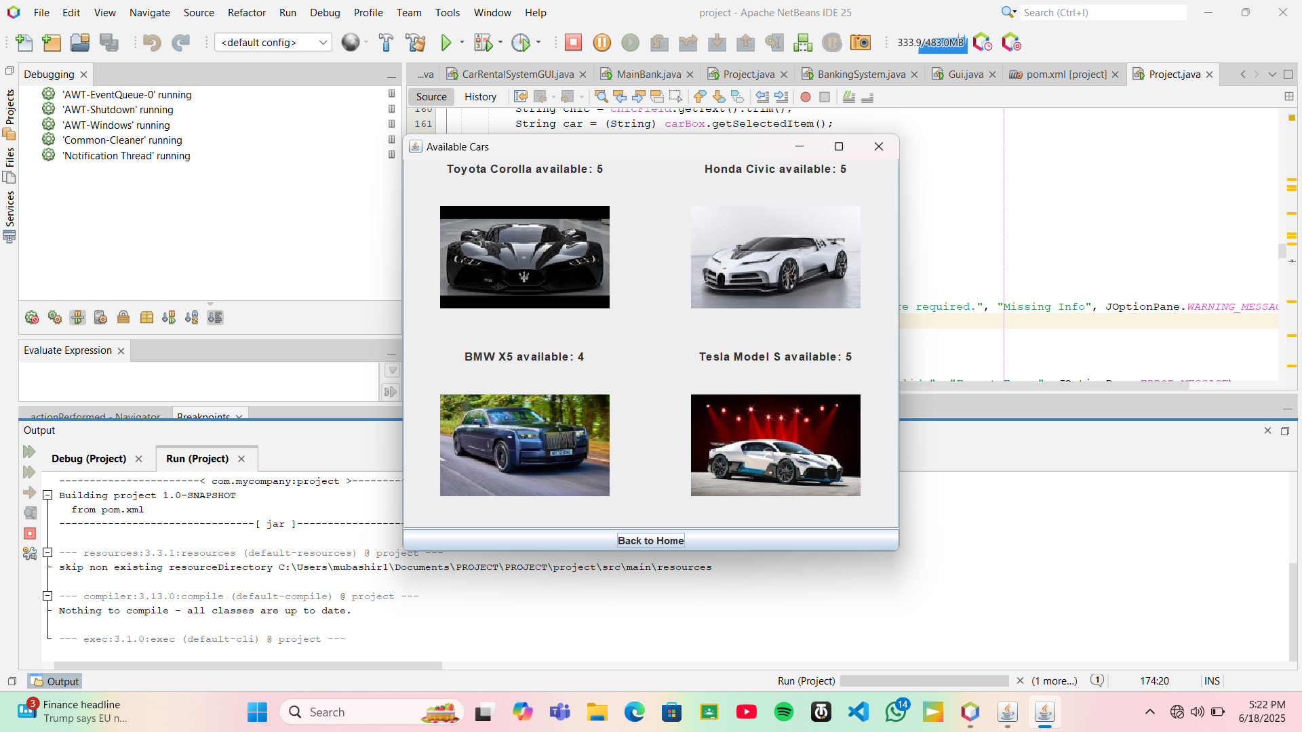
Available Cars:

Slide 11

THANK YOU FOR YOUR VALUABLE TIME

