Slide 1
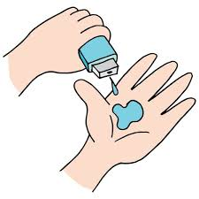
Project Title - Seasonal_Agriculture_Performance_Analysis
Student Name: Mohammed Mubasheeruddin
College Name: Kakatiya institute of technology and science
AICTE STU ID : STU6a13f8dd3f0c81779693789

Slide 2

PROBLEM STATEMENT
Agricultural activities are influenced by seasonal variations in environmental conditions, farming practices, resource availability and market conditions.
As a result, agricultural performance may differ from one season to another. However, raw agricultural data does not clearly explain how agricultural performance changes across seasons or what patterns can be observed in different seasonal conditions.
The problem is to analyze the given agricultural dataset and investigate seasonal differences in agricultural performance by identifying meaningful patterns, trends, relationships and variations within the available data.

Slide 3
Project Description
Seasonal Agriculture Performance Analysis is a data analytics project that examines the performance of agriculture during different agricultural seasons, crops, irrigation methods and environment. The data set includes 4000 agricultural data points and 28 attributes, and the project aims to uncover meaningful patterns and relationships in agricultural production.
Analysis is conducted on the important performance indicators like crop yield, production, profit and water utilization and includes other factors like rainfall, soil moisture status, temperature, fertilizer use, farm area, season and irrigation method. Exploratory data analysis was conducted after applying data preprocessing techniques like missing value imputation and outlier analysis.
This project relies on graphic tools created in Python, Pandas, NumPy, Matplotlib, and Seaborn to make comparisons on agricultural performance. The outcomes enable the recognition of better yields of crops, better irrigation techniques, seasonal trends and differences in water-use efficiency. These insights can help in improved crop selection, irrigation planning, resource allocation and seasonal agricultural decision making.

Slide 4

WHO ARE THE END USERS?
Farmers – To choose suitable crops, irrigation methods, and seasonal farming strategies.
Agricultural Officers – To analyze regional agricultural performance and plan resource allocation.
Agricultural Researchers – To study relationships between environmental factors and crop productivity.
Agribusinesses – To understand crop profitability, production, and resource efficiency.
Government & Policy Makers – To support data-driven agricultural planning and policy decisions.
Agricultural Consultants – To provide recommendations for improving yield, profitability, and water-use efficiency.

Slide 5

Technology Used
Python – Main programming language for data analysis.
Google Colab – Development and execution environment.
Pandas – Data loading, cleaning, and manipulation.
NumPy – Numerical and statistical operations.
Matplotlib – Data visualization and chart generation.
Seaborn – Statistical visualizations and heatmaps.
Jupyter Notebook (.ipynb) – Project analysis and documentation format.

Slide 6
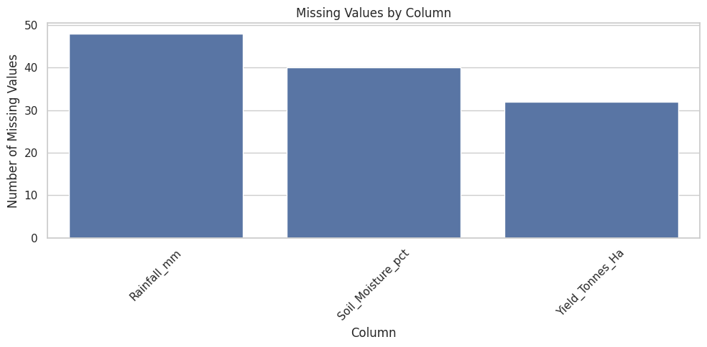
RESULTS
Missing Values Analysis
Missing observations were concentrated in Rainfall (48), Soil Moisture (40) and Yield (32); preprocessing removed the remaining missing values.

Slide 7
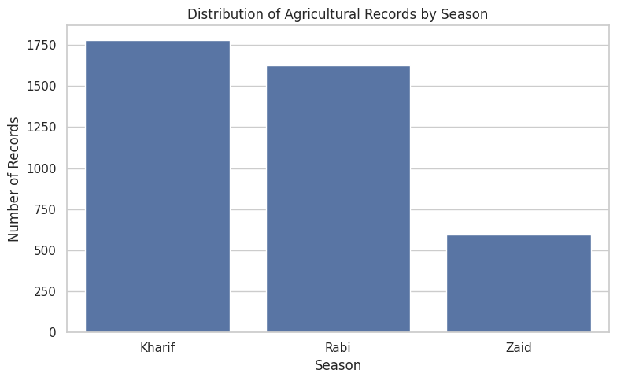
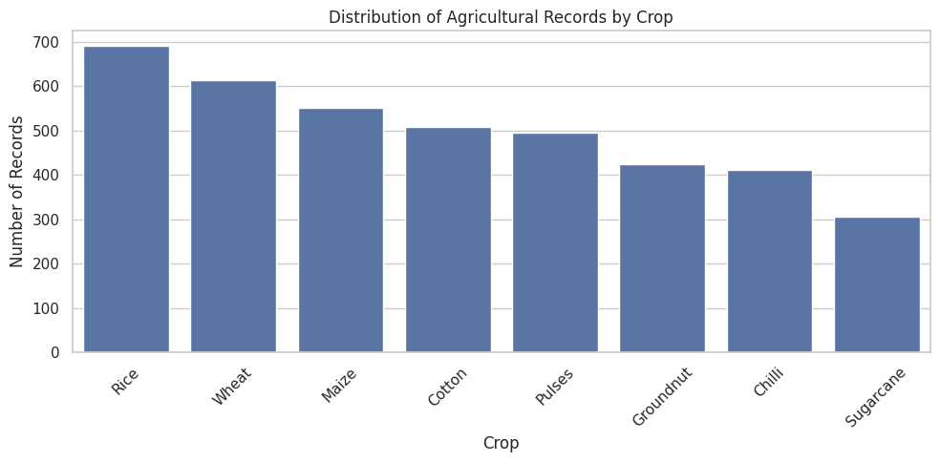
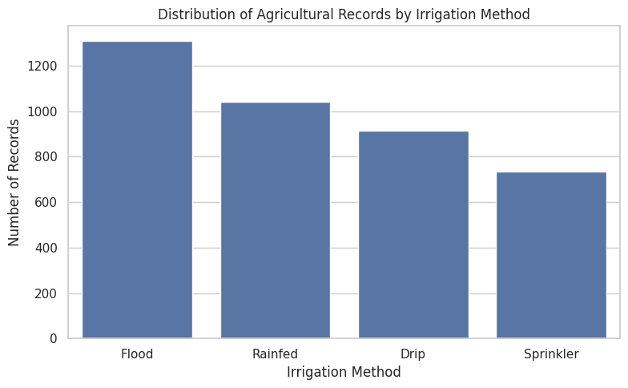
RESULTS
Season, Crop & Irrigation Distribution
Kharif is the most represented season; Rice is the largest crop category; Flood irrigation is the most common method.

Slide 8
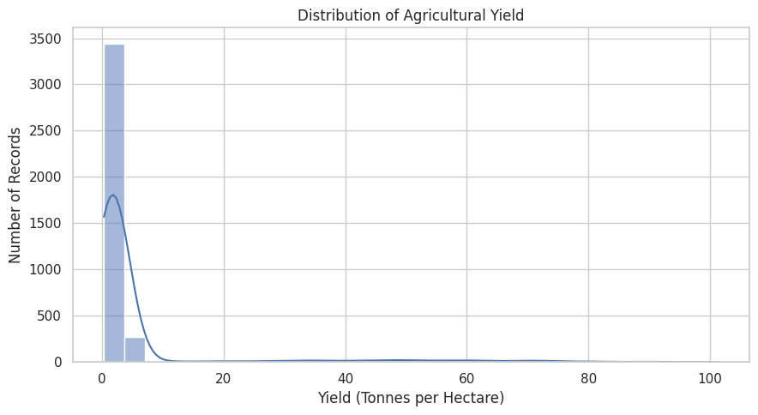
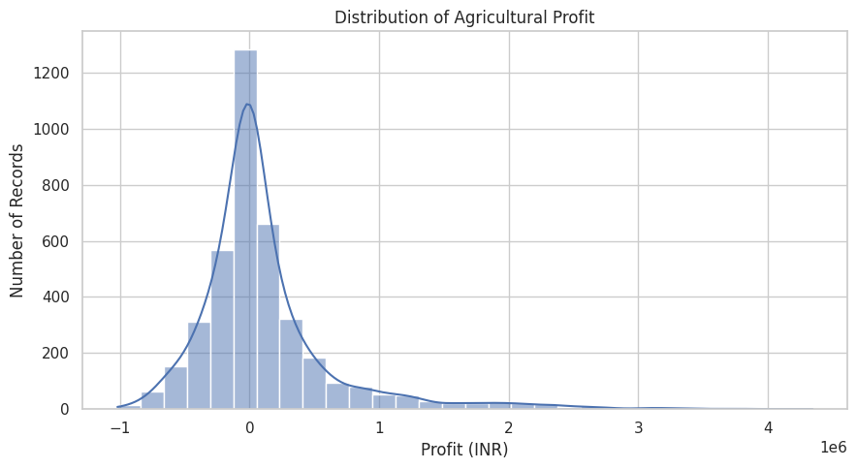
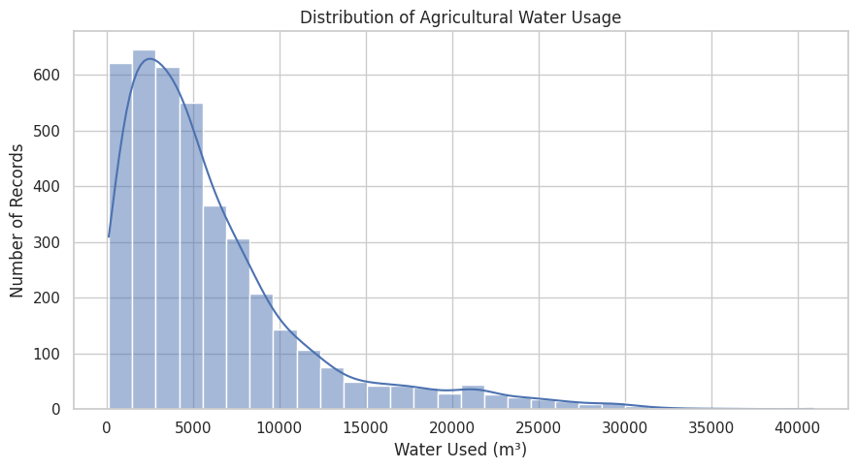
RESULTS
Yield, Profit & Water Usage Distributions
Yield, profit and water-use distributions are right-skewed, indicating substantial variation across farms.

Slide 9
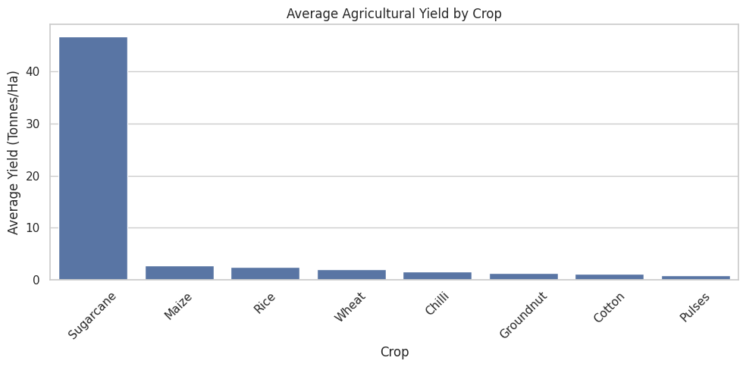
RESULTS
Crop-wise Yield
4,000 records • 28 variables • Covers crop, season, environmental, irrigation, production, profit and water-use variables.
Sugarcane has the highest average yield (46.64 tonnes/ha), while Pulses has the lowest (0.92 tonnes/ha).

Slide 10
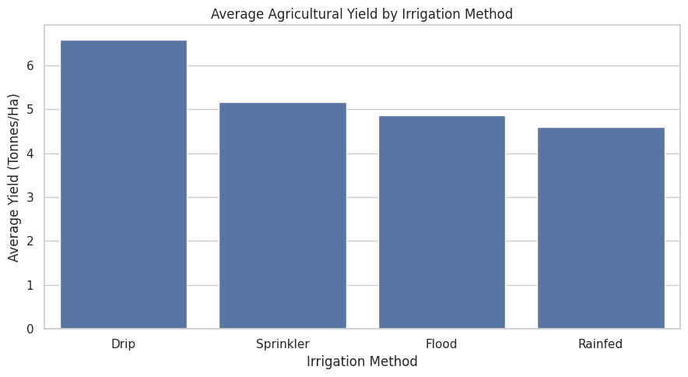
RESULTS
Irrigation Method vs Yield
4,000 records • 28 variables • Covers crop, season, environmental, irrigation, production, profit and water-use variables.
Average yield: Drip 6.58 • Sprinkler 5.16 • Flood 4.86 • Rainfed 4.60 tonnes/ha.

Slide 11
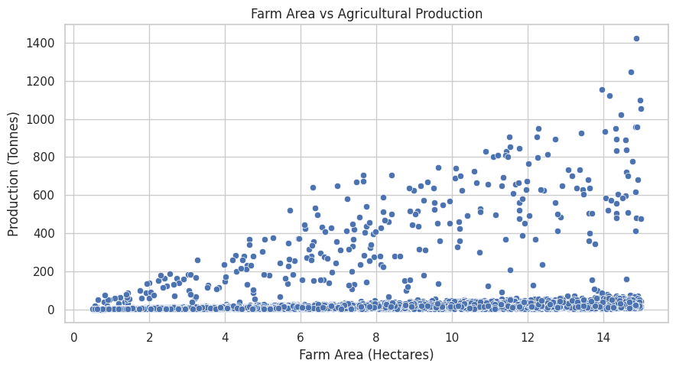
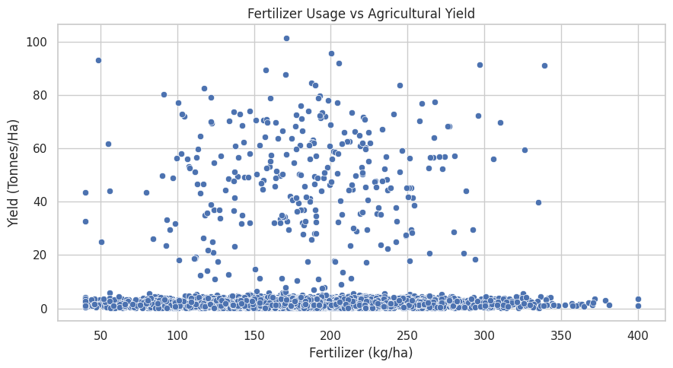
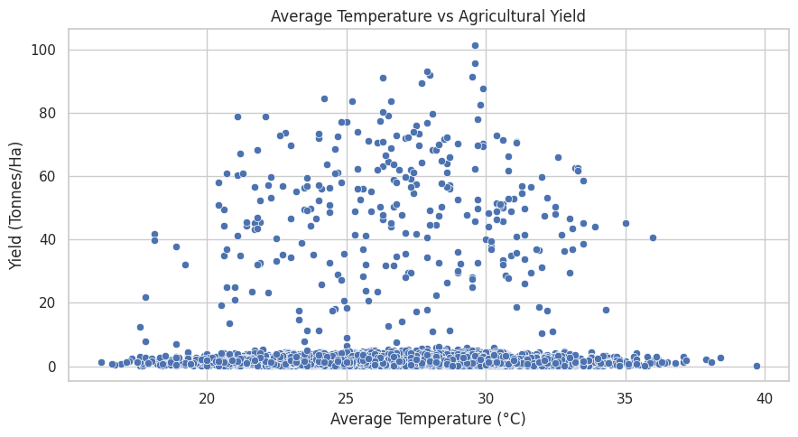
RESULTS
Environmental Factors vs Yield
4,000 records • 28 variables • Covers crop, season, environmental, irrigation, production, profit and water-use variables.
Rainfall, temperature and soil moisture each show very weak linear relationships with yield in this dataset.

Slide 12
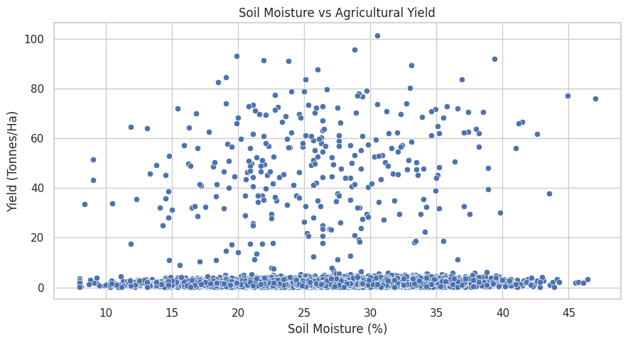
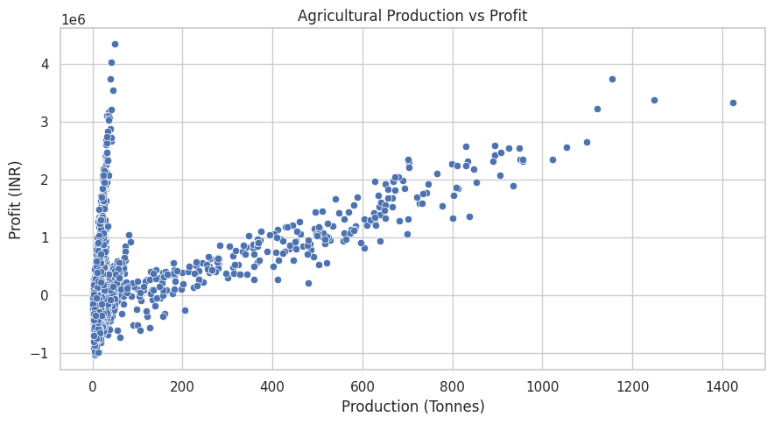
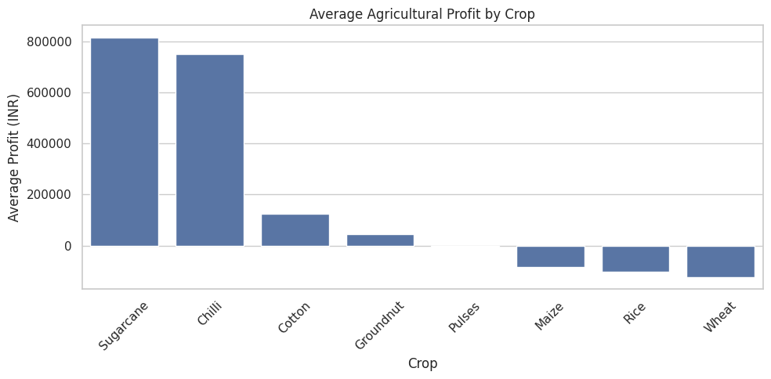
RESULTS
Production, Profit & Water Usage Relationships
4,000 records • 28 variables • Covers crop, season, environmental, irrigation, production, profit and water-use variables.
Production–profit correlation ≈ 0.55; water-use–production correlation ≈ 0.52; crop profitability varies strongly.

Slide 13
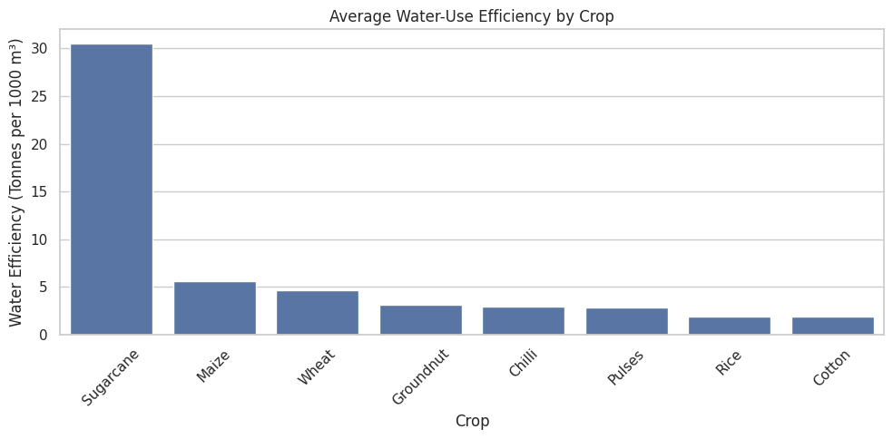
RESULTS
Water-use Efficiency by Crop
4,000 records • 28 variables • Covers crop, season, environmental, irrigation, production, profit and water-use variables.
Sugarcane has the highest observed water-use efficiency (30.48 tonnes/1,000 m³), substantially above the other crops.

Slide 14
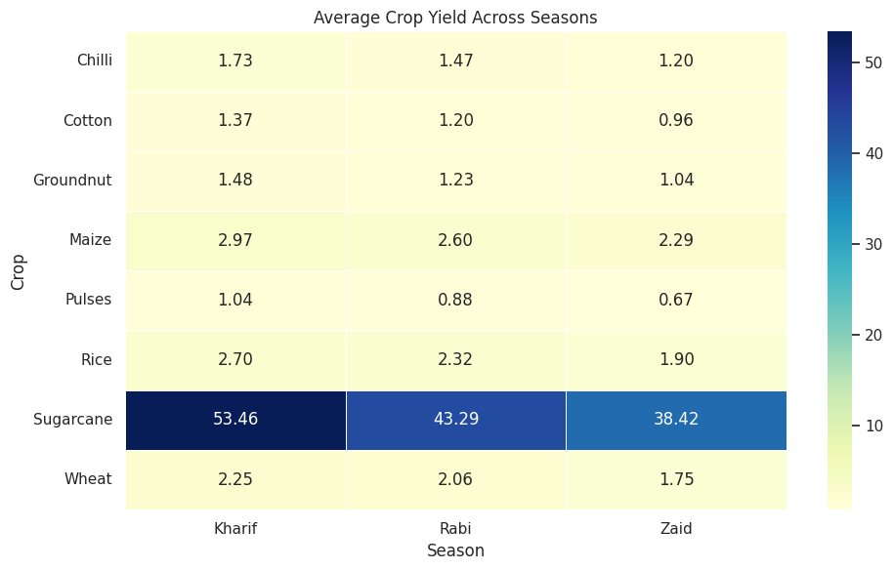
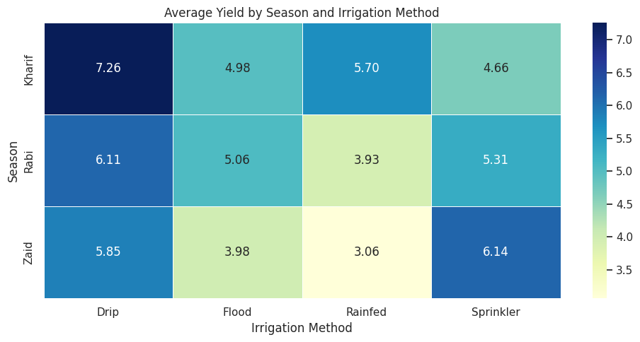
RESULTS
Crop × Season & Season × Irrigation
4,000 records • 28 variables • Covers crop, season, environmental, irrigation, production, profit and water-use variables.
Yield changes with both crop and season, and irrigation performance also varies by season—showing the value of interaction analysis.

Slide 15
Future scope
Predictive Modeling – Develop machine learning models to predict crop yield and profitability.
Real-Time Data Integration – Incorporate live weather, rainfall, soil moisture, and market-price data.
Crop Recommendation System – Recommend suitable crops based on season, soil, climate, and available resources.
Smart Irrigation – Develop an intelligent system to recommend optimal irrigation methods and water requirements.
Regional Analysis – Extend the analysis to different states, regions, and soil types.
Interactive Dashboard – Build a dashboard using tools such as Power BI or Streamlit for real-time agricultural insights.
Advanced Optimization – Optimize crop selection, water usage, fertilizer application, and expected profit.

Slide 16
GitHub Link
https://github.com/Mubasheermohd18/Seasonal_Agriculture_Performance_Analysis

Slide 17

VOIS Course completion certificate - Course name- Data Visualization

Slide 18
Thank you
.
.

