Slide 1

Project Title - Car Market Trends Analysis with CarDekho Data
AICTE STU ID : STU6a13f8dd3f0c81779693789
Student Name: Mohammed Mubasheeruddin

Slide 2

PROBLEM STATEMENT
The used-car market contains vehicles with different prices, models, manufacturing years, fuel types, transmission types, and usage levels. It can be difficult for buyers and sellers to understand which factors influence the selling price of a used car.
This project aims to analyze CarDekho car-market data using Python to identify important pricing patterns and market trends. The analysis focuses on factors such as present price, manufacturing year, kilometers driven, fuel type, seller type, transmission, and previous ownership to understand their relationship with the selling price.

Slide 3
Project Description
This project aims to analyze CarDekho used-car data and get an in-depth knowledge of the trends in the used-car market. It's a dataset with car model information, year of production, selling price, current price, kilometers, fuel type, type of seller, transmission and used car or not. The data is then analyzed and graphed using Python, Pandas, Matplotlib, and Seaborn to look for trends in car prices. The project compares the different types of vehicles and investigates the relationship between car age, current price, fuel type, transmission, and kilometres driven and selling price. The analysis serves to comprehend the used-car pricing patterns and offers valuable insights for used-car buyers, sellers, dealers, and market analysts.

Slide 4

WHO ARE THE END USERS?
1. Car Buyers
They can use the analysis to understand car prices and compare different vehicle options.
2. Car Sellers
They can understand how factors such as car age, model, fuel type, and usage relate to selling prices.
3. Car Dealers
Dealers can use market trends to support better vehicle buying and pricing decisions.
4. Market Analysts
They can use the analyzed data to study patterns and trends in the used-car market.
5. Online Car Platforms
Car-selling platforms can use similar analysis to improve price comparison and vehicle recommendations.

Slide 5

Technology Used
Python
Used as the main programming language for data analysis.
Pandas
Used for loading, cleaning, organizing, and analyzing the CarDekho dataset.
NumPy
Used for numerical calculations and data processing.
Matplotlib
Used to create charts and graphs for visualizing car-market trends.
Seaborn
Used to create statistical visualizations such as correlation heatmaps and regression plots.
Google Colab Used as the cloud-based environment to write and execute Python code.
CSV Dataset
CarDekho used-car data is used as the source dataset for the analysis.

Slide 6
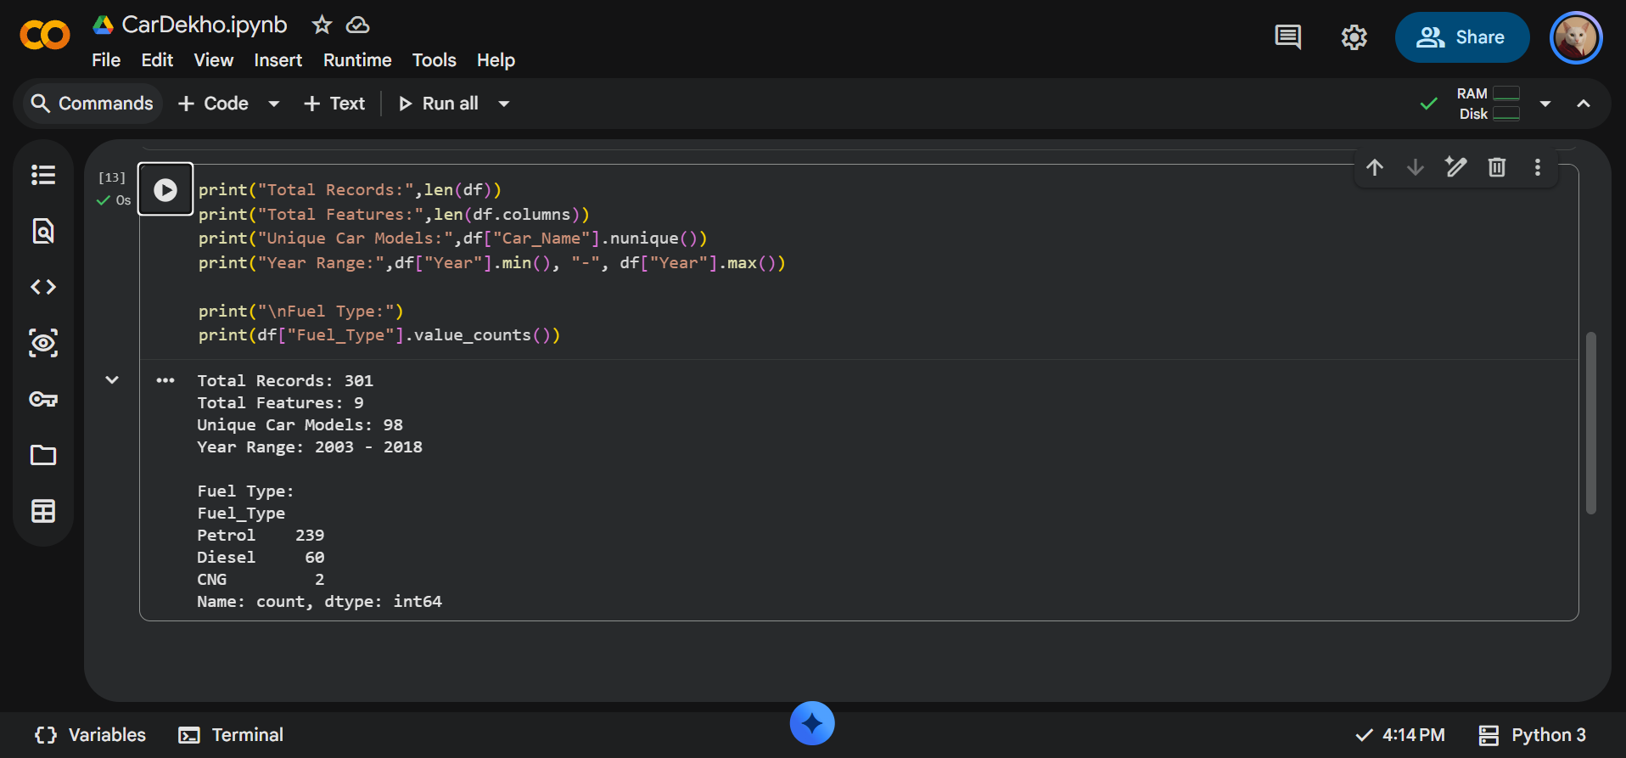
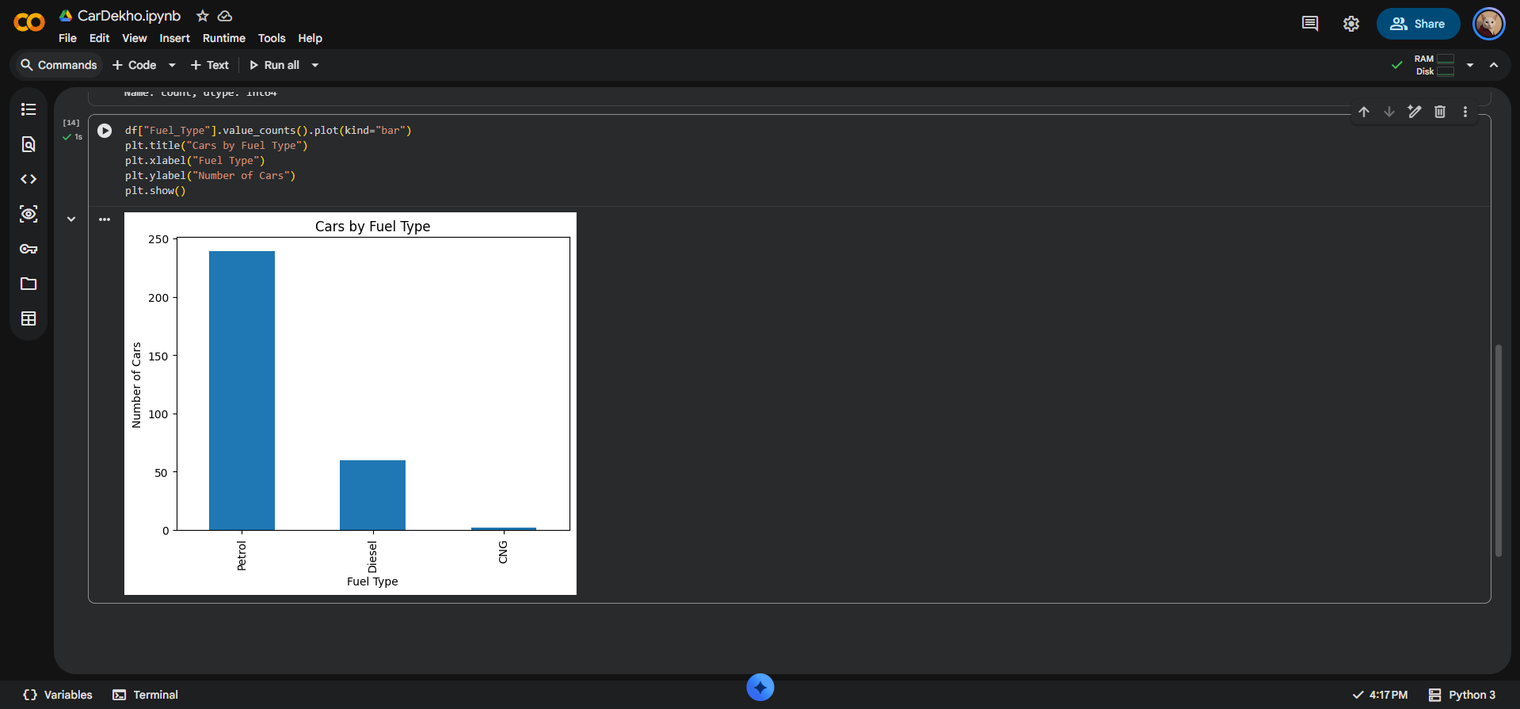
RESULT 1 - Dataset Overview
https://github.com/Mubasheermohd18/car-market-trends-analysis

Slide 7
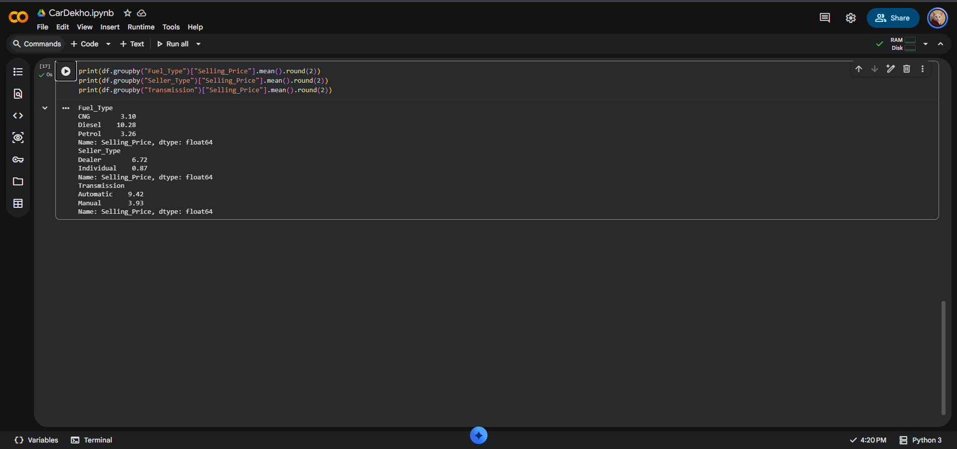
RESULT 2 - Market Segmentation
https://github.com/Mubasheermohd18/car-market-trends-analysis

Slide 8
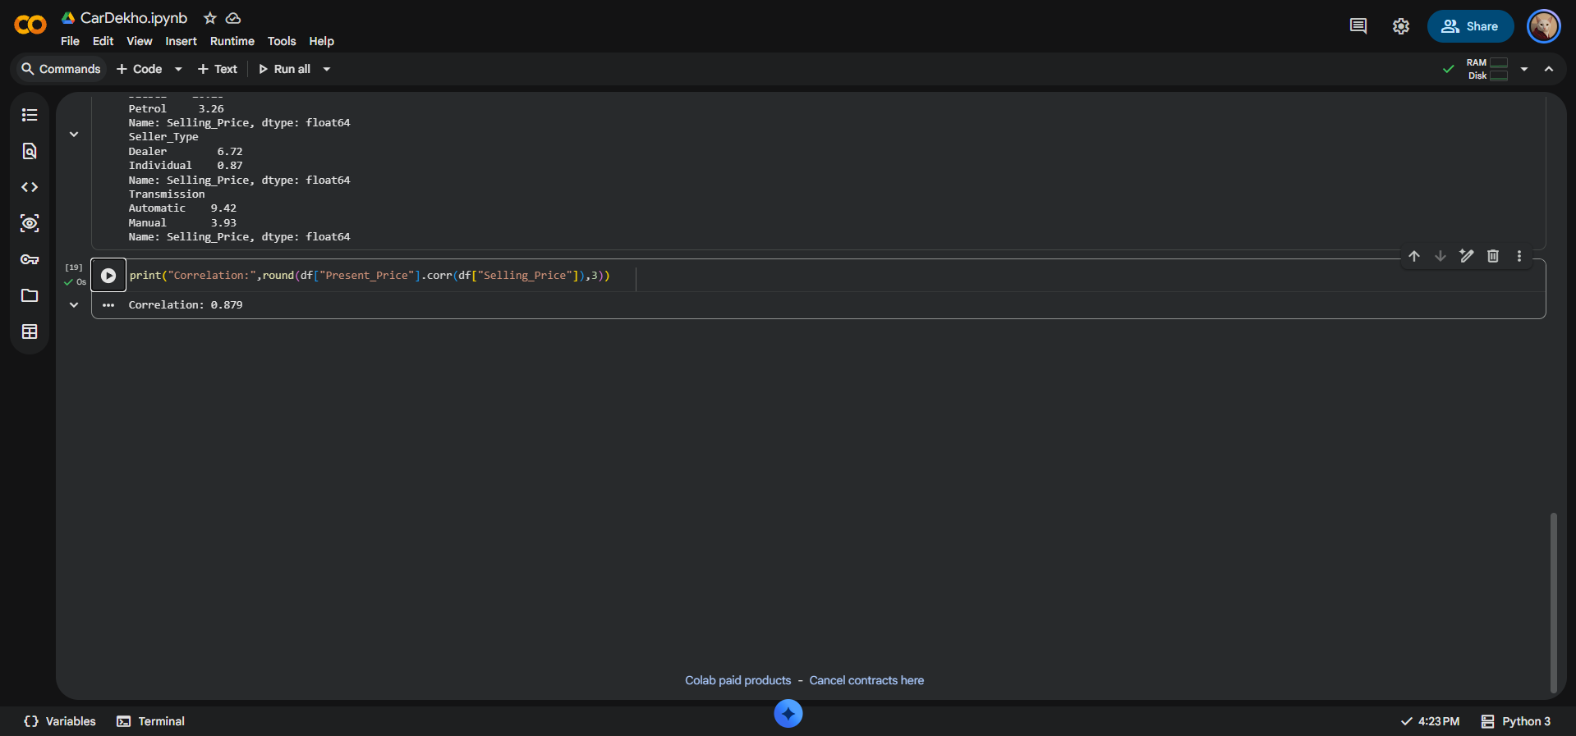
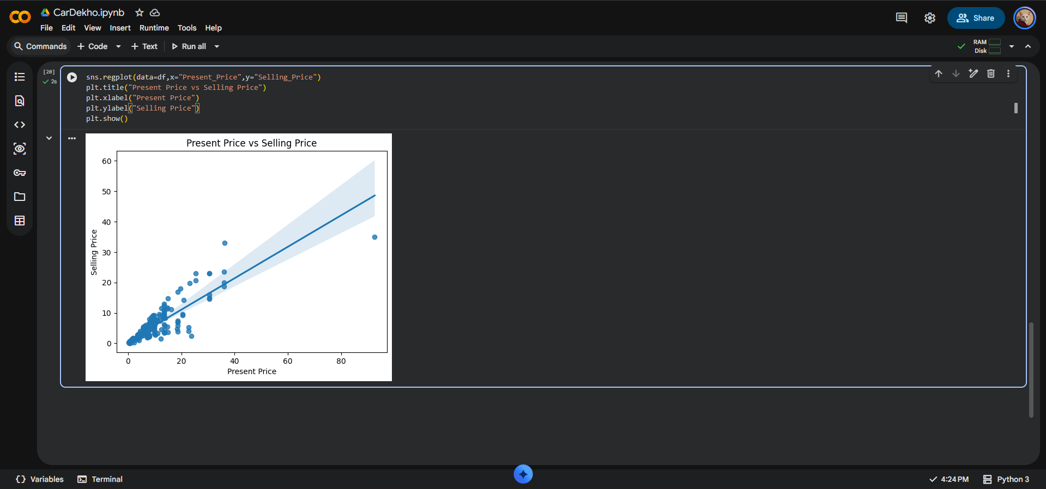
RESULT 3 - Present Price vs Selling Price
https://github.com/Mubasheermohd18/car-market-trends-analysis

Slide 9
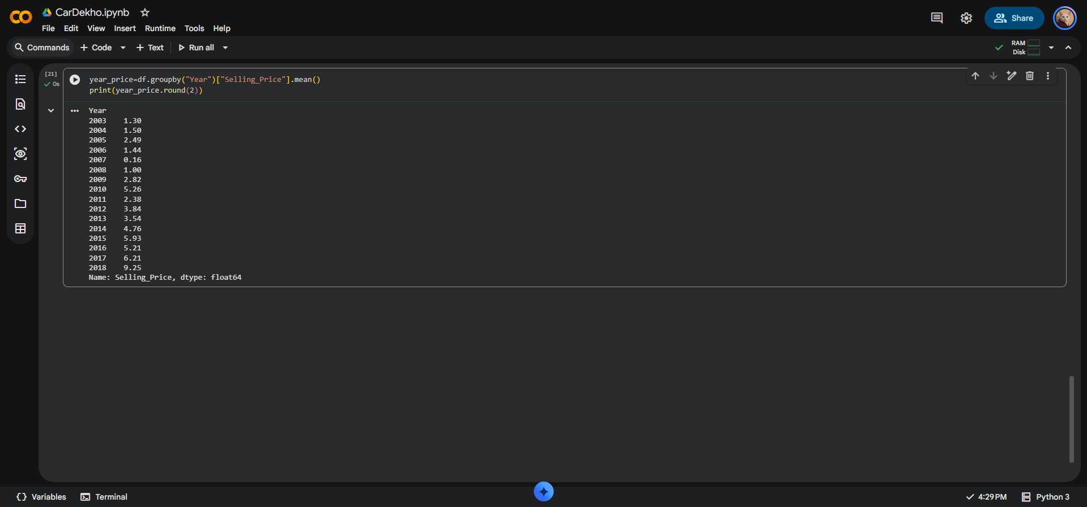
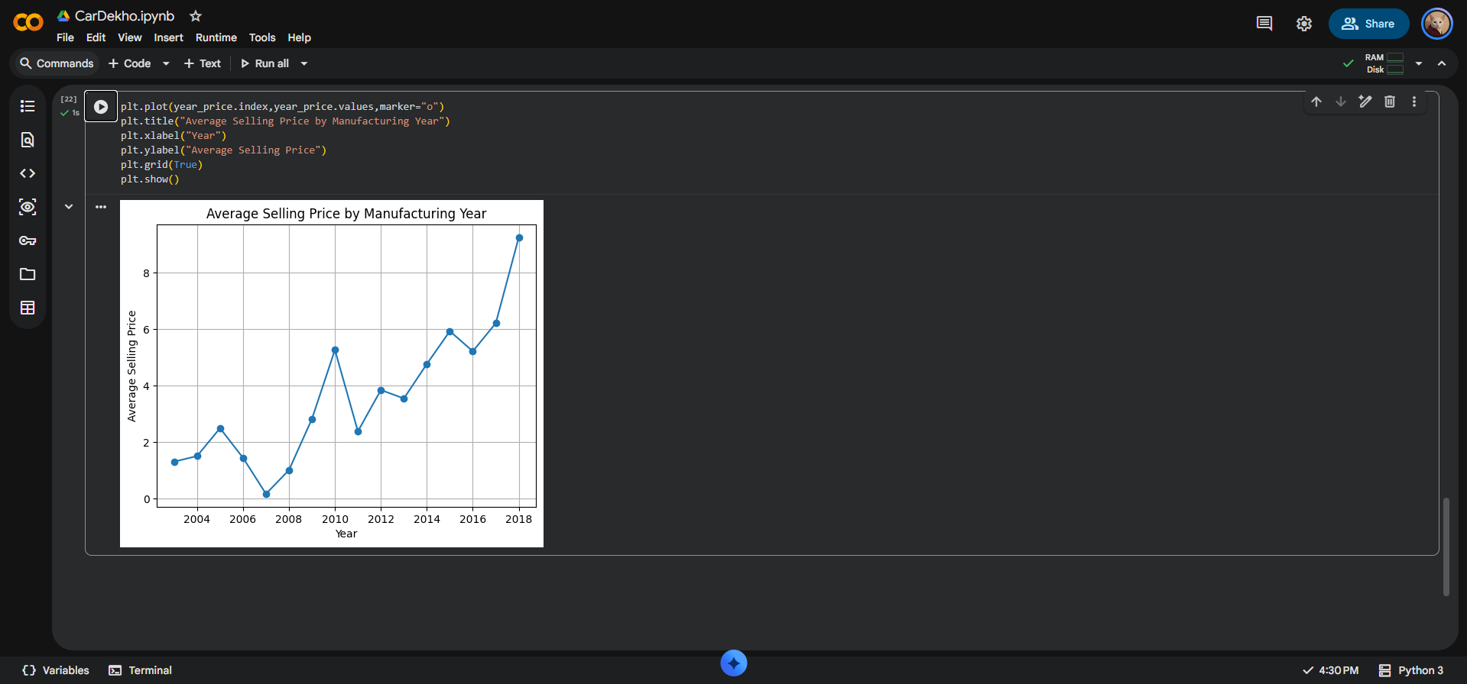
RESULT 4 - Manufacturing Year vs Selling Price
https://github.com/Mubasheermohd18/car-market-trends-analysis

Slide 10
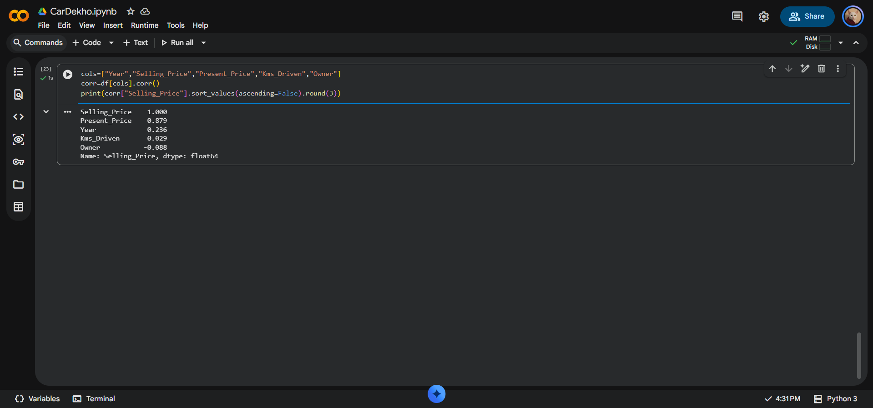
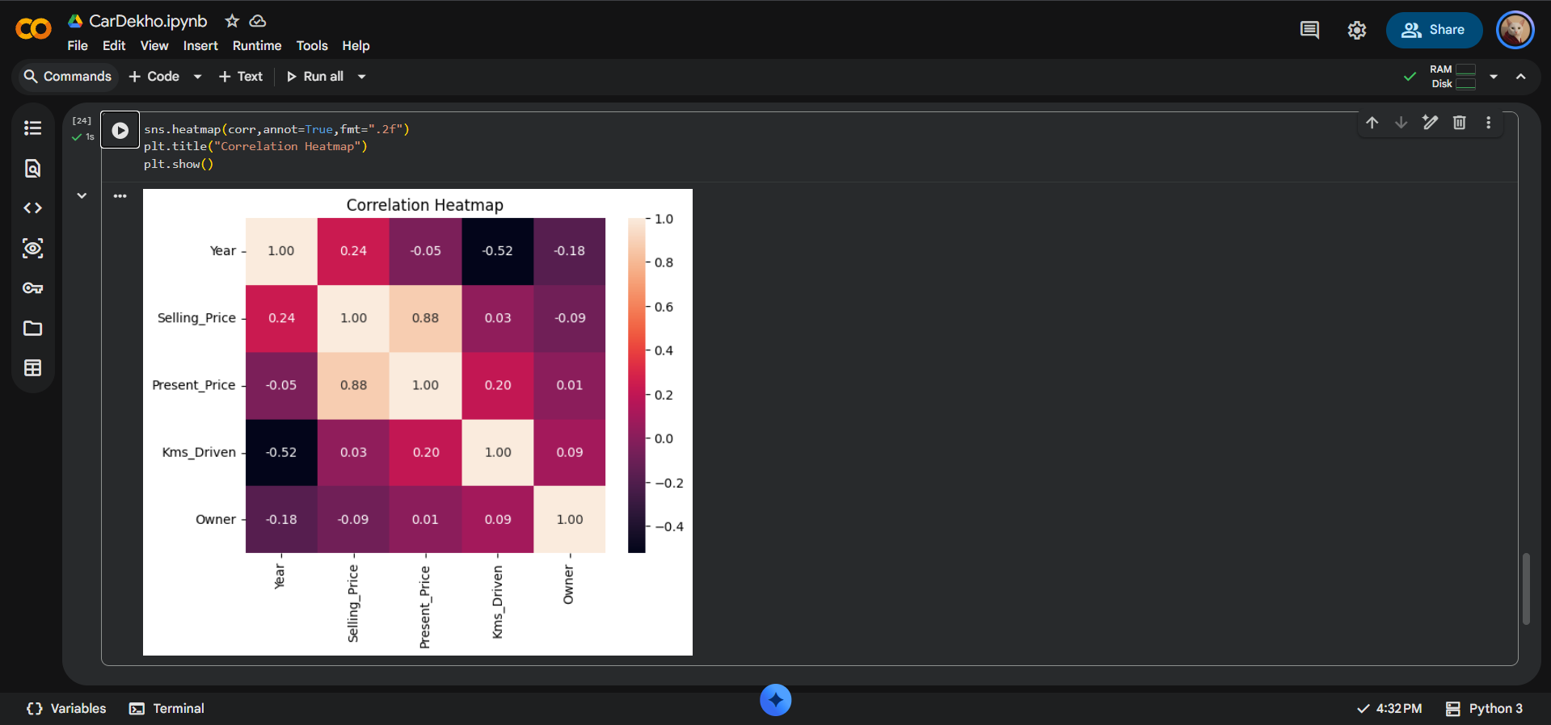
RESULT 5 - Correlation Analysis
https://github.com/Mubasheermohd18/car-market-trends-analysis

Slide 11
Thank you
.
.

