Slide 1
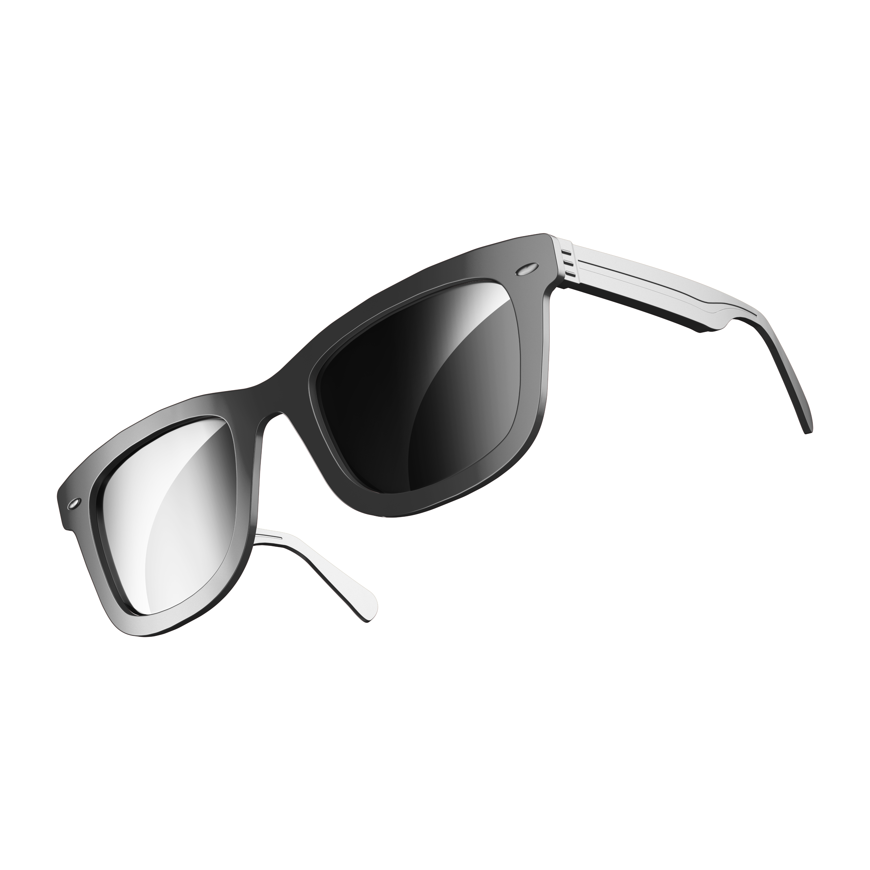
PROJECT BASARAT
Vision Beyond Sight

Slide 2

The Challenge Of Visual Impairment
Imagine yourself buying your favorite chocolate at a supermarket
Now imagine yourself doing the same with your eyes closed!

Slide 3

1.2M
People in Pakistan face this issue everyday
Reference: A comprehensive study capturing vision loss burden in Pakistan (1990-2025): Findings from the Global Burden of Disease (GBD) 2017 study

Slide 4
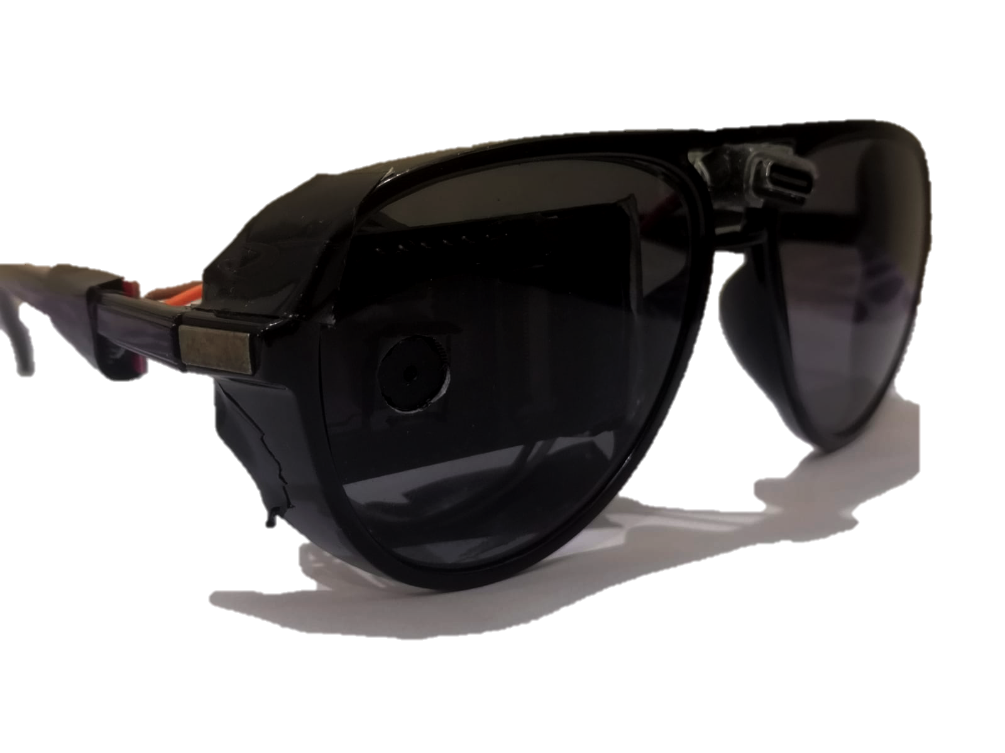
BASARAT
Smart Glasses
AI-powered glasses enabling vision beyond sight.
Audio feedback describes surroundings and reads text
Reduces dependence, enhances life quality.

Slide 5

Affordable Innovation for All
Affordable Price
Light-weight and Intuitive
Affordable for everyone
Designed for low-income users
Estimated cost to build: 5,000 PKR
Looks like normal sunglasses
No tech expertise needed.
Simple button operation

Slide 6
Why Basarat Stands Out
01
02
03
04
Affordability
Compact Design
Competition like Envision AI costs more than 700,000 PKR
Basarat’s Smart-glasses look like any other normal glasses
Modular Design
Easy Local Production
Basarat’s glasses are built with modularity and repairibility in mind.
Upto 80% of the parts of Basarat smart-glasses can be locally manufactured

Slide 7

Our RoadMap
Design Refinements
Commercialization
Working Concept
Human Testing
A refined design is being made
Once all things are finalized we will progress towards commercialization of Basarat Glasses.
Completed
A working concept of the glasses is ready
We’re underway preparation to request for testing from National Bioethics Committee.

Slide 8
Commercialization
Total Addressable Market
Designed for Manufacturing
1.15M visually impaired individuals in Pakistan and 50M+ worldwide
The Basarat glasses are designed keeping in mind manufacturing principles and constraints in Pakistan
Easy Adaptation
Local Production
Low price and simple use design makes it easy for the Pakistani market to adapt
The parts of the Basarat glasses are easy to source and so it can be easily produced locally produced.

Slide 9
THANKS!
DO YOU HAVE ANY QUESTIONS?
PROJECT BASARAT
Team Members
Habibullah Khan
Mubasher Ahmed
Bassam Siraj

