Slide 1
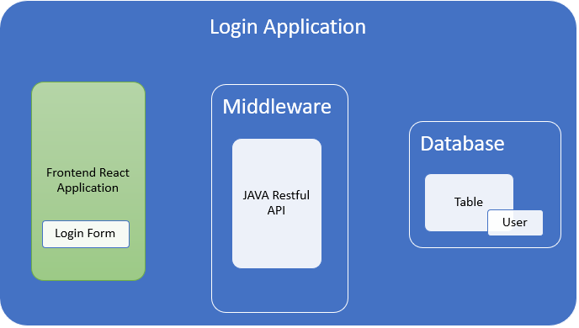
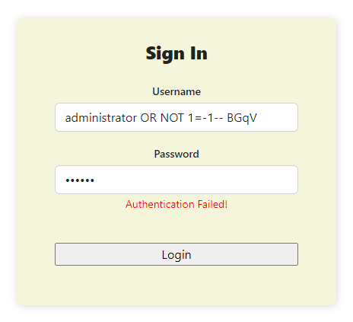
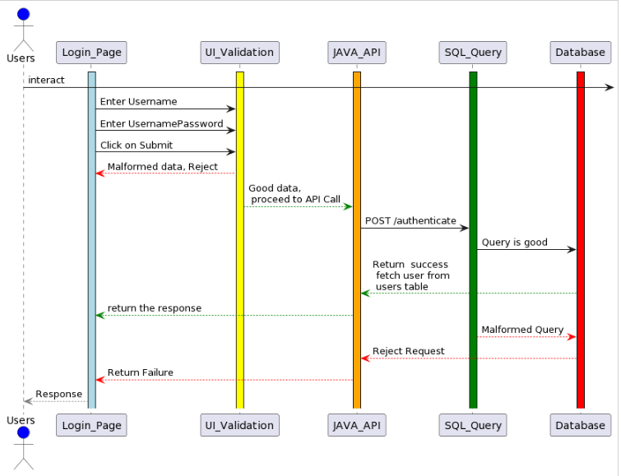
Advisor Name: Aiman
Darwiche
Grand Canyon University
Detection and Prevention of SQL Injection Attacks
Mubasher Mehnaz Begum
Abstract & Introduction
Application Design
Implications
One of the popular methods used by hackers to target databases is the SQL injection attack. Even though this vulnerability has been around for a while, most mitigation strategies are based on safe coding techniques as many programmers do not evaluate the reliability of user input data when writing code, which increases the security risks of applications. Users can enter a database query code and receive the desired data based on the program's output.
This project aims to provide SQL Injection vulnerability mitigation techniques that may be used with practically any programming language and any kind of database.
This project demonstrates how the SQL query might be changed to thwart such an attack; the project compares Safe Code against Unsafe Code.
The project will likely give a central comprehension of how to perceive and guard against SQL Infusion Assaults.
Step by step instructions to confirm input information, keep away from SQL Infusion assaults, and plan safe SQL queries that acknowledge input from online applications.
Prevent SQL injection when running queries against the database and to safeguard the database.
Using a unique static and dynamic analytic approach to detect SQL injection threats.
Prevent loss of personal information data resulting in data breach and loss of customer trust in the company.
Research Question
How to prevent SQL Injection Attacks?
What are the countermeasures for Login Bypass Attack?
UI Screen
Materials & Methods
Software’s Requirements
Open-source Java SDK
IntelliJ Idea Community version
Open-source Microsoft Visual Studio Code
Microsoft MySQL Installed, MySQL Workbench, Postman for API Testing
Hardware: Windows/Mac OS
External Libraries:
Node JS, Node package Manager – Frontend Web Application Development
React, JavaScript, HTML5, CSS3 – Frontend Web Application Development
Spring boot, Hibernate, MySQL driver, Maven. – JAVA RESTful API Development
Databases Required: MySQL/PostgreSQL
Browser Requirements for Testing: Chrome/Edge/Safari
Application Flow
References
Administrator. (2012, December 24). Sql injection authentication bypass cheat sheet. Penetration Testing Lab. https://pentestlab.blog/2012/12/24/sql-injection-authentication-bypass-cheat-sheet/.
Aliero, M. S., Qureshi, K. N., Pasha, M. F., Ahmad, A., & Jeon, G. (2020, July 22). Detection of structure query language injection vulnerability in web driven database application. Wiley Online Library. https://onlinelibrary.wiley.com/doi/10.1002/cpe.5936.
Authentication bypass using sql injection on login page. GeeksforGeeks. (2020, November 20). https://www.geeksforgeeks.org/authentication-bypass-using-sql-injection-on-login-page/.
kitploit - hacker tools on twitter: "sqlidetector - helps you to ... (n.d.). Retrieved March 1, 2023, from https://twitter.com/KitPloit/status/1618608611017588750
Muscat, I. (2020, May 13). Prevent SQL injection vulnerabilities in PHP applications and fix them. Acunetix. https://www.acunetix.com/blog/articles/prevent-sql-injection-vulnerabilities-in-php-applications/.
(PDF) a study on SQL injection techniques. ResearchGate. (n.d.). https://www.researchgate.net/publication/316886377_A_study_on_SQL_injection_techniques.
StackHawk. (n.d.). Laravel SQL Injection GUIDE: Examples and Prevention. StackHawk. https://www.stackhawk.com/blog/sql-injection-prevention-laravel/.
System architecture for SQL injection and INSIDER misuse detection system FOR DBMS. IEEE Xplore. (n.d.). https://ieeexplore.ieee.org/abstract/document/4631942.
Using SQL injection to bypass authentication. PortSwigger. (n.d.). https://portswigger.net/support/using-sql-injection-to-bypass-authentication.
We would like to acknowledge the support received from GCU in the form of feedback received which helped me complete my project.

