Slide 1
SUPERTEAM PAKISTAN · EDVERSITY
ReliefChain
Transparent Giving. Verifiable Impact.
A blockchain-powered platform for transparent humanitarian donations.
CRYPTO WORLD’S FAIR PAKISTAN TRACK · HACKATHON PROTOTYPE
Notes:
Welcome everyone. Today we are presenting ReliefChain, a platform built during the Crypto World’s Fair Pakistan Track to make humanitarian giving completely transparent and verifiable.

Slide 2


THE PROBLEM
Donors struggle to verify where giving goes
Donation records can be hard to verify independently. Fundraising platforms may not always offer easy transaction evidence.
THE VISIBILITY GAP
Donors want visibility into campaign progress and reported impact.
DONOR
CAMPAIGN
Sends contribution
Receives relief funds
NO VISIBLE EVIDENCE
Donation records can be difficult to verify independently.
Transparency builds trust between donors and organizers.
Notes:
When people donate to humanitarian causes, they often wonder where the money actually went. The disconnect is not malice, it is simply a lack of visible, independent transaction evidence.

Slide 3




CORE CAPABILITIES
Campaign-Based Experience
ReliefChain makes every donation checkable
Clear relief causes with visible funding goals, organizers, and verified progress milestones.
Phantom Wallet Integration
Public accountability built into every step of the donation journey, from wallet tap to live ledger.
One-click browser wallet connection supporting SPL test tokens on Solana Devnet.
Server-Side Verification
Independent backend confirmation queries the Solana cluster before storing any record.
Transparency Dashboard
Public live log displaying verified totals, donor addresses, and direct Solana Explorer links.
Live Solana Devnet connection
Notes:
ReliefChain solves this by combining standard campaign fundraising with Phantom wallet signing, Devnet SPL tokens, backend validation, and a public transparency dashboard with Solana Explorer links.

Slide 4
HOW IT WORKS
Seven stations from donor intent to verified impact
1
2
3
4
5
6
7
VISIT
CONNECT
DONATE
SUBMIT
VERIFY
RECORD
DASHBOARD
Donor visits a campaign
Connects a Phantom wallet
Starts a supported token donation
Transaction goes to Solana Devnet
Backend independently verifies the transfer
Only verified donations are recorded as verified
Shows verified records and totals
NOT RECORDED AS VERIFIED
Not recorded as verified.
Primary verification pathway
Exception branch: unverified transactions rejected
Notes:
Here is the life of a donation. The donor connects Phantom and signs. The transaction submits to Devnet, our backend verifies the exact recipient and amount, and only validated events reach the dashboard.

Slide 5
ARCHITECTURE CONCEPTS
Phantom and Solana, in plain language
PHANTOM WALLET
SOLANA DEVNET
Non-custodial authorization
Decentralized state engine
Phantom securely manages the donor’s keys. When contributing, the user signs locally inside their wallet app. The ReliefChain backend never sees, handles, or stores private keys.
Solana settles transactions in sub-second slots with minimal fees. The ledger provides immutable public proof, allowing anyone to inspect signatures on Solana Explorer.
Key custody stays 100% with the user
Public on-chain ledger proof
Status: Solana Devnet demonstration prototype · Running on test tokens, not real money.
Notes:
To non-crypto judges: Phantom acts like a secure digital passport where the user controls access. Solana acts as a public bulletin board that records proofs instantly. We run on Devnet with test tokens.

Slide 6
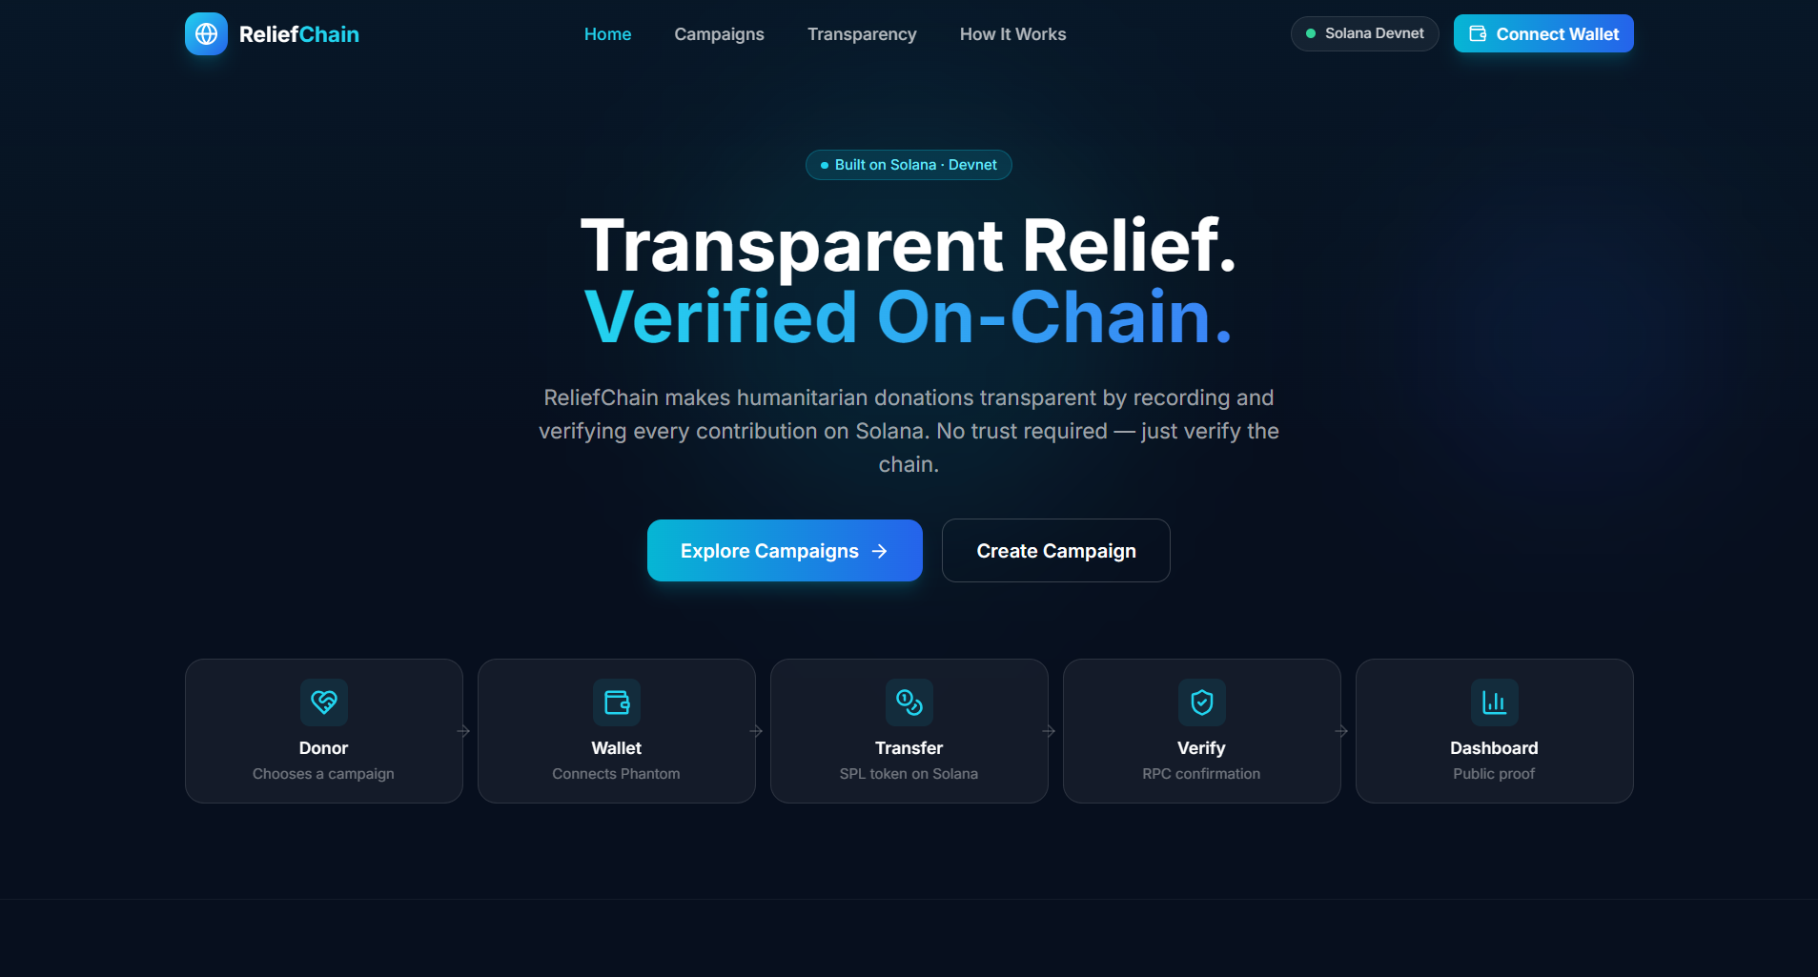
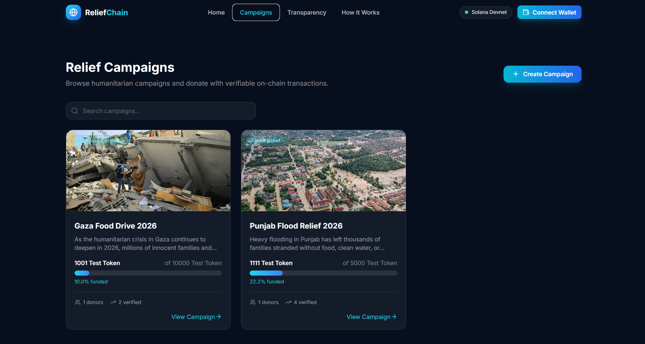
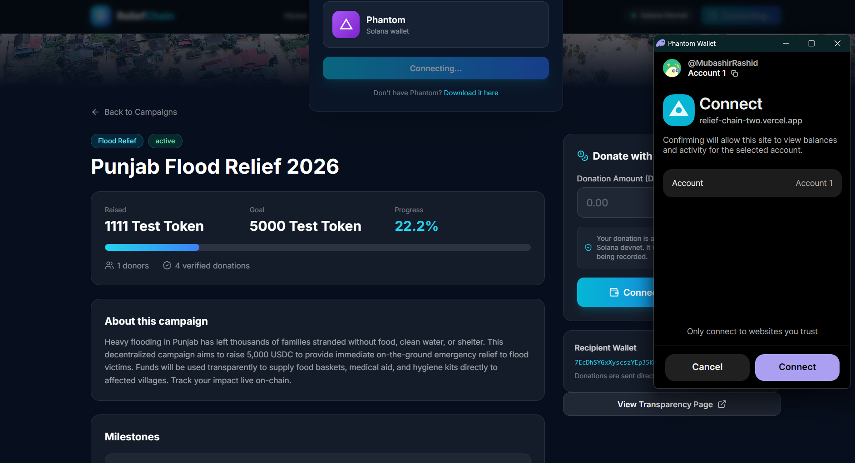
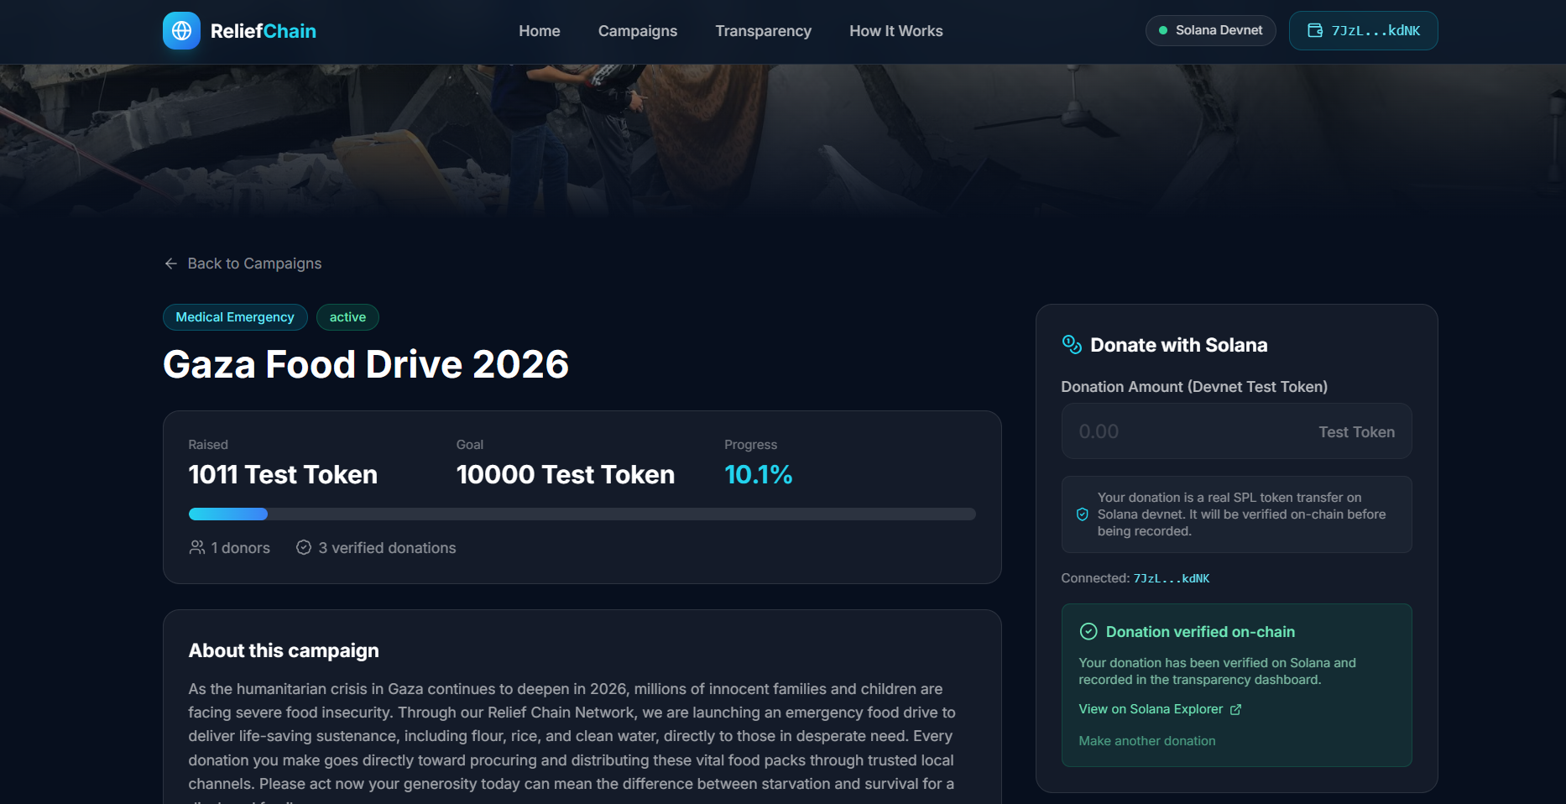
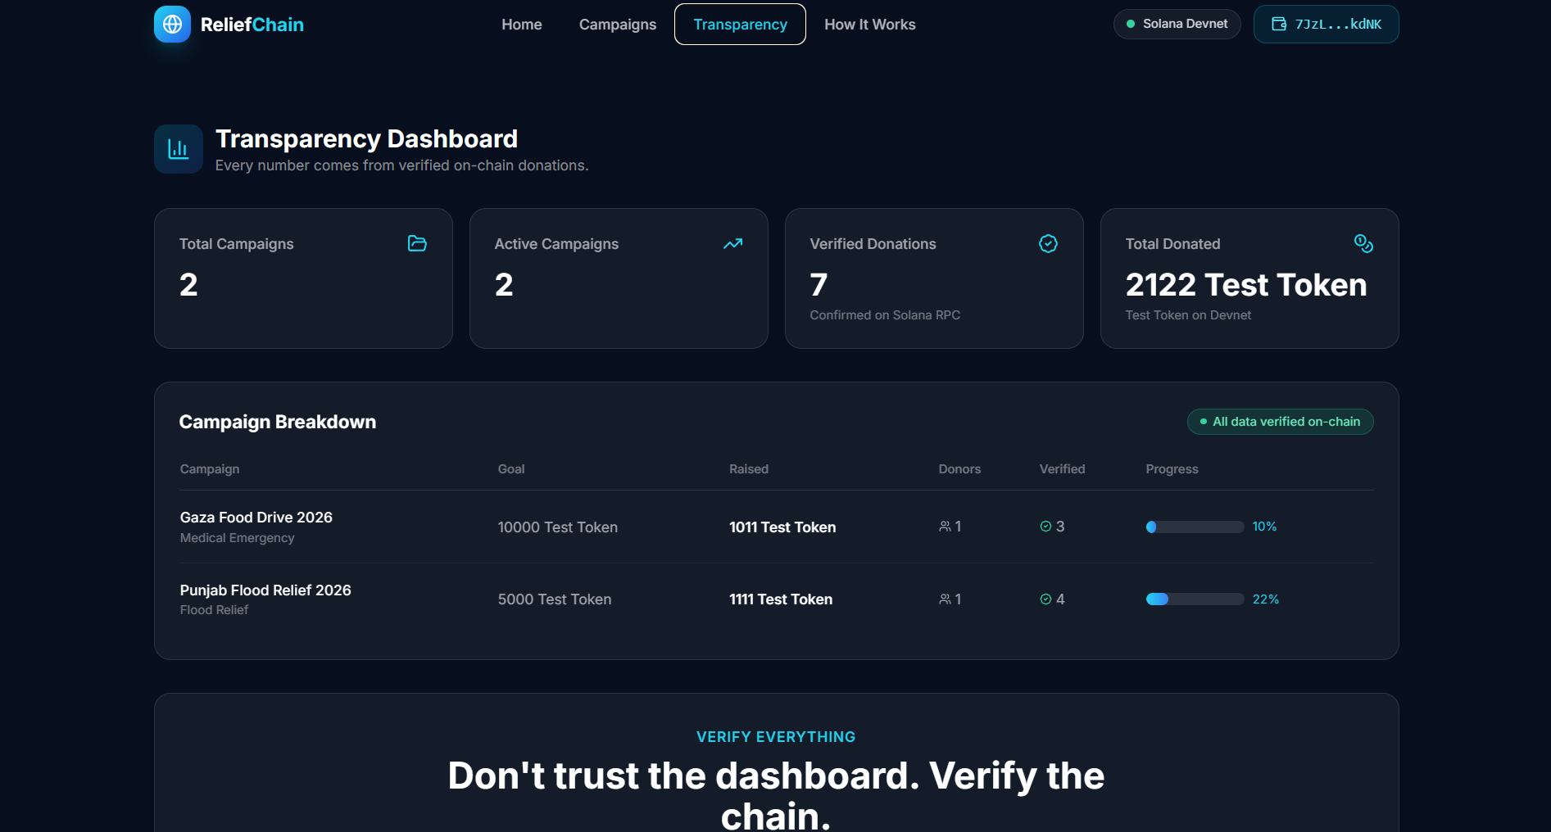
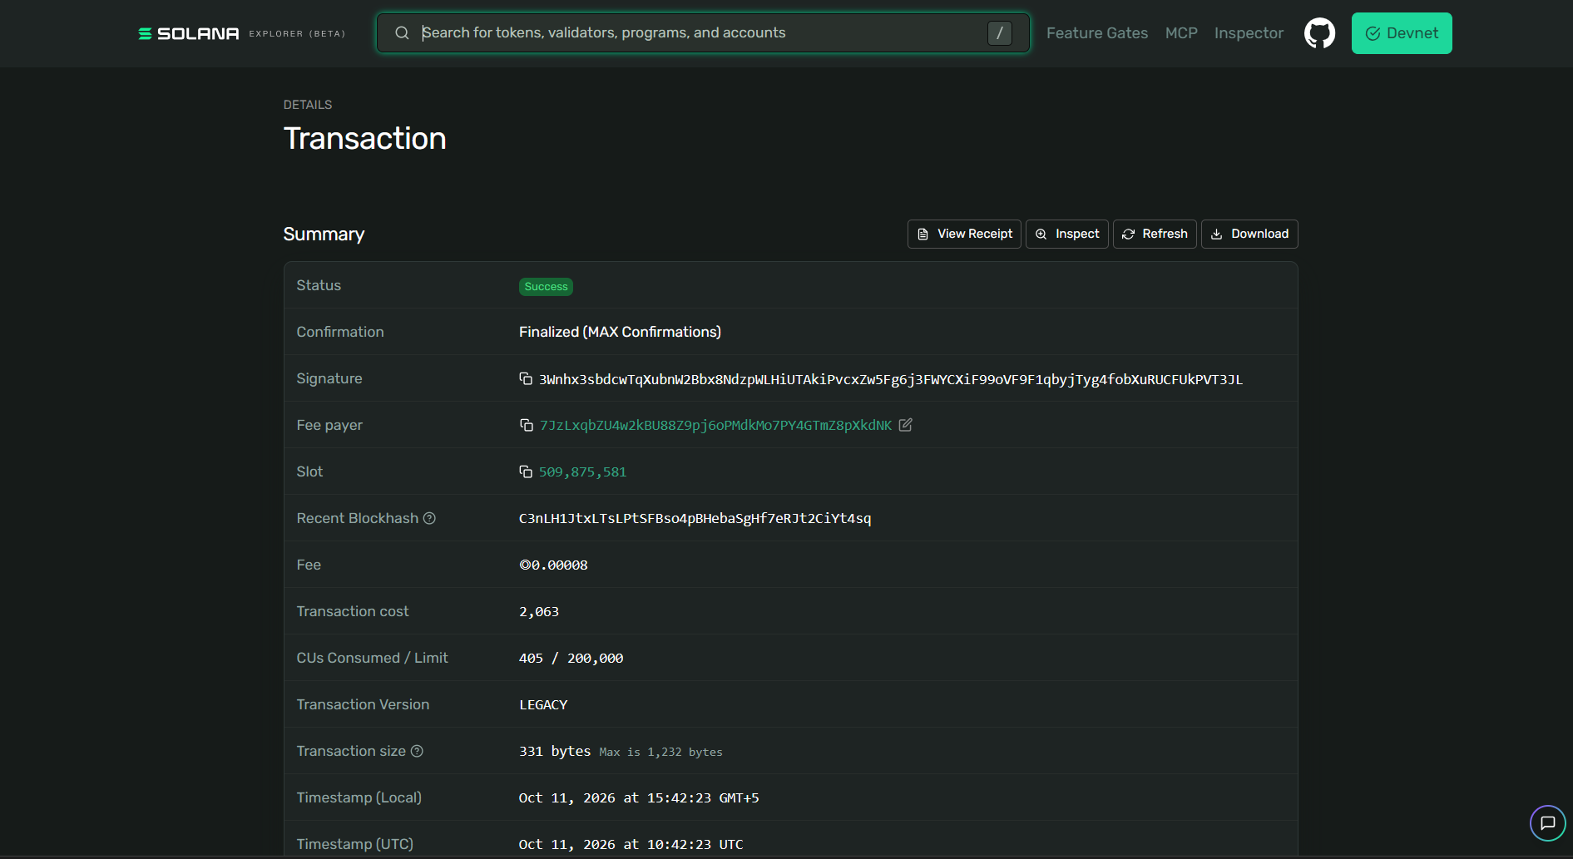
APPLICATION INTERFACE
The product, as it runs today
Notes:
These six plates are placeholders because screenshots could not be captured automatically. Replace each with real product evidence before presenting.

Slide 7
SYSTEM DESIGN
Technical architecture
CLIENT LAYER
BLOCKCHAIN
VERIFICATION
PERSISTENCE
React 18 & Vite
Solana Devnet
Supabase Functions
PostgreSQL DB
TypeScript, Tailwind CSS, and Phantom wallet adapter managing responsive frontend state.
Solana Web3.js and SPL Token library processing immutable transfers and block confirmations.
Deno runtime edge functions running Zod validation and direct JSON-RPC on-chain checks.
Stores verified campaign progress and indexed records for rapid query performance.
Data Pipeline: Donor → Web App → Phantom Wallet → Solana Devnet → Supabase Edge Function (Verification RPC) → PostgreSQL → Transparency Dashboard.
Notes:
Under the hood, we pair React 18 with Solana Web3.js and Supabase Edge Functions. Storing verified records in Postgres ensures fast dashboard queries without hammering the RPC node for every page visit.

Slide 8
SECURITY & INTEGRITY
Built so only verified donations count
01
02
03
04
Server-Side Check
5-Point Audit
Replay Prevention
Public Explorer
Verification runs strictly on Supabase Edge Functions, never trusting client-side claims.
Backend inspects status, SPL token mint, recipient address, transfer amount, and sender.
Database enforces unique transaction signatures so no hash can ever be recorded twice.
Every stored transaction links to Solana Explorer for universal third-party auditability.
Security Note: Hackathon prototype developed for educational demonstration; no external security audit has been performed.
Notes:
Integrity is crucial. We do not trust frontend success events. Our backend performs a five-point check on the Solana signature and blocks replay attacks before writing a single row to our database.

Slide 9
POTENTIAL AUDIENCE
Who ReliefChain could serve
Individual donors
Community-led fundraising campaigns
Humanitarian relief organizers
Nonprofit organizations
Donors who want verifiable transaction records
Accessible evidence could improve transparency and donor confidence. Potential only: no user counts, partners or outcomes claimed.
Notes:
ReliefChain could serve individual donors, community-led campaigns, humanitarian relief organizers, nonprofits, and donors seeking verifiable transaction records. Accessible evidence could improve transparency and donor confidence.

Slide 10
ROADMAP & FUTURE VISION
Growth opportunities, still ahead
Campaign management tools for organizations
Optional analytics and reporting services
Partnerships with established relief organizations
Solana Mainnet after testing and security review
More token and wallet options
Real-world donation channels, subject to technical and regulatory requirements
Future possibilities, not features. Mission stays central.
Notes:
These are possibilities, not features today. The mission stays central as we explore management tools, reporting, partnerships, Mainnet after review, more wallets, and real-world channels.

Slide 11
STATUS AND ROADMAP
Where we are and where we go next
LIVE NOW · SOLID ROUTE
ROADMAP · DASHED ROUTE
Live website on Solana Devnet
Phantom donations with SPL tokens and server-side verification
Transparency dashboard with Explorer links, campaign creation with milestones
Uses a configurable Devnet test token, not real USDC
Mainnet after testing and review
Better organizer tools
More detailed impact reporting
Humanitarian partnerships
More wallets and tokens
Improved monitoring, testing and reliability

Slide 12
END OF LINE · THANK YOU
Thank you
ReliefChain: Transparent Giving. Verifiable Impact.
Humanitarian giving should be easy to verify, so every donor can see the proof.
LIVE SITE: RELIEF-CHAIN-TWO.VERCEL.APP
GITHUB: GITHUB.COM/MUBASHIR-RASHID-AWAN/RELIEF-CHAIN

