Slide 1

Prepared by :
Name: Khyber Khan Zaland
F_Name: Muhammad Khetab
Section : ‘A’
Roll No: 16
Name: Abdul-shokoor
F_Name:
Section : ‘A’
Roll No:

Slide 2
Students exam management system
.

Slide 3
Contents at a glance
Part One: What is problem without DB.
Part two: The Requirements gathering Phase:
Introduction
Goals
Java
MySQL
Swing
Operating System
Part Two: The Design phase:
Introduction to design phase

Slide 4
Purpose of design phase
ERD(Entity Relationship Diagram)
use case diagram
Class diagram
Part three: The implementation phase:
Creation of database
Connectivity of database with classes
Building the Interface

Slide 5
What is problem without DB:
While taking exams in an university or school, administrator have to calculate student's marks, store it and process it until a student graduates from school. it's a hard task to store exam's record in paper-based system. In the university, administrator is responsible for handling all exams information such as all subjects teachers, students failure and success and students obtained marks until a student graduates and administrator provides his information in a transcript.

Slide 6
Introduction
The goal of requirements gathering is to understand what various stakeholders want from the software that is to be built.
Purpose :
The main purpose of this project is to store all information and records of exams in a school.

Slide 7
Goals
Store all information and records of exams in school.
store record and information of teachers.
store record and information of students.
collect students marks.
Store subjects exam date and taken by whom and teacher's associate.

Slide 8
java
Java is a general-purpose programming language first released by Sun Microsystems in 1995.
Java is fast, secure, and reliable.
Java applications are typically compiled to byte code that can run on any Java virtual machine (JVM) regardless of computer architecture.
our project is fully developed in java.

Slide 9
MYSQL
In order to store and retrieve information, we need a database and DBMS to store and retrieve data and also to do operations on it.
So we selected MySQL DBMS for our project. MySQL is open-source RDBMS,that runs as a server providing multi-user access to a number of databases.
MySQL was designed for three principles, which are performance, reliability and usability. A cheap, fast and efficient RDBMS was created by following those principles. MySQL becomes a perfect tool for developers and administrators to establish maintain and configure complex applications.

Slide 10
Swing:
Swing is a GUI widget toolkit for java.
it is part of Oracle's java foundation classes- an API for providing a graphical user interface (GUI) for java programs.
in this project we will use swing library to provide graphical interface.

Slide 11
Operating system:
Java is platform independent and run on every operating system.
for example windows, Linux windows server.
that runs JVM (java virtual machine).
but our main purpose is to develop a project that runs on windows operating systems.

Slide 12
Introduction to design phase:
In the design phase the architecture is established.
This phase starts with the requirement document delivered by the requirement phase and maps the requirements into architecture.
The architecture defines the components, their interfaces and behaviors.
The design document describes a plan to implement the requirements.
The design may include the usage of existing components.

Slide 13
Purpose of the design phase:
The purpose of the Design Phase is to transform the requirements into complete and detailed system design specifications. Once the design is approved, the Development Team begins the Development Phase.
The design phase provides details about the software data structures, architecture, interfaces, and components.

Slide 14
Use cases:
Use cases: are simply an aid to define what exists outside the system (actors) and what should be performed by the system (use cases).
use case captures a contract ... [that] describes the system’s behavior under various conditions as the system responds to a request from one of its stakeholders.
The first step in writing a use case is to define the set of “actors” that will be involved in the story. Actors are the different people (or devices) that use the system or product within the context of the function and behavior that is to be described.
One diagram of Use case for student exam is in the next page.

Slide 15
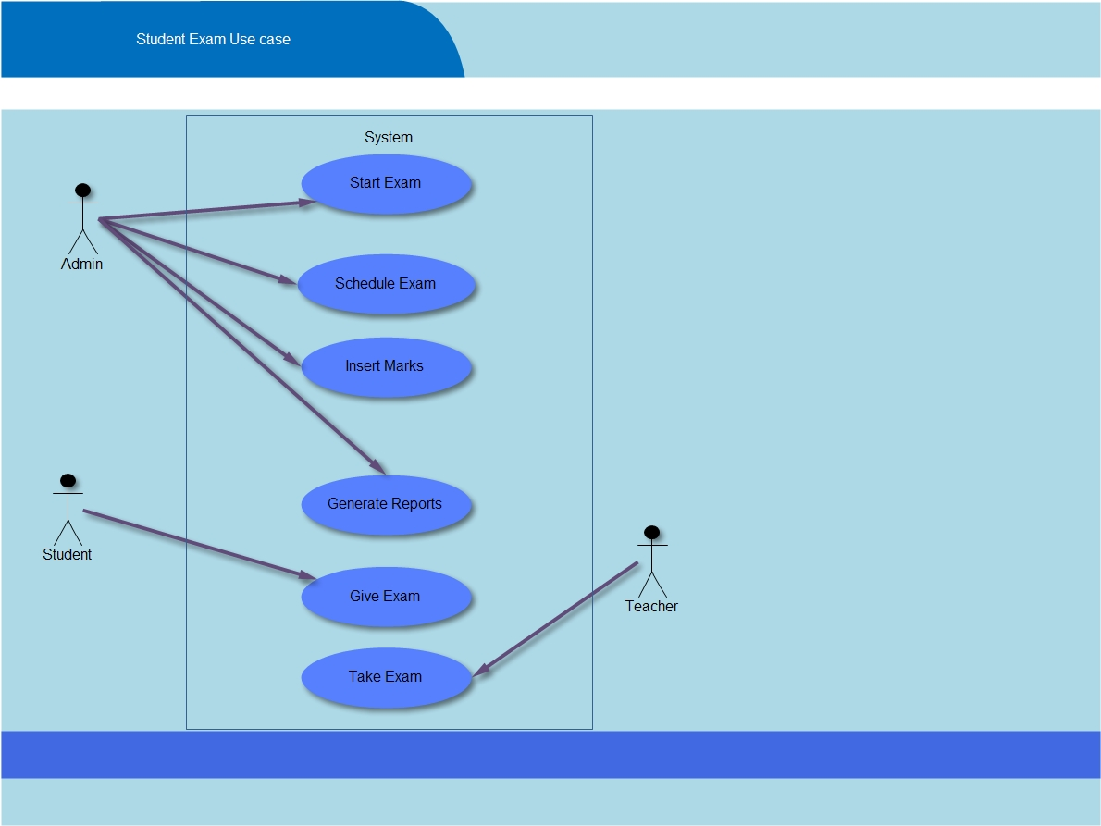

Slide 16
Entity-Relationship Diagrams
The object-relationship pairs can be represented graphically using the entity-relationship diagram (ERD).
The ERD was originally proposed for the design of relational database systems and.
Instead of ERD,UML can be use for database design applications.
In the next diagram the strongly entity is exam entity, which has relationship with teacher and student, attendance entity depends on the student entity, subject entity depends on the teacher entity,

Slide 17
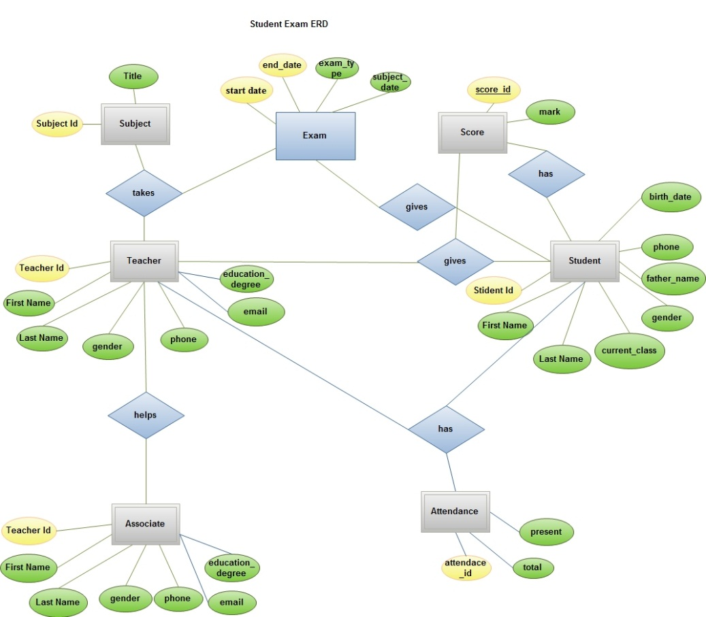

Slide 18
Class diagram:
In the next slide we have class diagram for student exam .
This diagram has different classes, with the name of associate , teacher, student, subject, score, exam and attendance, these classes have different methods, attributes.
Scenario for student :In the first student do registration for the exam, and gives the examination, It the student passed and he will gain marks from the teacher, if he\she gotten more then 80% marks, will be gainer of the ‘A’ grade, if he gain more than 75% marks, he\she will gainer of ‘B’ grade. If he\she failed he will have two chances to pass, if it lost it is chances and he\she unfortunately he will be drop, and will go to home , he\she must do sleep in camera, or the teacher was bribe taker he will be passed after this position.

Slide 19
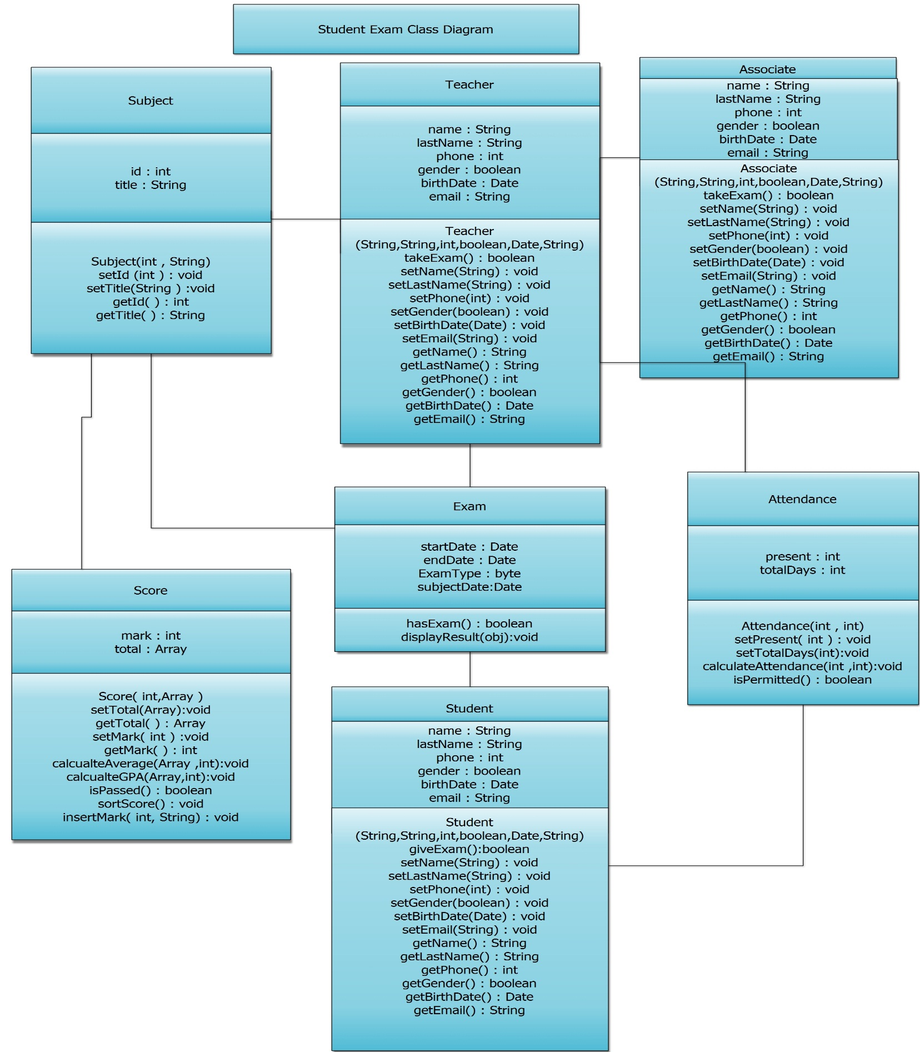
.

Slide 20
Implementation phase:
In implementation phase we do codding according to our design phase.
the classes we must converting to tables.
Simply very easily we can that.
Procedure of converting classes to table:
Change class name to table name.
Change attributes of class to column name.
And create table.
If they have relationship make relationship between them.
Create primary key to tables if there was necessary.

Slide 21

One example creation of table our project. Teacher table
Teach_Id | First_Name | Last Name | gender | phone | Email
1 | Khyber khan | Zaland | male | 0790114349 | Khyber…*gmail.com
 | z

Slide 22
JDBC
JDBC means java database connectivity.
When you make database do connectivity of database with java.
After make interface for the end user so simply and user friendly.
May be the end user will be illiterate.
the user interface will be built-in pollymorpically.

Slide 23
References:
From how to program java book.
From java complete reference of java book.
From software engineering A Practitioner’s Approach.

