Slide 1
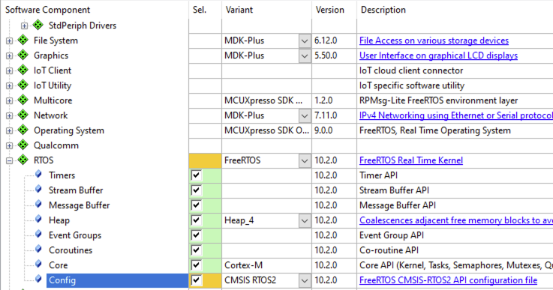
Adding FreeRTOS

Slide 2
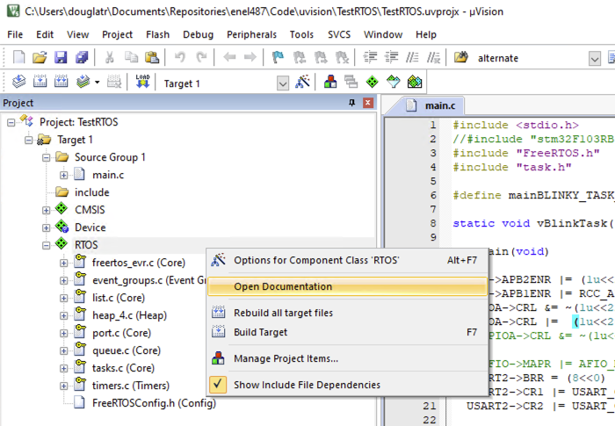
FreeRTOS Documentation
Notes:
Right click RTOS and Open Documentation

Slide 3
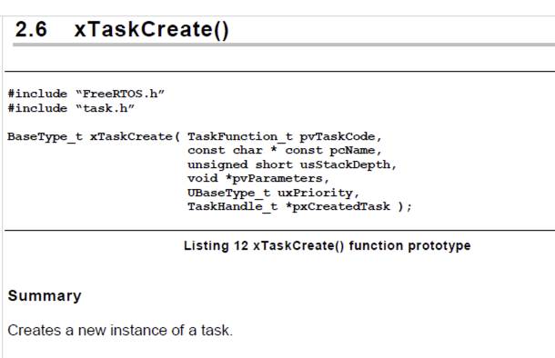
Task Creation
Notes:
Right click RTOS and Open Documentation
pvTaskCode – Function pointer
pcName – Task name
usStackDepth – how large to make the stack
pvParameters – possible to pass parameters to the task
uxPriority – Priority of the task
pxCreatedTask – pass a handle to the task for reference for the rest of the program

Slide 4
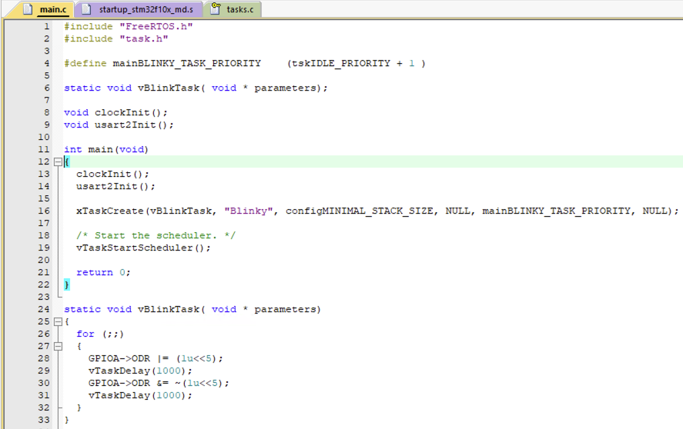
Task Example
Notes:
vTaskDelay
Delay for so many ticks

Slide 5
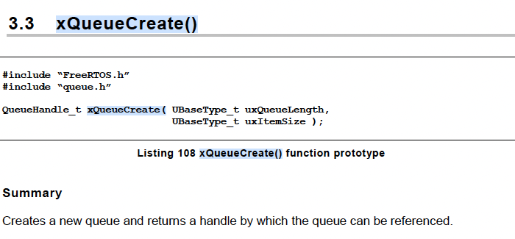
Queue Creation
Put QueueHandle_t xQueue variable at the top of main to reference this Queue globally.
Create the Queue
xQueue = xQueueCreate( 1, sizeof( char ) );
Notes:
Parameters
xQueue The handle of the queue
pvBuffer A pointer to the memory into which the received data will be copied.
xTicksToWait portMAX_DELAY will cause the task to wait indefinitely (without timing out)

Slide 6
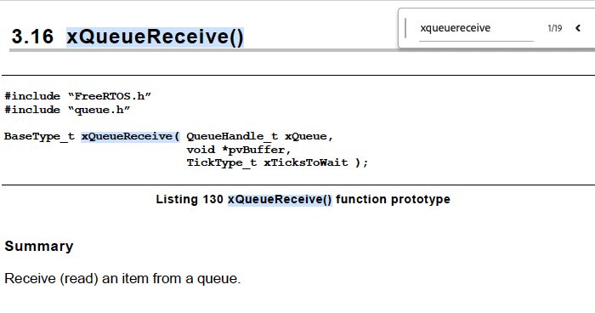
Queue Creation
Put QueueHandle_t xQueue variable at the top of main to reference this Queue.
Notes:
Parameters
xQueue The handle of the queue
pvBuffer A pointer to the memory into which the received data will be copied.
xTicksToWait portMAX_DELAY will cause the task to wait indefinitely (without timing out)

Slide 7
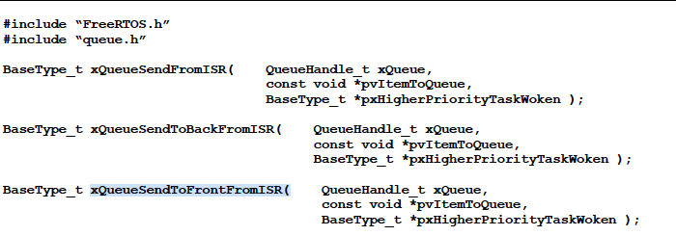
Send to Queue from ISR
Inside the USART 2 ISR
uint8_t characterReceived;
characterReceived = USART2->DR;
xQueueSendToFrontFromISR( xQueue, &characterReceived, NULL);
Notes:
Parameters
xQueue The handle of the queue to which the data is being sent (written).
pvItemToQueue A pointer to the data to be copied into the queue.
pxHigherPriorityTaskWoken From FreeRTOS V7.3.0 pxHigherPriorityTaskWoken is an optional parameter and can be set to NULL.

Slide 8
Application Example
Blinky Task
USART2 ISR
CLI Task
Notes:
vTaskDelay
Delay for so many ticks

