Slide 1
ENSE 452
Timer 2 and USART Interrupt

Slide 2
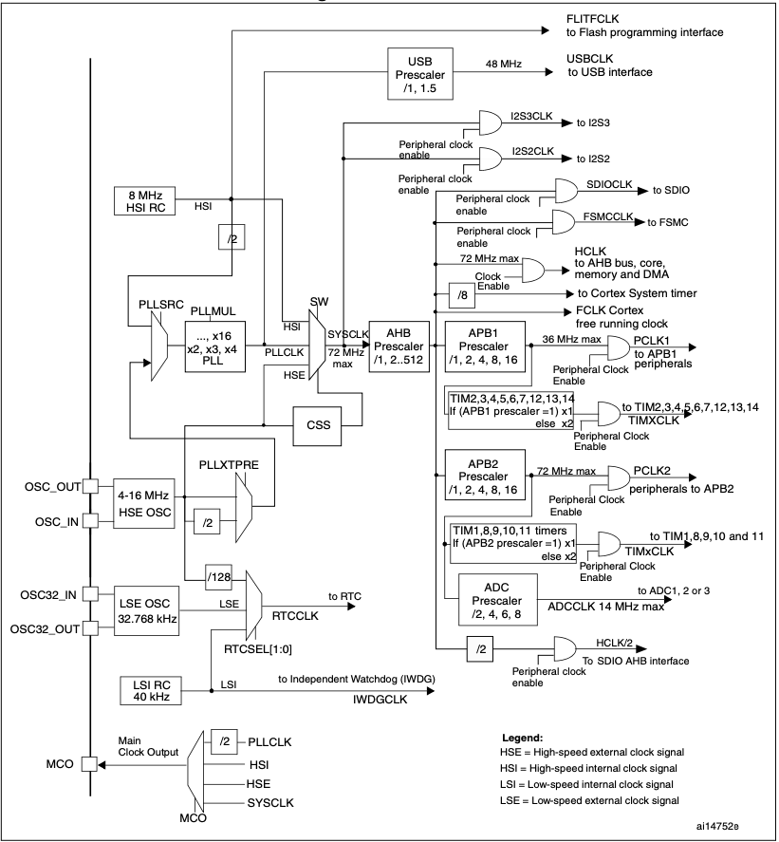
STM32 Clock Tree

Slide 3
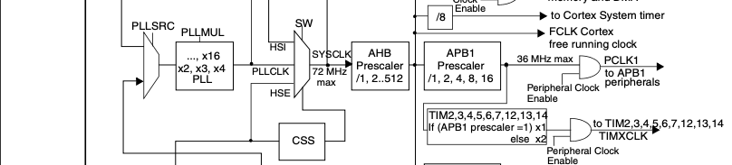
STM32 Clock Tree
Since the CPU clock is 72MHz and APB1 clock is 36MHz, the prescaler for APB1 is set to 2. So if the APB1 prescaler =2 then the clock to the general purpose timers (Timer 2) is:
36MHz x 2 = 72MHz

Slide 4
Timer Registers of Interest
APB1_ENR – Peripheral Clock Enable Register
TIMx_CNT – Counter Register
TIMx_PSC – Prescaler Register
TIMx_ARR – Auto-Reload Register
TIMx_CR1 – Control Register 1
TIMx_SR – Status Register

Slide 5
Polling vs Interrupt
Polling
Ties down the CPU
CPU services the device
Inefficient
Interrupt
Hardware Mechanism
Interrupt handler works with the device
Saves CPU cycles

Slide 6
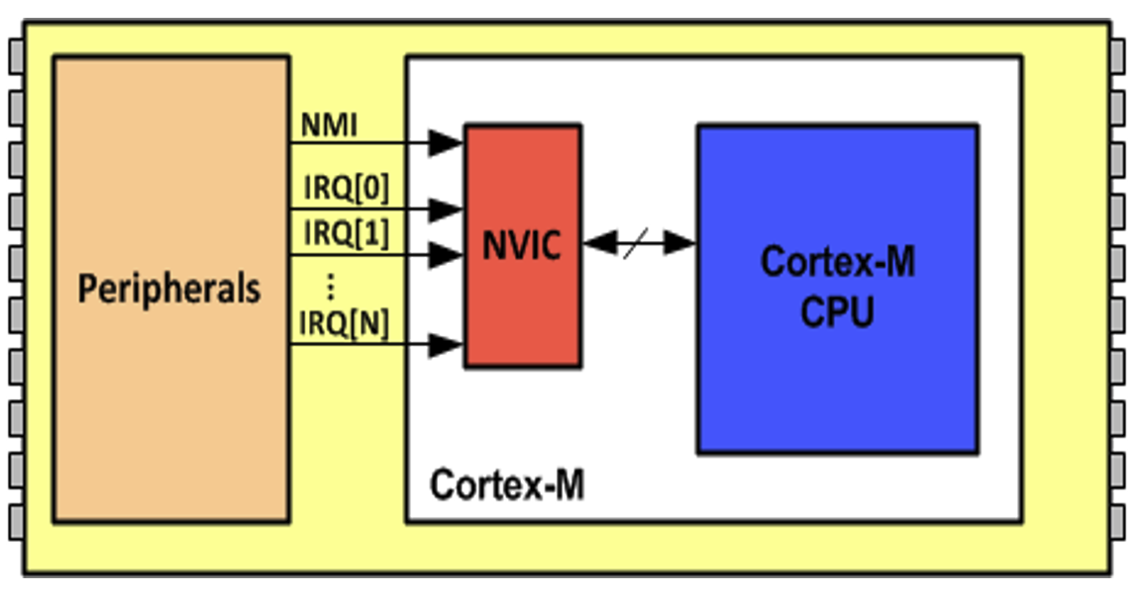
Interrupt in Cortex-M
NVIC – Nested Vector Interrupt Controller

Slide 7
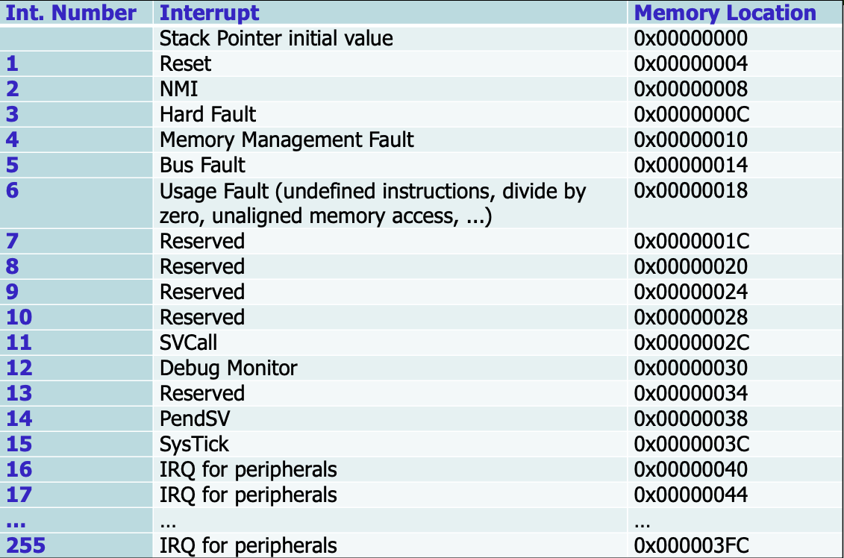
Interrupt in Cortex-M
Interrupt Vector

Slide 8
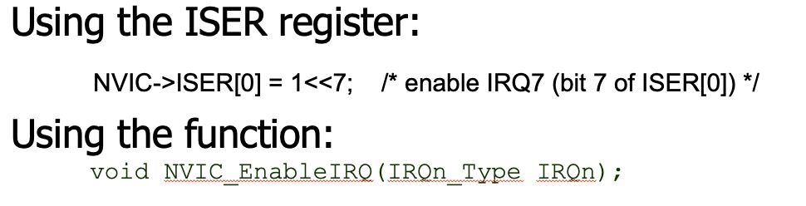
Enabling Peripheral Interrupts
To use the function include “stm323f10x.h”

Slide 9
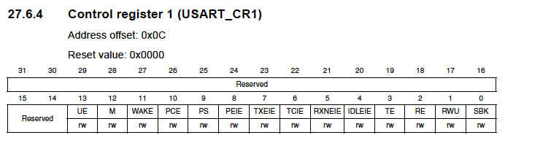


Enabling USART Interrupts

Slide 10
Interrupt Service Routines Best Practices
Keep them short and sweet
Global variables – be careful
Calling functions in ISR’s - not recommended
Indicate that the interrupt has been serviced when done

