Slide 1


Gold Trend Predictor
Meraj
Usman
Mubashir

Slide 2

Problem Statement
Price Volatility: Gold prices change rapidly, making it hard to predict trends.
Investor Confusion: People struggle to decide when to buy or sell gold.
High Risk: Without data, investors make wrong guesses and face losses.
Our Solution: An Android App that predicts if the price will go UP or DOWN using Machine Learning.

Slide 3

Team Roles & Responsibilities
Meraj : Responsible for data gathering, cleaning, and pre-processing to ensure high-quality input.
Usman Khan : Focuses on training multiple models and selecting the best one with the highest accuracy.
Mubashir : Responsible for building the DVC pipeline, developing the FastAPI, and integrating the model into the Android App.

Slide 4



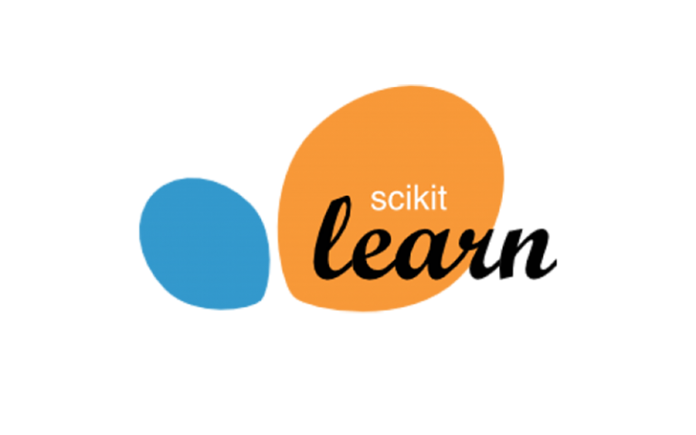


Member: Meraj
Tools: Python | yfinance | Pandas | Scikit-learn
Where did data come from?
Source: Collected 26 years of Gold price data (2000 – Jan 2026).
Library: Used yfinance (Yahoo Finance) for real-time and historical market data.

Slide 5
2. Feature Engineering (Making the data smart):
Technical Indicators: Created 10+ key features for better prediction.
Trend Analysis: Calculated 7-day & 30-day averages to see price trends.
Market Signals: Added Momentum, Volatility, and Z-scores.
Target: Defined trend signal (1 = Price Up, 0 = Price Down).
3. Data Quality & Pre-processing (Cleaning the mess):
Cleaning: Handled missing values (nulls) and removed outliers.
Normalization: Applied Standard Scaling so all features have equal weight.
Result: Exported a clean, high-quality dataset for model training.

Slide 6


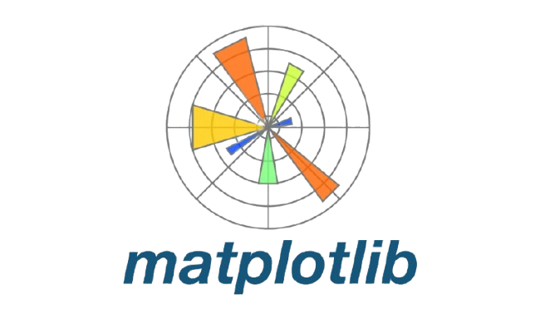

Member : Usman
Tools: Matplotlib | Seaborn | Scikit-learn | XGBoost | LightGBM
1.Data Visualization & Insights:
EDA: Used Matplotlib and Seaborn to create charts and identify price trends.
Correlation

Slide 7
2. Model Training (The "Big 5" Algorithms):
Trained and compared 5 top-tier classifiers to find the best predictor:
XGBoost: For high performance and handling complex data.
Random Forest: To prevent overfitting and ensure stability.
SVM: For finding the clear boundary between "Up" and "Down" trends.
Logistic Regression: Used as a strong baseline model.
LightGBM: For fast training and high efficiency.
3. Optimization & Final Result
Fine-Tuning: Applied Hyperparameter Tuning to squeeze out every bit of accuracy.
Evaluation: Compared Accuracy, Precision, and Recall scores.
Delivery: Selected the "Champion Model" and handed it over to Mubashir.

Slide 8




Member: Mubashir
Tools: DVC | FastAPI | Flutter | GitHub | Python
1. End-to-End MLOps Pipeline (DVC)
Built a robust DVC Pipeline to automate the entire workflow in 5 stages:
Data Ingestion: Automatically fetching raw gold data.
Data Preprocessing: Cleaning and handling missing values.
Feature Engineering: Converting raw data into smart indicators.
Model Building: Training the selected "Champion Model.“
Model Evaluation: Testing performance before deployment.

Slide 9
2. Backend & Integration:
FastAPI: Developed a high-performance API to serve the model's predictions.
App Development: Built a cross-platform Android App using Flutter.
Connection: Integrated the ML model with the mobile app for real-time "Up/Down" trend results.
3. Android App Interface (UI)
App Features:
User-Friendly Design: Simple and clean interface for investors.
Real-time Prediction: One-tap button to see if Gold will go UP or DOWN Tomorrow.
Accuracy Tracking: Displays the model's confidence in the current prediction.
Live News
Graph of Recent 90 Days Trend
Fast Response: Optimized API calls for instant results.

Slide 10

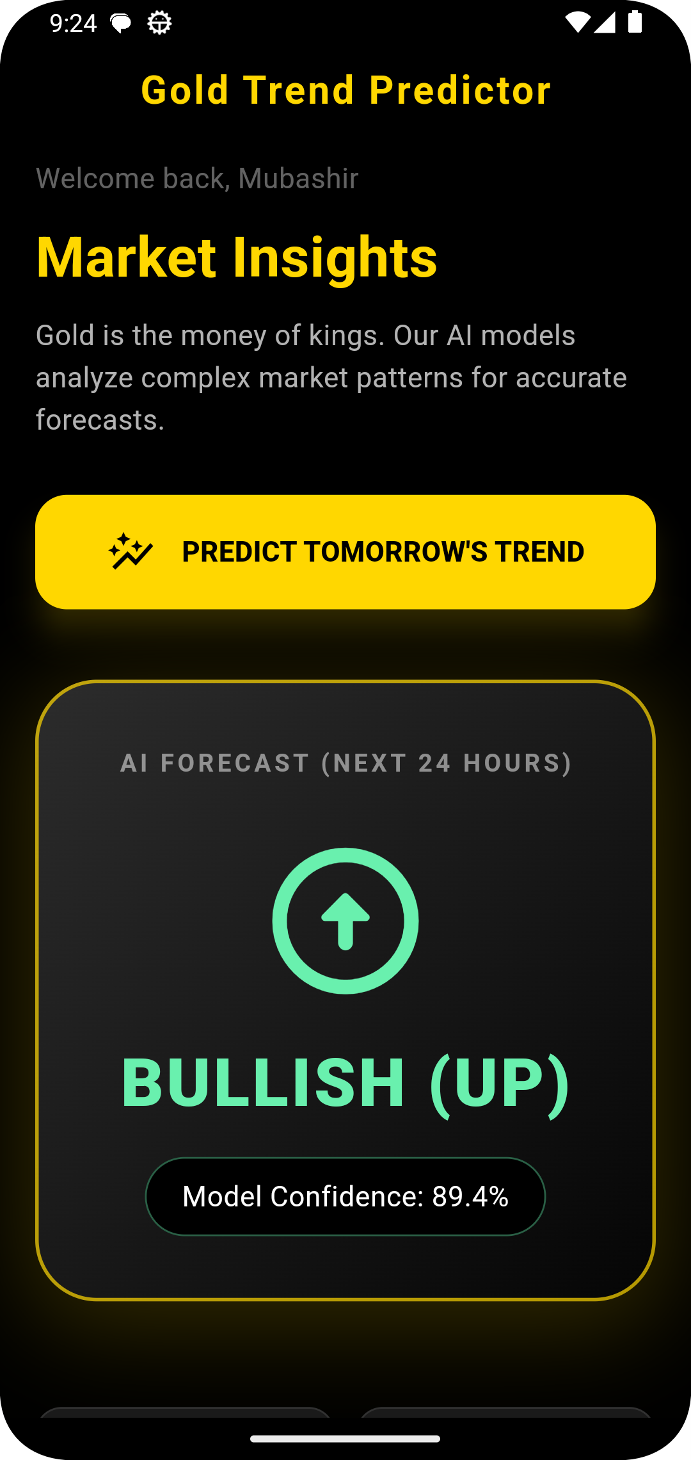
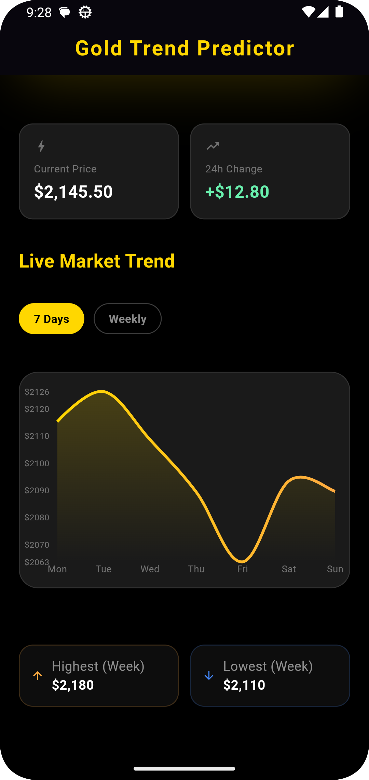
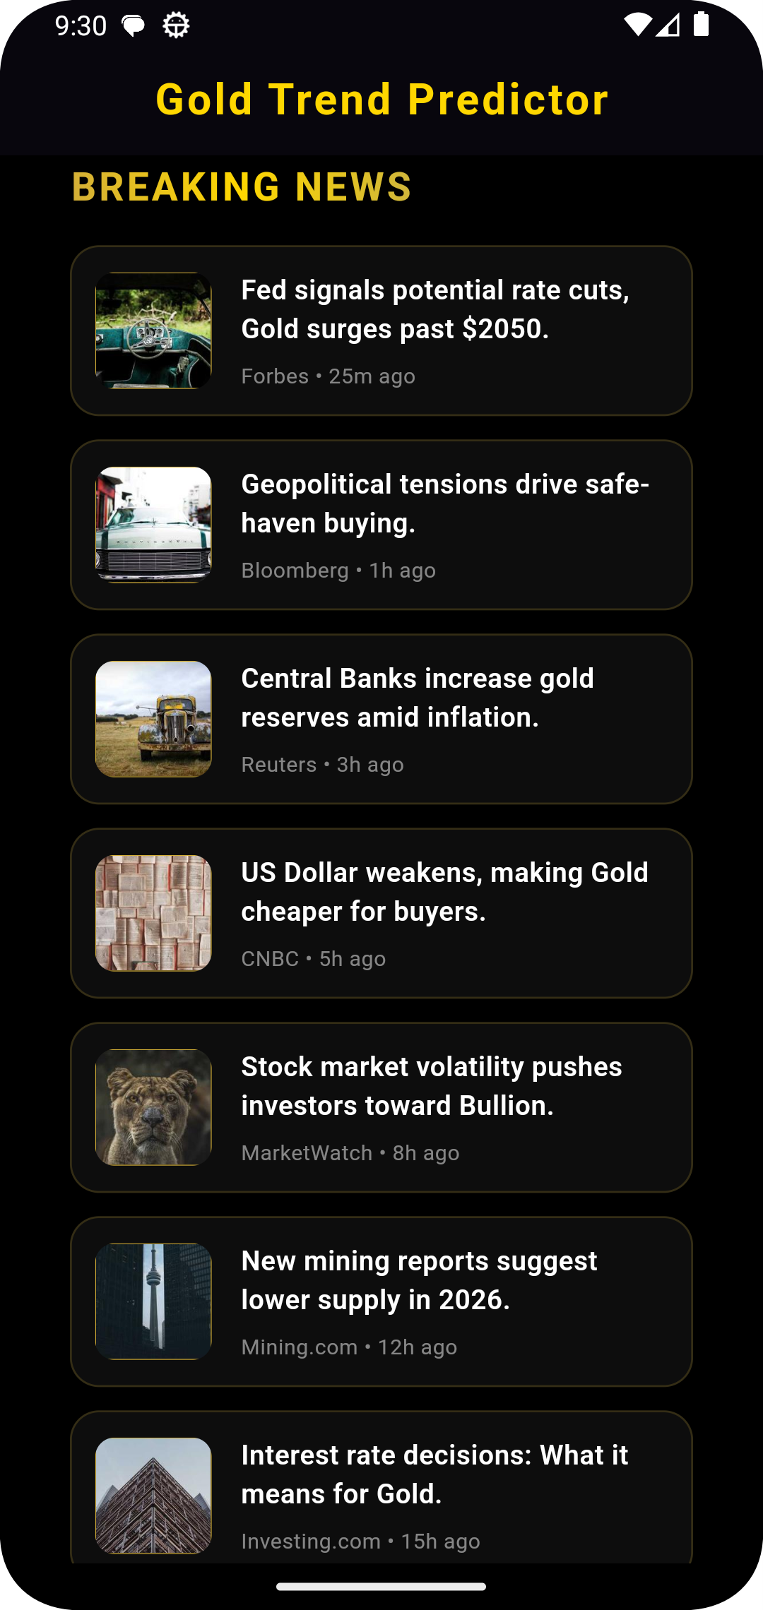

Slide 11
Thank You!
Any Questions?

