Slide 1
CSE299 Project - EduVid Educational Video Sharing Site
CSE299.14 - Junior Design
Fall 2019 – Group 5
Name | ID No.
Tanvir Ahmed | 1410982042
Md. Ariful Islam | 1520244042
Mubashir Zahid | 1610146042

Slide 2
What it its?
EduVid is a learning website where a user can learn by watching educational video tutorials.
The site will provide a good amount of video tutorials related to our NSU courses.

Slide 3
Purpose
In our NSU student life, there have been lots of times when we got frustrated, depressed and lost. Most of them are for not being able to understand something related to courses.
As a result, most of the students get bad grades and fall into probation. Even some of them abandon pursuing of higher study. Higher education is tough and NSU is tougher.
We are surviving somehow and at the ﬁnale of our undergraduate life. Sometimes we wonder what we are leaving behind for our juniors. We didn’t have proper guidance.

Slide 4
Therefore, we made lots of mistakes and wasted lots of times which resulted in retaking many courses. But what about our juniors, how we can help and guide them in the right track with our years of experiences.
This is why we wanted to build a platform where only students of NSU will visit and get help from us. As we are CSE students, we will post CSE related course tutorials. We know the problems because we faced them, so we will show the students how to solve them.
Also, we will discuss and help them anyway we can in their academic career. Because at the end of the day what we are doing for others matters.

Slide 5
Other Related Works
For this project we have researched some websites similar to ours. Udemy.com, Brightstorm.com, W3Schools.com.
Some of them aren’t free, private, no personalization, simple, doesn’t contain discussion feature or any video tutorials.
We tried to fill those gap, so that every one can be benefited.

Slide 6
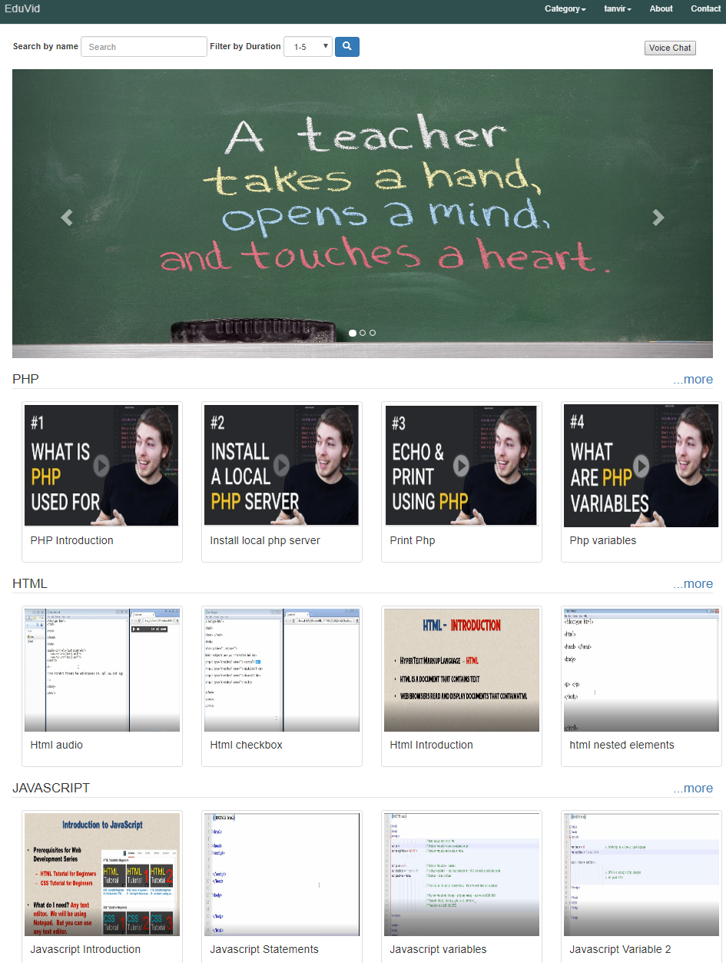
Interface

Slide 7
About Features in our Project
1. User Option:
2. Admin Panel Option:

Slide 8
User Options
Login/Logout option.
Individual profile
Search Option
Categorized Tutorial Videos
Comment Section For Discussion
Playlist Option Like YouTube
Bookmarking Option
Registered Users
Profile, Video Comment Discussion

Slide 9
Admin Panel Options
View & Remove User
Add & Delete Video
Add Category

Slide 10
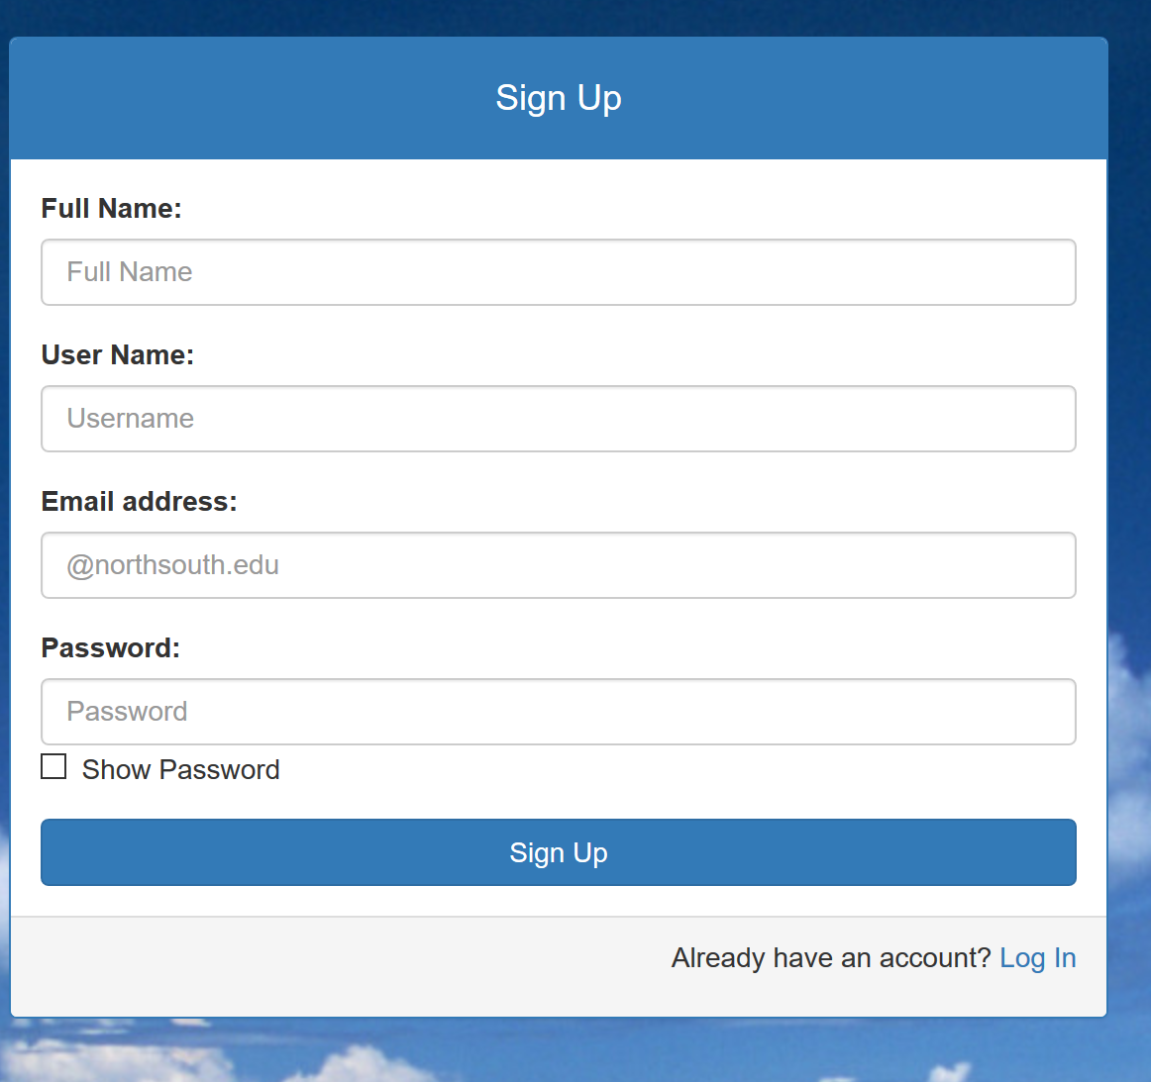
Login/Logout option
Individual Login and Logout option
Only NSU Email Accepted 8-digit Password

Slide 11
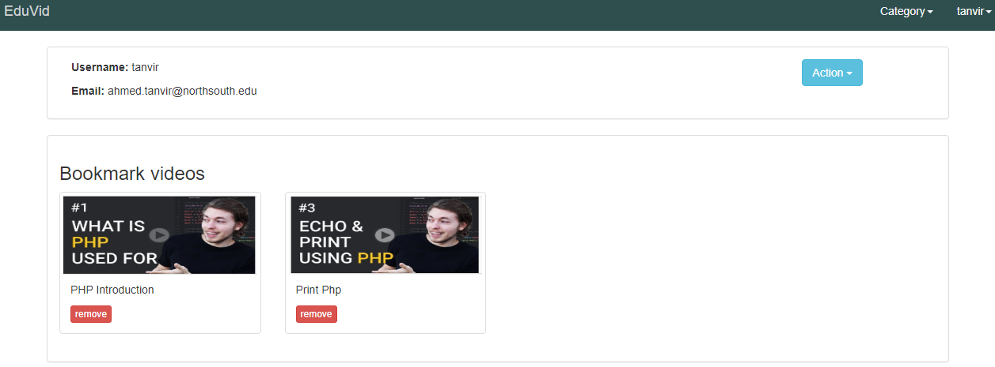
Individual profile
Every User Have Individual Profile
Can Save Bookmark

Slide 12
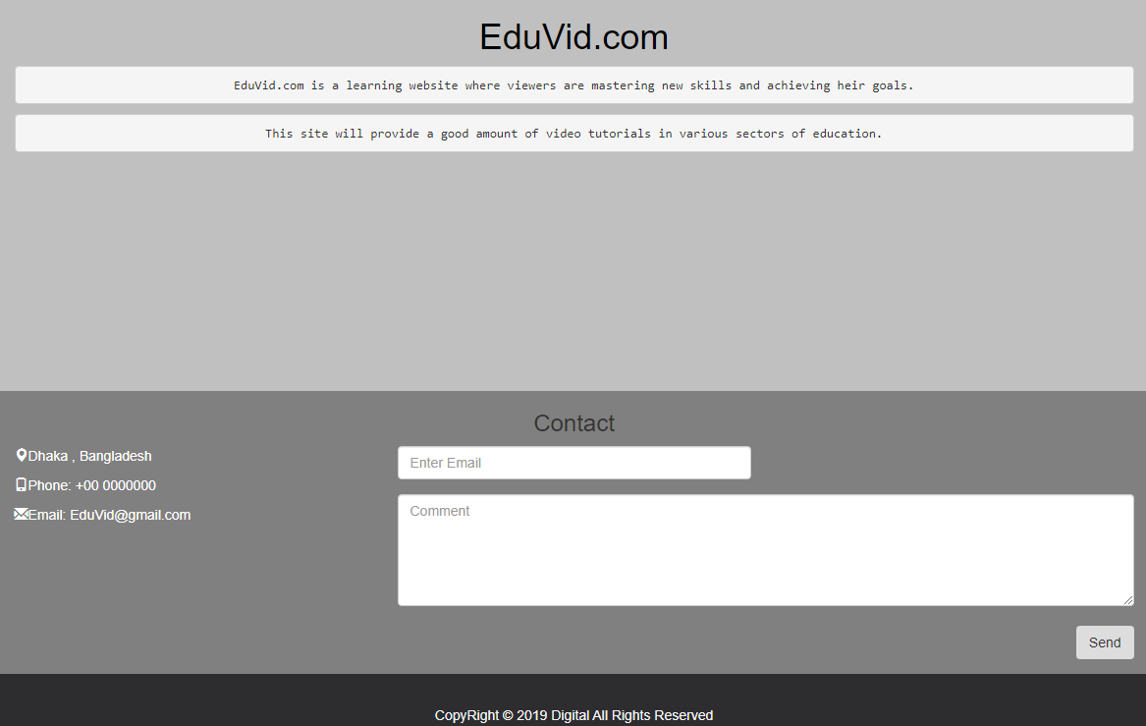
Search /Comment, Discussion Option
Search By Name, Time ,Category
Also can comment

Slide 13
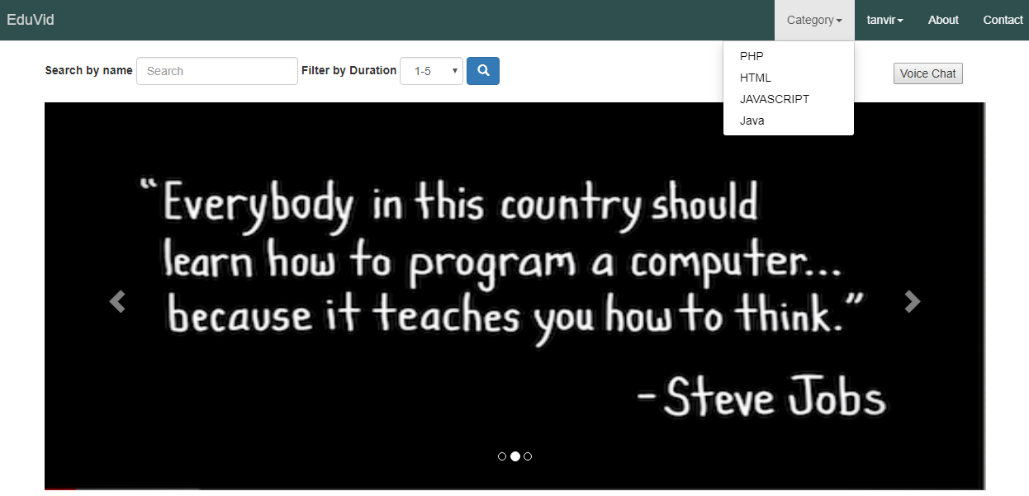
Categorized Tutorial Videos
Different Categorized Video
PHP, HTML, CSS, JAVASCRIPT, JAVA

Slide 14
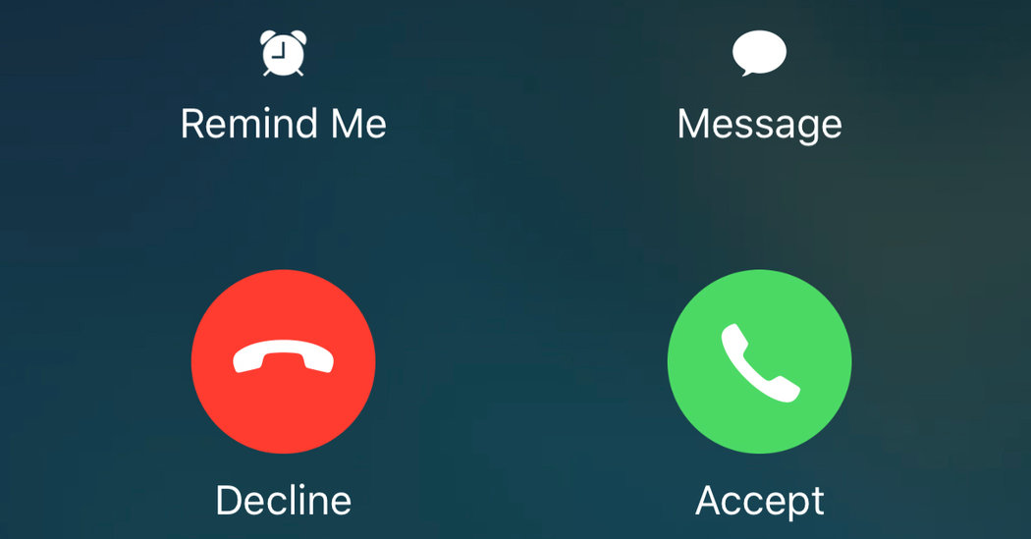
Voice Communication
User can communicate With Voice Call. Although it uses third party server. In future we are going to implement out own servers.

Slide 15
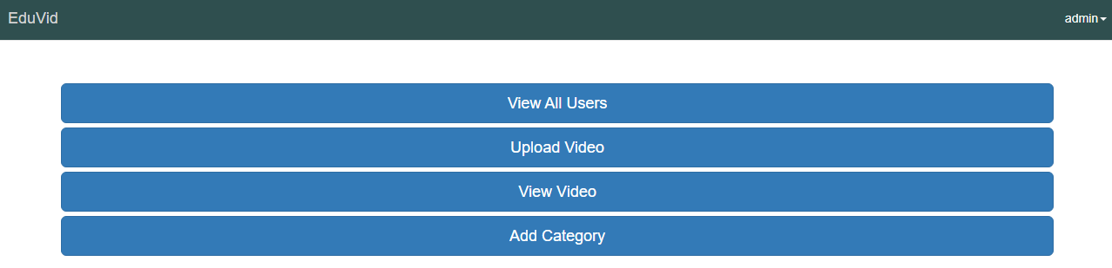
Admin Panel

Slide 16
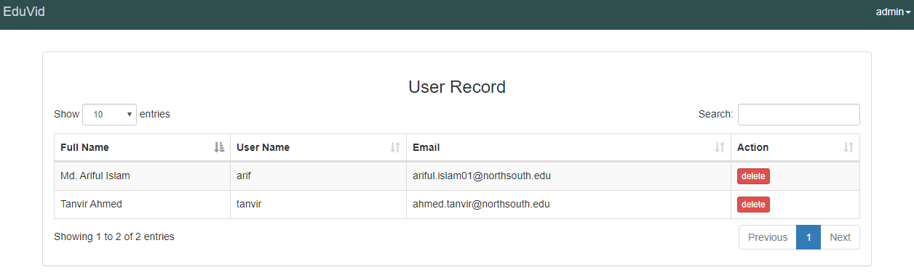
View & Remove User
Admin Can Delete A User

Slide 17
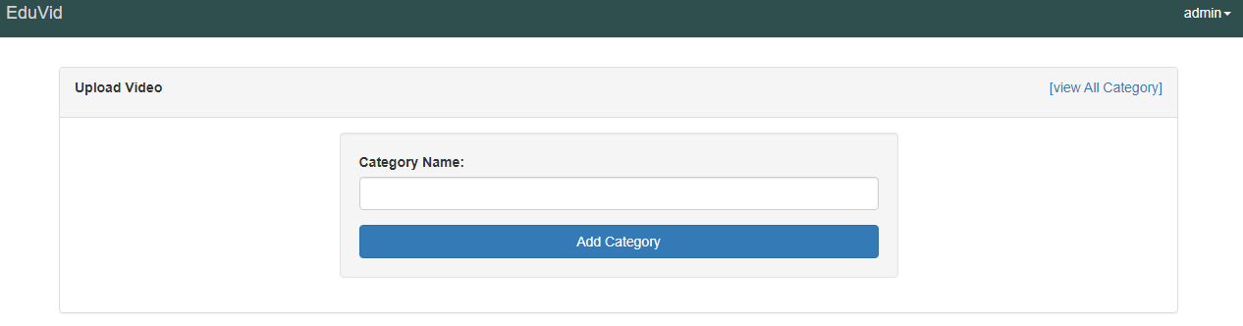
Add Category
Admin Can Add A Category

Slide 18
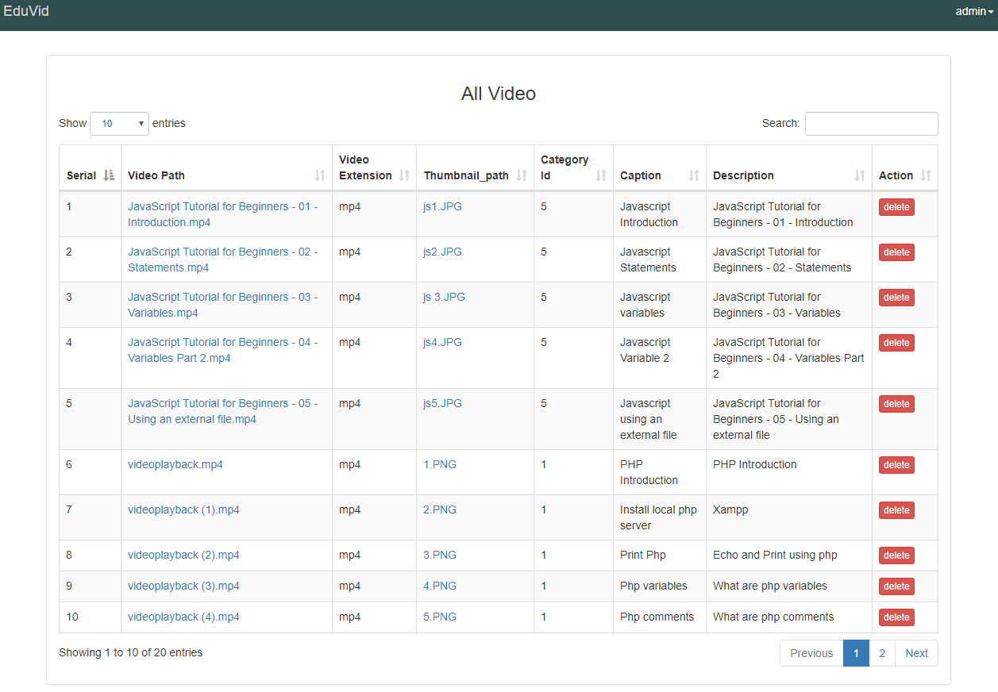
Add & Delete Video
Admin Can Add & Delete Video

Slide 19
More
Simplistic View: Our website will not have much complexity. It will be simple and easy for users to roam around.
Mobile Friendly: We will use Bootstrap, so that the users can browse from mobile devices as comfortably as desktop.
Free & Unlimited: It’s free and unlimited to use.

Slide 20
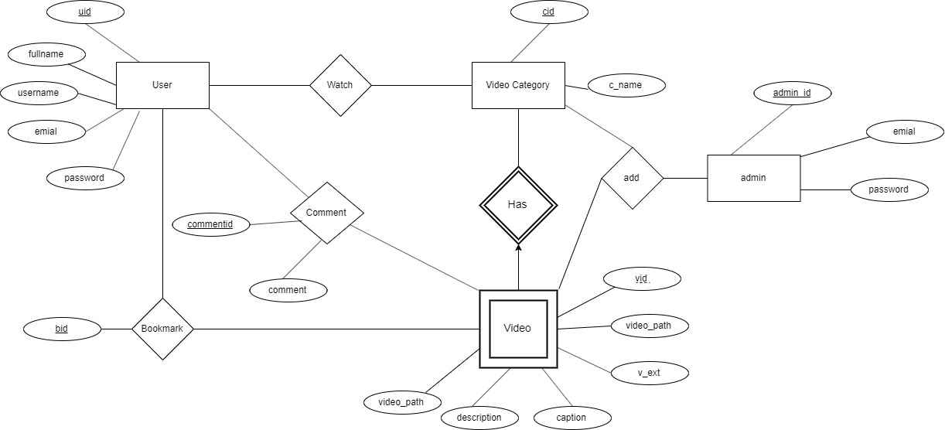
Implementation – ER Diagram
First, we drew an ER diagram and a font-end design

Slide 21
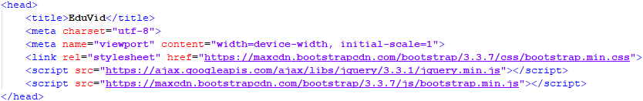
Implementation – Front-end
Then, we developed the front-end design by using CSS, JavaScript, Bootstrap
HTML and CSS for structure and styling the web pages
Bootstrap for a responsive page
JavaScript works with HTML, CSS and Bootstrap to make up the website

Slide 22
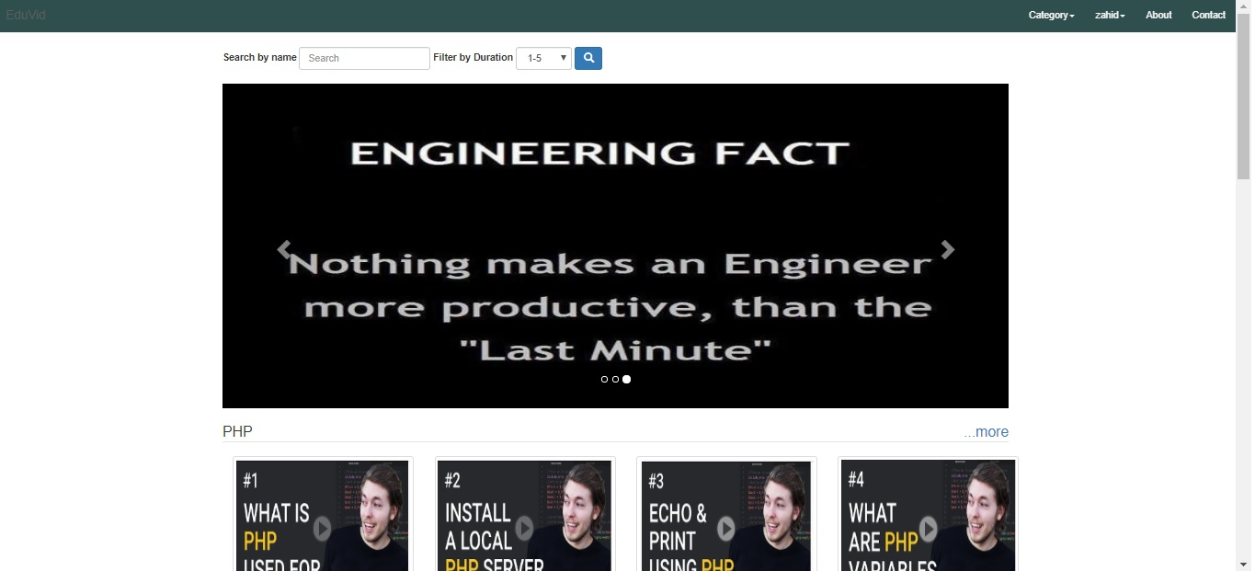
Homepage

Slide 23
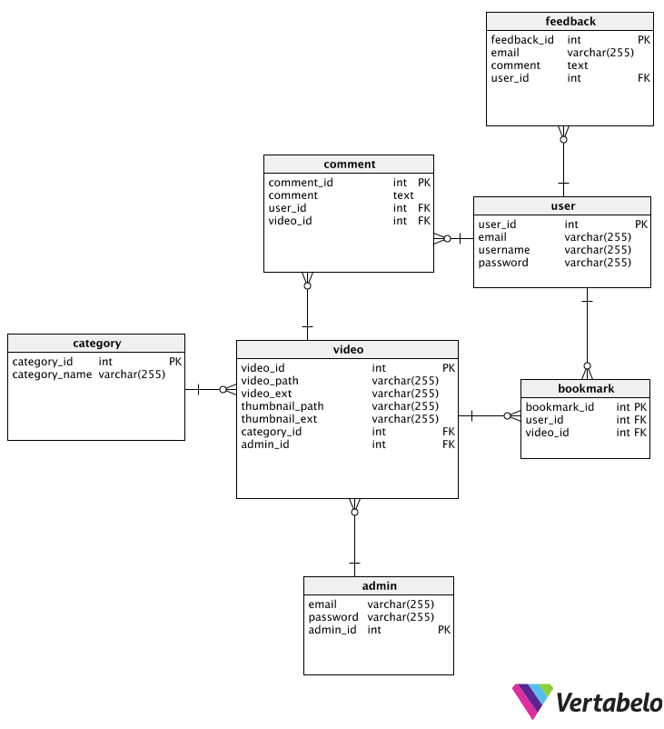
Database Schema
After that, we designed the database schema of our website

Slide 24
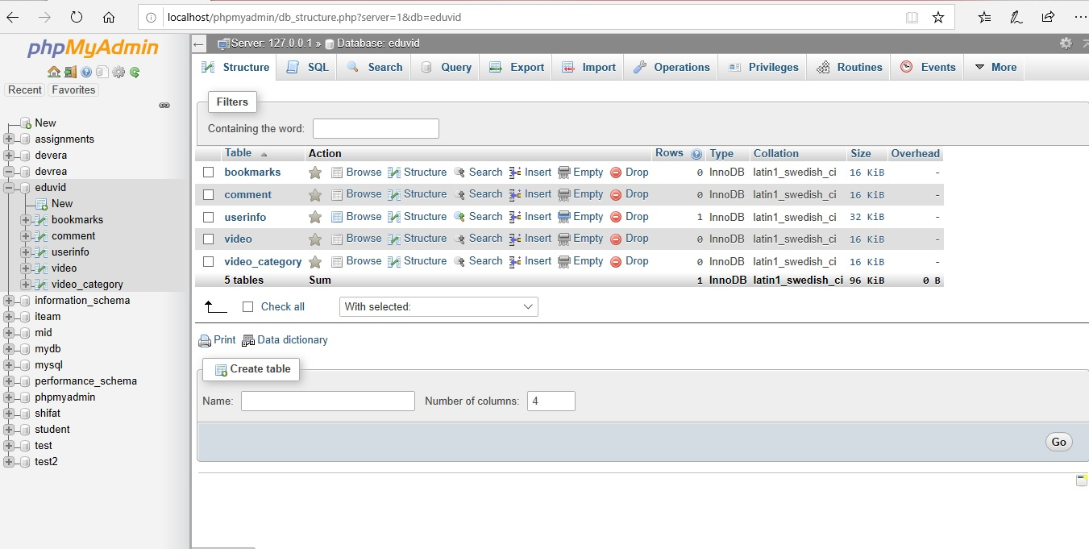
MySQL - Database
Then we created the main database of the website in MySQL

Slide 25
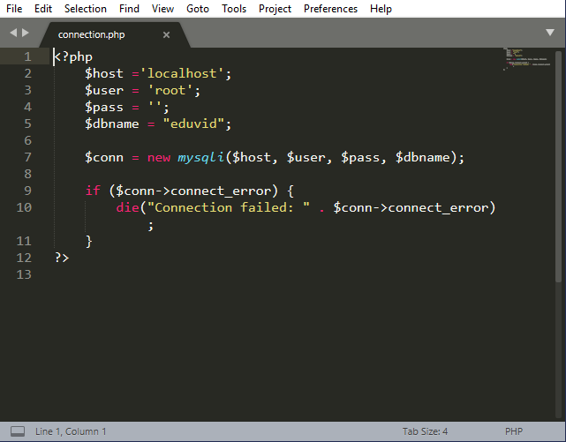
PHP Codes
Then we connected the database with the webpages using php

Slide 26
Benefits
Improvement of academic performance of the students
Juniors getting guidelines
Improvement of communal bond amongst the students
No payments

Slide 27
Lessons Learned From This Project
We learned how to work scientifically, methodically and equally in a team.
Thank you our honorable faculty Dr. Md. Mahfuzur Rahman sir for his guidance.

Slide 28
Future Work
In the future :
We will try to add a new feature where the users can upload videos and the admin can monitor those videos
We will try to make slide sharing options
We will add group video chat option
We will include quizzes and exams based on particular topics

Slide 29
Individual Contributions
Name | Contributions
Tanvir Ahmed | Planning, Documentations, Diagrams, Schema, Database, MySQL, Admin Related Pages
Md. Ariful Islam | CSS, Design, Images, Videos, User Related Pages
Mubashir Zahid | Sign Up-Login, Search & Bookmark Options. PHP Database Connection.

Slide 30
THANK YOU

