Slide 1
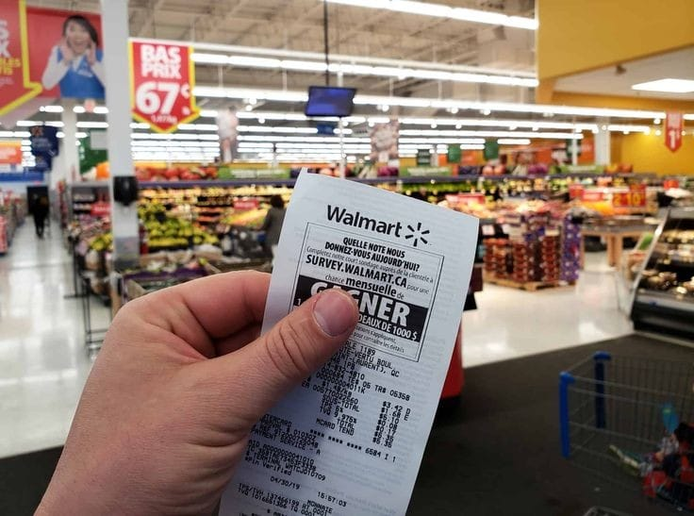
Walmart Sales
DATA ANALYSIS USING SQL
MUBASHIRA

Slide 2

INTRODUCTION
This project focuses on analyzing Walmart’s sales data to identify factors that influence weekly sales performance across different stores. The key areas of analysis include:
Impact of External Factors: Investigating how variables such as air temperature, fuel prices, consumer price index (CPI), and unemployment rates affect sales.
Seasonality and Holidays: Analyzing the effects of holidays and seasonal trends on sales by comparing performance between holiday weeks and regular working days.
Store-Level Performance: Comparing sales across different Walmart stores to identify top-performing and underperforming stores.
The scope of this analysis covers a specific period of Walmart’s weekly sales data and aims to deliver actionable insights that can enhance sales strategies and operational efficiency.

Slide 3

DATASET DESCRIPTION
The dataset contains sales data from Walmart, including various factors that may influence sales performance. The key columns are:
Store: Store number
Date: Sales week start date
Weekly_Sales: Sales
Temperature: Air temperature in the region
Fuel_Price: Fuel cost in the region
CPI: Consumer price index
Unemployment: Unemployment rate
Day_Type: Indicates whether the day is a 'Holiday' or 'Working day'.

Slide 4
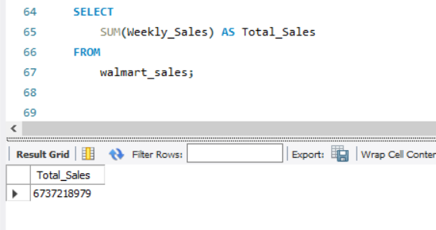
SQL QUERIES AND RESULTS
Revenue Metrics
Total Sales

Slide 5
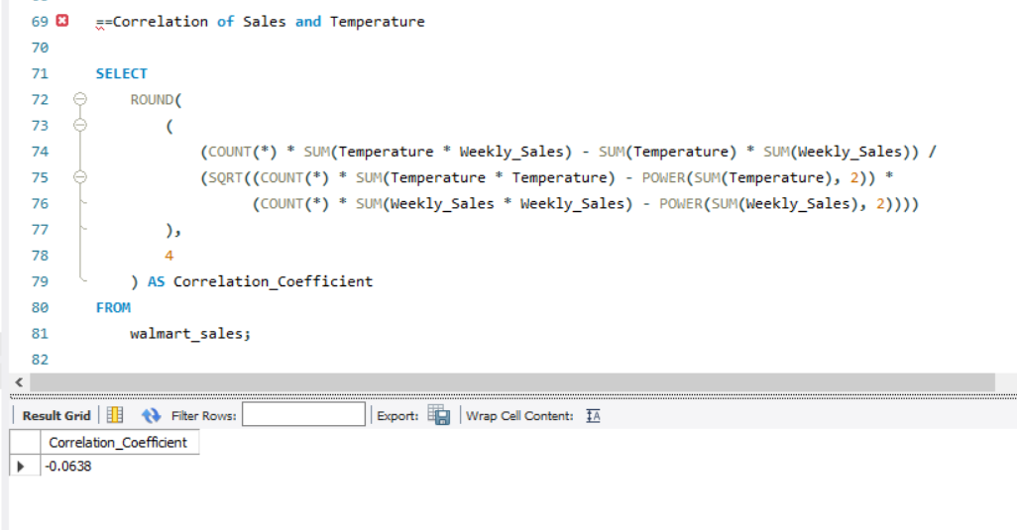
Factors Analysis
Average Temperature Impact
Interpretation: Weak negative correlation: Since the value is close to 0, there is almost no linear relationship between temperature and sales. A correlation of -0.0638 suggests that sales tend to decrease very slightly as the temperature increases slightly, but this relationship is weak and insignificant.

Slide 6
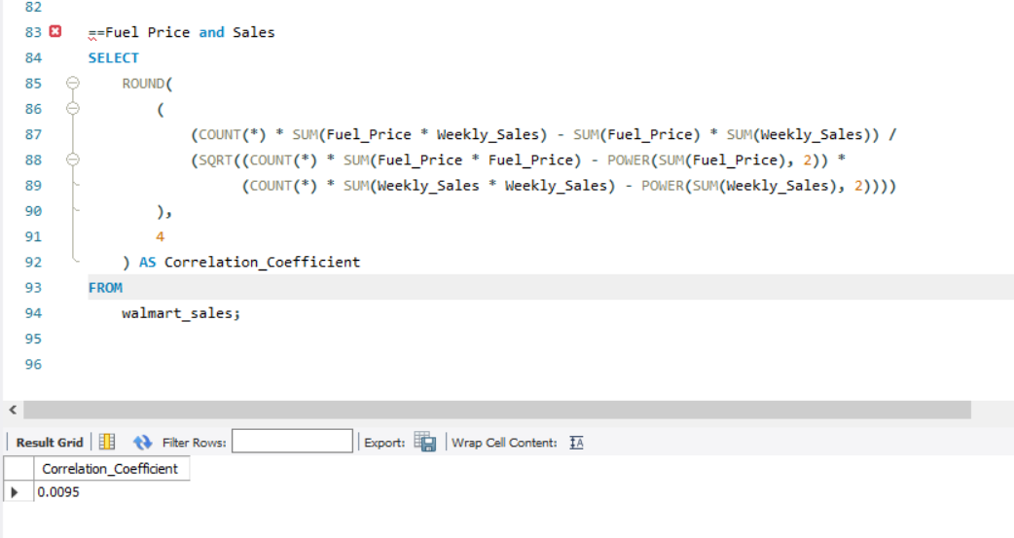
2. Average Fuel Price Impact
Interpretation:
Almost no correlation: A correlation coefficient close to 0 (like 0.0095) suggests virtually no linear relationship between Fuel Price and Weekly Sales.
Positive but negligible: While it is a slightly positive value, the magnitude is so small that it does not indicate any significant association. A change in fuel prices has almost no impact on sales.

Slide 7
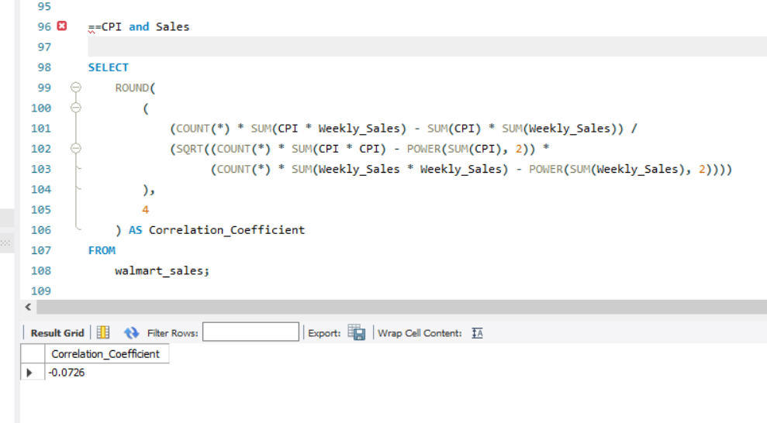
3.Consumer Price Index (CPI) Effect
Interpretation:
Weak negative correlation: The value of -0.0726 is close to zero, indicating a fragile relationship. It suggests that as the CPI (which reflects inflation) increases, Weekly Sales tend to decrease slightly, but the effect is minimal.
Slight inverse relationship: The negative sign implies that when consumer prices rise (indicating inflation), sales tend to drop very slightly. However, the weak magnitude of the correlation means that the relationship is not strong enough to draw firm conclusions.

Slide 8
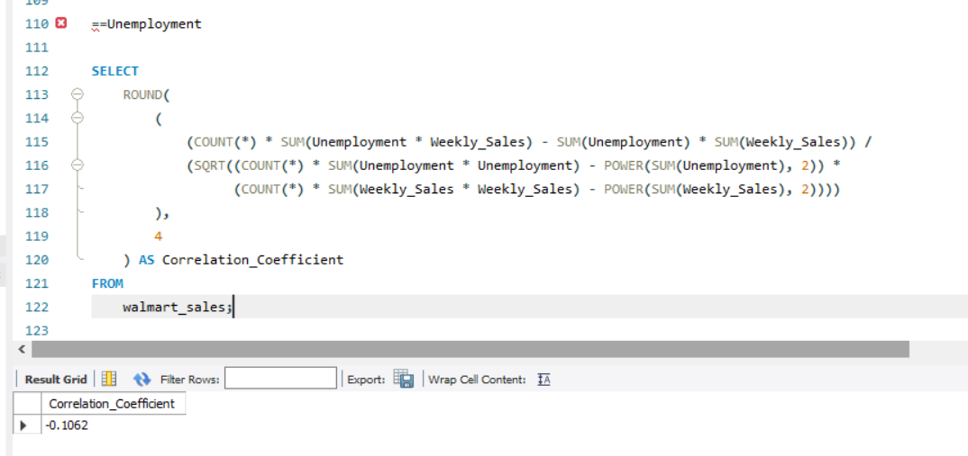
4. Unemployment Rate Influence
Interpretation:
Weak negative correlation: The value -0.1062 suggests that as unemployment increases, Weekly Sales tend to decrease slightly, but the relationship is still weak. The negative sign means that higher unemployment rates are generally associated with lower sales, but the effect is not very strong.
Inverse relationship: This weak negative correlation implies that when more people are unemployed, there is a slight decline in sales, likely due to reduced consumer spending. However, the weak magnitude of the correlation indicates that unemployment isn't the only factor driving sales.

Slide 9
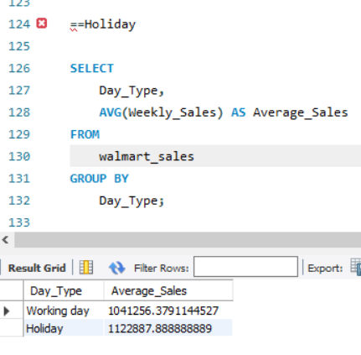
5. Holiday Impact
Average Sales During Holiday vs. Working day
Interpretation:
Higher sales on holidays: The sales during holidays are higher than on regular working days. This makes sense as holidays often drive more consumer activity, especially for shopping events like Black Friday, Christmas, or other major holidays. People tend to spend more on gifts, food, and other goods during these periods.
Sales boost during holidays: The difference between working day and holiday sales shows that holidays provide a notable boost in revenue. This suggests that Walmart likely experiences increased demand during holidays.

Slide 10
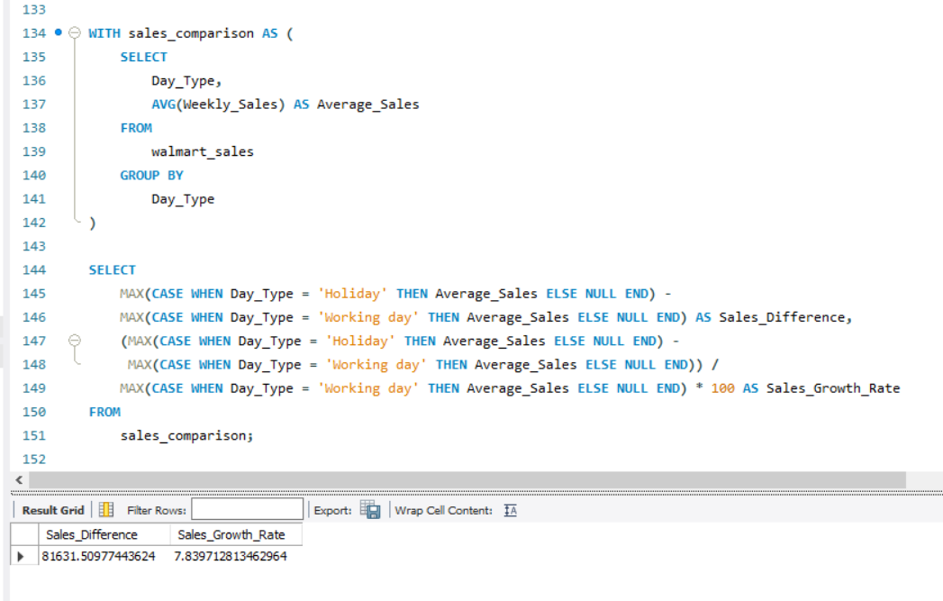
Change in Average Sales between Holiday and Working day periods
Interpretation:
Holiday drive extra revenue: The difference of $81,631.51 suggests that Walmart sees a noticeable increase in sales during holidays. This increase could be attributed to factors like holiday shopping, seasonal discounts, and consumer behavior where people tend to spend more on special occasions.
Holiday impact: Even though the percentage growth (7.84%) shows a moderate increase, the actual sales difference provides a more tangible understanding of the financial boost that holidays bring. For each holiday period, Walmart generates an additional $81,631.51 in revenue compared to working days.

Slide 11
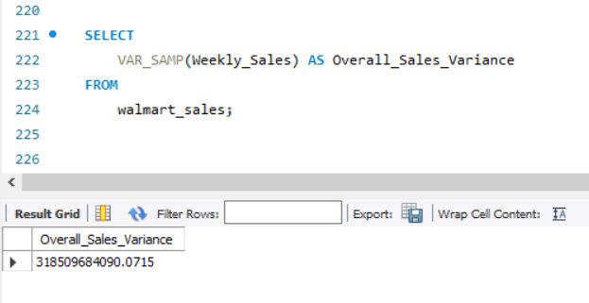
Store Performance Metrics
Overall Sales Variability
Interpretation:
High variability: The large variance value indicates that there is a significant difference in sales performance across Walmart stores. Some stores are likely generating much higher sales than others, which could be due to factors like store location, customer demographics, store size, and competition.

Slide 12
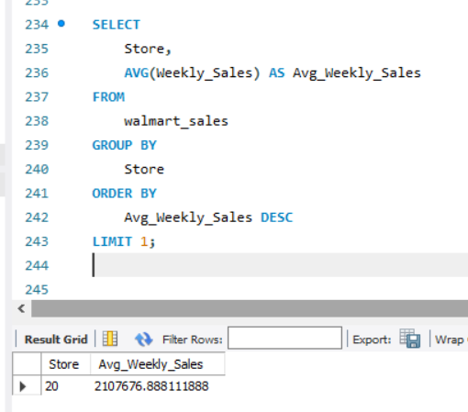
High performing store
Interpretation:
Store 20 is the top performer among all stores with the highest average weekly sales.
With an average weekly sales of $2,107,676.89, this store significantly outperforms others, indicating strong customer demand or effective management practices.

Slide 13
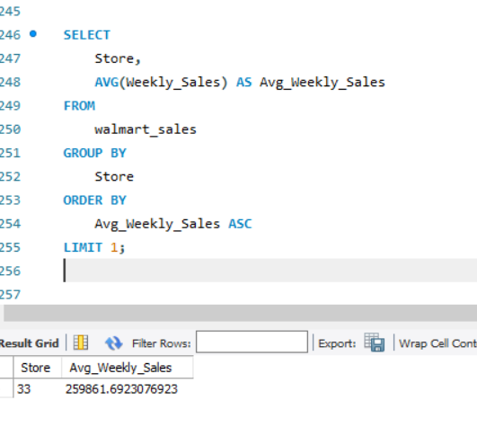
Low performing store
Interpretation:
Store 33 is the low-performing store with the lowest average weekly sales.
With an average weekly sales of $259,861.69, this store is underperforming compared to others. This could be due to various factors like location, competition, or operational issues.

Slide 14
CONCLUSION
Sales variance across stores is significant, with some stores outperforming others substantially. High-performing stores like #20 can serve as benchmarks for improving underperforming locations like #33.
Holiday sales outperform working day sales, with a 7.84% sales growth rate during holidays, suggesting Walmart benefits greatly from seasonal shopping patterns.
Economic factors show weak correlation with sales, with unemployment having the strongest impact (-0.1062), indicating minimal but notable influence from broader economic conditions.
Targeted marketing and operational improvements can help low-performing stores, reducing the overall sales variance across locations and enhancing store performance consistency.
Maximizing holiday promotions and learning from high-performing stores are key strategies for boosting overall sales and maintaining competitive advantage.

Slide 15
SUGGESTIONS
Enhanced Holiday Promotions: Since holiday sales are significantly higher than working day sales, consider increasing marketing and promotions during holiday periods. Tailor your campaigns to attract more customers during these times.
Holiday Product Offerings: Introduce special holiday-themed products or discounts to capitalize on higher consumer spending during holidays.
Optimizing Working Days: Develop strategies to boost sales on working days. This could include:
Targeted Discounts: Offer discounts or promotions to increase foot traffic and sales during the week.
Customer Loyalty Programs: Implement loyalty programs or rewards to encourage repeat purchases on non-holiday days.
Analyze Success Factors: Identify what makes a high-performing store (here it is store 20) successful. This includes analyzing their location, product assortment, customer service, marketing strategies, and operational practices.
Benchmarking: Use high-performing stores as benchmarks for others. Document successful strategies and replicate them in lower-performing stores.

