Slide 1
Name: MOHD MUBASSHIR
Course: B.Tech IBM
Subject: Cloud Computing
Topic: Kubernetes Architecture
College Name: United University

Slide 2
Kubernetes Architecture Overview
Kubernetes (K8s) follows a architecture, consisting of:
Control Plane (Master Node) Responsible for cluster control & decision making.
Worker Nodes run the actual applications (Pods).

Slide 3
Control Plane Components
1) API SERVER
  Front-end of the cluster all components communicate through it
2) ETCD
  Distributed and consistent key-value store Stores cluster state and configuration
3) SCHEDULER
  Assigns Pods to nodes based on resource availability and constraints
4) CONTROLLER MANAGER
  Runs controllers:
    Node controller
    ReplicaSet controller
    Deployment controller
    Endpoints controller

Slide 4
Worker Node Components
Kubelet:
Ensures that containers are running as Expected on the node.
2) kube-proxy:
Manages network routing and load balancing for services.
3) Container Runtime:
It is the software that runs containers.

Slide 5
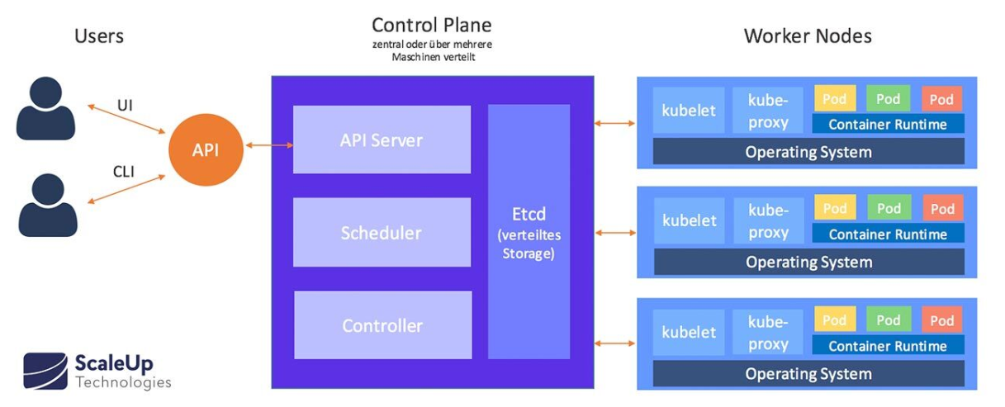




Slide 6
THANKYOU

