Slide 1

- Mubasshira Quraishi

Slide 2
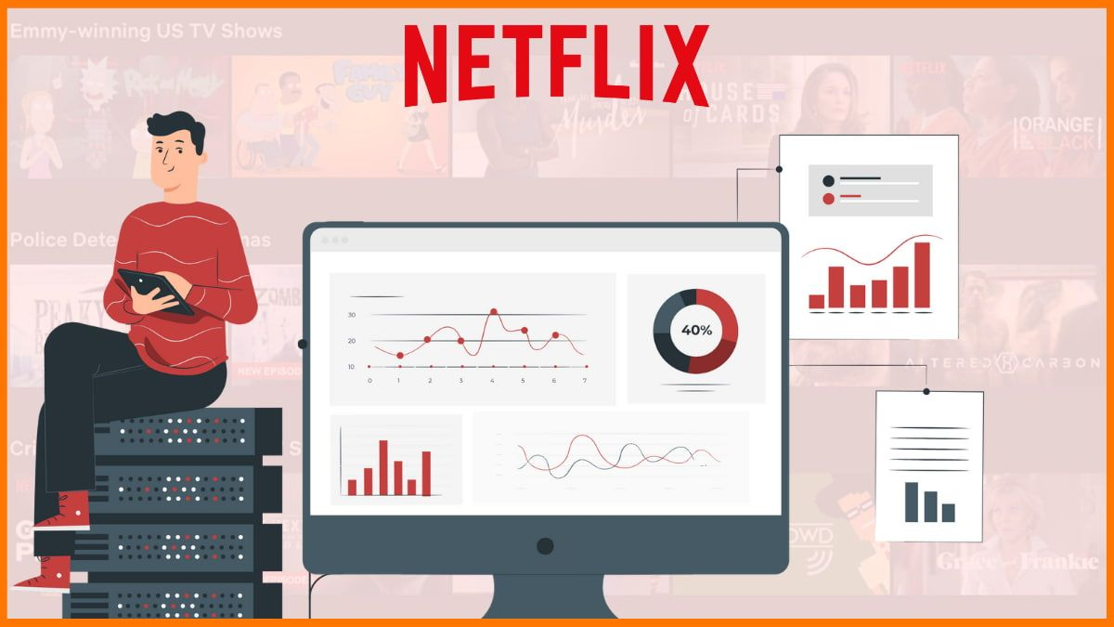
Netflix Rating Prediction Model
- Netflix is a media service provider that is based out of America. It provides movie streaming through a subscription model. It includes television shows and in-house produced content along with movies.
- Netflix is a globally renowned streaming platform that offers a vast array of TV shows, movies, documentaries, and original content. With millions of users worldwide, it has revolutionized entertainment consumption by providing on-demand access to a diverse range of genres and captivating stories.
- As a leader in the streaming industry, Netflix continues to innovate and entertain audiences with its ever-expanding library of high-quality content."

Slide 3
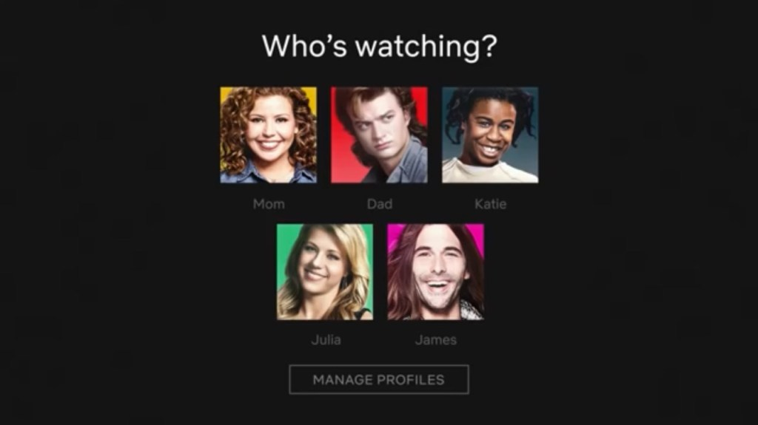
About Dataset :
Column | Description
Show-id | Identifier for each show/movie in the dataset.
type | Type of content (TV Show or Movie).
title | Title of the show/movie.
director | Director(s) of the show/movie.
cast | Cast members of the show/movie.
country | Country where the show/movie was produced.
date_added | Date when the show/movie was added to Netflix.
release_year | Year when the show/movie was released.
rating | Content rating of the show/movie.
duration | Duration (runtime) of the show/movie.
listed_in | Categories/genres the show/movie falls under.
description | Brief description or summary of the show/movie content.
Source : Kaggle Link : https://www.kaggle.com/datasets/shivamb/netflix-shows
Rows | Columns
8807 | 12

Slide 4

"Comprehensive Approach to Predicting Netflix Content Updates using Machine Learning Algorithms"
Utilizing the provided dataset for the purpose of predicting Netflix content updates, the following comprehensive approach will be undertaken: 1. Data Cleaning
Data Visualization
Label Encoding
Balancing the Data
Predictive Modeling Various machine learning algorithms will be employed for prediction:
Random Forest
Logistic Regression
Decision Tree
KNN
Ada boost

Slide 5


Accuracy :
Random Forest Accuracy: 1.00 Logistic Regression Accuracy: 0.17 Decision Tree Accuracy: 1.00 KNN Accuracy: 0.95 Adaboost Accuracy: 0.18
Prediction:
Based on the provided accuracy values for each model on the test dataset:
The Random Forest and Decision Tree models exhibit perfect accuracy (1.00).
The K-Nearest Neighbors (KNN) model also achieves a high accuracy of 0.95, indicating robust performance on the test data.
This suggests that the KNN , Decision Tree, Random Forest model might be a good choice for this classification task.

Slide 6

print(‘Thank you!”)

