Slide 1

Welcome
“চাকরি লাগবে?”

Slide 2

Simply Hired !
A premium solution to job seekers

Slide 3
Contents
Topics -
App Features.
Our Targets.
Problems we are trying to solve.
Developing kits.
Connectivity between our app and society.
Glimpse of our interface.
Group Members.

Slide 4
App Features
User Login
Cost-Effective
Regular job alerts
Confidential
Efficient
Endless job opportunities
Easy selection of candidates
Easy resume search

Slide 5

Developing Kit
1.IDE:Android Studio 2. Language: Java
. 3.Android Version: Android 8.0 (Oreo) 4. Api:26

Slide 6
Connectivity between our app and society.
1.Bridging the Gap
2.Increased Accessibility
3.Economic Impact
4.Social Empowerment

Slide 7

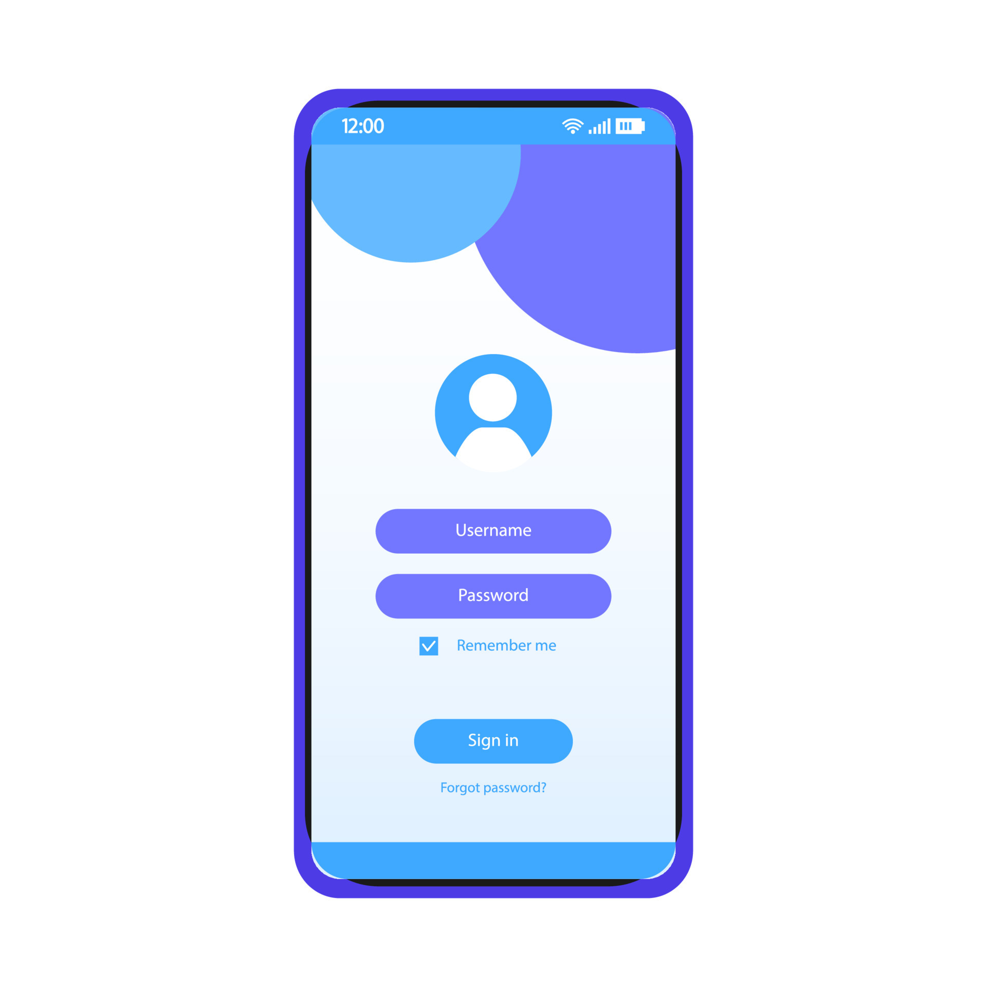
Glimpse of our Interface

Slide 8
Our Targets
User Engagement
Job Matching Accuracy
Scalability and Performance
Security and Privacy
Seamless Integration
Continuous Improvement

Slide 9
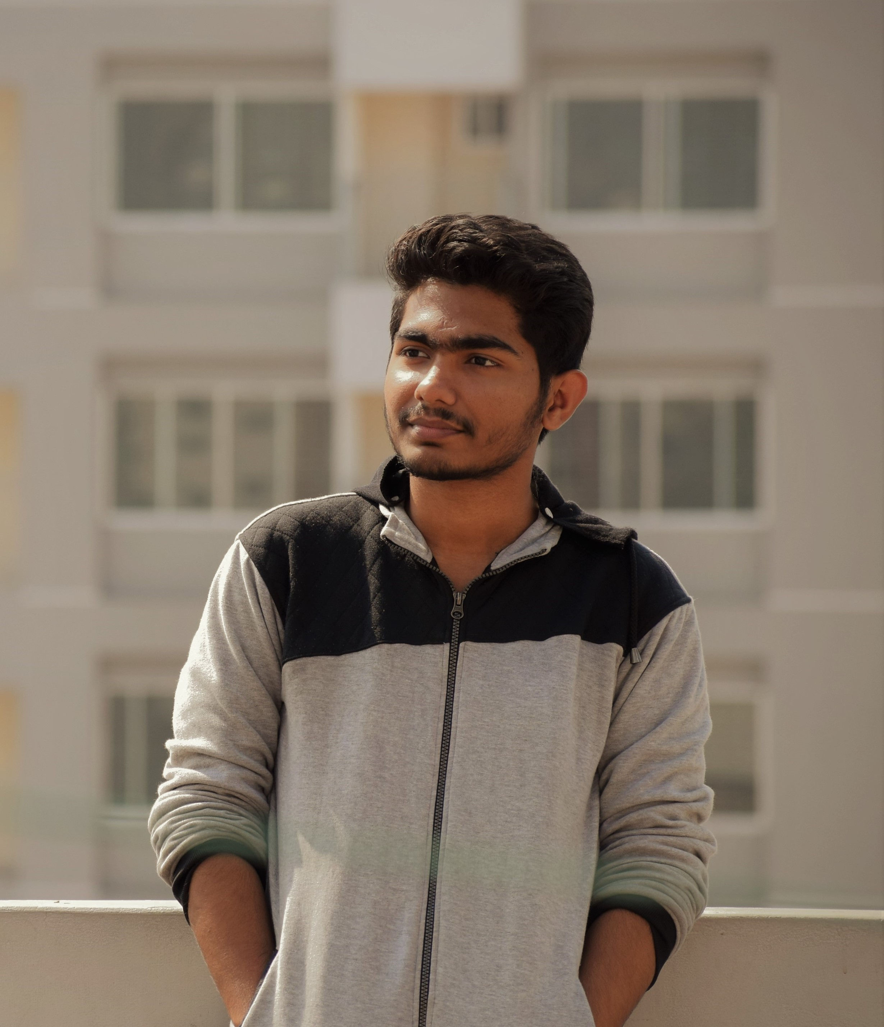


Team Members
ANIK KUMAR SANNYASHI
ID: 20210104077
MUBASWIRA IBNAT ZIDNEY
ID: 20210104077
ANIKA ANJUM ARIN
ID: 20210104077

Slide 10
THANK YOU!
Any Questions?

