Slide 1
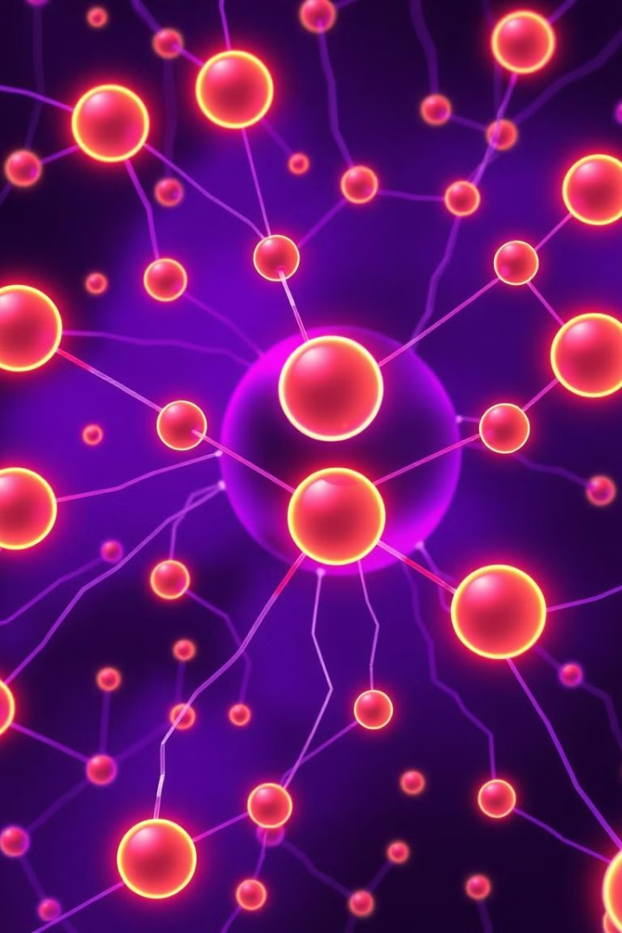

Implementation of ANN and CNN Architectures for Regression and Classification Tasks
This presentation explores the application of Artificial Neural Networks (ANNs) and Convolutional Neural Networks (CNNs) for both regression and classification tasks, using popular datasets and frameworks.
By:
Mubbara Majid
Noor Fatima

Slide 2
ANN Regression: California Housing Prices
Dataset
Preprocessing
California Housing Prices
Handled outliers
Features: 8 (e.g., Average Rooms, Population)
Standardized features
Target: Median House Value
Train/Validation/Test Split: 64% 64%, 16% 16%, 20% 20%

Slide 3
ANN Regression: Architecture
Input Layer
Hidden Layers
Output Layer
8 nodes
Dense (64, ReLU)
1 node, Linear Activation
Dense (32, ReLU)

Slide 4
ANN Regression: Results
Loss Function
Metrics
Performance
Mean Squared Error (MSE)
MSE, MAE, 𝑅 2 R 2 -Score
Test MSE: 1.3339
Test MAE: 0.9160
𝑅 2 -Score: 0. 0023

Slide 5
ANN Classification: CIFAR-10
Dataset
Preprocessing
Architecture
CIFAR-10
Images normalized to range [ − 1 , 1 ]
Input Layer (32 × 32 × 3 32×32×3)
Classes: 10 (Airplane, Car, Bird, etc.)
Fully Connected Layers: Dense (512, ReLU)
Train/Validation/Test Split
Dense (256, ReLU)
Output Layer (10, Softmax)

Slide 6
ANN Classification: Results
Loss Function
Metrics
Performance
CrossEntropyLoss
Precision, Recall, F1-Score
Classification Report
Confusion Matrix

Slide 7
CNN Classification: CIFAR-10 (Keras)
Dataset
Preprocessing
Architecture
CIFAR-10
Images normalized to range [ 0 , 1 ]
Convolutional Layers: Conv2D (32, 3 × 3 3×3, ReLU, Max Pooling)
Classes: 10 (Airplane, Car, Bird, etc.)
One-hot encoding for labels
Conv2D (64, 3 × 3 3×3, ReLU, Max Pooling)
Conv2D (128, 3 × 3 3×3, ReLU, Max Pooling)
Dense Layers: Dense (128, ReLU, Dropout)
Output Layer (10, Softmax)

Slide 8
COMPARATIVE TABLE:
Model | Dataset | Key Hyper-parameters | Final Metric | Training Time
Pytorch ANN Regression | California Housing Dataset | LR: 0.01 Epochs = 10 | Test MSE: 1.3339 Test MAE: 0.9160 | ~ 3 min
Pytorch ANN Classification | CIFAR 10 | LR = 0.01 Epochs = 10 | Accuracy = 72 % | ~ 3 min
Keras CNN Clasification | CIFAR 10 | LR = 0.01 Epochs = 10 | Accuracy = 71% | ~4 min

