Slide 1
E-commerce Customer Churn Analysis
Presented By:
Mubeen Arshad

Slide 2
Objective
Number of churn and retained customer across various attributes/dimensions
Explore the reasons behind customer churn
What necessary actions can you take to help the company reduce its churn rate.

Slide 3
Project Approach
The dataset had lots of information about our customers like their profiles, how satisfied they were, how they like to pay, and how long it's been since they ordered.
We made sure the data was clean and tidy using a tool called MS Excel, and we looked at it in a visual way using Microsoft Power BI.

Slide 4

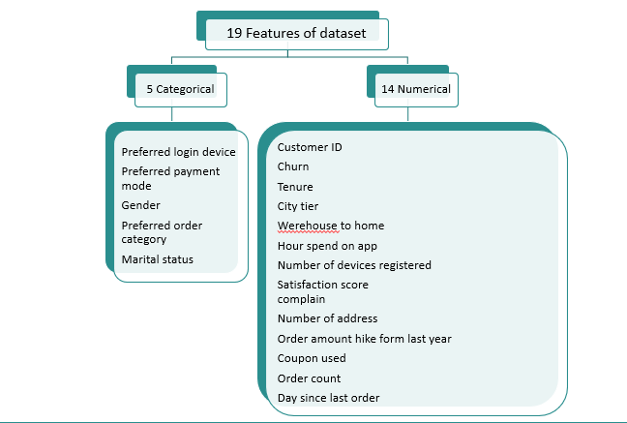
Exploratory Data Analysis

Slide 5
Analysis workflow stages:
Data Cleaning
Data Exploration
Insights Generation
Recommendations

Slide 6
Problem statement
What is the overall churn rate for the mobile app?
Do customers with longer tenure tend to churn less? Calculate the average tenure for both churned and retained customers.
Does customer satisfaction score correlate with churn? Calculate the average satisfaction score for both churned and retained customers.
Are customers who place more orders less likely to churn? Calculate the average order count for both churned and retained customers.
Are there any differences in churn rates based on the preferred payment mode?
What is the distribution of the churn customers across different city tier?

Slide 7
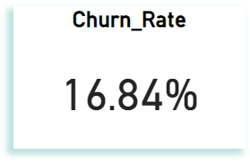
Overall Churn rate
The churn rate of 16.84% shows that a specific portion of customers in the dataset have ended their association with the company.

Slide 8
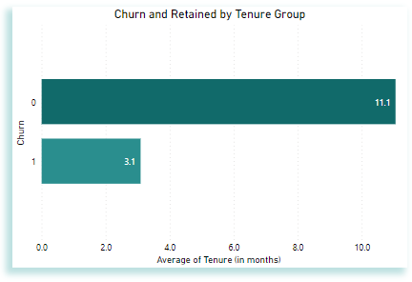
Churn by Tenure
This analysis indicates that the customers who churned have less average tenure period which is 3.1 and the customers who are retained with the company have an average of longer tenure around 11.1.

Slide 9
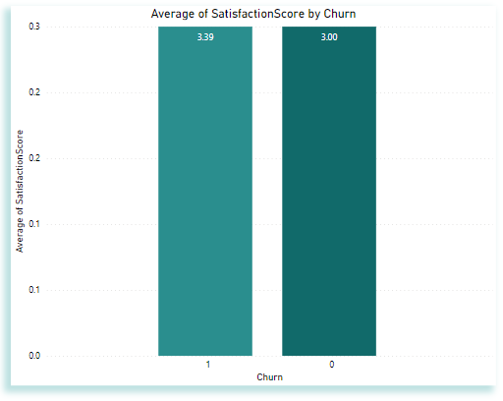
Churn by customer satisfaction
The average satisfaction score for churned customers is 3.39 and retained customers is 3.00. which indicated that the customers who are more satisfied tend to churn more likely and customers who are not satisfied are retained with the company.

Slide 10
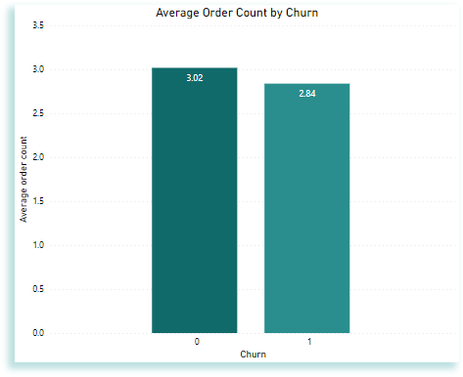
Churn by Order Count
The analysis shows that the average order count for retained customers is 3.02, which is more than the churned customers which is 2.84.

Slide 11
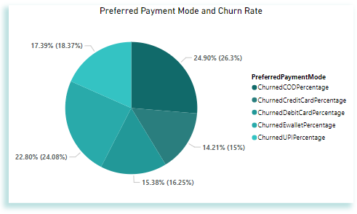
Churn rates based on Preferred Payment Mode:
The most preferred payment modes among churned customers are “Cash on Deliver” and “E wallet”, with 24.90% and 22.80% of churned customers, respectively. This indicates that these two payment modes might be more commonly associated with churn. While “Debit card” and “Credit card” have lower churn rates.

Slide 12
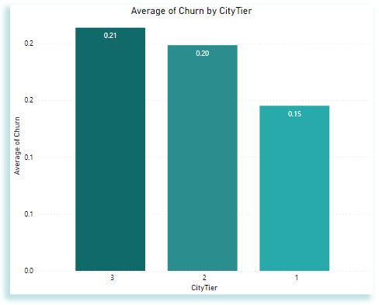
Churn by City tier
The analysis shows that the city tier has an impact on customer churn rates. Tier 1 cities have lower churn rates than Tier 2 and Tier 3 cities, possibly due to competition, customer preferences, or the availability of alternatives across different city tiers.

Slide 13
Recommendations
Tailor retention and understand the preferences and needs of customers in each tier to provide target offerings and incentives that resonate with them.
Simplify the payment process particularly for options like cash on delivery and E wallet enhance security measures and offer incentives for customers to use more reliable payment methods.
Improve customer support, and actively listen to customer feedback, and make necessary improvements to address their concerns.
Proactively engage and reward satisfied customers across all satisfaction levels.
Regularly communicate with customers through personalized messages, exclusive offers, and loyalty programs to maintain their loyalty and reduce the risk of churn.

Slide 14
Thankyou

