Slide 1

Chrome Extension for Detecting Phishing Websites
Presentation by:
Mubeena Nazar
Roll no:41
S3 MCA

Slide 2

Introduction
Relevance of my topic
Existing System
Interface Diagram
Data flow Diagram
Use case Diagram
Literature Review
Advantages
Disadvantages
Time Line
Reference
OVERVIEW

Slide 3


Introduction
Phishing attacks are the practice of sending fraudulent communications that appear to come from a reputable source.
The goal is to steal sensitive data like credit card and login information, or to install malware on the victim’s machine.

Slide 4

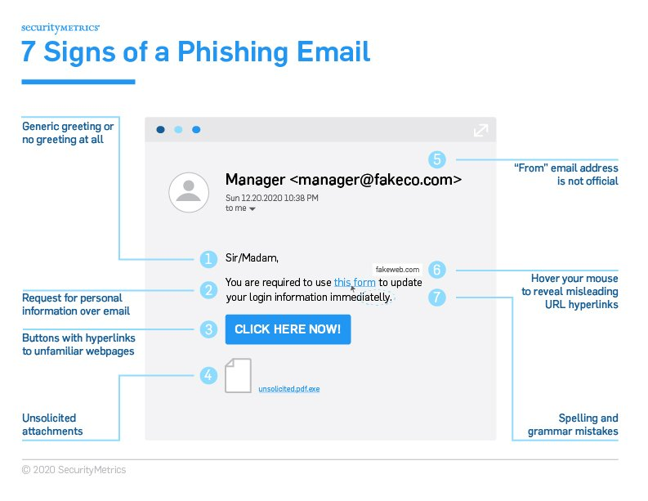
Ways to Prevent Phishing Attacks
Relevance of my topic
Don’t give your information to an unsecured site
Rotate passwords regularly
Don’t ignore those updates
Install firewalls
Don’t be tempted by those pop-ups
Don’t give out important information unless you must
And many more..

Slide 5


Relevance of my topic
Chrome Extension for Detecting Phishing Websites
Easier way
More Easier way
use a website for detection of phishing
TO ADD AS A CHROME EXTENSION

Slide 6

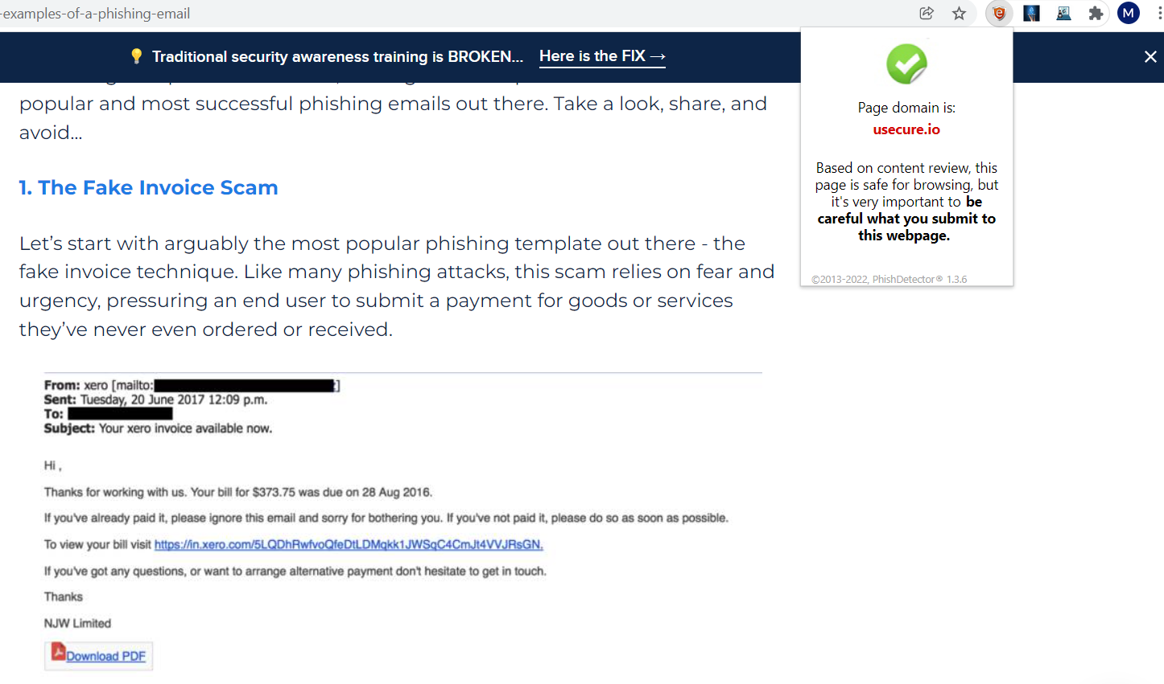

Existing System
1) PhishDetector - True Phishing Detection

Slide 7
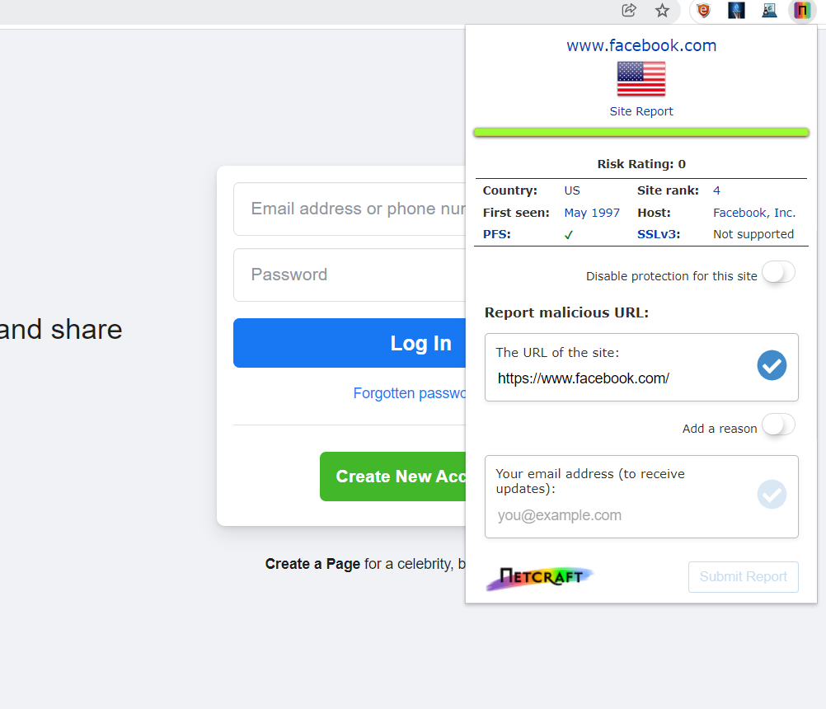

Existing System
2) Netcraft Extension

Slide 8
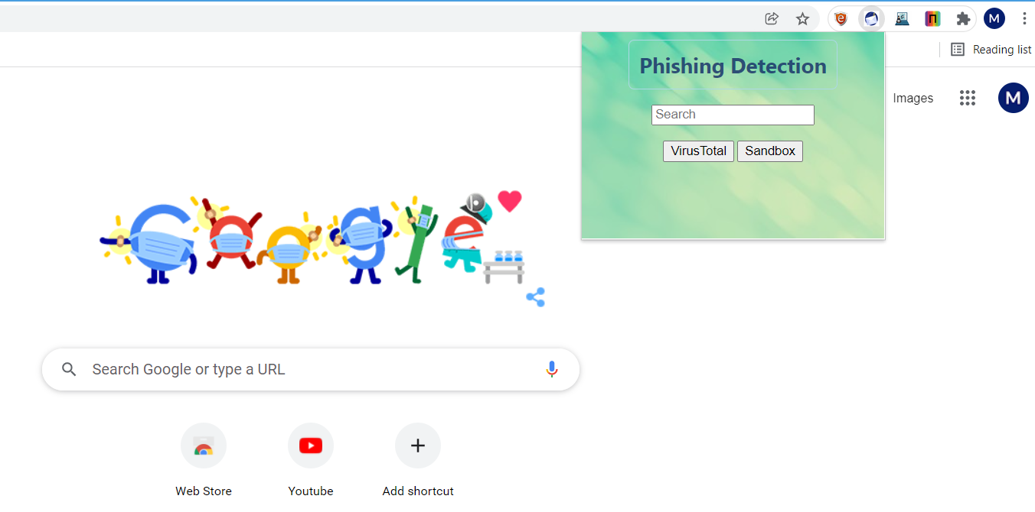
Interface Design

Slide 9
Data Flow Diagram
Client enters URL
Chrome extension fetches URL
Extraction of URL features or attributes
Result Legitimate/Phishing Website
Database Collection (connecting to multiple external website)

Slide 10


Use case Diagram
Add Extension
Store Whitelist
User
Store blacklist
Phishing System
Check
Store Previous history
Alert user
Register
User Management

Slide 11
Literature Review
Detection and classification of phishing websites
Link : https://www.peertechzpublications.com/articles/TCSIT-6-140.php
Inferences:
There two approaches that are typically used in detecting phishing websites blacklist based approach and heuristic-based approach
This paper uses the classification rule which is one of the induction technique in datamining as the paper is chooses to go with heuristic based approach
This paper suggest how to use the machine learning technique to classify the Phishing website as the usage of blacklist to identify the phishing website is not effective in zero hour attack

Slide 12
Literature Review
Chrome Extension for Detecting Phishing Websites
Link: https://www.irjet.net/archives/V7/i3/IRJET-V7I3590.pdf
Inference:
This paper proposed a chrome plugin that automates the job of detecting and overcoming traditional methods by using a machine learning algorithm
The paper utilizes the Random Forest discriminative classifier for detection of phishing website.

Slide 13

Advantages
Reduces security risks
Detection by hiding the users identity from phishers.
The computation time is very short
Using multiple websites for better results

Slide 14

Disadvantages
Results are not 100% accurate
Relies on external websites
Working offline is not possible

Slide 15
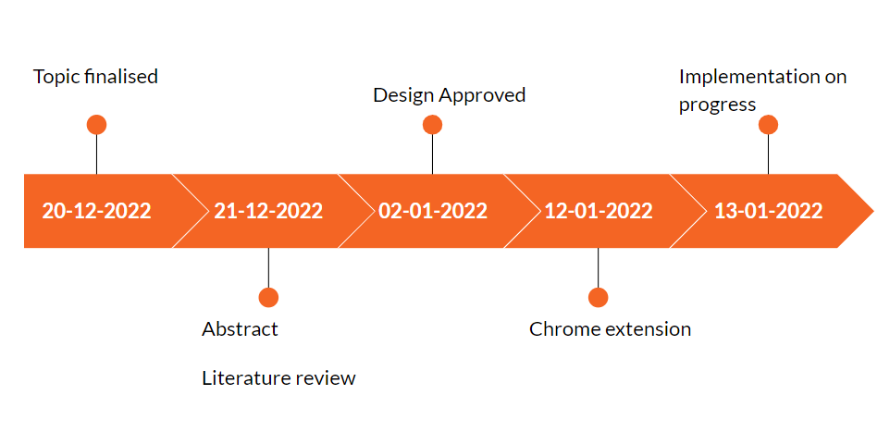
Time Line

Slide 16
Reference
A review on phishing website detection using machine learning: https://www.researchgate.net/publication/352785109_a_review_on_phishing_website_detection_using_machine_learning
Chrome extension for detecting phishing websites: https://www.irjet.net/archives/v7/i3/irjet-v7i3590.pdf
Detection and classification of phishing websites : https://www.Peertechzpublications.Com/articles/TCSIT-6-140.Php
Framework for detection and prevention of phishing website using machine learning approach: https://www.Bibliomed.Org/mnsfulltext/197/197-1599115293.Pdf?1640007654

