Slide 1

Chrome Extension for Detecting Phishing Websites
Presentation by:
Mubeena nazar
Roll no:41
S3 MCA

Slide 2

Phishing attacks are the practice of sending fraudulent communications that appear to come from a reputable source.

Slide 3

CHROME EXTENSION
DETECTION OF PHISHING WEBSITE FOR CYBER SAFETY

Slide 4
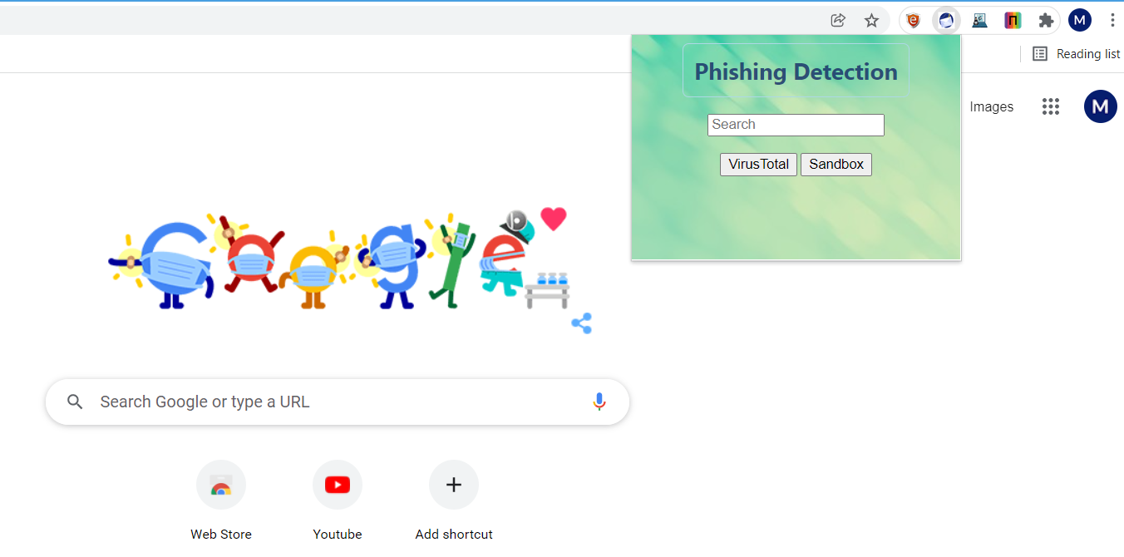
Basic design

Slide 5
ALERT → phishing website or not
WHY ? Results from various websites
Eg: SSLTrust,Sitehecker,IPqualityscore
3. Result from VIRUSTOTAL

Slide 6
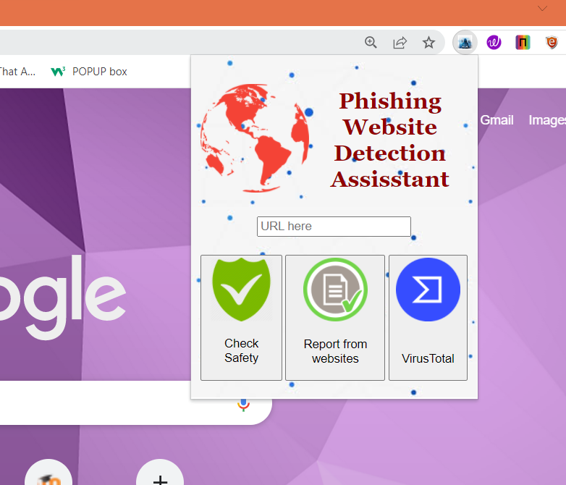
Lets have a live demo !!!

Slide 7
Current Status
1. Modifying POPUP
2. Report Preparation

Slide 8


expect to complete by Feb 20

