Slide 1
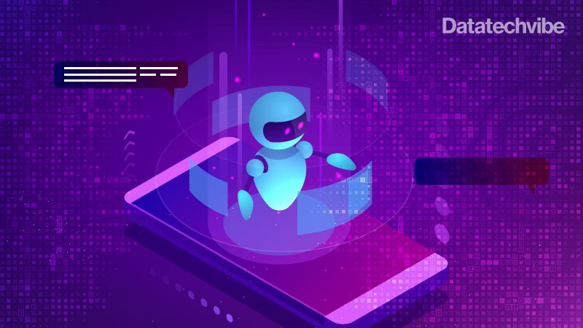
Create a chatbot with python
A Creative Problem-Solving Approach
Name: Mubeena E M
Reg.No:513521104028
Department: CSE Year: III
NM ID: au513521104028
Email:mubeenacse28@gmail.com

Slide 2
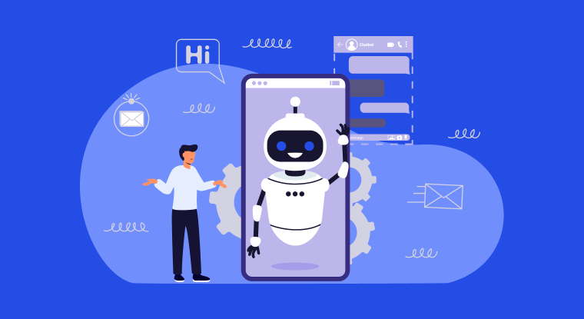
INTRODUCTION:
Chatbots are intelligent software programs designed to simulate conversation with human users, typically over the Internet. They leverage artificial intelligence (AI) and natural language processing (NLP) technologies to understand and respond to user queries, allowing for interactive and engaging interactions. Chatbots can be found in various platforms, including websites, messaging applications, and social media channels, serving purposes such as customer support, information dissemination, and entertainment.
Dataset link :https://www.kaggle.com/datasets/grafstor/simple-dialogs-for-chatbot

Slide 3
FUNCTIONALITY OF CHATBOT:
1. Greeting Users : Chatbots can greet users when they initiate a conversation. This creates a friendly atmosphere and sets the tone for the interaction.
2. Answering Frequently Asked Questions (FAQs):Chatbots can provide instant responses to frequently asked questions, saving time for both users and customer support representatives.
3. Processing Transactions : Chatbots in e-commerce platforms can help users browse products, add items to the cart, and even complete the purchase process.
4. Scheduling Appointments and Reservations : Chatbots can integrate with calendars and booking systems to help users schedule appointments, book tables at restaurants, or reserve tickets for events.
5. Language Translation : Some chatbots can translate messages from one language to another, facilitating communication between users who speak different languages.
6. Providing Recommendations : Based on user preferences and history, chatbots can suggest products, movies, restaurants, or other items of interest.
7. Learning and Improving Over Time : Some chatbots are powered by machine learning algorithms and can learn from user interactions, improving their responses over time.
8. Security and Privacy: Chatbots handling sensitive information must ensure data security and user privacy, often incorporating encryption and secure authentication methods.

Slide 4
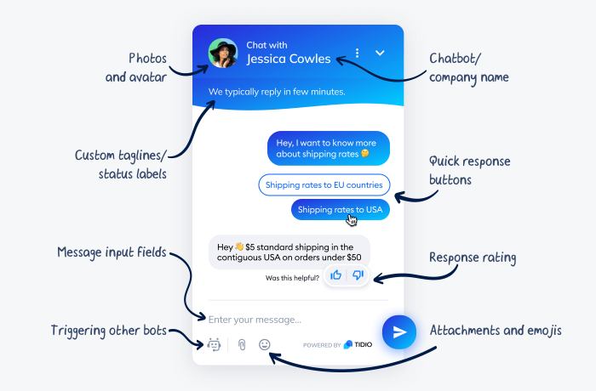
User interface of chatbot:
Chat Window:
The chat window is where the conversation between the user and the chatbot is displayed.
Messages from the user and the chatbot are shown in this area.
Scrollbars are often added to allow users to navigate through the conversation history.
Input Field:
An input field where users can type their messages to interact with the chatbot.
Users enter their queries or commands here before sending them to the chatbot.
Send Button:
A button that users can click to send their typed message to the chatbot.
Alternatively, pressing the 'Enter' key can also be programmed to send the message.

Slide 5
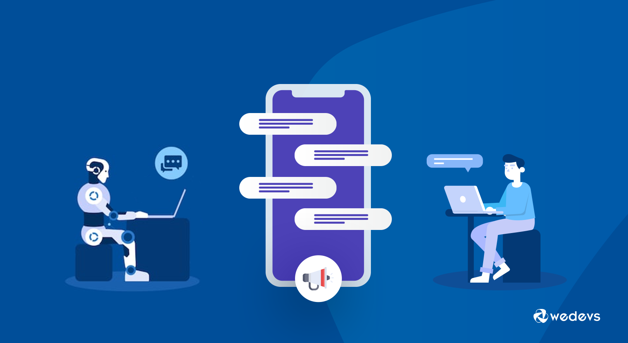
Natural language processing in chatbot:
1.Tokenization: Tokenization is the process of breaking down a text into smaller units called tokens. Tokens can be words, phrases, or even sentences.
2. Part-of-Speech Tagging: Part-of-speech tagging assigns grammatical parts of speech to words in a sentence, such as nouns, verbs, adjectives, etc.
3. Named Entity Recognition (NER): NER is the process of identifying named entities (such as names of people, places, organizations, etc.) in text.
4. Sentiment Analysis: Sentiment analysis determines the sentiment or emotion expressed in a piece of text, such as positive, negative, or neutral.
5. Intent Recognition: Intent recognition identifies the purpose or goal behind a user's input. In the context of chatbots, it determines what the user wants to accomplish.
6. Dialogue Management: Dialogue management involves managing the flow of conversation between the user and the chatbot, including understanding context and handling multi-turn conversations.
7. Language Generation: Language generation involves creating human-like text based on the context and user input.

Slide 6
Testing strategies of chatbot:
1.Unit Testing:
Test individual components, functions, or methods of the chatbot to ensure they work correctly.
Verify the logic of response generation and intent recognition algorithms.
2. Integration Testing:
Test how different components of the chatbot work together.
Verify the interactions between the user interface, NLP modules, and backend services.
3. User Acceptance Testing (UAT):
Involve real users or stakeholders to interact with the chatbot in a controlled environment.
Gather feedback on usability, understandability, and overall user satisfaction.
4. Regression Testing:
After implementing changes or updates, ensure that existing functionalities still work as expected.
Prevent new updates from breaking previously functional features.
5.Performance Testing:
Evaluate the chatbot’s performance under different conditions, including high user loads.
Measure response times and system resource usage to ensure optimal performance.
6. Security Testing:
Perform security testing to identify vulnerabilities and ensure that user data is protected.
Implement measures to prevent common security threats like SQL injection or cross-site scripting.

Slide 7
Improvement strategies of chatbot:
1. User Feedback Analysis:
Gather feedback from users and analyze their interactions with the chatbot.
Identify common issues and areas for improvement based on user suggestions and complaints.
2. Natural Language Processing (NLP) Enhancement:
Fine-tune NLP models based on user interactions.
Incorporate user queries and responses into training data to improve the bot's language understanding.
3. Error Handling Refinement:
Identify common errors and ambiguous queries.
Implement specific error messages or prompts to guide users and request clarifications.
4. Context Management Optimization:
Enhance the chatbot’s ability to maintain context across conversations.
Implement context-aware responses, allowing the bot to refer to past interactions.
5. A/B Testing:
Implement A/B testing to compare different versions of the chatbot.
Analyze user engagement metrics and user feedback to determine which version performs better.
6. Continuous Monitoring:
Monitor chatbot interactions in real-time.
Use analytics to track user behavior, identify drop-off points, and enhance the user journey.

Slide 8
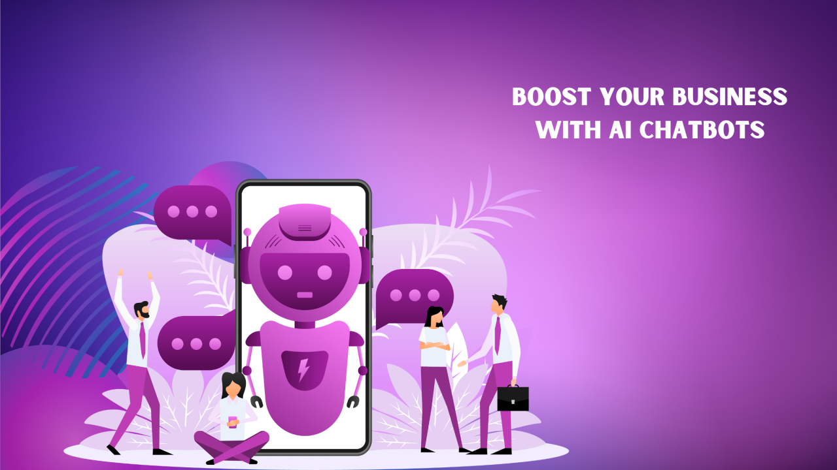
Conclusion:
Chatbots represent a transformative force in human-computer interaction. Their ability to engage, assist, and learn from users is reshaping how we access information, seek assistance, and connect with businesses and services. As we move forward, the collaboration between human creativity and artificial intelligence will continue to define the future of chatbots, offering boundless opportunities to enhance user experiences, streamline processes, and create meaningful, personalized interactions in the digital realm. The journey has just begun, and the potential for innovation in the world of chatbots knows no bounds.

