Slide 1
Hadith usama.sarfraz1982@gmail.com
Definition
Its history
Kinds of hadiths
Importance
Its need and its position in Islam

Slide 2
Definition
Any report that narrates a Sunnah of the Holy Prophet (SAW) is called Hadith.
Sunnah means a manner of acting or mode of life.
It is technically defined as a word spoken or an act done or a confirmation given by the Holy prophet Muhammad (SAW).
The Sunnah is the second source of Islamic Law.
Its authority is derived from the text of the Quran

Slide 3
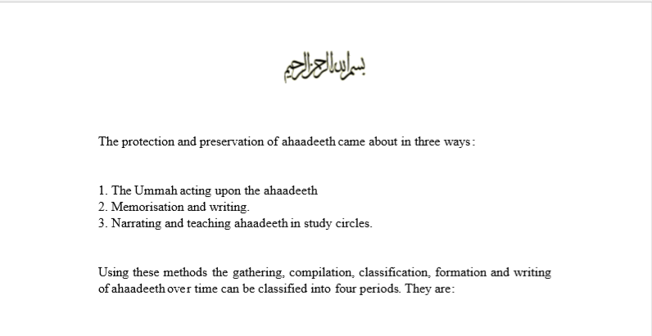
History of hadith (four periods)

Slide 4
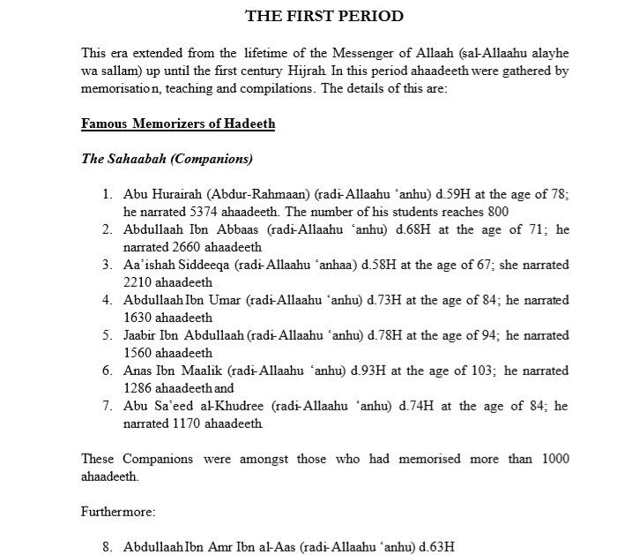

Slide 5
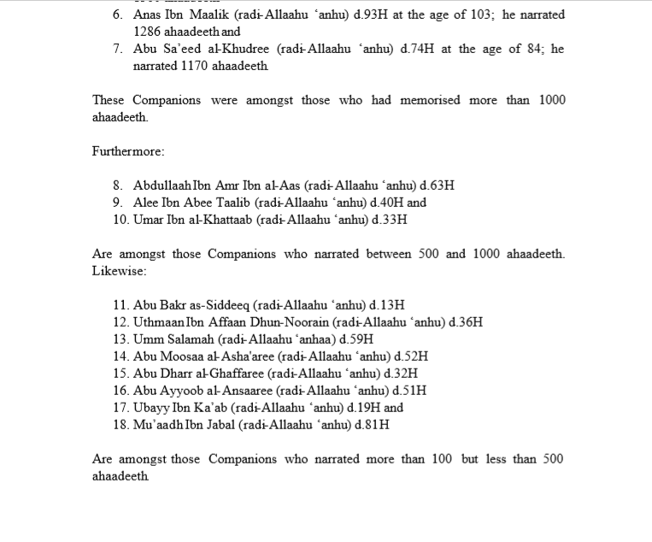

Slide 6
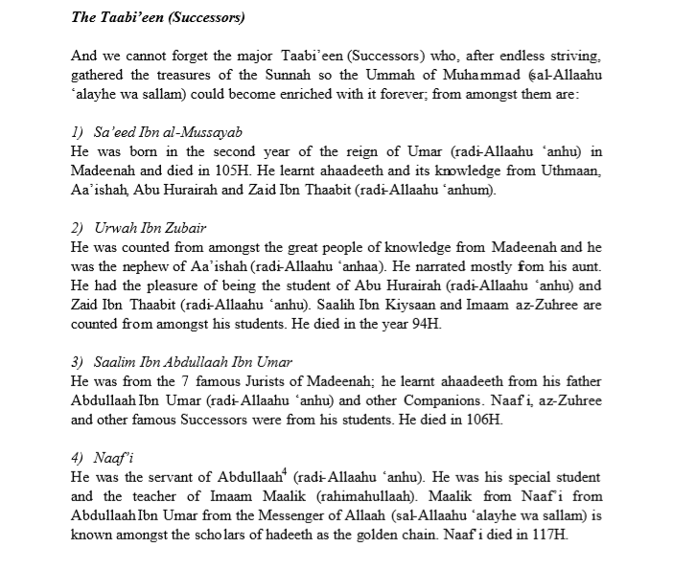

Slide 7
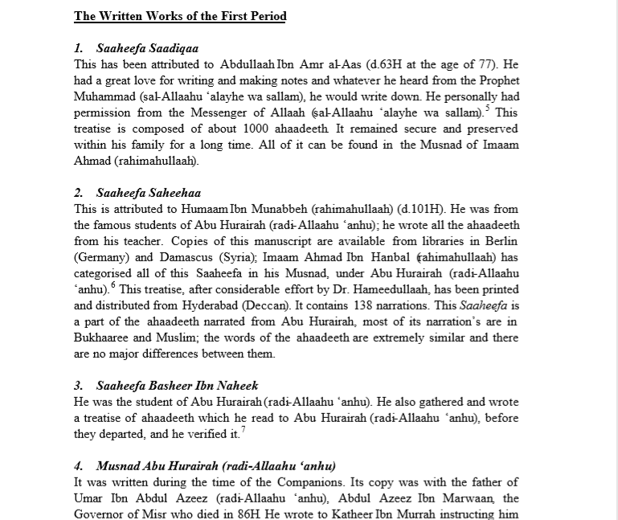

Slide 8
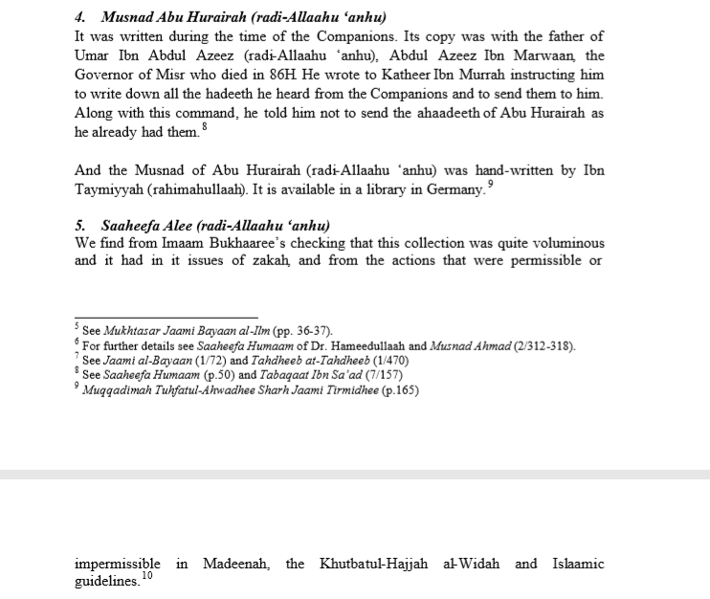

Slide 9
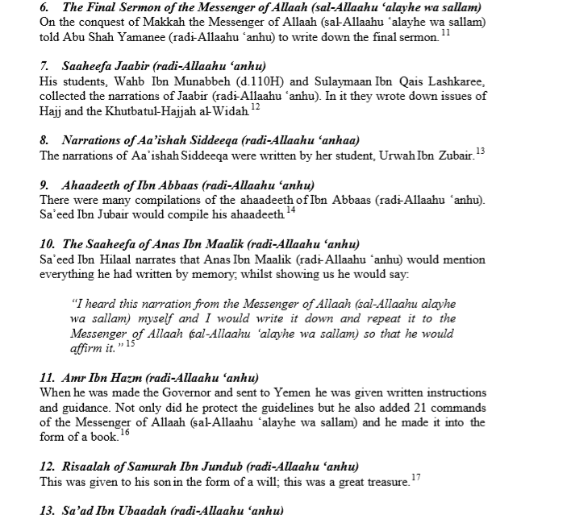

Slide 10
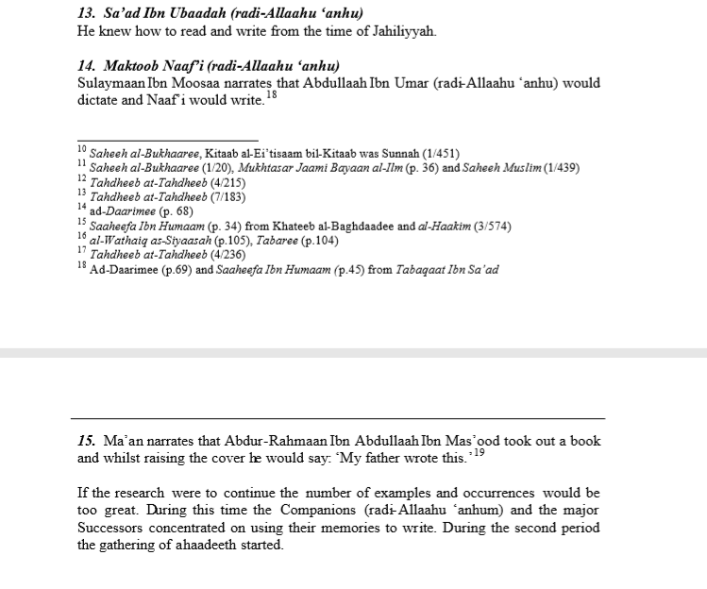

Slide 11
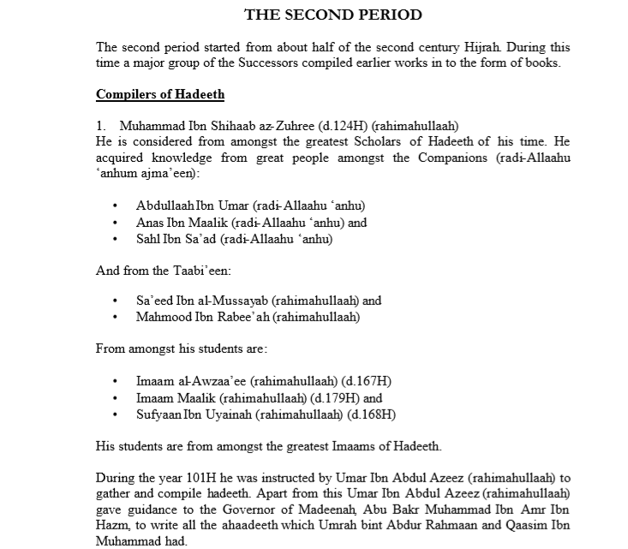

Slide 12
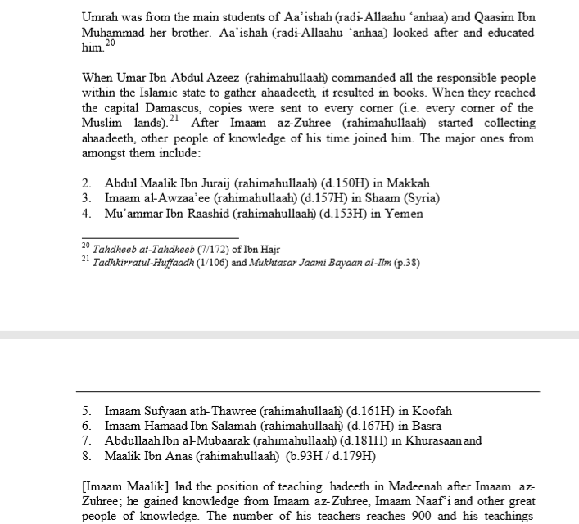

Slide 13
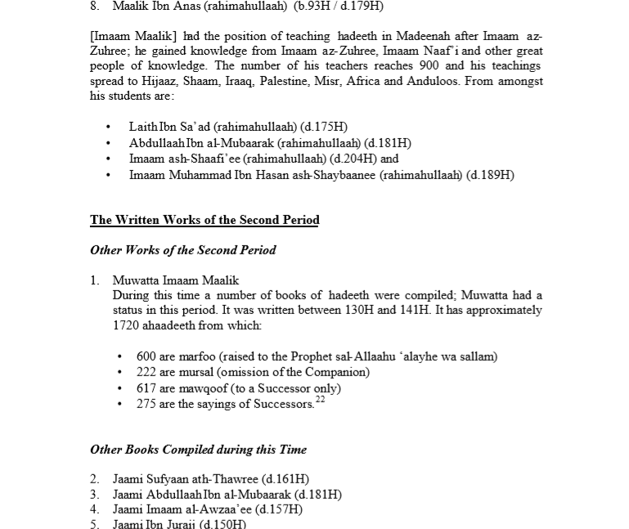

Slide 14
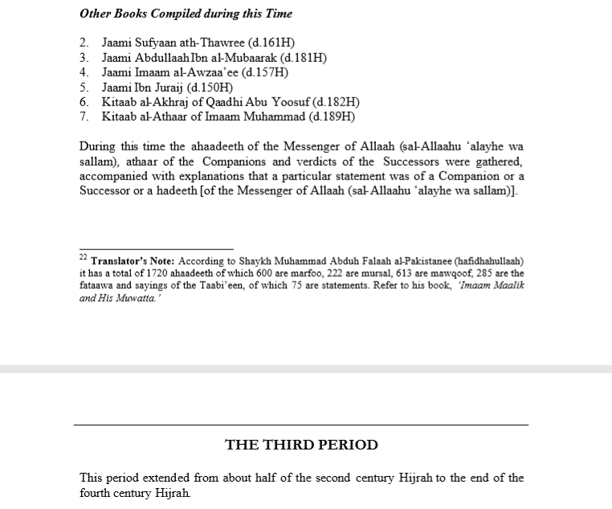

Slide 15
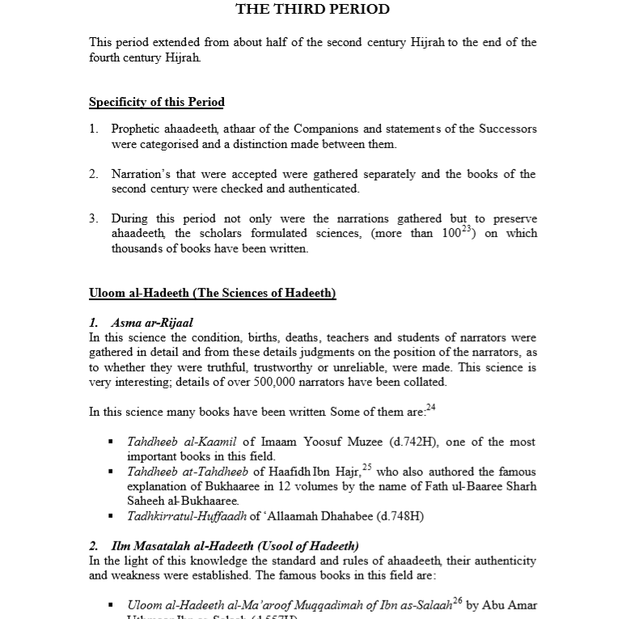

Slide 16
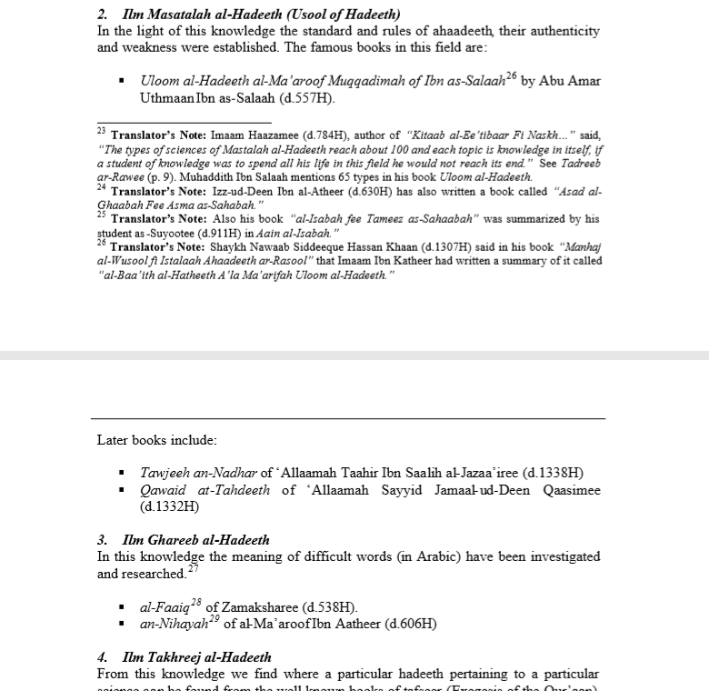

Slide 17
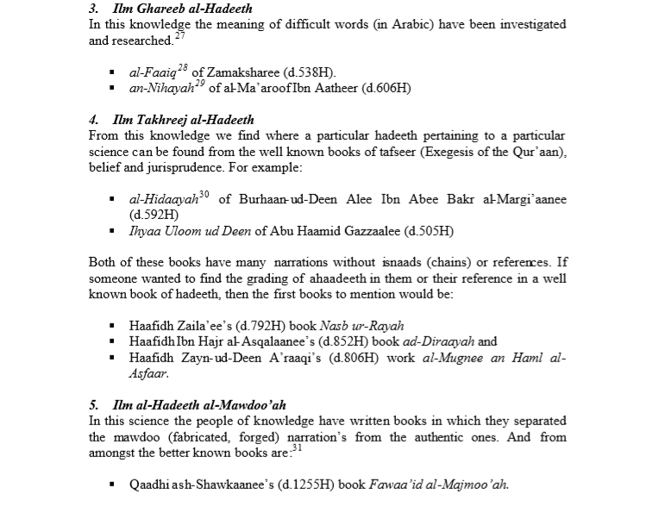

Slide 18
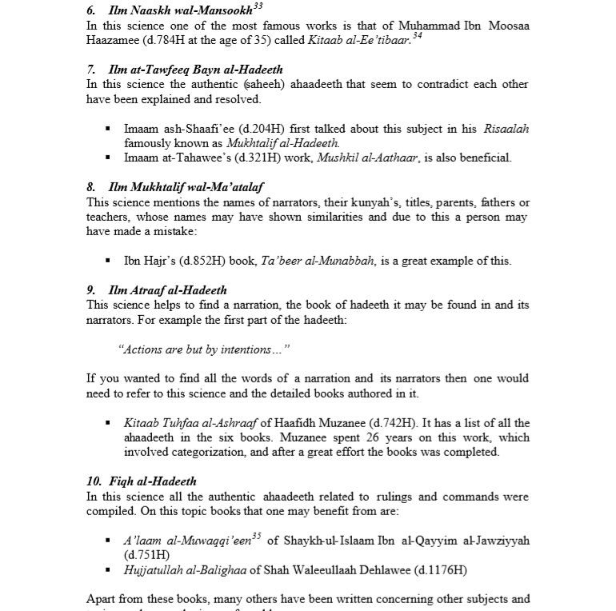

Slide 19
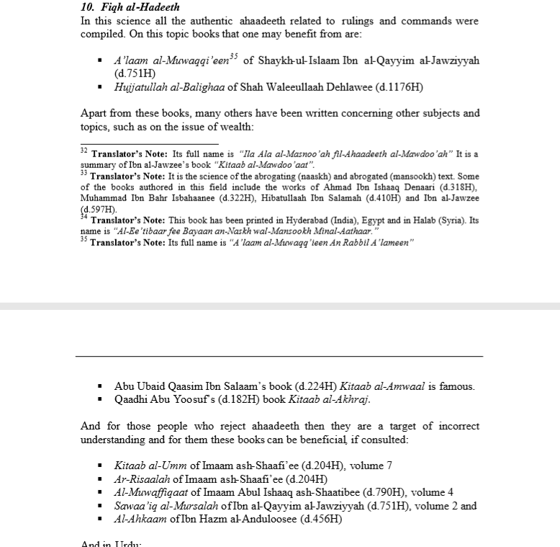

Slide 21
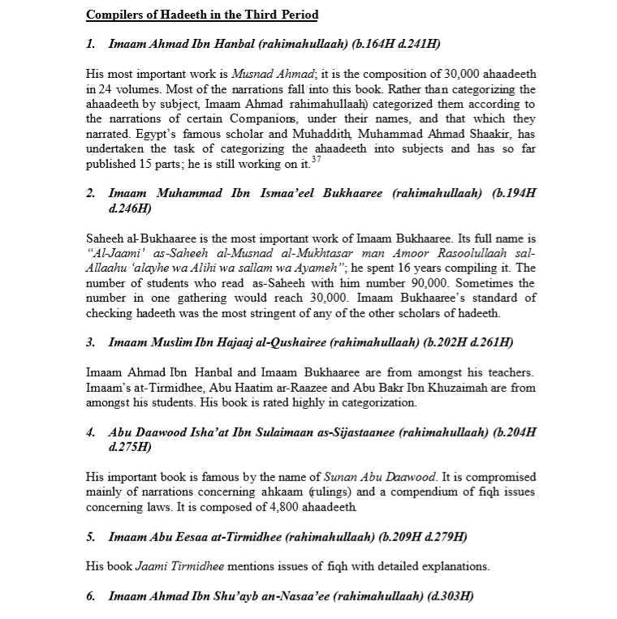

Slide 22
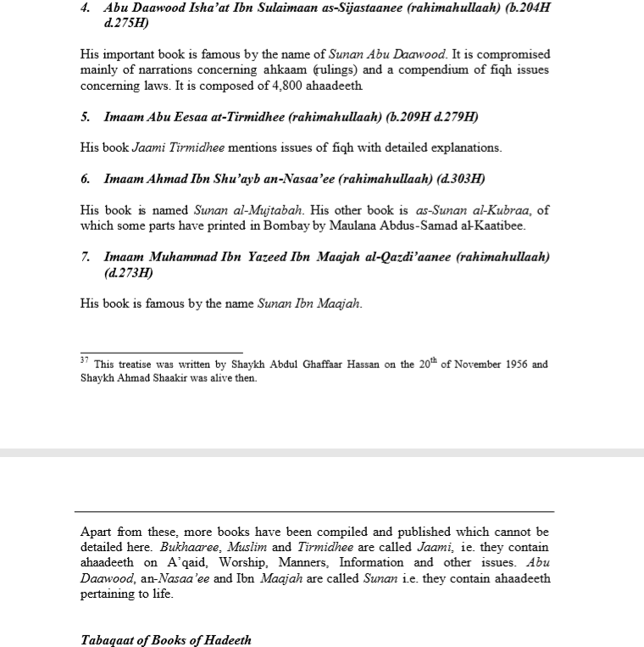

Slide 23
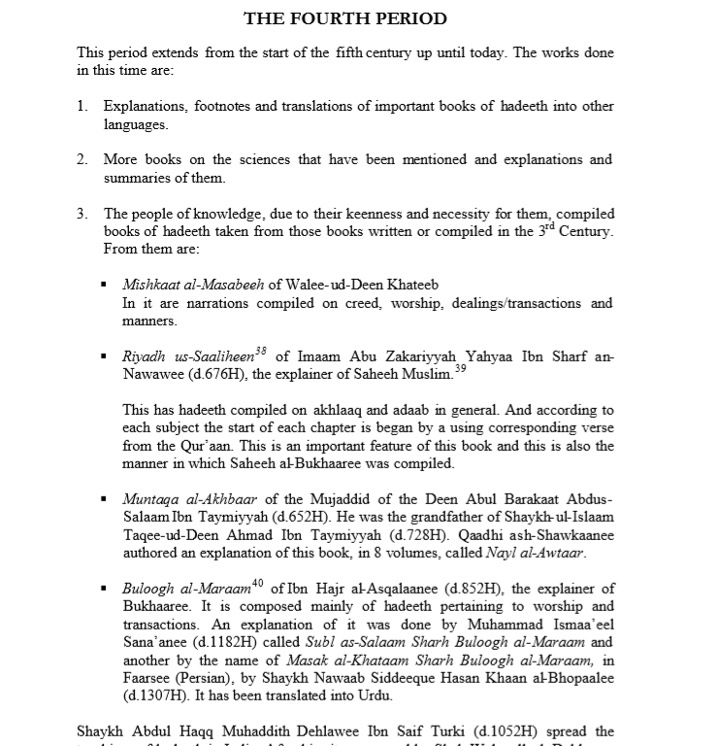

Slide 24
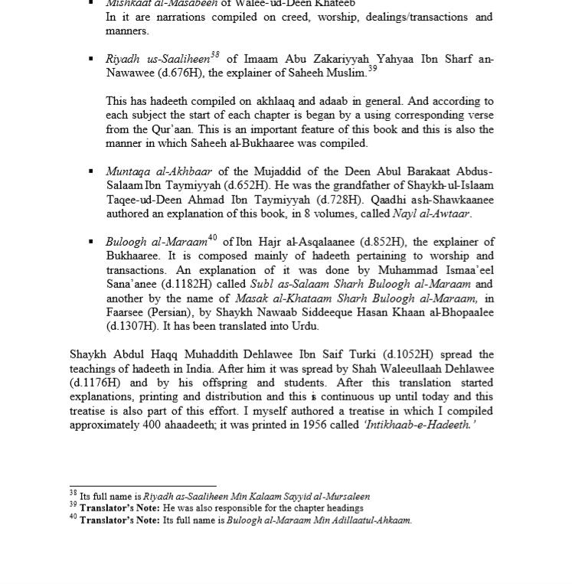

Slide 25
Levels of Hadiths
According to the qualities of the narrators, Hadiths can be divided into four types:
Sahih صحيح
A Hadith reported by an uninterrupted chain of narrators, each one of whom is pious and of strong memory, provided that the report is not against the narration of a greater number of reliable narrators and It does not suffer from an illah علة (an infirmity discovered only by experts of hadith).
Hassan حسن
A hadith reported by a pious narrator whose memory is of a lower standard than that of the narrator of Sahih but not absolutely weak.
Da’if ضعيف
A hadith reported by a narrator who is not pious or is of weak memory.
Maudu موضوع
A hadith reported by a person held as liar

Slide 26
Hadith Importance Its need and its position in Islam

Slide 27
Authority of Hadith حُجِّیَّتِ حدیث

Slide 28
Four Responsibilities Of Prophet Muhammad (صلى الله عليه وسلم )

Slide 29
لقد من الله على المؤمنين إذ بعث فيهم رسولا من أنفسهم يتلوا عليهم آيته ويزكيهم ويعلمهم الكتب والحكمة وإن كانوا من قبل لفي ضلل مبين , (سورة آل عمران: 164)
Allah has surely conferred favor on the believers when He raised in their midst a messenger from among themselves who recites to them His verses and makes them pure and teaches them the book and the wisdom, while earlier, they were in open error.

Slide 30
Summary of the Verse
Great blessing from Allah that He chose the Holy Prophet as a messenger.
He chose the messenger among them not from any other creature.
And for very 1st audience, chose the messenger among them not from other clan or nation.
1st Responsibility is to recite to them His verses
2nd is to teach them the book
3rd is to teach them the wisdom
4th to make them pure

Slide 31
وما ينطق عن الهوى إن هو إلا وحي يوحى
(3,4النجم:)
He (The Prophet) doesn’t speak out of
(his own) desire. It is but revelation revealed (to him).
وأطيعوا الله ورسوله إن كنتم مؤمنين(الانفال:۱)
“ And obey Allah and His Messenger, if you are believers”.
(44النحل:)وأنزلنا إليك الذكر لتبين للناس ما نزل إليهم
we have revealed the book to you, so that you may explain to them what have been revealed to them.

Slide 32
قل أطيعوا الله وأطيعوا الرسول فإن تولوا فإنما عليه ما حمل وعليكم ما حملتم وإن (54تطيعوه تهتدوا وما على الرسول إلا البلاغ المبين(النور:
Say, Obey Allah and obey the messenger. But if you turn away, then on him (the messenger) lies (the responsibility of) what he is burdened with, and on you lies (the responsibility of) what you are burdened with. And if you obey, you will get the right path. The duty of the messenger is no more than to convey the message clearly.
لقد كان لكم في رسول الله أسوة حسنة (الاحزاب:۲۱
“Indeed, for you the life of the Prophet is a model of behavior”.
قل أطيعوا الله وأطيعوا الرسول فإن تولوا فإن الله لايحب الكافرين(آل عمران:۳۲)
Say, Obey Allah and obey the messenger. But if you turn away, then Allah doesn't love nonbelievers.

Slide 33
وما آتاكم الرسول فخذوه وما نهاكم عنه فانتهوا(الحشر:۷)
“And whatsoever the Messenger Muhammad (SAW) gives you, take it and whatsoever he forbids you, abstain from it”.
من يطع الرسول فقد أطاع الله(النساء:۸۰ )
Who ever obeyed the Messenger obeyed Allah
(64وما أرسلنا من رسول إلا ليطاع بإذن الله(النساء:
we have not sent down any prophet for any mission except that he, with the will of Allah be obeyed (by the people)
.
(31آل عمران:)قل إن كنتم تحبون الله فاتبعوني يحببكم الله ويغفرلكم ذنوبكم
Say, If you love Allah follow me, Allah will love you and forgive you your sins.

Slide 34
يأمرهم بالمعروف وينههم عن المنكر ويحل لهم الطيبات ويحرم عليهم الخبائث ويضع عنهم إصرهم والأغلال (سورة الأعراف: 157)
And who bids them what is fair and forbids what is unfair, and makes lawful for them good things, and makes unlawful for them impure things, and relieves them of their burden and the shackles that were upon them.

Slide 35
Quiz# , 3/6/2021 , 5 marks.
describe the literal and technical meaning of Sunnah.
what is Hadith?
What is the most powerful evidence of being Sunnah an authority in Islamic law.
What importance does Sunnah has in the Islamic law?
Write down any 2 verses that support the idea of being Sunnah an authority.

