Slide 1
Pilgrimage
حج

Slide 2
Definition Of Hajj (حج)
Literally meaning of hajj:
Hajj means “To Intention” (ارادہ کرنا ، قصد کرنا)
In The Terminology of Islamic Law:
To make a Intention to Baitullah (بیت اللہ) in specific month, in specific days and with specific acts.

Slide 3
Virtue of Hajj…
العمرة إلى العمرة كفارة لما بينهما والحج المبرور ليس له جزاء إلا الجنة.( البخاري ومسلم )
The Prophet said:
Umra is an expiation for the sins committed between it and the previous Umra; and the reward of Hajj Mabrur (i.e., one accepted) is nothing but Jannah.
من حجّ فلم يرفث ولم يفسق رجع كيوم ولدته أمه. ( لفظ البخاري )
Whoever performs hajj and does not commit any obscenity nor commit any evil, will return as sinless as a new-born child

Slide 4
Virtue of Hajj…
تابِعُوا بَيْنَ الْحَجِّ وَالْعُمْرَةِ فَإِنهُمَا يَنفِيَان الفقرَ وَالذنوبَ كمَا يَنفِي ‏ ‏الْكِيرُ ‏ ‏خَبَثَ ‏ ‏الحَدِيدِ وَالذهَبِ وَالفِضَّةِ وَليْسَ لِلْحَجِّ المَبْرُور ثَوَابٌ دُونَ الْجَنةِ. ( النسائي والترمذي )
Alternate between Hajj and Umrah, for these two remove poverty and obliterate sins just as the blacksmith's bellows removes all impurities from metals like iron, gold and silver. The reward for Hajj Mabrur is nothing short of Paradise.

Slide 5
Months of Hajj
Hijri Calendar:
1. Muharram
2. Safar
3. Rabi’ al-Awwal
4. Rabi’ al-Thani
5. Jumada al-Ula
6. Jumada al-Thaniya
7. Rajab
8. Shaban
9. Ramadan
10. Shawwal (شوال)
11. Dhul-Qedah (ذو القعدة)
12. Dhul-Hijjah (ذو الحجة)
Days of Hajj
All in the 12th month, (ذو الحجة)
8th Dhul-Hijjah: day of Tarwiyah
(یوم الترویہ)
9th Dhul-Hijjah: day of Arafah
(يوم العر فة)
10th Dhul-Hijjah: day of NaHr (يوم النحر) (Eid)
11th Dhul-Hijjah: 1st day of tashreeq
12th Dhul-Hijjah: 2nd day of tashreeq
13th Dhul-Hijjah: 3rd day of tashreeq

Slide 6
Important Terms

Slide 7
Mawaqeet (مواقيت)
Mawaqeet (مواقيت) is the plural of Meeqat (ميقات): the geographical boundary that a person intending Hajj or Umra may not cross without assuming Ihram for Hajj or Umra, or both.
A Muslim intending Hajj or Umra who crosses the Meeqat without Ihram must return to the Meeqat and make Ihram from there. If he/she does not return and make Ihram from the Meeqat, then he/she must offer an animal sacrifice (Fidya).

Slide 8
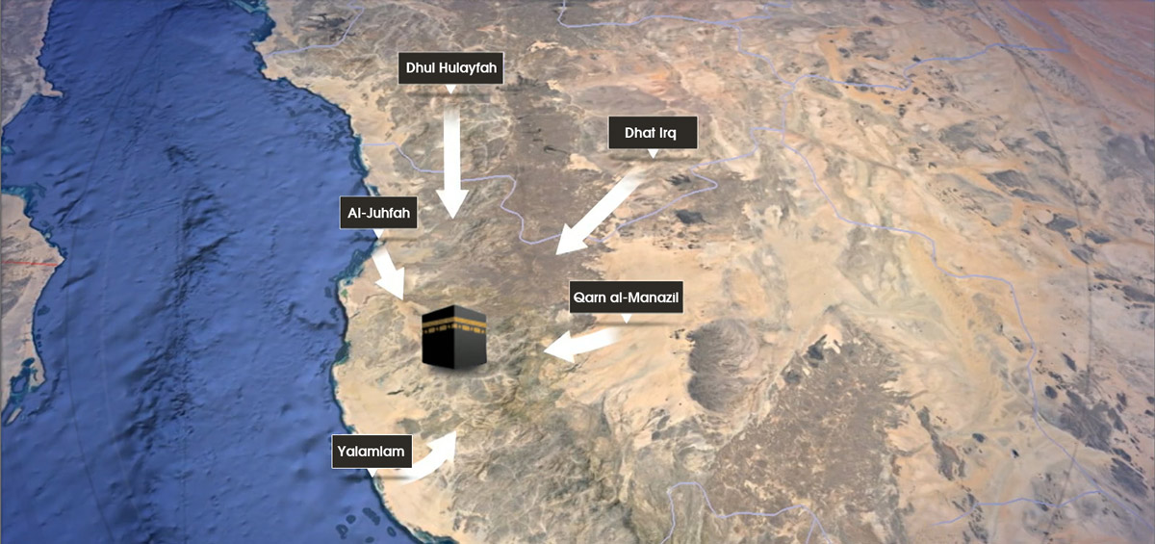

Slide 9
Mawaqeet (مواقيت)
Dhu-l Hulayfah (ذو الحُليفة) | Coming from Madinah, other name is Abyar Ali
Al Juhfah (الجُحفة) | Coming from North Africa, Syria,
Dhatu ‘Irq (ذات عرق) | Coming from Iraq
Yalamlam (يلملم) | Coming from Yemen
Qarn Al Manazil ((قرن المنازل | Coming from Najd (Riyadh, UAE) For Pakistanies too

Slide 10
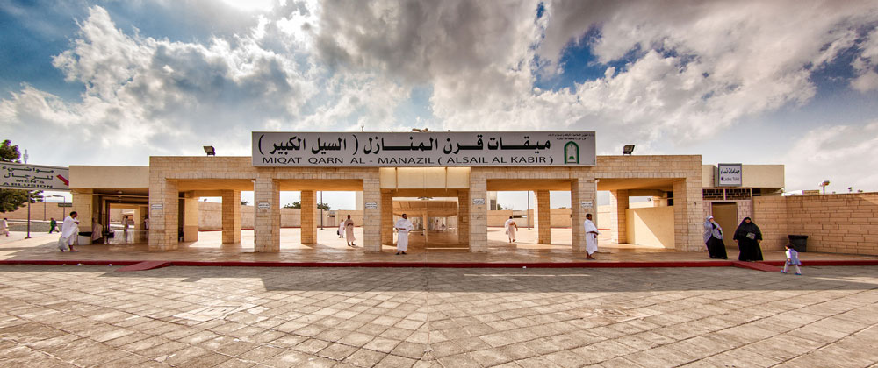
Our meeqat

Slide 11
Tawaf طواف
Tawaf around the Ka'bah
Start from the Black Stone.
Ka’bah being to your left.
Go around the Ka’bah past the Black Stone seven times.
Kiss the Black Stone or say Takbeer every time you pass by it. (i.e. every circuit)

Slide 12
Tawaf طواف
Two Sunnahs apply to this Tawaf:
Ar-Ramal (الرَّمَل) (for men only)
a strong and quick walk with boldness, in which the shoulders are thrust forwards in the first three rounds, then walk normally in the rest
Al-Idtiba‘ (الإضطِبَاع) (for men only)
wearing the Ihram under your right armpit and over the left shoulder
throughout the seven rounds of Tawaf

Slide 13
Tawaf طواف
All kinds of Tawaf, including optional Tawaf, consist of seven circuits around the Ka'bah.
The Ka’bah should be to your left. Do not do Tawaf with your back or right to the ka’bah. Do not walk backwards.
Tawaf shall be performed within the boundaries of Al-Masjid Al-Haram.
A state of Wudu is required for all kinds of Tawaf.
A menstruating woman does not make Tawaf until she becomes clean.
You do not have to say your intention out loud to begin Tawaf. Saying intentions out loud is something the Prophet (صلى الله عليه وسلم) never did except after Ihram when he said, “Labbayk Allahuma Umra wa Hajj.”

Slide 14
Tawaf طواف
Continue Tawaf without interruption, unless it is necessary, otherwise it will be void.
When it is time for the obligatory Salat you stop your Tawaf, join the Salat in your place and then resume your Tawaf from where you left.
If you need to go to the restroom you may interrupt your Tawaf and go. Make Wudu before coming back to resume your Tawaf. You resume your Tawaf from where you left. However, some scholars say that you need to start over from the beginning (this is a safer option).

Slide 15
Tawaf طواف
In case of doubt about the number of circuits you performed you have to base your decision on the least number of circuits. For example if you have doubts whether you did 6 or 7 circuits, you base it on 6 and add one circuit.
If you get doubts after you finish your Tawaf then you just ignore it and do not act on it.

Slide 16
Tawaf طواف
Touch the Yamani corner with your right hand each time you pass and do not kiss it. If you are not able to touch it then you should not make any sign towards it with your hand at all.
Do not face your hand to the Yamani corner and say Allahu Akbar. This is only for the Black Stone.
You do not touch the Shami or the 'Iraqi Corners at all.
Do not wipe the walls of the Ka’bah during Tawaf. The Messenger of Allah (صلى الله عليه وسلم) did not touch anything other than the Black Stone and the Yamani Corner.

Slide 17
Tawaf طواف
There is no particular dhikr for Tawaf, so you may read Quran or say any dhikr you like.
Do not follow those Du’a books that make up a specific Du’a for each circuit around the Ka’bah. Read Quran and make Du’a from your heart and glorify Allah.
Make Du’a by yourself, do not do it in a shouting group.
You can say the Prophet’s Du’a between the Yamani and the Black Stone corners:
ربنا آتنا في الدنيا حسنة وفي الآخرة حسنة وقنا عذاب النار

Slide 18
Sa’y between Safa & Marwa (صفا اورمروہ کے درمیان سعی)
إِنَّ الصَّفَا وَالْمَرْوَةَ مِن شَعَآئِرِ اللّهِ فَمَنْ حَجَّ الْبَيْتَ أَوِ اعْتَمَرَ فَلاَ جُنَاحَ عَلَيْهِ أَن يَطَّوَّفَ بِهِمَا وَمَن تَطَوَّعَ خَيْراً فَإِنَّ اللّهَ شَاكِرٌ عَلِيم( البقرة، 158 )
“Surely the Safa and the Marwa are among the Symbols of Allah; so whoever makes a pilgrimage to the House or pays a visit (to it), there is no sin if he goes round them both; and whoever does good of his own accord, then surely Allah is Grateful, Knowing.”

Slide 19
Sa’y between Safa & Marwa (صفا اورمروة کے درمیان سعی)
Start with the Safa
Recite Ayah [2,158]
Make Dhikr and Du’a
Walk to the Marwa (first lap)
On the Marwa, do the same as on the Safa
Walk back to the Safa (second lap)
Complete seven laps in the same manner
Finish at the Marwa

Slide 20
Ihraam (احرام)
Literally Ihraam in Arabic means to declare something unlawful upon yourself.
In Shariah it means making lawful things unlawful upon yourself after you enter into Ihraam. For example, cutting the hair or the nails, using Itar or wearing sewn clothes and covering the head for males.
A person in Ihraam is called a Muhrim.
Ihraam is a state in which a person enters into after wearing two sheets of cloth, making intention and reciting Talbiyah.
It is not the two sheets themselves, as it is commonly misunderstood.
Women should wear their regular clothes and observe normal Pardah (veil) without any cloth touching their faces.

Slide 21
Preparation Of Ihram
Clip the nails and remove the under-arm and pubic hair.
Make ghusl (shower). If this is not possible then, do wudhu and make intention that this ghusl or wudhu is to enter into Ihraam.
Put on the two sheets of cloth.
Use Itar (Sunnah) without leaving any visible signs of its existence on the sheets of Ihraam.
If it is not makrooh time then perform two rakaats of Ihraam (Sunnah), with the head and shoulders covered.
Males should remove their head cover until free from Ihraam. Most captains on Muslim airlines make an announcement before entering miqaat).
Make the following intention for Umrah only and not Hajj.
Recite the following Talbiyah three times, audibly for males and in a low voice for females. Recite Durood Shareef and make Dua.
Remember that from now onwards you are in the state of Ihraam and all restrictions of Ihraam apply.

Slide 22
Prohibitions of Ihram محظورات احرام
Clothing
Men cannot wear any sewn clothes such as a shirt, turban, hooded cloak, trousers, underwear, etc., socks or shoes. Women can wear their normal clothes, but without covering their faces or hands
You should not wear gloves, although there is no harm in wrapping the hands in cloth.
Men cannot cover their head with something that touches it.
Fragrance
You should not perfume yourself, your clothing, your food or drink after entering Ihram. You should also abstain from cleansing yourself with scented soap.
There is no harm in what remains of the effect of perfume used prior to Ihram.

Slide 23
Prohibitions of Ihram محظورات احرام
Cleansing
You should not remove any hair from any part of the body.
You should not clip your nails.
You should not kill lice.
Scholars differed about taking a bath, unless it is for Janabah (wet dream). But it is reported that the Prophet (صلى الله عليه وسلم) took a bath while in a state of Ihram
Hunting
You should not hunt or assist someone in hunting.
You should not kill animals except those that are harmful or that would attack people, such as mice, snakes and scorpions.
Sexual intercourse
All matters leading to it such as kissing, touching, or talking with one's wife/husband about intercourse or related matters

Slide 24
Talbiyah
After intention is made, recite aloud:
لبيك اللهم لبيك، لبيك لا شريك لك لبيك، إن الحمد والنعمة لك والملك، لا شريك لك Here I am O Allah, here I am. Here I am, there is no partner with You, here I am. Verily all praise is for You, and every bounty is from You, and all dominion is Yours - You have no partner.
Talbiyah should be continued until you see the Ka’bah (or until the Ramy of the largest Jamrah in the case of Hajj).
Make Talbiyah especially:
while descending or ascending during travel,
joining a party of people,
after every Salat,
and in the morning and evening

Slide 25
Kinds of Hajj

Slide 26
Tamattu’ (تمتع )
Tammatu means ‘to profit’.
Before passing miqaat, intention is only made for Umrah without including Hajj.
After arriving in Makkah and performing the rites of Umrah the hair is trimmed or shaved and the Ihraam of Umrah finishes.
Without going back to the homeland, on the 8th of Zil Hijjah enter into Ihraam with the intention of Hajj only and complete the rites of Hajj.
This is known as Hajj-e-Tammatu. A person performing this type of Hajj is known as a Mutammat’e. (متمتع )

Slide 27
Qiran (قِران)
Qiraan means to join two things together.
Here it means to join Umrah with Hajj by entering into Ihraam with the intention of performing Umrah and Hajj.
A person performing this type of Hajj is known as a Qaarin.
After performing Umrah, the individual will have to remain in Ihraam until Hajj is complete.

Slide 28
Ifrad (ِافراد )
Ifraad means to ‘do single’.
In Shariah Hajj-e-Ifraad is to make intention for only Hajj before passing miqaat and entering into Ihraam with this intention as well.
Umrah should not be performed at all in the months of Hajj.
A person performing this type of Hajj is known as a Mufrid.(مفرِد)

Slide 29
Sa’y between Safa & Marwa (صفا اورمروة کے درمیان سعی)
نبدأ بما بدأ الله به
كما قال النبي عليه الصلاة والسلام
We begin with that which Allah began with
Then climb the Safa until you see the Ka’bah. But this may not be easy with today's construction. So it's sufficient to just face the Ka'bah.

Slide 30
Arafa عرفہ
The Prophet (صلى الله عليه وسلم) said: "There is no day on which Allah frees more of His slaves from Fire than the Day of Arafah. He draws near, then praises them before the angles, saying: What do they seek?"
The Prophet (صلى الله عليه وسلم) said:
الحج العرفہ
(stay at) Arafa is ( رکن اعظم of) Hajj
Pray Dhuhr and Asr at Masjid Namira, two Rak’at each, combined at the time of Dhuhr, after listening to the Imam’s sermon.

Slide 31
Arafa عرفہ
It may be difficult to go to Masjid Namira because of the crowd. In which case you may pray in your camp with your group. This saves a lot of time.
Namira is not part of Arafah, but part of the Masjid is within the limits of Arafah.
Follow the Sunnah of the Prophet (صلى الله عليه وسلم) and join the Dhuhr and ‘Asr prayers regardless of whether you pray in the Masjid, in your camp or any other location in Arafah.
After Salat move to your place inside the limits of Arafah, stand facing the Qiblah, raising your hands making Du'a and reciting Talbiyah.

Slide 32
Wajibaat Of Hajj
Wuqoof at Muzdalifah (after Subh Sadiq).
Sa’ee between Safaa and Marwah.
Rami Jimaar (Pelting Shaytaan).
Qurbani (Dam-e-Shukr) for a person performing Qiraan and Tammatu.
Shaving or trimming the hair of the head.
Tawaaf Widaa.
(Note)If a Wajib is left out whether intentionally or accidentally, a penalty can be paid which will make the Hajj valid but only repentance will wash away the sin of missing out the Wajib act.

Slide 33
Compulsory Act Of Hajj
Ihram for Hajj:
To make intention for Hajj from the heart and to say Talbiyah.
Staying at Arafah:
To stay in Arafah for any period of time from the Zawal of the 9th Zil Hijjah up to the Subh Sadiq of the 10th Zil Hijjah.
Tawaaf Ziyaarah:
Tawaaf which is done after shaving or the hair from the Subh Sadiq of the 10th Zil Hijjah up to the of the 12th Zil Hijjah.
(Note)Each Fardh should be practiced in order and at its appropriate time and place. If any Fardh is left out then it will make the Hajj invalid. There is no penalty, which one can pay to make up for the loss.

Slide 34
5 days of Hajj

Slide 35
8th Zil Hijjah(Yawm At-Tarwiyah)
Before Fajr Salaah
1. Make ghusl, pray two rakaats (Sunnah) and wear the sheets of Ihraam.
2. Recite Talbiyah after making the following intention of Hajj onlyOh Allah, I make intention for Hajj. So, make it easy for me and accept it from me.
3. If you have intention of performing Sa'ee of Hajj then perform a Nafl Tawaaf before Sa’ee, followed by the two rakaats Wajib of Tawaaf with Ramal and Idhtibah. Sa'ee for Hajj (Wajib) is permissible before Hajj but it is preferable to perform this Sa'ee of Hajj after Tawaaf Ziyaarah for a Mutammat’e.
4. Leave for Mina after sunrise. (But nowadays due to the vast number of Hujjaj, the Muallims start to locate everyone to their tents in Mina starting from late after Esha with coaches carrying on arriving in Mina throughout the entire night).
5. Fajr. (If you arrive early in Mina).
6. Zuhr.
7. Asar.
8. Maghrib.
9. Esha.

Slide 36
9th of Zil Hijjah(Yawm Al-Arafah)
in Arafah
1. Fajr. (Pray in Mina).
2. Leave Mina for Arafat after sunrise.
3. Pray Zuhr and Asar on their prescribed times in the tents. Zuhr and Asar will only be prayed together at Masjid Namira. It is recommended to stay in the tents rather than wasting this precious time by getting lost in the sea of tents and trying to find your way back. Remain engaged in Dua until departure.
4. Cannot leave Arafah before sunset.
5. Leave for Muzdalifah after sunset without praying Maghrib.

Slide 37
9th of Zil Hijjah (Yawm Al-Arafah)
Muzdalifah
6. Pray Maghrib and Esha at Esha time with one adhaan and one takbeer. Pray both of the fardh Salaah first then the remaining of Maghrib then Esha.
7. Collect 49 or 70 pebbles at Muzdalifah and a few extra incase some miss the target or fall out. Wash them (incase it is dry mud) and keep them safe.
8. Stay overnight in Muzdalifah (Sunnah until Subh Sadiq) and make Dua etc.
9. Pray Fajr and leave for Mina after making wuqoof which is Wajib after Subh Sadiq until sunrise. Note down the time of Fajr in Makkah before leaving Makkah and pray your Fajr in Muzdalifah a few minutes later and do not get mislead by people hastily praying before time.

Slide 38
10th of Zil Hijjah
in Mina
1. Rami (Wajib) of the Big Shaytaan. Masnoon time is from sunrise till zawal. It is permissible after zawal until Maghrib and makrooh after Maghrib, but not makrooh for the elderly, sick and women.
2. Stop recital of Talbiyah after pelting the first pebble.
3. Qurbani of Hajj (Wajib).
4. Shave or trim the hair (Sunnah in Mina). The head must be shaved even if there is no hair on the head.
5. Now you are free from the restrictions of Ihraam and can dress into normal sewn clothes and the head can be covered but maritial relations are not permissible until after Tawaaf Ziyaarah.
6. All Salaahs on time.
7. Leave for Makkah.

Slide 39
10th of Zil Hijjah
In Makkah
8. Tawaaf of Ziyaarah (Fardh) with Ramal if followed by Sa'ee (if this Sa’ee was not performed on the 8th). Do Idhtibah as well if you are still in Ihraam.
9. Menstruating women should delay Tawaaf Ziyaarah until clean.
10. Put on normal clothes if not dressed yet.
11. Return to Mina.Mina
12. Sunnah to spend the night in Mina. Perform all Salaahs on time. No other rite.

Slide 40
11th of Zil Hijjah
in Mina
1. Rami of all three Shayateen after zawal - sequence small to big.
2. Sunnah until Maghrib and makrooh until Subh Sadiq but not makrooh for the women, elderly and the sick.
3. Mustahab to make Dua after pelting the small and middle Shaytaan.
4. All Salaahs on time.

Slide 41
12th of Zil Hijjah
in Mina
1. Rami of all three Shayateen after zawal - sequence small to big.
2. Sunnah until Maghrib and makrooh until Subh Sadiq but not makrooh for the women, elderly and the sick.
3. Mustahab to make Dua after pelting the small and middle Shaytaan.
4. You may leave for Makkah before sunset or else it is makrooh to leave after sunset, but not makrooh for the elderly, sick and women. If one stays in Mina until Subh Sadiq then the Rami of the 13th Zil Hijjah is Wajib.
HAJJ COMPLETED

Slide 42
13th of Zil Hijjah
if you stayed in Mina
1. Rami makrooh after Ishraaq and Sunnah from zawal until Maghrib.
2. Rami of all three Shayateen, same order.
3. Mustahab to make Dua after pelting the small and middle Shaytaan.
4. Leave for Makkah.

Slide 43
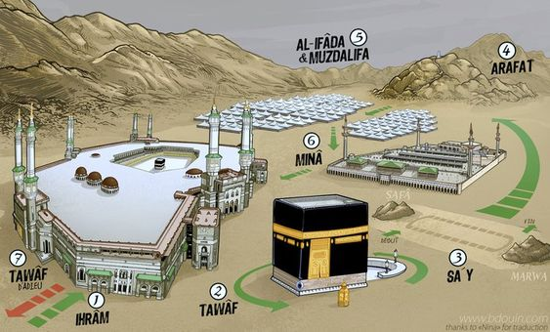

Slide 44
