Slide 1
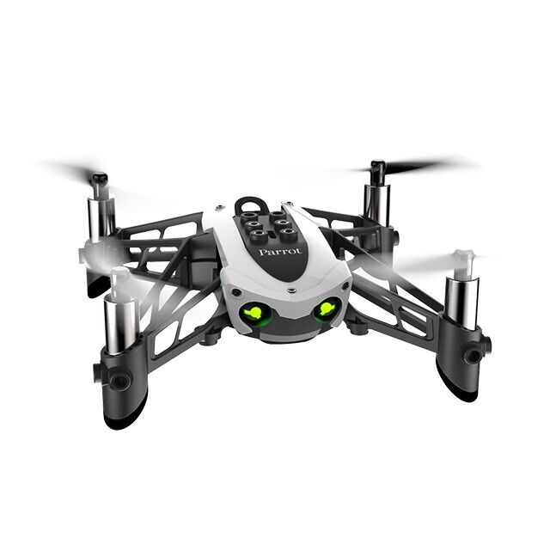
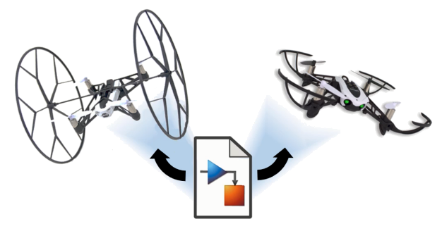
Reinforcement Learning for Parrot Mambo Minidrone Attitude Control
Mücahid Rıdvan KAPLAN
Mehmet SAKARYA
Computer Engineering & Hacettepe University
07 Jun, 2024

Slide 2
Introduction
Quadcopter Overview
PID Algorithms
Why RL Algorithms Used
Overview of Related Works
Project Main Idea
Training Algorithms
Training Results & Analyzes
Notes:
Our Project is the controlling of quadcopter angles with RL agent instead of PID controller.
Because PID system is not stable for unknown environment.
We planned to use the DDPG and PPO agents for xy controller and z controller.
Why we chose these two agents ?
Before the Project proposal presentation we searched related literatures and noticed these two agent performance is better than other agents. Therefore we focused these.
We are planning to new reward function that is unlike the literature ones to find an better performance, if possible.

Slide 4
Introduction
Notes:
Our Project is the controlling of quadcopter angles with RL agent instead of PID controller.
Because PID system is not stable for unknown environment.
We planned to use the DDPG and PPO agents for xy controller and z controller.
Why we chose these two agents ?
Before the Project proposal presentation we searched related literatures and noticed these two agent performance is better than other agents. Therefore we focused these.
We are planning to new reward function that is unlike the literature ones to find an better performance, if possible.

Slide 5
Introduction
Notes:
Our Project is the controlling of quadcopter angles with RL agent instead of PID controller.
Because PID system is not stable for unknown environment.
We planned to use the DDPG and PPO agents for xy controller and z controller.
Why we chose these two agents ?
Before the Project proposal presentation we searched related literatures and noticed these two agent performance is better than other agents. Therefore we focused these.
We are planning to new reward function that is unlike the literature ones to find an better performance, if possible.

Slide 6
Introduction
Notes:
Our Project is the controlling of quadcopter angles with RL agent instead of PID controller.
Because PID system is not stable for unknown environment.
We planned to use the DDPG and PPO agents for xy controller and z controller.
Why we chose these two agents ?
Before the Project proposal presentation we searched related literatures and noticed these two agent performance is better than other agents. Therefore we focused these.
We are planning to new reward function that is unlike the literature ones to find an better performance, if possible.

Slide 7
Introduction
Notes:
Our Project is the controlling of quadcopter angles with RL agent instead of PID controller.
Because PID system is not stable for unknown environment.
We planned to use the DDPG and PPO agents for xy controller and z controller.
Why we chose these two agents ?
Before the Project proposal presentation we searched related literatures and noticed these two agent performance is better than other agents. Therefore we focused these.
We are planning to new reward function that is unlike the literature ones to find an better performance, if possible.

