Slide 1
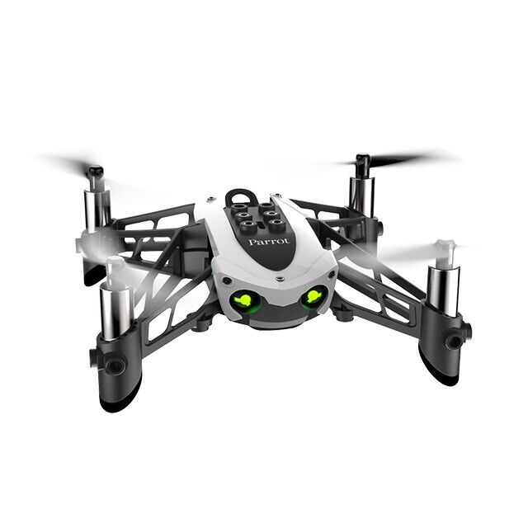
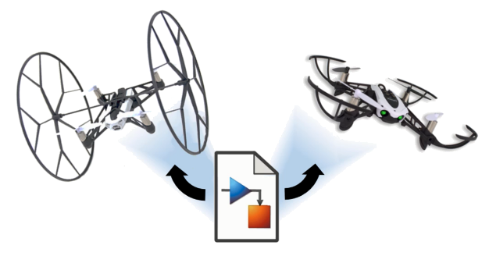
Reinforcement Learning for Parrot Mambo Minidrone Attitude Control
Mücahid Rıdvan KAPLAN
Mehmet SAKARYA
Computer Engineering & Hacettepe University
07 Jun, 2024

Slide 2
Introduction
Quadcopter Overview
PID Algorithms
Why RL Algorithms Used
Training Algorithms
Overview of Related Works
Project Overview
Training Results & Analyzes
Notes:
Our Project is the controlling of quadcopter angles with RL agent instead of PID controller.
Because PID system is not stable for unknown environment.
We planned to use the DDPG and PPO agents for xy controller and z controller.
Why we chose these two agents ?
Before the Project proposal presentation we searched related literatures and noticed these two agent performance is better than other agents. Therefore we focused these.
We are planning to new reward function that is unlike the literature ones to find an better performance, if possible.

Slide 3
Quadcopter Overview

Slide 4
PID Algorithms

Slide 5
Why RL Algorithms Used

Slide 6
Training Algorithms
1- Deep Deterministic Policy Gradient Algorithm (DDPG)

Slide 7
2- Proximal Policy Optimization (PPO)

Slide 8
Literature-1 Overview

Slide 9
Literature-1 Results

Slide 10
Literature-2 Overview

Slide 11
Literature-2 Results

Slide 12
Simulink Environment of Project

Slide 13
Flight Control System Block

Slide 14
Roll-Pitch RL Agent

Slide 15
Trainig Results

Slide 20
Analysis of Results

Slide 21
Conclusions

Slide 22
References

Slide 23
Thanks for Listening.

