Slide 1
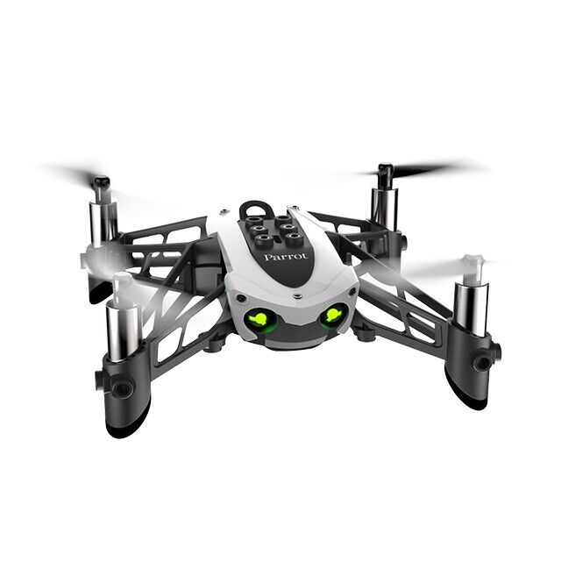
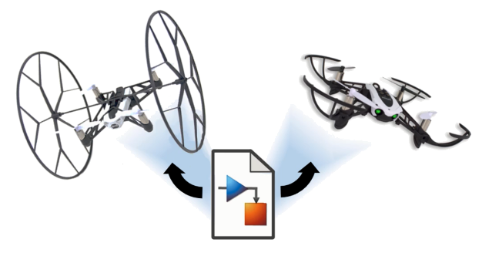
Reinforcement Learning for Parrot Mambo Minidrone Attitude Control
Mücahid Rıdvan KAPLAN
Mehmet SAKARYA
Computer Engineering & Hacettepe University
07 Jun, 2024

Slide 2
Introduction
Quadcopter Overview
PID Algorithms
Why RL Algorithms Used
Training Algorithms
Overview of Related Works
Project Overview
Training Results & Analyzes
Notes:
Our Project is the controlling of quadcopter angles with RL agent instead of PID controller.
Because PID system is not stable for unknown environment.
We planned to use the DDPG and PPO agents for xy controller and z controller.
Why we chose these two agents ?
Before the Project proposal presentation we searched related literatures and noticed these two agent performance is better than other agents. Therefore we focused these.
We are planning to new reward function that is unlike the literature ones to find an better performance, if possible.

Slide 3
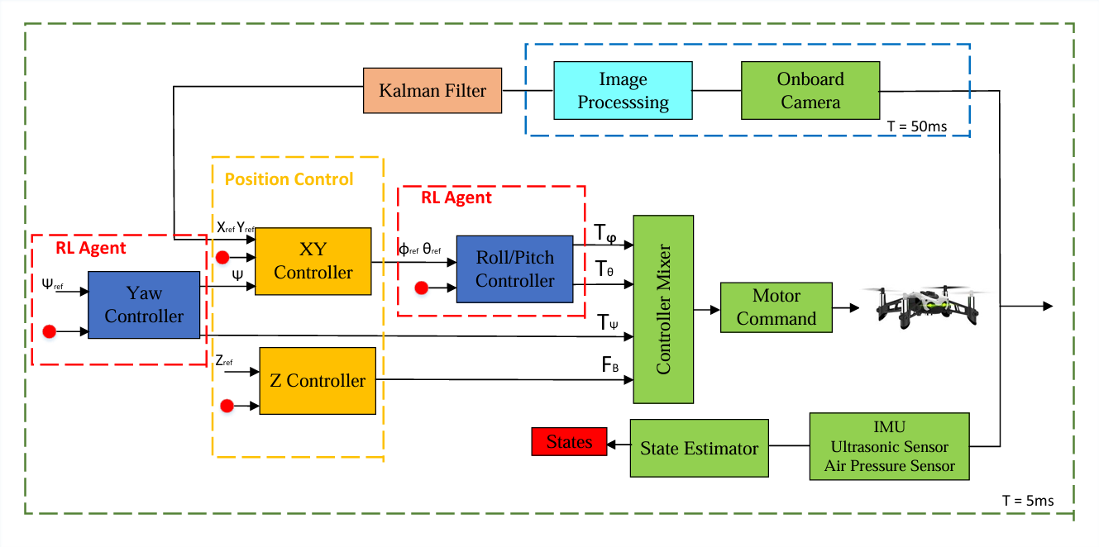
Quadcopter Overview

Slide 4
PID Algorithms
Limitations in Varying Environments
PID controllers struggle with unknown dynamics such as wind and voltage sag.
Adaptability Requirement
Next-gen systems need to adapt to mutable dynamics and varying environments.
Performance in Stable Environments
PID controllers perform close to ideally in stable conditions.

Slide 5
Why RL Algorithms Used
Advantages
Self-Learning: RL agents learn control strategies through trial and error in a simulated environment, reducing manual tuning.
Adaptability: RL agents can adapt to changing environments and new tasks by continuously learning from experience.

Slide 6
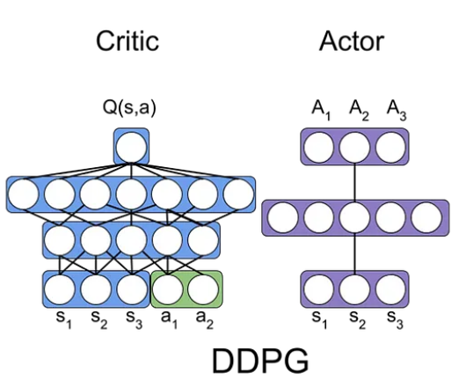
Training Algorithms
1- Deep Deterministic Policy Gradient Algorithm (DDPG)
Model-free, online, off-policy reinforcement learning method
DDPG agent is an actor-critic reinforcement learning agent
Actor: takes state and returns corresponding actions
Critic: takes observation and action as input and return corresponding expectation of the long term reward

Slide 7
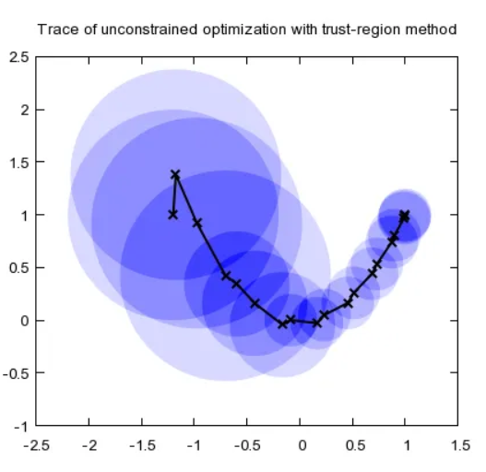
2- Proximal Policy Optimization (PPO)
Model-free, online, on-policy, policy gradient reinforcement learning algorithm
Working process is
Decide step size α
Construct a circle with radius α (trust region)
Once having the best point, determine the direction
Repeat until the optimal point is reached

Slide 8
Literature-1 Overview

Slide 9
Literature-1 Results

Slide 10
Literature-2 Overview

Slide 11
Literature-2 Results

Slide 12
Simulink Environment of Project

Slide 13
Flight Control System Block

Slide 14
Roll-Pitch RL Agent

Slide 15
Trainig Results

Slide 20
Analysis of Results

Slide 21
Conclusions

Slide 22
References

Slide 23
Thanks for Listening.

