Slide 1
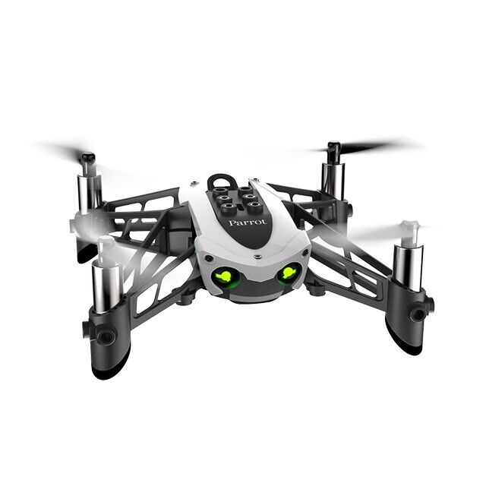
Reinforcement Learning for Parrot Mambo Minidrone Attitude Control
Mücahid Rıdvan KAPLAN
Mehmet SAKARYA
Computer Engineering & Hacettepe University
09 May, 2024

Slide 2
Project Description
Control algorithm of the quadcopter for roll - pitch and yaw angles are made by using the PID control systems.
PID control system dynamics is not stable for unknown environments
In this project RL algorithm approaches planned instead of the PID controller by using 2 different RL agents.
2 different agent will be used for xy controller and z controller for 2 stages
Creating a new reward function is harder than the implementing that agent.

Slide 3
Simulink Environment of Project

Slide 4
Flight Control System Block

Slide 5
Roll & Pitch PID Attitude Controller

Slide 6

Roll & Pitch RL Agent
${\text{r}}_{t}$= -clip(sum(|${\text{e}}_{t}$|/3 ${\text{Ω}}_{max}$,0,1)
Observation States
Roll angle reference
Pitch angle reference
Estimated Roll angle
Estimated Pitch angle
Estimated Roll body rate
Estimated Pitch body rate
Action States
Tau Pitch
Tau Roll

Slide 7
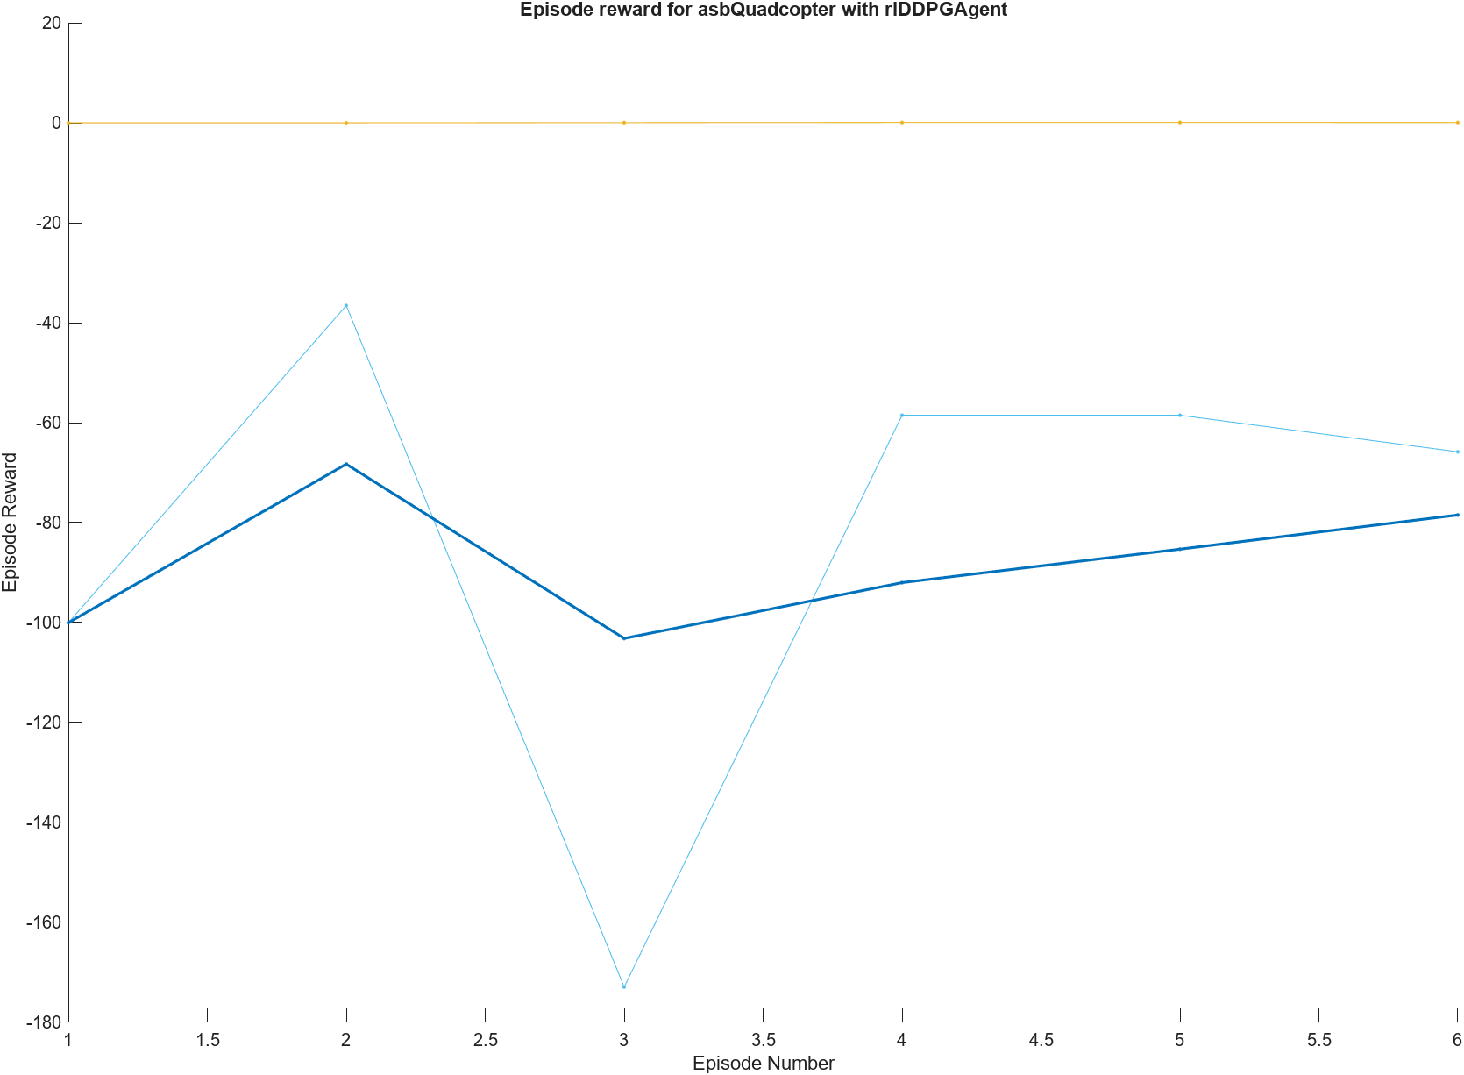
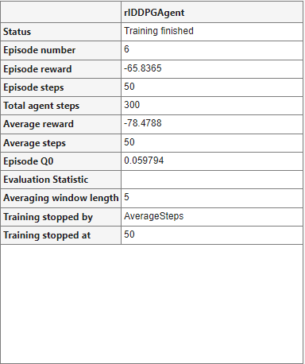
Agent Training

Slide 8
Future Plans & Progress
Solving training problems
Limiting the observation and action blocks
Implementing 2 different DDPG and PPO algorithms together
Agent configuration parameter values search
Searching and comparing layer affect

Slide 9
Thanks for listening.

