Slide 1
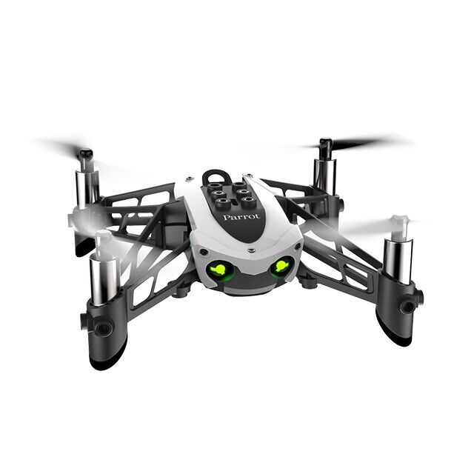
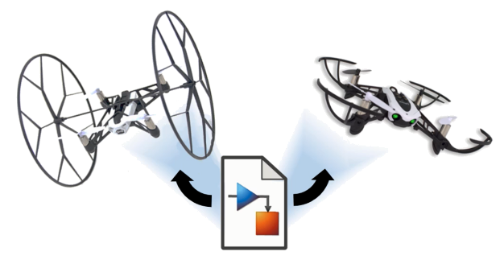
Reinforcement Learning for Parrot Mambo Minidrone Attitude Control
Mücahid Rıdvan KAPLAN
Mehmet SAKARYA
Computer Engineering & Hacettepe University
09 May, 2024

Slide 2
Introduction
Control algorithm of the quadcopter for roll - pitch and yaw angles are made by using the PID control systems.
PID control system dynamics is not stable for unknown environments
In this project RL algorithm approaches planned instead of the PID controller by using 2 different RL agents.
2 different agent will be used for xy controller and z controller for 2 stages
Creating a new reward function is harder than the implementing that agent.
Notes:
Our Project is the controlling of quadcopter angles with RL agent instead of PID controller.
Because PID system is not stable for unknown environment.
We planned to use the DDPG and PPO agents for xy controller and z controller.
Why we chose these two agents ?
Before the Project proposal presentation we searched related literatures and noticed these two agent performance is better than other agents. Therefore we focused these.
We are planning to new reward function that is unlike the literature ones to find an better performance, if possible.

Slide 3
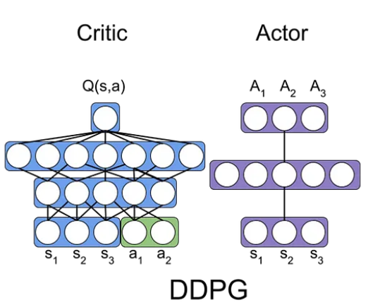
Deep Deterministic Policy Gradient (DDPG) Algorithm
Model-free, online, off-policy reinforcement learning method
DDPG agent is an actor-critic reinforcement learning agent
Actor: takes state and returns corresponding actions
Critic: takes observation and action as input and return corresponding expectation of the long term reward
Notes:
Actor-critic 🡪 searches for an optimal policy that maximizes the expected cumulative long-term reward.
How DDPG (Deep Deterministic Policy Gradient) Algorithms works in reinforcement learning ? | by Amaresh Marekar | Medium
Actor : decides by selecting actions based on the current policy (policy is modelled)
explores the action space to maximize reward
Critic : value function , evaluates the actions
estimates the value of actions by providing feedback on their performance

Slide 4
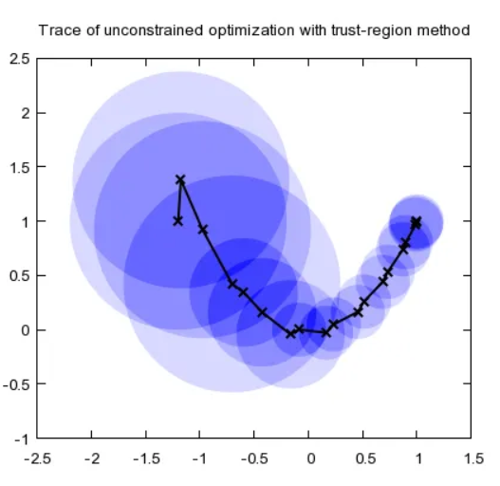
Trust Region Policy Optimization (TRPO) Algorithm
Model-free, online, on-policy, policy gradient reinforcement learning algorithm
Working process is
Decide step size α
Construct a circle with radius α (trust region)
Once having the best point, determine the direction
Repeat until the optimal point is reached

Slide 5
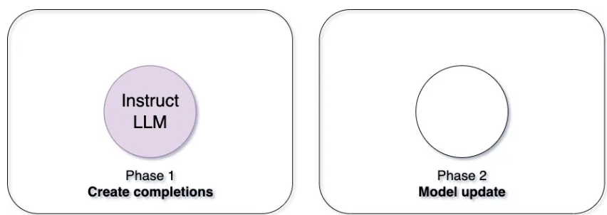
Proximal Policy Optimization (PPO) Algorithm
3 main advantages:
Simplicity
Stability
Sample efficiency
Easier to implement and tune while performing well in challenging environments.
Instead of making big changes all at once, PPO encourages small and gradual improvements.
Notes:
“Proximal” means staying close to the original style
“Policy Optimization” is about finding better strategies.

Slide 6
Article 1 – RL for UAV attitude control
Specific Focus
Deep dive into the accuracy and precision of attitude control using intelligent flight controllers trained with RL.
Training Environment
Introduction of GymFC, an OpenAI Environment, designed for training intelligent flight control systems.
RL Application
Application of RL algorithms for attitude control and their potential transfer to physical hardware.
Koch, William, et al. "Reinforcement learning for UAV attitude control." ACM Transactions on Cyber-Physical Systems 3.2 (2019): 1-21.
Notes:
As an alternative way to the supervised learning method to make intelligent flight control system is using the RL algorithms as this projects main aim.
This Project focuses on intelligent flight controller with RL algorithms to make better accuracy and precision of attitude control.

Slide 7
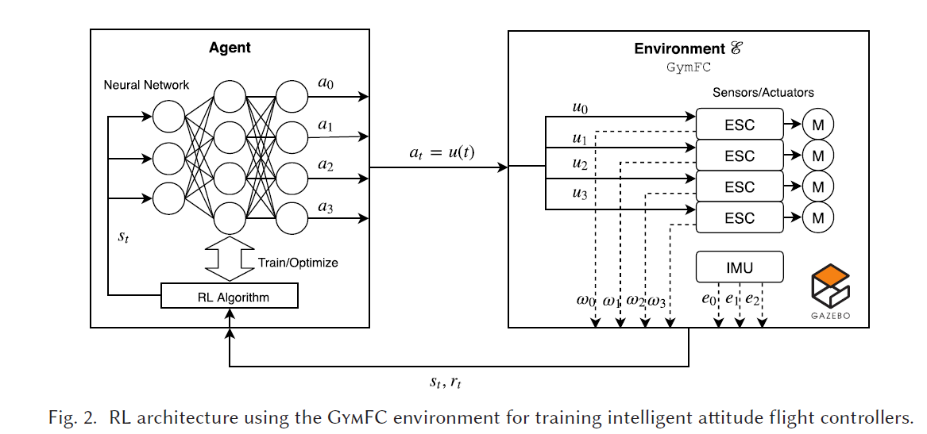
Environment

Slide 8
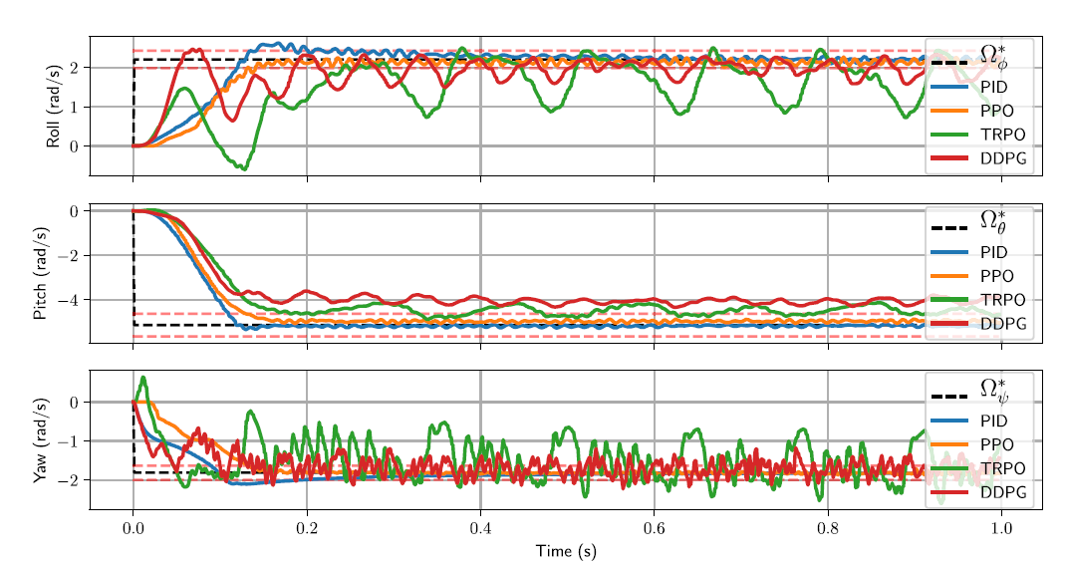
Results

Slide 9
Article 2 – Attitude Control of Quad-copter using DPGA
Specific Focus
Controlling the quadcopter by using DDPG & D4PG RL algorithms.
Training Environment
GymFC for training intelligent flight control of quadcopter.
RL Application
Comparative analysis of the performance of DDPG &D4PG algorithms in terms of reward generation, actor loss, and critic performance.
Ghouri, Usama Hamayun, et al. "Attitude control of quad-copter using deterministic policy gradient algorithms (DPGA)." 2019 2nd International Conference on Communication, Computing and Digital systems (C-CODE). IEEE, 2019.

Slide 10
DDPG & D4PG Algorithms
DDPG: Deep Deterministic Policy Gradient
D4PG : Distributed Distributional Deterministic Policy Gradient
Extended and enhanced algorithm of DDPG for improving :
Stability
Sample efficiency
Performance

Slide 11
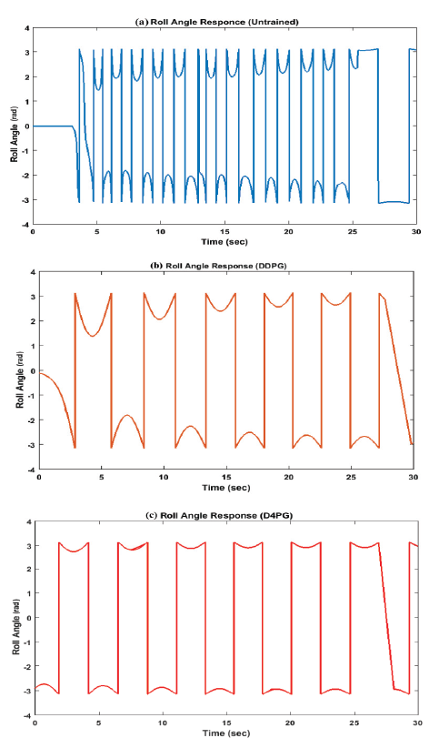
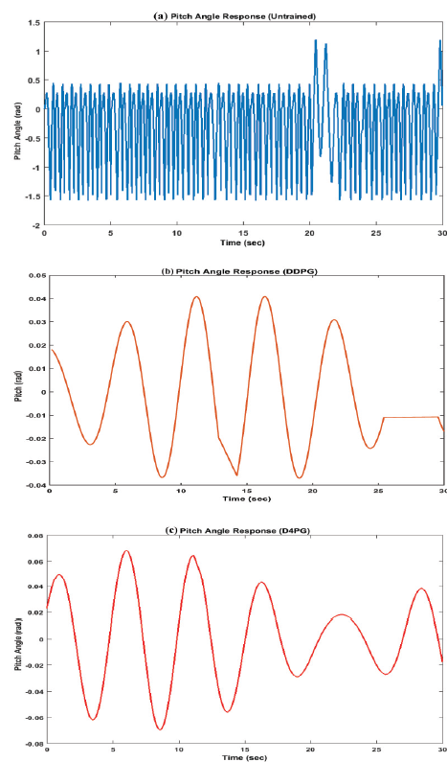
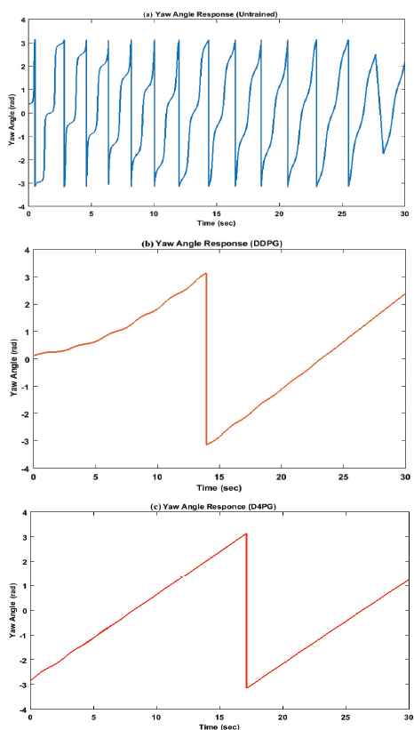
Angle Stabilization Performances

Slide 12
Simulink Environment of Project
Notes:
This is the our Project environment at Simulink platform. Each block responsible for different tasks.
Signal Editor : It generates position and attitude commands
Sensors : It includes the model of sensors such as IMU on the quadcopter
Flight Control System : It is responsible for position and attitude control. Here, we will perform attitude control using RL (Reinforcement Learning)
Environment : It includes gravity, air temperature, speed of sound, pressure, air density, and magnetic field
Airframe : It contains the nonlinear model of the quadcopter
Visualization: : It facilitates logging and scoping of commands, control signals, and states, it contains also workspace and Simulink 3D animation.

Slide 13
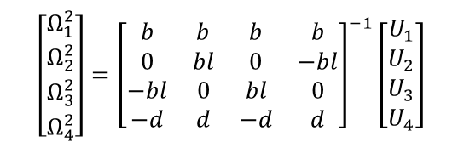

Flight Control System Block
$$\begin{aligned}&\left.F_{thrust }^{B}=b(Ω_{1}^{2}+Ω_{2}^{2}+Ω_{3}^{2}+Ω_{4}^{2}\right) \\ &τ_{φ}=bl\left(Ω_{3}^{2}−Ω_{1}^{2}\right) \\ &τ_{φ}=bl\left(Ω_{4}^{2}−Ω_{2}^{2}\right) \\ &\left.τ_{ψ}=d(Ω_{2}^{2}+Ω_{4}^{2}−Ω_{1}^{2}−Ω_{3}^{2}\right)\end{aligned}$$
$$\left[\begin{matrix}Ω_{1}^{2} \\ Ω_{2}^{2} \\ Ω_{3}^{2} \\ Ω_{4}^{2}\end{matrix}\right]={\left[\begin{matrix}b & b & b & b \\ 0 & bl & 0 & −bl \\ −bl & 0 & bl & 0 \\ −d & d & −d & d\end{matrix}\right]}^{−1}\left[\begin{matrix}U_{1} \\ U_{2} \\ U_{3} \\ U_{4}\end{matrix}\right]$$
Notes:
This is the flight control system block that we focused one.
The orange blocks are normally controlled with PID controller. However, we added inside these blocks RL agents.
Our plan was firstly run the environment with PID controlling blocks. And this worked fine
After then changed one of the blocks with RL agent and trained. We did not change both of these blocks simultaneously. If it is done simultaneously agent training itself wrongly due to the two unknown dynamic struct
$b$ is the thrust coefficient, $l$ $distance between the Parrot Mambo^{′}s center of gravity and rotors$, and $Ω_{i}$ is the angular velocity

Slide 14


Roll & Pitch PID Attitude Controller
$$τ_{φ}=bl\left(Ω_{3}^{2}−Ω_{1}^{2}\right)$$
$$τ_{φ}=bl\left(Ω_{4}^{2}−Ω_{2}^{2}\right)$$
Notes:
This is PID control block for roll and pitch attitude controller for quadcopter. Additionally, back calculation was used as an anti wind up method. The PID Controller's output creates pitch and roll torque commands.
…………………………………….

Slide 15



Roll & Pitch RL Agent
$$τ_{φ}=bl\left(Ω_{3}^{2}−Ω_{1}^{2}\right)$$
$$τ_{φ}=bl\left(Ω_{4}^{2}−Ω_{2}^{2}\right)$$
Observation States
Roll angle reference
Pitch angle reference
Estimated Roll angle
Estimated Pitch angle
Estimated Roll body rate
Estimated Pitch body rate
Action States
Tau Pitch
Tau Roll
${\text{r}}_{t}$= -clip(sum(|${\text{e}}_{t}$|/3 ${\text{Ω}}_{max}$,0,1)
Notes:
This is the agent and its environment block for roll and pitch attitude control.
Input parameters are observation, reward Function and flag. the output is the action.

Slide 16
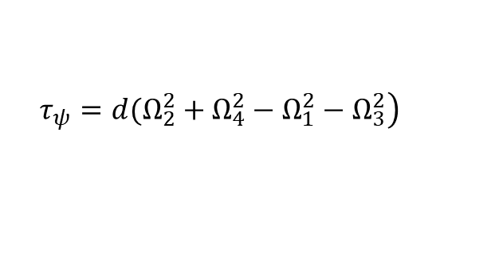
Yaw PD Attitude Controller
$$\left.τ_{ψ}=d(Ω_{2}^{2}+Ω_{4}^{2}−Ω_{1}^{2}−Ω_{3}^{2}\right)$$
Notes:
This is PD control block for yaw attitude controller for quadcopter. We generally aim to keep the yaw controller at 0 degree angle.

Slide 17
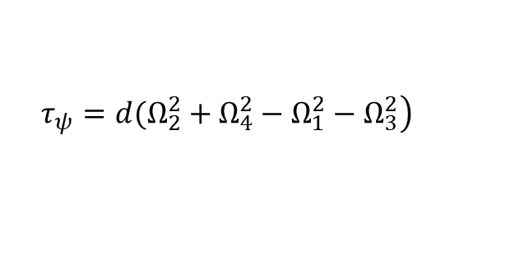
Yaw RL Agent
$$\left.τ_{ψ}=d(Ω_{2}^{2}+Ω_{4}^{2}−Ω_{1}^{2}−Ω_{3}^{2}\right)$$
Observation States
Yaw angle reference
Estimated Yaw angle
Estimated Yaw body rate
Action State
Tau Yaw
${\text{r}}_{t}$= -clip(sum(|${\text{e}}_{t}$|/3 ${\text{Ω}}_{max}$,0,1)
Notes:
This is the agent and its environment block for yaw attitude control.
Input parameters are observation, reward Function and flag. the output is the action.

Slide 18
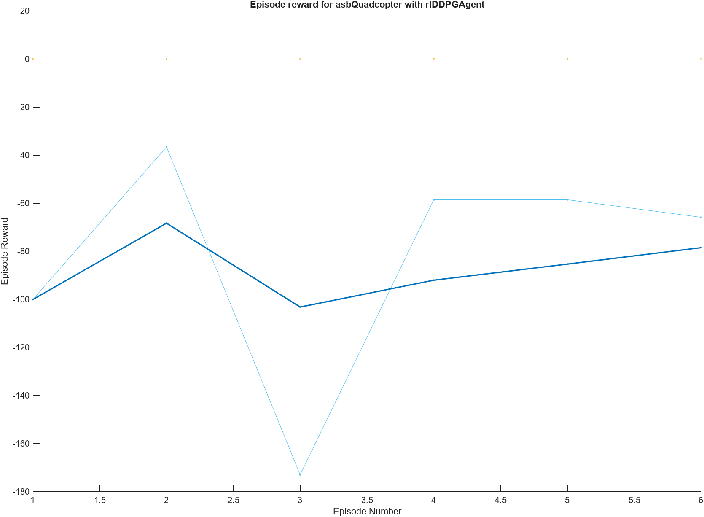
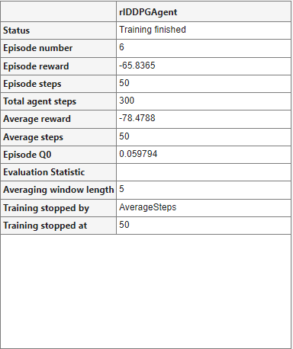
Agent Training
Notes:
This is our first output of trained RL agent.
This is not an true for us for this because we only focused to obtain some data from the agent block.
This is trained with 6 episodes. This is not enough and episodes will be more and more to obtain better training agent.
This agent is negative because of the reward function which is multiplied by -1.
While the actions close to the desired positions, reward will be around 0.

Slide 19
Command Generation for Task
Notes:
Here, it is planned to give attitude control performance tests x and y position references instead of giving direct roll, pitch, yaw angle references. Because a constant roll angle causes the quadcopter to go quickly in the y direction, and a constant pitch angle causes the quadcopter to go quickly in the x direction. For this reason, we will calculate the performance of attitude control, which actually always works in its inner loop, by giving xy position commands, with performance indexes such as integral absolute error and integral square error.
In this slide, the patterns we plan to give as xy position commands are given.

Slide 20
Future Plans & Progress
Solving training problems
Limiting the observation and action blocks
Implementing 2 different DDPG and PPO algorithms together
Agent configuration parameter values search
Searching and comparing layer affect
Notes:
Up to this point we created the running environment without any problem with PID system.
Agent trainig and optimizing reward function trials started and continue but has some problems. Therefore we will solve the training problems soon.
Observation and action block parameters was not limited and should be limited.
We have chosen DDPG and PPO algorithms. These algorithms will be worked together simultaneously in the final version of the project.
Whatever the agent is configuration parameters should be configured. This parameters configure the agent. Therefore, we will search this affects our agents.
Layer affect also another parameter that affect the agent this will be searched. For this now we are using 128? layer.

Slide 21
Thanks for listening.

