Slide 1
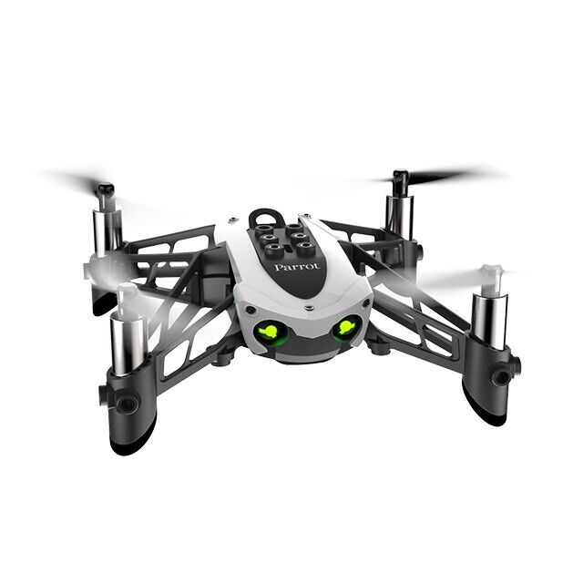
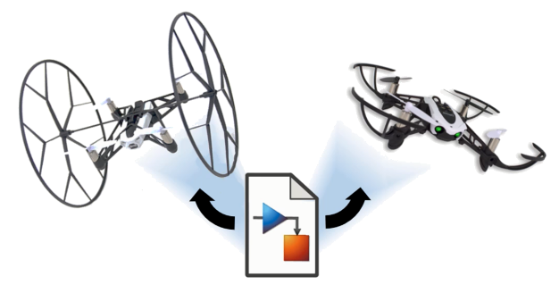
Reinforcement Learning for Parrot Mambo Minidrone Attitude Control
Mücahid Rıdvan KAPLAN
Mehmet SAKARYA
Computer Engineering & Hacettepe University
09 May, 2024

Slide 2
Introduction
Control algorithm of the quadcopter for roll - pitch and yaw angles are made by using the PID control systems.
PID control system dynamics is not stable for unknown environments
In this project RL algorithm approaches planned instead of the PID controller by using 2 different RL agents.
2 different agent will be used for xy controller and z controller for 2 stages
Creating a new reward function is harder than the implementing that agent.
Notes:
Our Project is the controlling of quadcopter angles with RL agent instead of PID controller.
Becasue PID system is not stable for unknown environment.
We planned to use the DDPG and PPO agents for xy controller and z controller.
Why we chose these two agents ?
Before the Project proposal presentation we searched related literatures and noticed these two agent performance is better than other agents. Therefore we focused these.
We are planning to new reward function that is unlike the literatüre ones to find an better performance, if posiible.

Slide 3
Simulink Environment of Project
Notes:
This is the our Project environment at Simulink platform. Each block responsible for different tasks.
Signal Editor : AC command are creted
Sensors : ……………………………….
Flight Control System : ………………………………….
Environment : ………………………………
Airframe : ………………………………

Slide 4
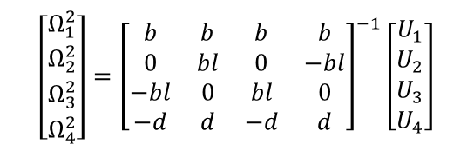

Flight Control System Block
$$\begin{aligned}&\left.F_{thrust }^{B}=b(Ω_{1}^{2}+Ω_{2}^{2}+Ω_{3}^{2}+Ω_{4}^{2}\right) \\ &τ_{φ}=bl\left(Ω_{3}^{2}−Ω_{1}^{2}\right) \\ &τ_{φ}=bl\left(Ω_{4}^{2}−Ω_{2}^{2}\right) \\ &\left.τ_{ψ}=d(Ω_{2}^{2}+Ω_{4}^{2}−Ω_{1}^{2}−Ω_{3}^{2}\right)\end{aligned}$$
$$\left[\begin{matrix}Ω_{1}^{2} \\ Ω_{2}^{2} \\ Ω_{3}^{2} \\ Ω_{4}^{2}\end{matrix}\right]={\left[\begin{matrix}b & b & b & b \\ 0 & bl & 0 & −bl \\ −bl & 0 & bl & 0 \\ −d & d & −d & d\end{matrix}\right]}^{−1}\left[\begin{matrix}U_{1} \\ U_{2} \\ U_{3} \\ U_{4}\end{matrix}\right]$$
Notes:
This is the flight control system block that we focused one.
The orange blocks are normally controlled with PID controller. However, we added inside these blocks RL agents.
Our plan was firstly run the environment with PID controling blocks. And this worked fine
After then changed one of the blocks with RL agent and trained . We did not change both of these blocks simultaneously. If it is done simultaneously agent training itself wrongly due to the two unknown
dynamic struct

Slide 5
Roll & Pitch PID Attitude Controller
Notes:
This is PID control block for attitude controller for quadcopter.
…………………………………….

Slide 6

Roll & Pitch RL Agent
Observation States
Roll angle reference
Pitch angle reference
Estimated Roll angle
Estimated Pitch angle
Estimated Roll body rate
Estimated Pitch body rate
Action States
Tau Pitch
Tau Roll
${\text{r}}_{t}$= -clip(sum(|${\text{e}}_{t}$|/3 ${\text{Ω}}_{max}$,0,1)
Notes:
This is the agent and its environment block.
Input parameters are observation, reward Function and flag. the output is the action.

Slide 7
Yaw PD Attitude Controller
Notes:
This is PD control block for yaw attitude controller for quadcopter.
…………………………………….

Slide 8
Yaw RL Agent
Observation States
Yaw angle reference
Estimated Yaw angle
Estimated Yaw body rate
Action State
Tau Yaw
${\text{r}}_{t}$= -clip(sum(|${\text{e}}_{t}$|/3 ${\text{Ω}}_{max}$,0,1)
Notes:
This is the agent and its environment block.
Input parameters are observation, reward Function and flag. the output is the action.

Slide 9
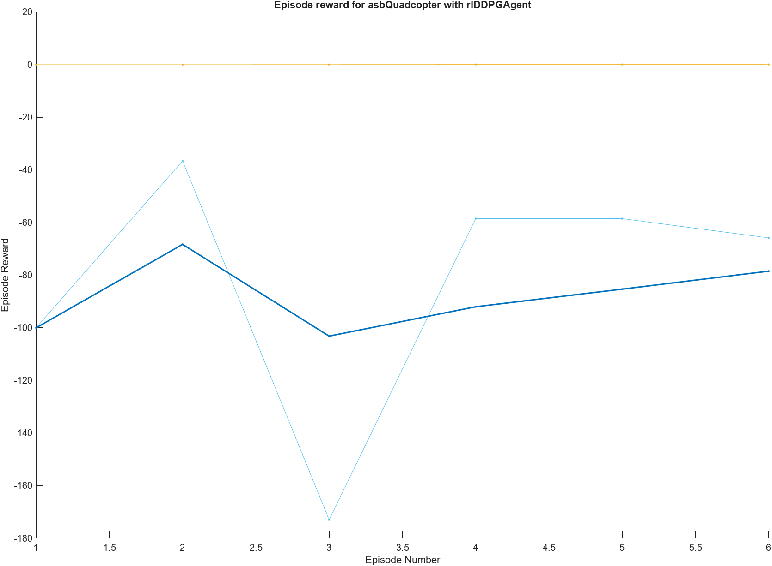
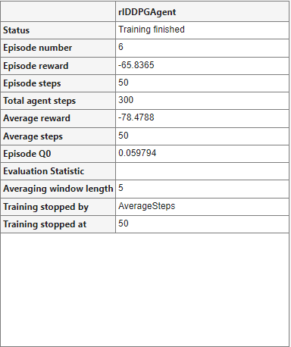
Agent Training
Notes:
This is our first output of trained RL agent.
This is not an true for us for this because we only focused to obtain some data from the agent block.
This is trained with 6 episodes. This is not enough and episodes will be more and more to obtain better training agent.
This agent is negative because of the reward function which is multiplied by -1.
While the actions close to the desired positions, reward will be around 0.

Slide 10
Command Generation for Task

Slide 11
Future Plans & Progress
Solving training problems
Limiting the observation and action blocks
Implementing 2 different DDPG and PPO algorithms together
Agent configuration parameter values search
Searching and comparing layer affect
Notes:
Up to this point we created the running environment without any problem with PID system.
Agent trainig and optimizing reward function trials started and continue but has some problems. Therefore we will solve the training problems soon.
Observation and action block parameters was not limited and should be limited.
We have chosen DDPG and PPO algorithms. These algorithms will be worked together simultaneously in the final version of the project.
Whatever the agent is configuration parameters should be configured. This parameters configure the agent. Therefore, we will search this affects our agents.
Layer affect also another parameter that affect the agent this will be searched. For this now we are using 128? layer.

Slide 12
Thanks for listening.

