Slide 1
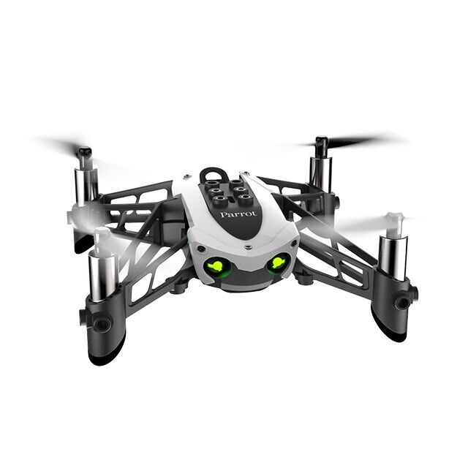
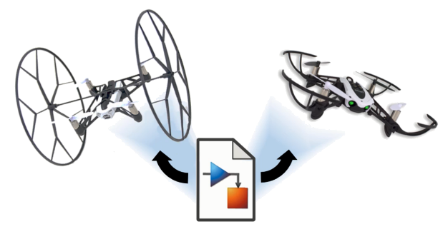
Reinforcement Learning for Parrot Mambo Minidrone Attitude Control
Mücahid Rıdvan KAPLAN
Mehmet SAKARYA
Computer Engineering & Hacettepe University
07 Jun, 2024

Slide 2
Outline
Introduction and Problem Statement
DDPG and PPO Reinforcement Learning Algorithms
Literature Review (Related Works)
Quadcopter Flight Simulation Model
Flight Control System Structure
Results
Conclusion and Contributions
Notes:
Our presentation will follow this outline: Firstly, we will discuss the introduction and problem statement. Then, we will briefly overview some RL algorithms commonly used in quadcopters. We will simulate the RL agent using the concept of feedback control in control theory. We will summarize two articles briefly through a literature review. We will describe the proposed quadcopter simulation model and flight control system structure. Finally, we will discuss the project's stages, expected results, and contributions to the literature before concluding the presentation.

Slide 3
Outline
Introduction and Problem Statement
Some Reinforcement Learning Algorithms
Literature Review (Related Works)
Quadcopter Flight Simulation Model
Flight Control System Structure
Results
Conclusion and Contributions
Notes:
Our presentation will follow this outline: Firstly, we will discuss the introduction and problem statement. Then, we will briefly overview some RL algorithms commonly used in quadcopters. We will simulate the RL agent using the concept of feedback control in control theory. We will summarize two articles briefly through a literature review. We will describe the proposed quadcopter simulation model and flight control system structure. Finally, we will discuss the project's stages, expected results, and contributions to the literature before concluding the presentation.

Slide 4
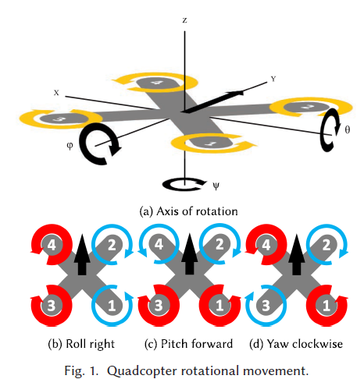
Introduction
Flight control systems generally composed of;
Position & altitude control
Speed control
Navigation control
Attitude control
PID (Proportional-Integral-Derivative) controllers are used due to their simplicity, stability and real time response capabilities.
While PID systems adequate for lots of operations, it has some challenges.
Notes:
We worked with the drone control systems. These systems composed of different control algorithms. We aimed to control the attitude controller.
This controller is made by using the PID controller . However, PID controllers have some limitations.

Slide 5
PID Algorithms
Limitations in Varying Environments
PID controllers struggle with unknown dynamics such as wind and voltage sag.
Adaptability Requirement
Next-gen systems need to adapt to mutable dynamics and varying environments.
Performance in Stable Environments
PID controllers perform close to ideally in stable conditions.
Notes:
PID controllers sensitive to varying environment conditions. Therefore, at the different environment, climate or mission conditions flight perfromance fall seriously.

Slide 6
Why RL Algorithms Used
Advantages
Self-Learning: RL agents learn control strategies through trial and error in a simulated environment, reducing manual tuning.
Adaptability: RL agents can adapt to changing environments and new tasks by continuously learning from experience.
Notes:
When we look at why we used RL algorithms, Their advantages are self learning mechanism and adaptability. Reinforcement learning is an machine learning subfield and hence it has capable to learn by training. And this training make it adapts to varying environment conditions easily.

Slide 7
Outline
Introduction and Problem Statement
DDPG and PPO Reinforcement Learning Algorithms
Literature Review (Related Works)
Quadcopter Flight Simulation Model
Flight Control System Structure
Results
Conclusion and Contributions
Notes:
Our presentation will follow this outline: Firstly, we will discuss the introduction and problem statement. Then, we will briefly overview some RL algorithms commonly used in quadcopters. We will simulate the RL agent using the concept of feedback control in control theory. We will summarize two articles briefly through a literature review. We will describe the proposed quadcopter simulation model and flight control system structure. Finally, we will discuss the project's stages, expected results, and contributions to the literature before concluding the presentation.

Slide 8
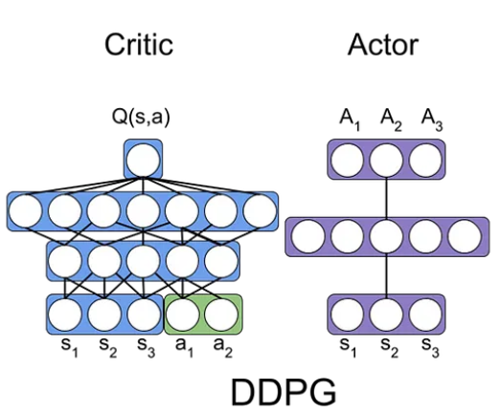
Deep Deterministic Policy Gradient Algorithm (DDPG)
Model-free, online, off-policy reinforcement learning method
DDPG agent is an actor-critic reinforcement learning agent
Actor: takes state and returns corresponding actions
Critic: takes observation and action as input and return corresponding expectation of the long term reward
Notes:
One of the most common used method is DDPG algorithm. It is an continuous system and therefore usable in the UAV’s
It consists of the actor and critic networks. Actor network takes the states and returns actions.
Critic network gets the state and action as input and returns the best action. This best action evaluated with the long term rewards.

Slide 9
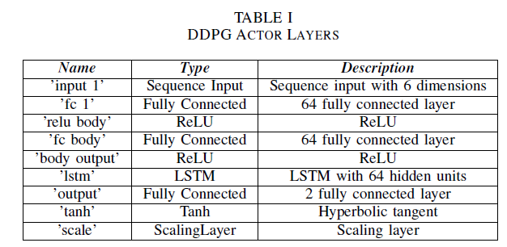
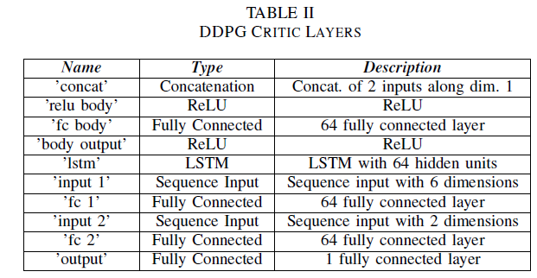
Deep Deterministic Policy Gradient Algorithm (DDPG)

Slide 10
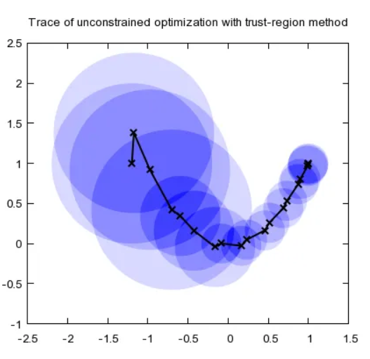
Proximal Policy Optimization (PPO)
Model-free, online, on-policy, policy gradient reinforcement learning algorithm
Working process is
Decide step size α
Construct a circle with radius α (trust region)
Once having the best point, determine the direction
Repeat until the optimal point is reached
Notes:
PPO algorithm also have actor-critic networks and it is continuous space agent.
Its working principle is based on small steps in the trusted region. It’s direction is determined when the best point is found in the circular. Once best point is found new trust region appears and again struggles to find best point. This process continue untill optimal,target, point is found.

Slide 11
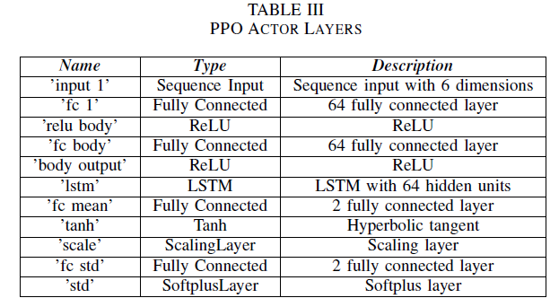
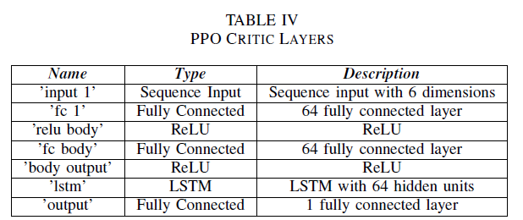
Proximal Policy Optimization (PPO)
Notes:
DDPG PPO actor critic figürleri alınacak

Slide 12
Outline
Introduction and Problem Statement
DDPG and PPO Reinforcement Learning Algorithms
Literature Review (Related Works)
Quadcopter Flight Simulation Model
Flight Control System Structure
Results
Conclusion and Contributions
Notes:
Our presentation will follow this outline: Firstly, we will discuss the introduction and problem statement. Then, we will briefly overview some RL algorithms commonly used in quadcopters. We will simulate the RL agent using the concept of feedback control in control theory. We will summarize two articles briefly through a literature review. We will describe the proposed quadcopter simulation model and flight control system structure. Finally, we will discuss the project's stages, expected results, and contributions to the literature before concluding the presentation.

Slide 13
Literature-1 Overview
Specific Focus
Deep dive into the accuracy and precision of attitude control using intelligent flight controllers trained with RL.
Training Environment
Introduction of GymFC, an OpenAI Environment, designed for training intelligent flight control systems.
RL Application
Application of RL algorithms for attitude control and their potential transfer to physical hardware.
Koch, William, et al. "Reinforcement learning for UAV attitude control." ACM Transactions on Cyber-Physical Systems 3.2 (2019): 1-21.

Slide 14
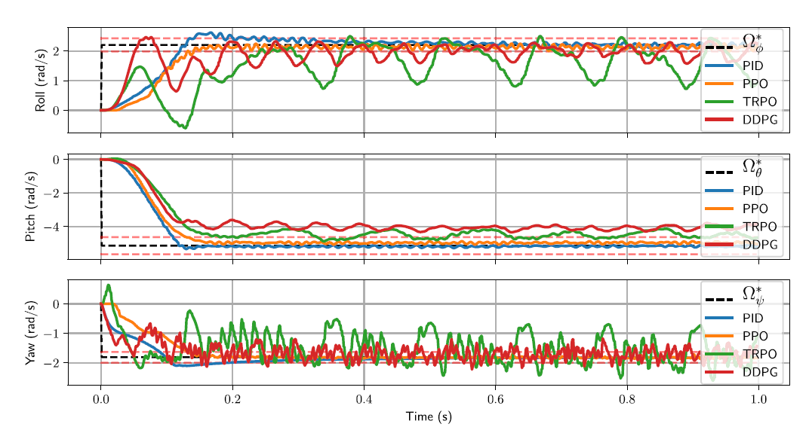
Literature-1 Results

Slide 15
Literature-2 Overview
Specific Focus
Controlling the quadcopter by using DDPG & D4PG RL algorithms.
Training Environment
GymFC for training intelligent flight control of quadcopter.
RL Application
Comparative analysis of the performance of DDPG &D4PG
algorithms in terms of reward generation, actor loss, and critic performance.

Slide 16
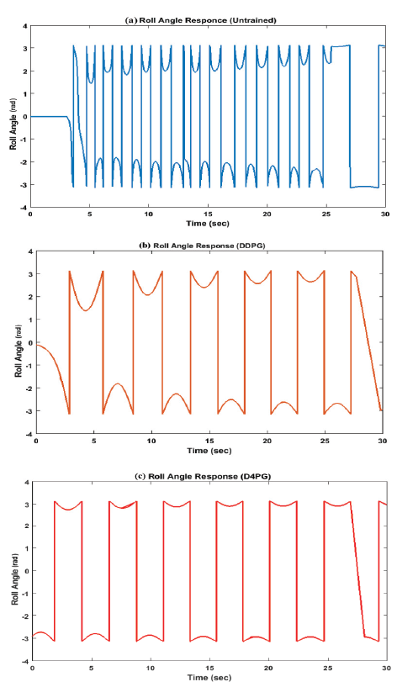
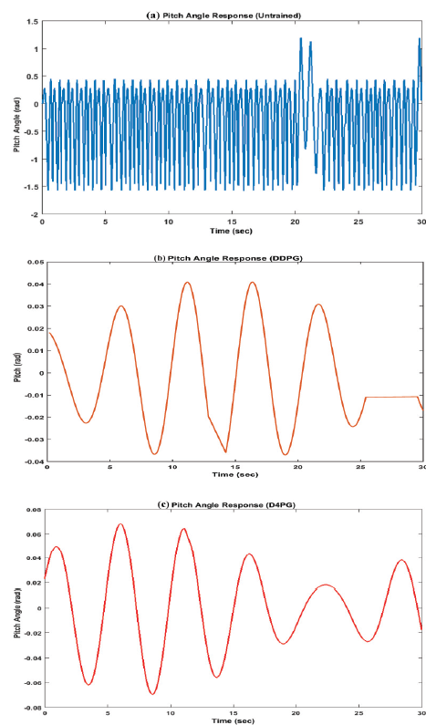
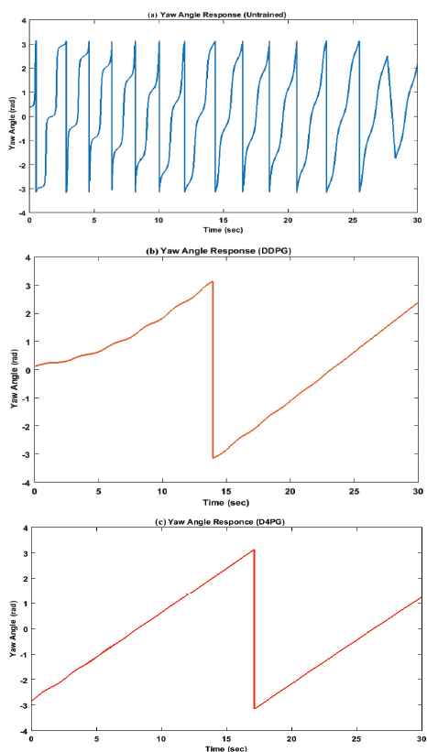
Literature-2 Results

Slide 17
Outline
Introduction and Problem Statement
DDPG and PPO Reinforcement Learning Algorithms
Literature Review (Related Works)
Quadcopter Flight Simulation Model
Flight Control System Structure
Results
Conclusion and Contributions
Notes:
Our presentation will follow this outline: Firstly, we will discuss the introduction and problem statement. Then, we will briefly overview some RL algorithms commonly used in quadcopters. We will simulate the RL agent using the concept of feedback control in control theory. We will summarize two articles briefly through a literature review. We will describe the proposed quadcopter simulation model and flight control system structure. Finally, we will discuss the project's stages, expected results, and contributions to the literature before concluding the presentation.

Slide 18
Simulink Environment of Project
Notes:
This is the our Project environment at Simulink platform. Each block responsible for different tasks.
Signal Editor : It generates position and attitude commands
Sensors : It includes the model of sensors such as IMU on the quadcopter
Flight Control System : It is responsible for position and attitude control. Here, we will perform attitude control using RL (Reinforcement Learning)
Environment : It includes gravity, air temperature, speed of sound, pressure, air density, and magnetic field
Airframe : It contains the nonlinear model of the quadcopter
Visualization: : It facilitates logging and scoping of commands, control signals, and states, it contains also workspace and Simulink 3D animation.

Slide 19
Outline
Introduction and Problem Statement
DDPG and PPO Reinforcement Learning Algorithms
Literature Review (Related Works)
Quadcopter Flight Simulation Model
Flight Control System Structure
Results
Conclusion and Contributions
Notes:
Our presentation will follow this outline: Firstly, we will discuss the introduction and problem statement. Then, we will briefly overview some RL algorithms commonly used in quadcopters. We will simulate the RL agent using the concept of feedback control in control theory. We will summarize two articles briefly through a literature review. We will describe the proposed quadcopter simulation model and flight control system structure. Finally, we will discuss the project's stages, expected results, and contributions to the literature before concluding the presentation.

Slide 20
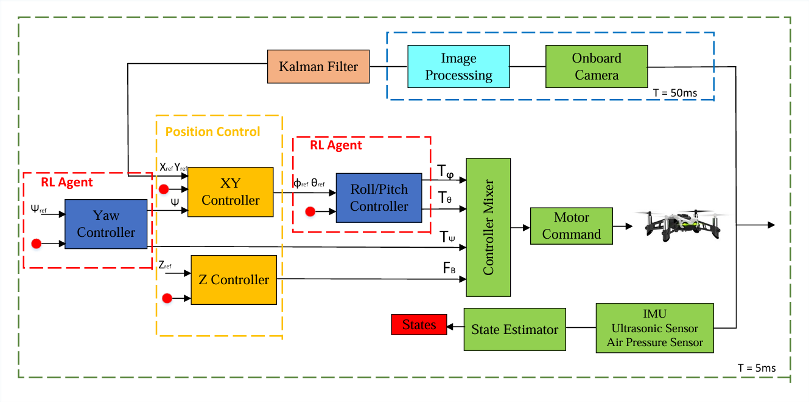
Flight Controller Block
Notes:
This is the flight control system block that we focused one.
The orange blocks are normally controlled with PID controller. However, we added inside these blocks RL agents.
Our plan was firstly run the environment with PID controlling blocks. And this worked fine
After then changed one of the blocks with RL agent and trained. We did not change both of these blocks simultaneously. If it is done simultaneously agent training itself wrongly due to the two unknown dynamic struct

Slide 21


Roll & Pitch RL Agent
$$τ_{\text{θ}}=bl\left(Ω_{3}^{2}−Ω_{1}^{2}\right)$$
$$τ_{φ}=bl\left(Ω_{4}^{2}−Ω_{2}^{2}\right)$$
Observation States
Roll angle error
Pitch angle error
Integral of roll angle error
Integral of pitch angle error
Estimated Roll body rate
Estimated Pitch body rate
Action States
Tau Pitch
Tau Roll
$$r_{1}\left(t\right)=e^{\text{−(0.5|}\text{θ}\text{r}\text{ −}\text{θ}\text{|+0.5|}\text{φ}\text{r}\text{ −}\text{φ}\text{|)}}$$
$$r_{2}\left(t\right)=−({\text{0.3}\text{(}\text{θ}\text{r}\text{ − }\text{θ}\text{)}}^{2}+{0.3\text{(}\text{φ}\text{r}\text{ − }\text{φ}\text{)}}^{2}+0.15\left(\left|p\right|+\left|q\right|\right)+0.1({τ_{\text{θ}}}^{2}+{τ_{φ}}^{2}))$$
$$r_{3}\left(t\right)=−({\text{(}\text{θ}\text{r}\text{ − }\text{θ}\text{)}}^{2}+{\text{(}\text{φ}\text{r}\text{ − }\text{φ}\text{)}}^{2})$$
$$r_{4}\left(t\right)=−(0.5\text{(}\text{θ}\text{r}\text{ − }\text{θ}\text{)}+0.5\text{(}\text{φ}\text{r}\text{ − }\text{φ}\text{)})$$
Notes:
This is the agent and its environment block for roll and pitch attitude control.
Input parameters are observation, reward Function and flag. the output is the action.

Slide 22
Outline
Introduction and Problem Statement
DDPG and PPO Reinforcement Learning Algorithms
Literature Review (Related Works)
Quadcopter Flight Simulation Model
Flight Control System Structure
Results
Conclusion and Contributions
Notes:
Our presentation will follow this outline: Firstly, we will discuss the introduction and problem statement. Then, we will briefly overview some RL algorithms commonly used in quadcopters. We will simulate the RL agent using the concept of feedback control in control theory. We will summarize two articles briefly through a literature review. We will describe the proposed quadcopter simulation model and flight control system structure. Finally, we will discuss the project's stages, expected results, and contributions to the literature before concluding the presentation.

Slide 23
Trainig Results 1
$$r_{1}\left(t\right)=e^{\text{−(0.5|}\text{θ}\text{r}\text{ −}\text{θ}\text{|+0.5|}\text{φ}\text{r}\text{ −}\text{φ}\text{|)}}$$
Notes:
Under normal conditions, the RL reward function is expected to be maximized. We usually observe oscillations in the cumulative reward value. In fact, in some steps, the reward has dropped significantly but then settled back to its previous oscillating value. The average reward is the average of the rewards from 10 episodes.
Reward function: We set the weighting value of roll error and pitch error to 0.5. We reward or penalize both errors equally. When it is 1 divided by exp, as the error approaches zero, the reward will approach 1. If the error goes to infinity, the reward will be 0. By using the exponential term, we limited the error to a value between 0 and 1.
Maximum step is set to 2000, what does this provide us? Each step can be a maximum of 1, so each episode can have a maximum value of 2000. Training stopping criteria is selected as 1500. {we never exceeded 900 and there were instantaneous oscillations}

Slide 24
Trainig Results 2
$$r_{2}\left(t\right)=−({\text{0.3}\text{(}\text{θ}\text{r}\text{ − }\text{θ}\text{)}}^{2}+{0.3\text{(}\text{φ}\text{r}\text{ − }\text{φ}\text{)}}^{2}+0.15\left(\left|p\right|+\left|q\right|\right)+0.1({τ_{\text{θ}}}^{2}+{τ_{φ}}^{2}))$$
Notes:
Due to the squared error terms in the reward function, we penalize the error parabolically as it increases. Additionally, in this reward function, we included body rate values and control signals in the reward, albeit at a low level. Although it seems to have settled at a certain value as a result of this training, we did not actually obtain an agent that stabilizes the quadcopter. Therefore, the drone crashes.

Slide 25
Trainig Results 3
$$r_{3}\left(t\right)=−({\text{(}\text{θ}\text{r}\text{ − }\text{θ}\text{)}}^{2}+{\text{(}\text{φ}\text{r}\text{ − }\text{φ}\text{)}}^{2})$$
Notes:
This time, we determined a reward based solely on the error parameter. However, we were unable to obtain a stable agent. In this graph, it settles to a certain value after a certain step, but that value still does not correspond to a stable agent.

Slide 26
Trainig Results 4
$$r_{4}\left(t\right)=−(0.5\text{(}\text{θ}\text{r}\text{ − }\text{θ}\text{)}+0.5\text{(}\text{φ}\text{r}\text{ − }\text{φ}\text{)})$$
Notes:
Instead of the squared error, we determined the reward by multiplying the absolute error by the same coefficient, but we observed an oscillating reward value as a result of the training. The training process was not successful in the 4th test shown in this presentation either. In fact, we also tuned the actor and critic learning rate values, but the results were not significant.

Slide 27
Outline
Introduction and Problem Statement
DDPG and PPO Reinforcement Learning Algorithms
Literature Review (Related Works)
Quadcopter Flight Simulation Model
Flight Control System Structure
Results
Conclusion and Contributions
Notes:
Our presentation will follow this outline: Firstly, we will discuss the introduction and problem statement. Then, we will briefly overview some RL algorithms commonly used in quadcopters. We will simulate the RL agent using the concept of feedback control in control theory. We will summarize two articles briefly through a literature review. We will describe the proposed quadcopter simulation model and flight control system structure. Finally, we will discuss the project's stages, expected results, and contributions to the literature before concluding the presentation.

Slide 28
Contributions
In this project we aimed to make yaw controller and roll-pitch controller with RL agent distinctly, and this study is not inside any literatüre that we have seen.
These training showed to possibilities of this idea.
Different algorithmic parameters and observation states lead to different outputs, seen at results.
Notes:
Yapılabilirliği üzerine bir çalışma yürütüldü istenilen performasnların sergilenemediği görüldü. Training yapılamadığı fakat drone üzerinde nonlinear sistemde RL çalışması yoktu ve biz bunu denemiş olduk.
Algoritma learning rate observation sattae training times:5 saat vb.
Training episode related with zaman
Oldukça uzun bir zam

Slide 29
References
[1] N. Bernini, M. Bessa, R. Delmas, A. Gold, E. Goubault, R. Pennec, S. Putot, and F. Sillion, “Reinforcement learning with formal performance metrics for quadcopter attitude control under non-nominal contexts,Engineering Applications of Artificial Intelligence, vol. 127, p. 107090,2024. [2] E. Bøhn, E. M. Coates, S. Moe, and T. A. Johansen, “Deep reinforcement learning attitude control of fixed-wing uavs using proximal policy optimization,” in 2019 international conference on unmanned aircraft systems(ICUAS). IEEE, 2019, pp. 523–533. [3] U. H. Ghouri, M. U. Zafar, S. Bari, H. Khan, and M. U. Khan, “Attitude control of quad-copter using deterministic policy gradient algorithms (dpga),” in 2019 2nd International Conference on Communication, Computing and Digital systems (C-CODE). IEEE, 2019, pp. 149–153. [4] W. Koch, R. Mancuso, R. West, and A. Bestavros, “Reinforcement learning for uav attitude control,” ACM Transactions on Cyber-Physical Systems, vol. 3, no. 2, pp. 1–21, 2019. [5] Y. Zhen, M. Hao, and W. Sun, “Deep reinforcement learning attitude control of fixed-wing uavs,” in 2020 3rd International Conference on Unmanned Systems (ICUS). IEEE, 2020, pp. 239–244.
[6] Reinforcement Learning Toolbox Documentation (mathworks.com)

Slide 30
Thanks for Listening.

