Slide 1
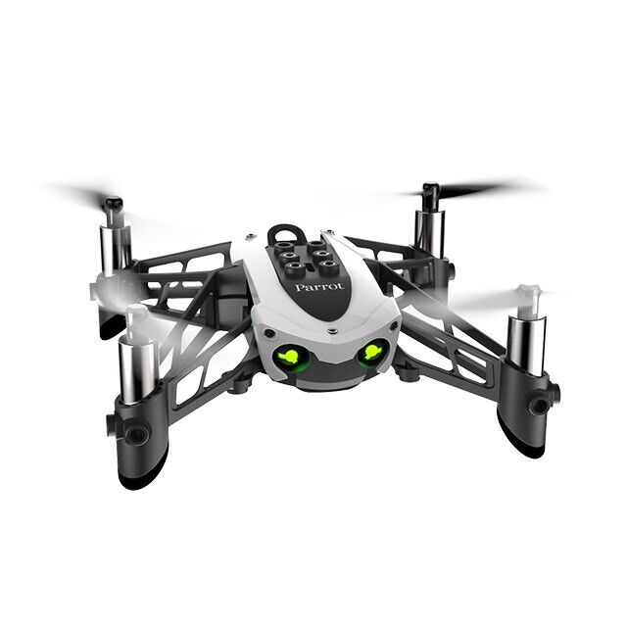
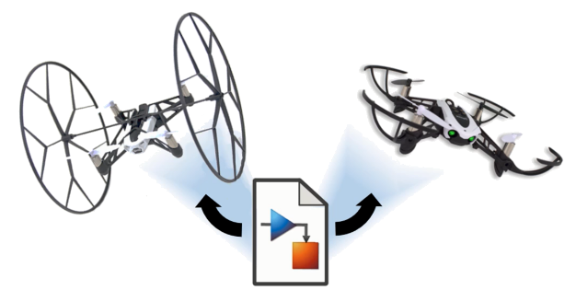
Reinforcement Learning for Parrot Mambo Minidrone Attitude Control
Mücahid Rıdvan KAPLAN
Mehmet SAKARYA
Computer Engineering & Hacettepe University
07 Jun, 2024

Slide 2
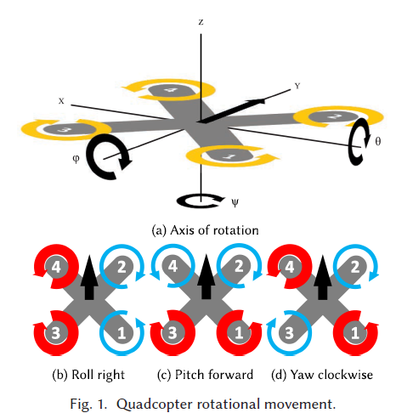
Introduction
Flight control systems generally composed of;
Position & altitude control
Speed control
Navigation control
Attitude control
PID (Proportional-Integral-Derivative) controllers are used due to their simplicity, stability and real time response capabilities.
While PID systems adequate for lots of operations, it has some challenges.
Notes:
Flight control systems are
In this project we focused on attitude control which controls the orientation with roll, pitch, yaw angles.

Slide 3
PID Algorithms
Limitations in Varying Environments
PID controllers struggle with unknown dynamics such as wind and voltage sag.
Adaptability Requirement
Next-gen systems need to adapt to mutable dynamics and varying environments.
Performance in Stable Environments
PID controllers perform close to ideally in stable conditions.

Slide 4
Why RL Algorithms Used
Advantages
Self-Learning: RL agents learn control strategies through trial and error in a simulated environment, reducing manual tuning.
Adaptability: RL agents can adapt to changing environments and new tasks by continuously learning from experience.

Slide 5
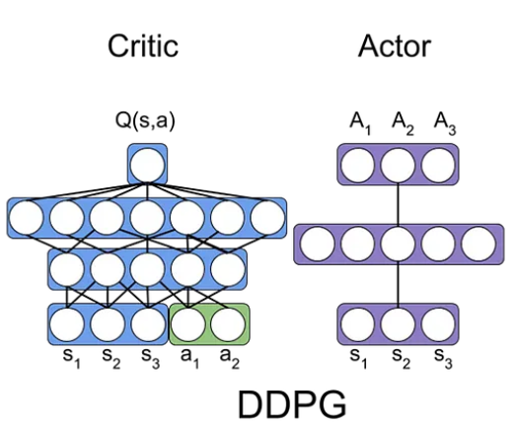
Training Algorithms
1- Deep Deterministic Policy Gradient Algorithm (DDPG)
Model-free, online, off-policy reinforcement learning method
DDPG agent is an actor-critic reinforcement learning agent
Actor: takes state and returns corresponding actions
Critic: takes observation and action as input and return corresponding expectation of the long term reward

Slide 6
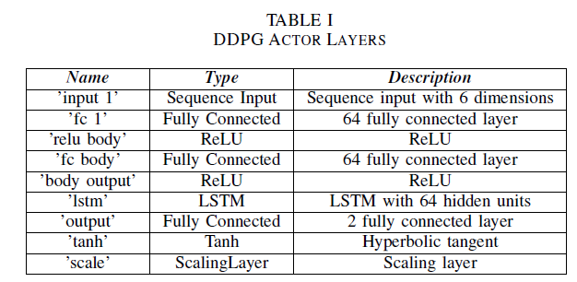
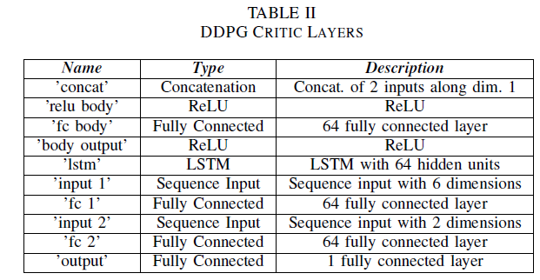
Notes:
Reward fonksiyon düzenlenecek

Slide 7
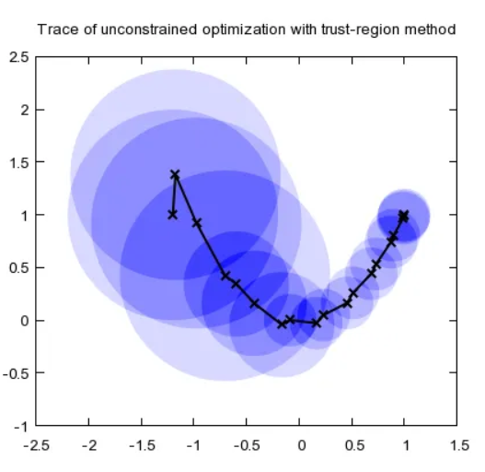
2- Proximal Policy Optimization (PPO)
Model-free, online, on-policy, policy gradient reinforcement learning algorithm
Working process is
Decide step size α
Construct a circle with radius α (trust region)
Once having the best point, determine the direction
Repeat until the optimal point is reached

Slide 8
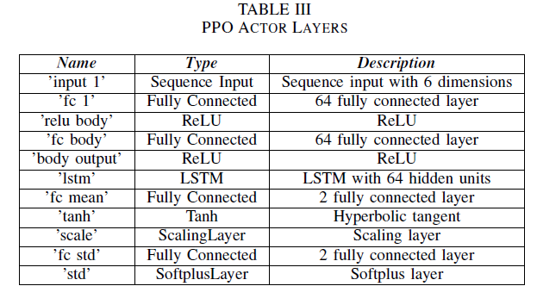
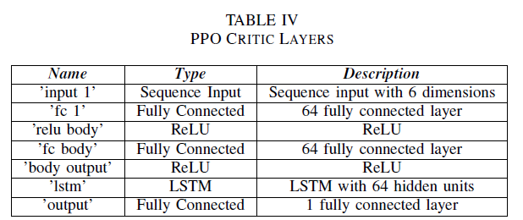
Notes:
DDPG PPO actor critic figürleri alınacak

Slide 9
Literature-1 Overview
Specific Focus
Deep dive into the accuracy and precision of attitude control using intelligent flight controllers trained with RL.
Training Environment
Introduction of GymFC, an OpenAI Environment, designed for training intelligent flight control systems.
RL Application
Application of RL algorithms for attitude control and their potential transfer to physical hardware.
Koch, William, et al. "Reinforcement learning for UAV attitude control." ACM Transactions on Cyber-Physical Systems 3.2 (2019): 1-21.

Slide 10
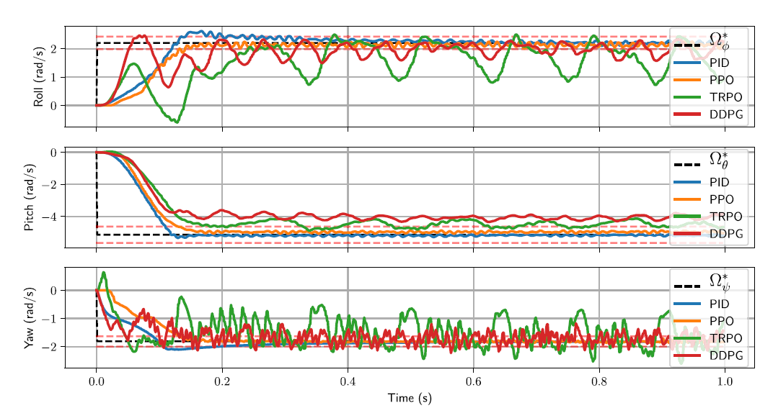
Literature-1 Results

Slide 11
Literature-2 Overview
Specific Focus
Controlling the quadcopter by using DDPG & D4PG RL algorithms.
Training Environment
GymFC for training intelligent flight control of quadcopter.
RL Application
Comparative analysis of the performance of DDPG &D4PG
algorithms in terms of reward generation, actor loss, and critic performance.

Slide 12
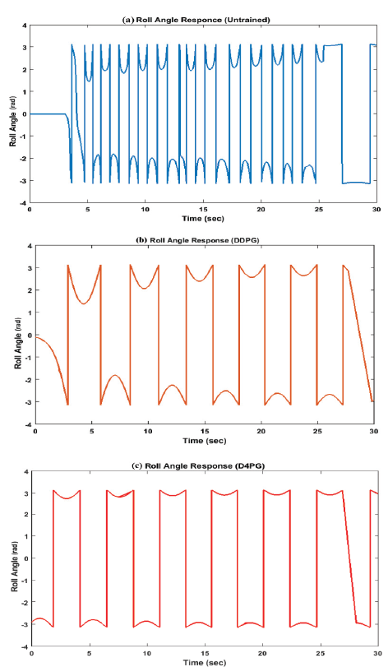
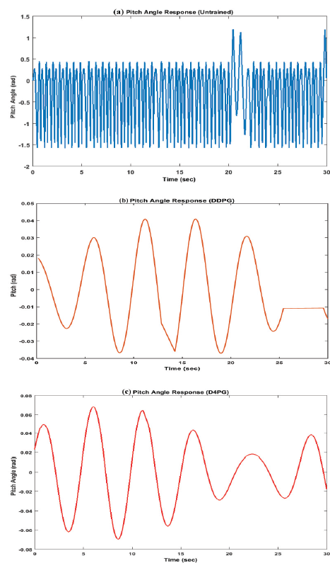
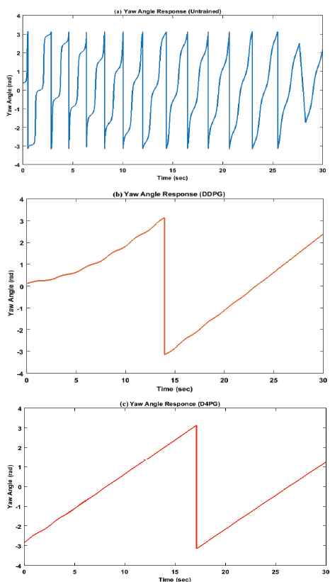
Literature-2 Results

Slide 13
Simulink Environment of Project

Slide 14
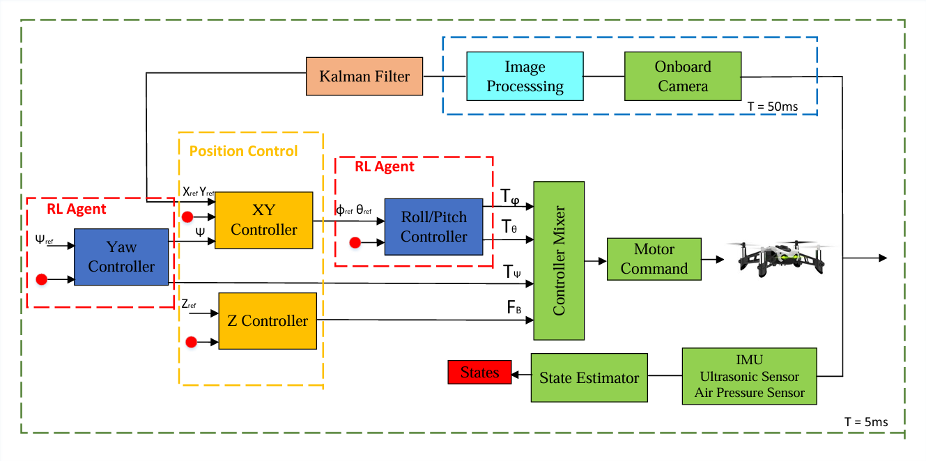
Flight Controller Block

Slide 15


Roll & Pitch RL Agent
$$τ_{φ}=bl\left(Ω_{3}^{2}−Ω_{1}^{2}\right)$$
$$τ_{φ}=bl\left(Ω_{4}^{2}−Ω_{2}^{2}\right)$$
Observation States
Roll angle error
Pitch angle error
Integral of roll angle error
Integral of pitch angle error
Estimated Roll body rate
Estimated Pitch body rate
Action States
Tau Pitch
Tau Roll
r1(t) = e−(0.5|θr −θ|+0.5|φr −φ|)
r2(t) = −(0.3(θr − θ)2 + 0.3(φr − φ)2 + 0.15(|p|+|q|) + 0.1(τθ 2 + τφ2))
r3(t) = −((θr − θ)2 + (φr − φ)2)
r4(t) = −(0.5(θr − θ) + 0.5(φr − φ))
Notes:
Reward fonksiyonların formülleri düzenlenecek.
This is the agent and its environment block for roll and pitch attitude control.
Input parameters are observation, reward Function and flag. the output is the action.

Slide 16
r1(t) = e−(0.5|θr −θ|+0.5|φr −φ|)
Notes:
Normalde rewardün maximize etmesi beklenir. Osilasyon belirli steplede reward
Average reward 10 tanesinin ortalaması
Reward function :
<roll error ve pitch error 0.5 . Bunların weight değerleri 2side 0.5 ikiside aynı oranda ödül + ceza.
>
<1 bölü e üzeri denklem… Bu hata sıfıra gittikçe reward 1 e yaklaşacak demek. Hata sonsuza giderse reward 0 olacak . Exponential terim klullanrak hataya 0 ve 1 arasına sınırlandırk [değer]
Maksimum step 2000 yapıldı, bu bize ne sağladı<
Her bir step maksimum 1 olabilir, bu yüzden her bir episode maksimum 2000 değerinni alır>
Training stopping criteria 1500 olarak seçildi. {hiçbir zaman 900 ün üzerine geçemedik ve anlık osilasyonlar oldu }

Slide 17
r2(t) = −(0.3(θr − θ)2 + 0.3(φr − φ)2 + 0.15(|p|+|q|) + 0.1(τθ 2 + τφ2))
Notes:
Katsayı ve üssel ifadelerden dolayı değişen hata oranlarında episoode reward değerinde hızlı yükseliş ve alçalışlar oluşmakta.
Başlangıçta < >
Steady State Yakınında <>
Sistem kararlı değildi roll ekseni etrafında dönmekte.

Slide 18
Trainig Results
r3(t) = −((θr − θ)2 + (φr − φ)2)
Notes:
Bu rewar function kullanarak değerlendirmeler

Slide 19
r4(t) = −(0.5(θr − θ) + 0.5(φr − φ))

Slide 20
Contributions
In this project we aimed to make yaw controller and roll-pitch controller with RL agent distinctly, and this study is not inside any literatüre that we have seen.
These training showed to possibilities of this idea.
Different algorithmic parameters and observation states lead to different outputs, seen at results.
Notes:
Yapılabilirliği üzerine bir çalışma yürütüldü istenilen performasnların sergilenemediği görüldü. Training yapılamadığı fakat drone üzerinde nonlinear sistemde RL çalışması yoktu ve biz bunu denemiş olduk.
Algoritma learning rate observation sattae training times:5 saat vb.
Training episode related with zaman
Oldukça uzun bir zam

Slide 21
References
[1] N. Bernini, M. Bessa, R. Delmas, A. Gold, E. Goubault, R. Pennec, S. Putot, and F. Sillion, “Reinforcement learning with formal performance metrics for quadcopter attitude control under non-nominal contexts,Engineering Applications of Artificial Intelligence, vol. 127, p. 107090, 2024. [2] E. Bøhn, E. M. Coates, S. Moe, and T. A. Johansen, “Deep reinforcement learning attitude control of fixed-wing uavs using proximal policy opti- mization,” in 2019 international conference on unmanned aircraft systems (ICUAS). IEEE, 2019, pp. 523–533. [3] U. H. Ghouri, M. U. Zafar, S. Bari, H. Khan, and M. U. Khan, “Attitude control of quad-copter using deterministic policy gradient algorithms (dpga),” in 2019 2nd International Conference on Communication, Com- puting and Digital systems (C-CODE). IEEE, 2019, pp. 149–153. [4] W. Koch, R. Mancuso, R. West, and A. Bestavros, “Reinforcement learning for uav attitude control,” ACM Transactions on Cyber-Physical Systems, vol. 3, no. 2, pp. 1–21, 2019. [5] Y. Zhen, M. Hao, and W. Sun, “Deep reinforcement learning attitude control of fixed-wing uavs,” in 2020 3rd International Conference on Unmanned Systems (ICUS). IEEE, 2020, pp. 239–244.
[6] Reinforcement Learning Toolbox Documentation (mathworks.com)

Slide 22
Thanks for Listening.

