Slide 1
BIL 337 İşletim Sistemleri
Modern Operating Systems
Author: Andrew S. Tanembaum
Third Edition.
Publisher: Prentice Hall International, 2007.
1

Slide 2
BIL 337
Introduction to the Course

Slide 3
Study Guide for
BIL337 Operating Systems Course
This study guide is to help you organize your efforts in learning the course subject (and therefore get sufficient grade to pass).
As I have mentioned in the class that the lecture notes are highlights of the material covered in the text book and aimed to introduce the basic concepts.
You should study the sections covered from the book, be able to solve the problems at the end of each section, and test yourself by solving the past exams as found on the course home page.

Slide 4
Chapters
Chapter 1 - Introduction
Chapter 2 - Processes
Chapter 3 - Threads
Chapter 4 – Process Scheduling
Chapter 5 – Inter-process Communication
Chapter 6 - Memory Management
Chapter 7 - Virtual Memory Management
Chapter 8 - OS Policies for Virtual Memory
Chapter 9 - Deadlocks
Chapter 10- File Systems
Chapter 11- Input-Output Systems
Chapter 12- Security and Protection
Chapter 13- Multimedia
Chapter 14- Multiple Processor Systems
Chapter 15- Operating System Design
Chapter 16- Case Studies (UNIX and LINUX , Windows 2000)

Slide 5
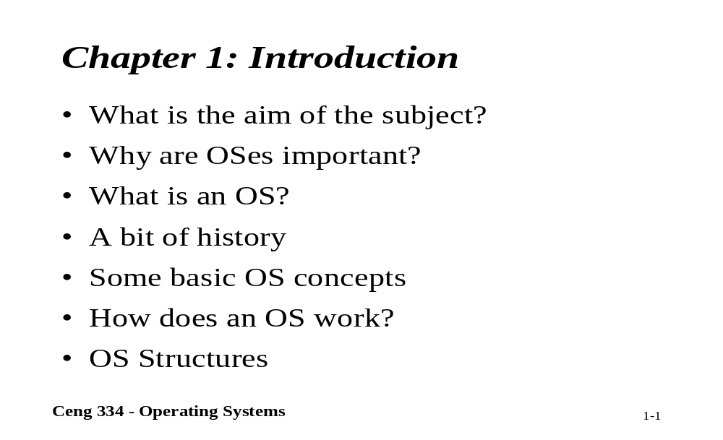
Chapter 1 - Introduction

Slide 6
Chapter 2 - Processes
The process model
Process Creation
Process Termination
Process Hierarchies
Process States
Implementation of Processes

Slide 7
Chapter 3 - Threads
The thread Model
Thread Usage
User Space Threads
Kernel Space Threads
Hybrid Implementation
Pop-up Threads

Slide 8
Chapter 4 - Process Scheduling
Scheduling in Batch Systems
Scheduling in Interactive Systems
Scheduling in Real-time Systems
Policy versus Mechanism
Thread Scheduling

Slide 9
Chapter 5 – Inter-process Communication
Race Condition
Critical Regions
Mutual Exclusion with Busy Waiting
Sleep and Wakeup
Semaphores
Mutexes
Monitors
Barriers

Slide 10
Chapter 6 - Memory Management
Storage hierarchy
Important memory terms
Basic Memory Management
Earlier Memory allocation schemas
Memory management with fixed partition
Memory management with dynamic partition
Managing free and allocated memory space

Slide 11
Chapter 7-Virtual Memory
What is virtual memory
Virtual memory management policies
  Paging
  Segmentation
  Segmentation with paging
Page table management

Slide 12
Chapter 8 - Operating System Policies for VM
Fetch Policy
Placement policy
Replacement Policy
Resident set management
Cleaning policy
Load control

Slide 13
Chapter 9 - Deadlocks
Resources
Deadlock detection and recovery
Deadlock avoidance
Deadlock prevention
Other issues

Slide 14
Chapter 10 - File System
What is a file system?
FS objectives and user requirement
Characteristics of file and directories
Directory implementation
Free block management
Increasing file system performance

Slide 15
Chapter 11- Input-Output Systems
I/O hardware; classification, device drivers
I/O techniques; programmed, interrupt driven and DMA
Structuring I/O software
Disks; performance, arm scheduling, common disk errors
RAID configurations

Slide 16
Chapter 12 – Security and Protection
The security environment
Basics of cryptography
User authentication
Attacks from inside the system
Attacks from outside the system
Protection mechanisms
Trusted systems

Slide 17
Chapter 13 - Multimedia
Introduction to multimedia
Multimedia files
Video compression
Multimedia process scheduling
Multimedia file system paradigms
File placement
Caching
Disk scheduling for multimedia

Slide 18
Chapter 14 - Multiple Processor Systems
Multiprocessors
Multicomputers
Distributed systems

Slide 19
Chapter 15 - Operating System Design
The nature of the design problem
Interface design
Implementation
Performance
Project management
Trends in operating system design

Slide 20
Chapter 16 - Case Studies
(UNIX and LINUX)
History of unix
Overview of unix
Processes in unix
Memory management in unix
Input/output in unix
The unix file system
Security in unix

Slide 21
Chapter 16 - Case Studies
(Windows 2000)
History of windows 2000
Programming windows 2000
System structure
Processes and threads in windows 2000
Memory management
Input/output in windows 2000
The windows 2000 file system
Security in windows 2000
Caching in windows 2000

