Slide 1
Chapter 1
Introduction
1

Slide 2
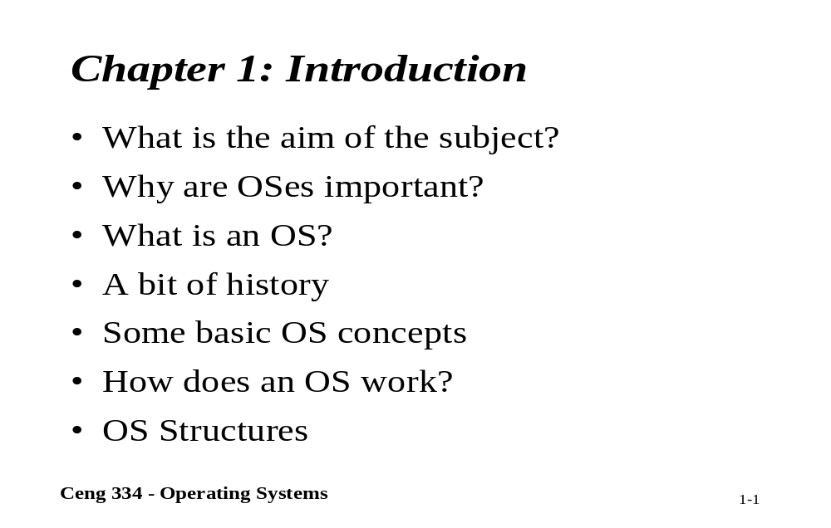
Chapter 1: Introduction

Slide 3
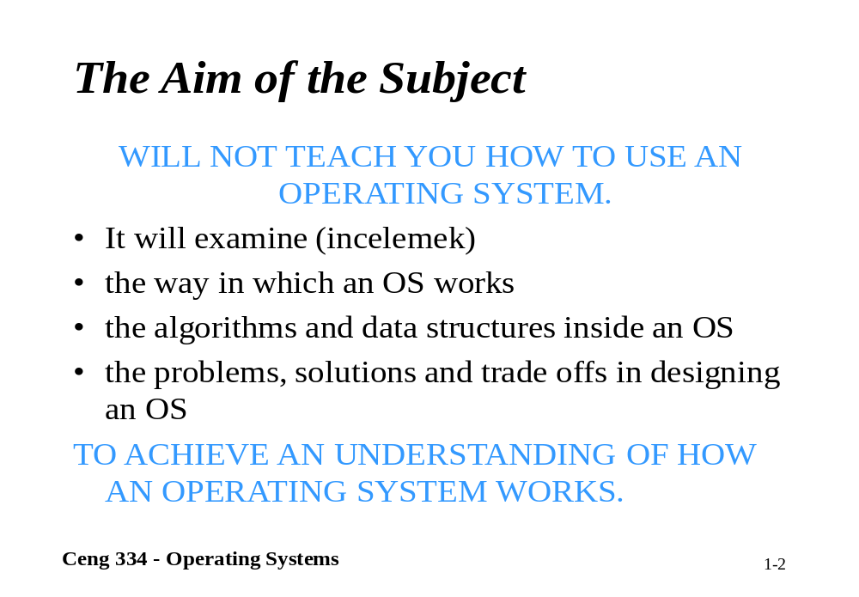
What is the aim of the sucject

Slide 4
What is an Operating System
It is an extended machine
  Hides the messy details which must be performed
  Presents user with a virtual machine, easier to use
It is a resource manager
  Each program gets time with the resource
  Each program gets space on the resource

Slide 5
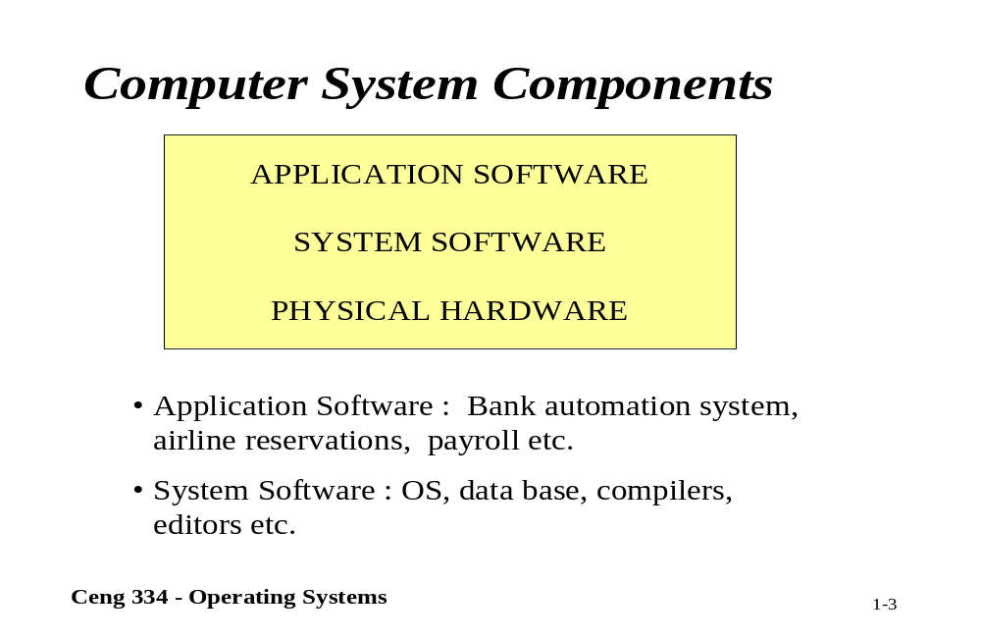
Computer system components

Slide 6
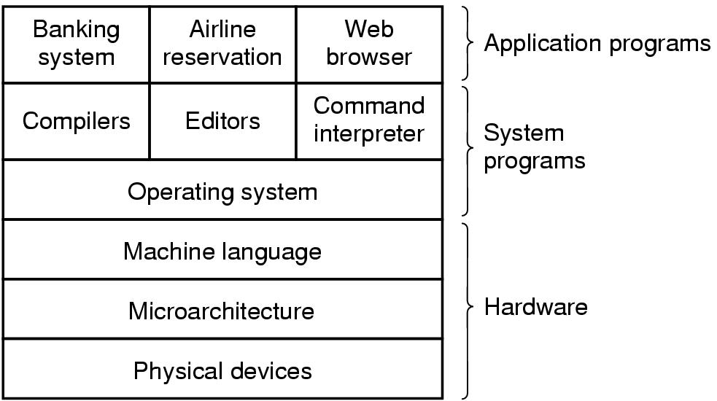
Introduction
A computer system consists of
  hardware
  system programs
  application programs

Slide 7
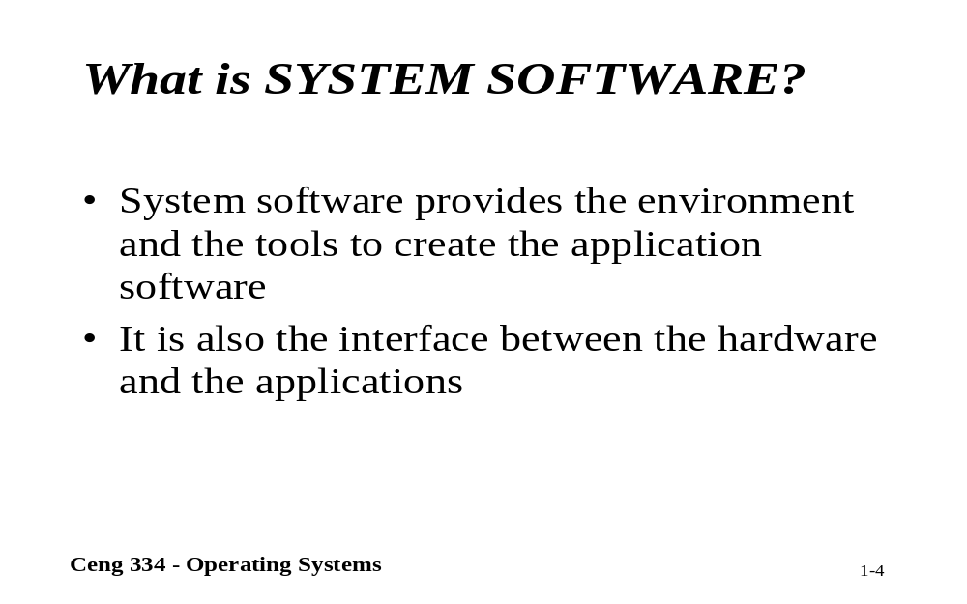
What is the Software

Slide 8
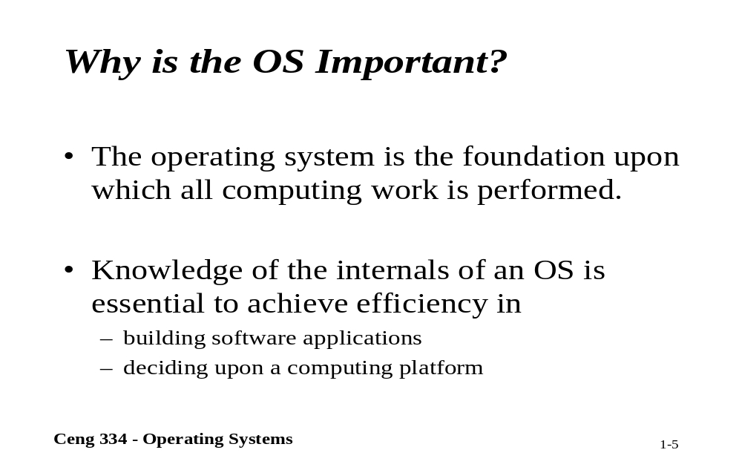
Why is the Operating system Important?

Slide 9
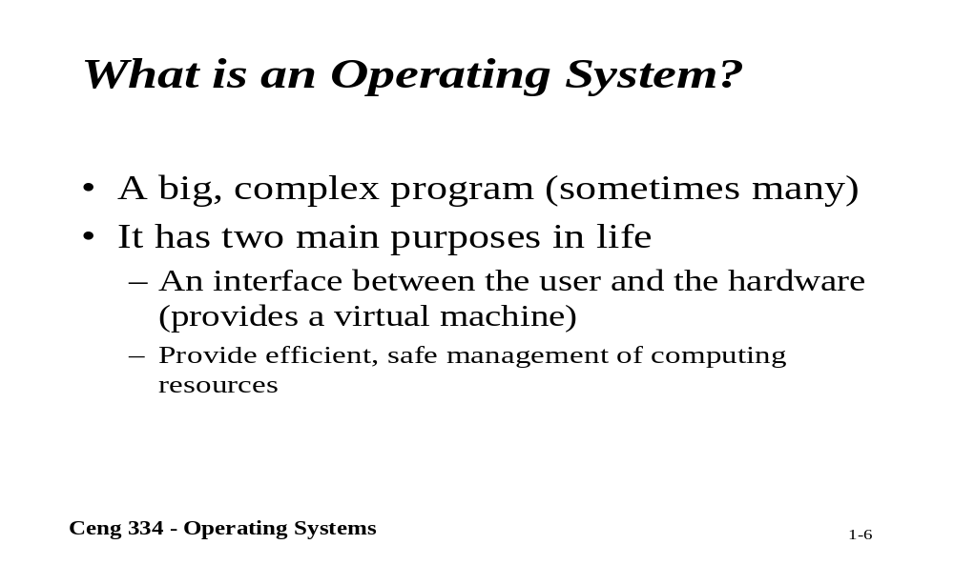
What is an Operating system?

Slide 10
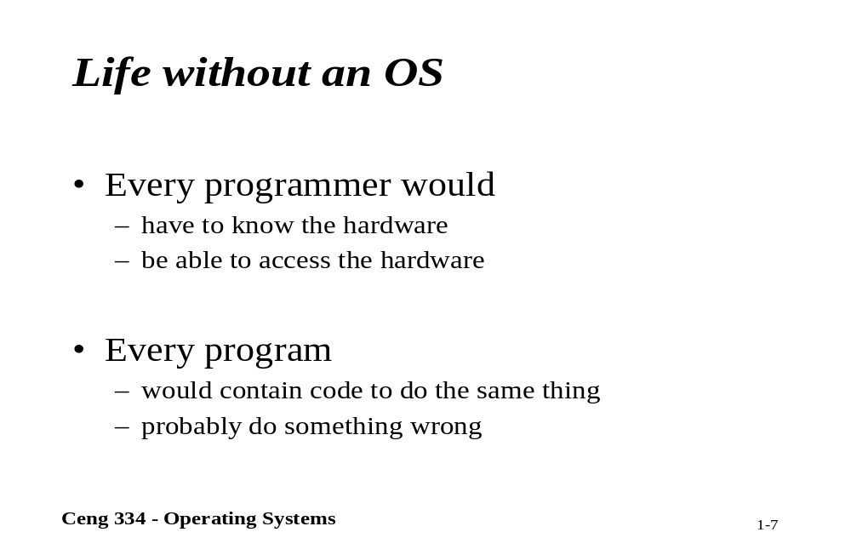
Computer without an operating system

Slide 11
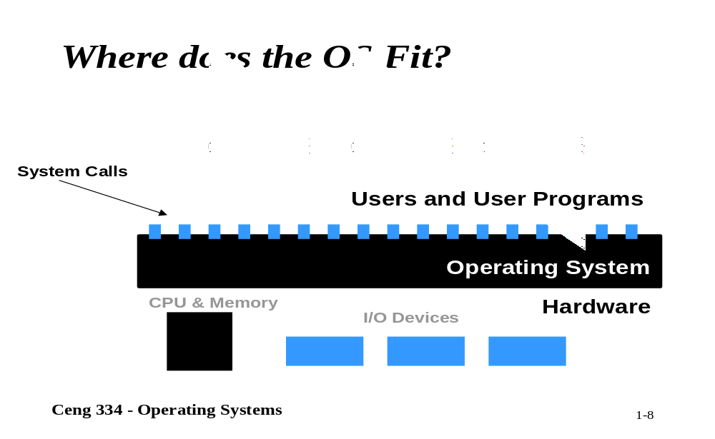
Where does the operating system fit?

Slide 12

History of Operating Systems (1)
Early batch system
  bring cards to 1401
  read cards to tape
  put tape on 7094 which does computing
  put tape on 1401 which prints output

Slide 13
History of Operating Systems (2)
First generation 1945 - 1955
  vacuum tubes, plug boards
Second generation 1955 - 1965
  transistors, batch systems
Third generation 1965 – 1980
  ICs and multiprogramming
Fourth generation 1980 – present
  personal computers

Slide 14
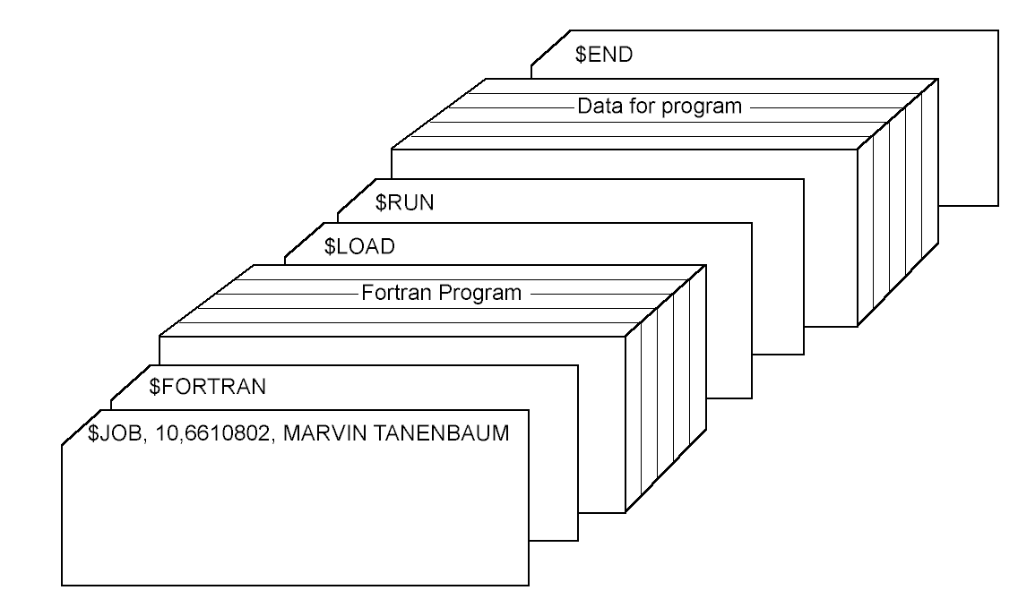
History of Operating Systems (3)
Structure of a typical FMS job – 2nd generation

Slide 15

History of Operating Systems (4)
Multiprogramming system
  three jobs in memory – 3rd generation

Slide 16
The Operating System Zoo
Mainframe operating systems
Server operating systems
Multiprocessor operating systems
Personal computer operating systems
Real-time operating systems
Embedded operating systems
Smart card operating systems

Slide 17
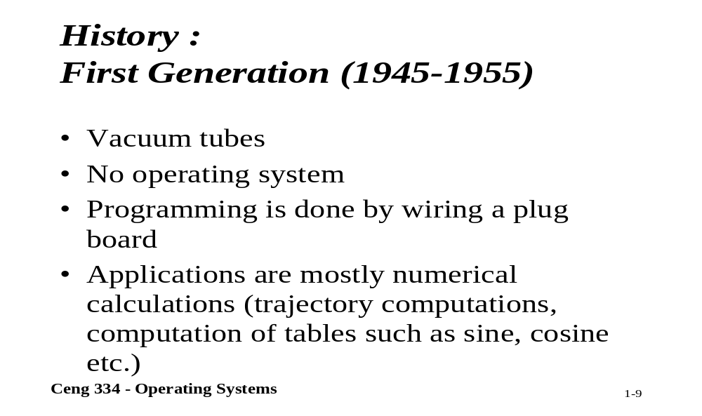
History: First Generation

Slide 18
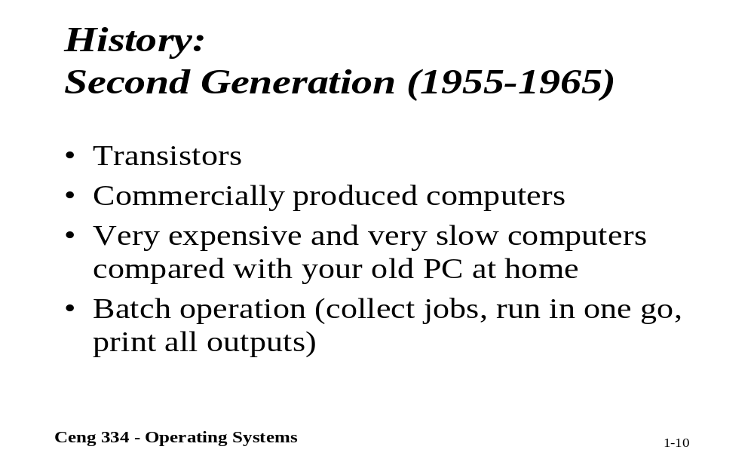
History: Second Generation

Slide 19
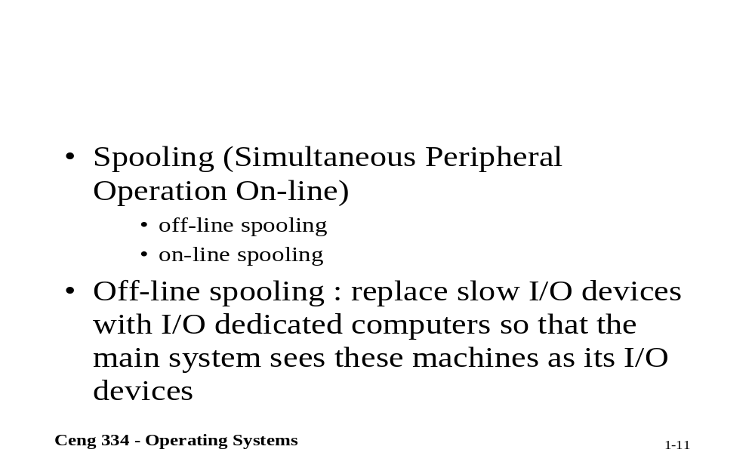

Slide 20
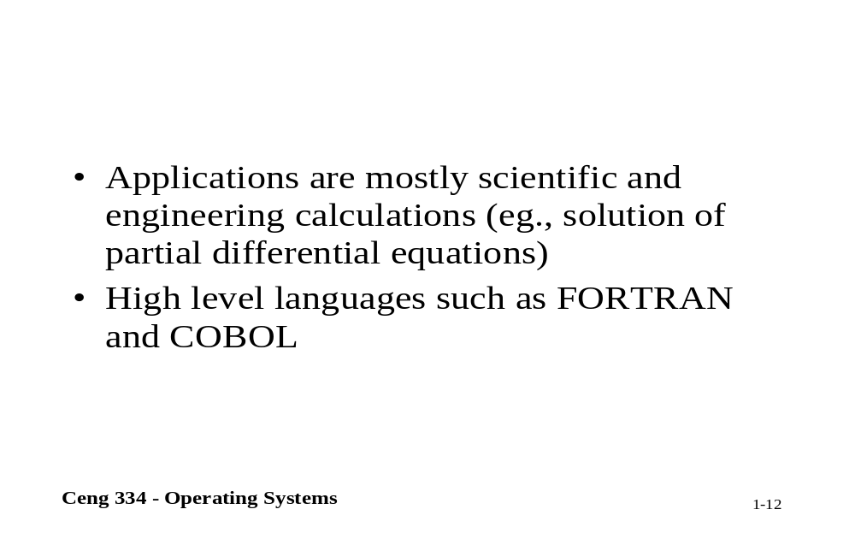

Slide 21
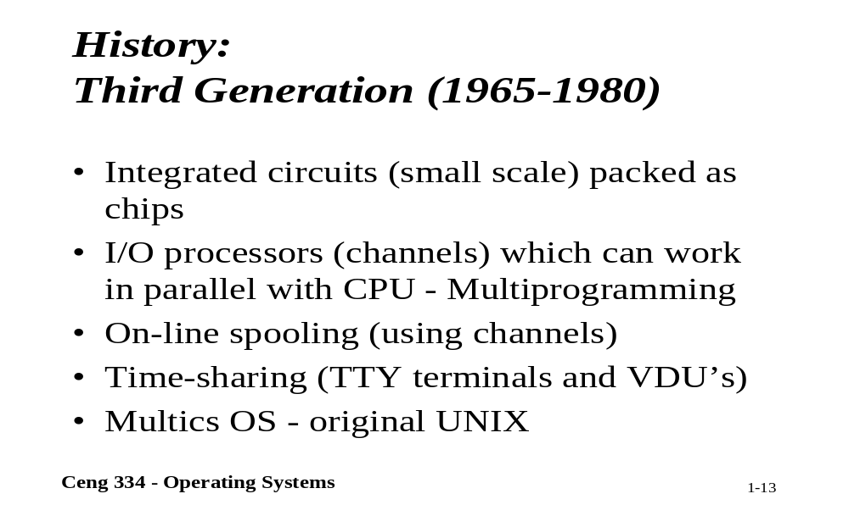
History: Thirs Generation

Slide 22
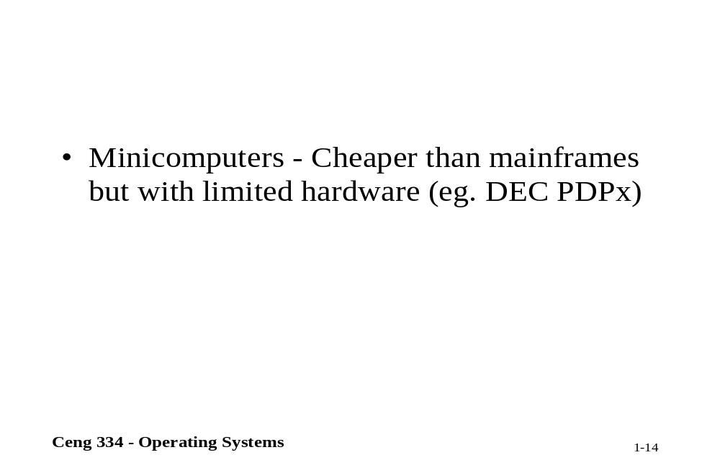

Slide 23
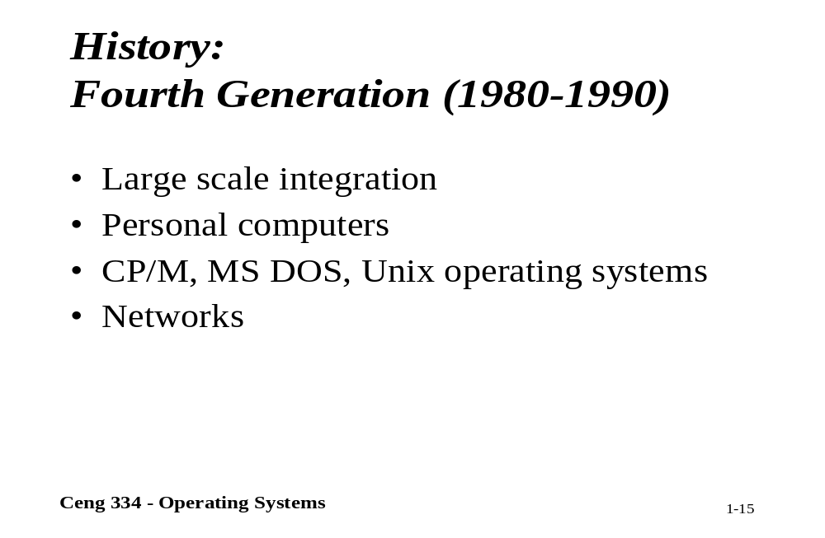
History: Fourth Generation

Slide 24
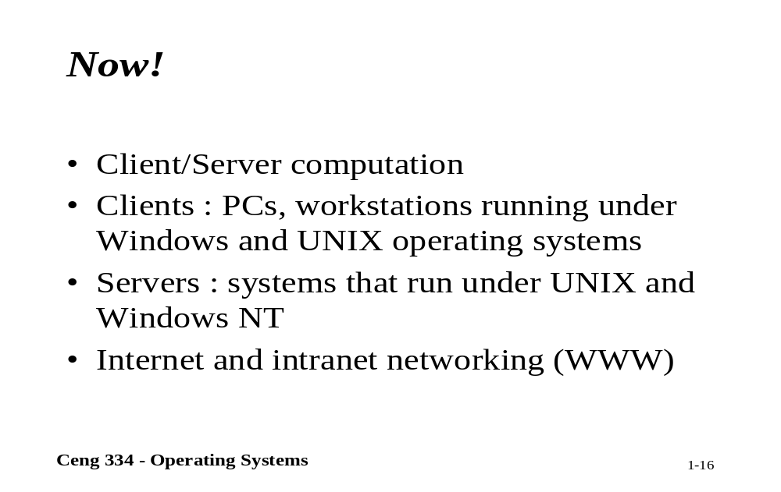
Now

Slide 25
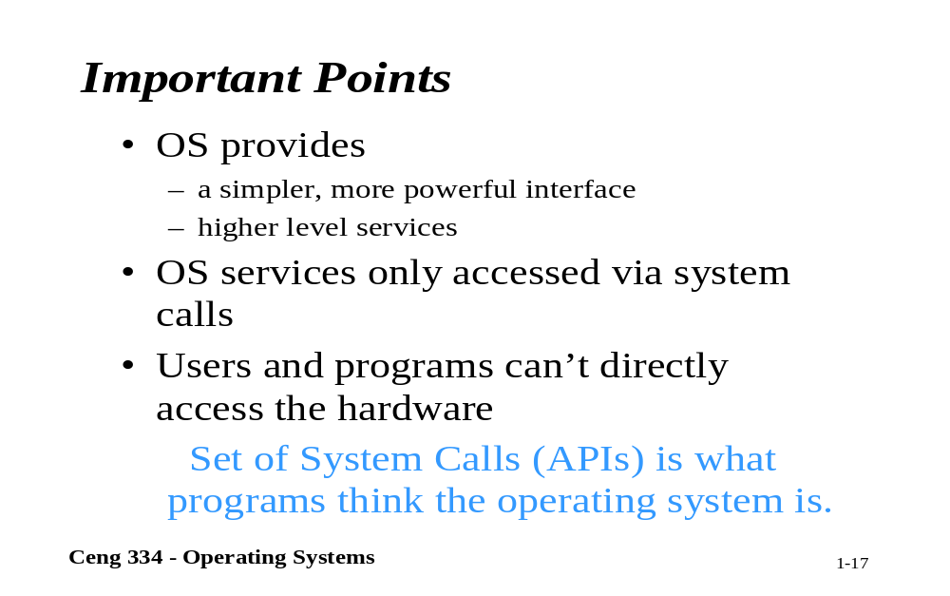
Important Points

Slide 26
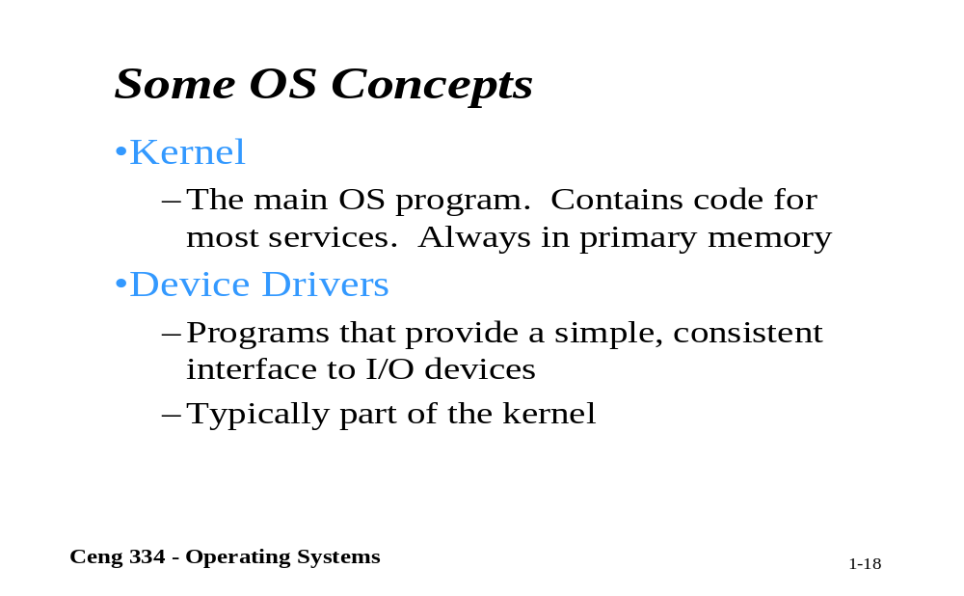
Same Operating System Concepts

Slide 27
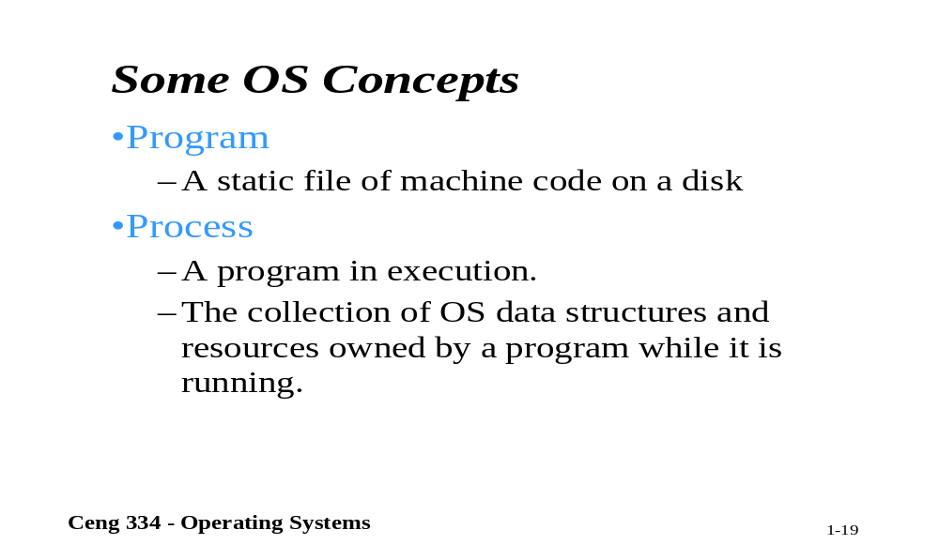
Same Operating System Concepts

Slide 28
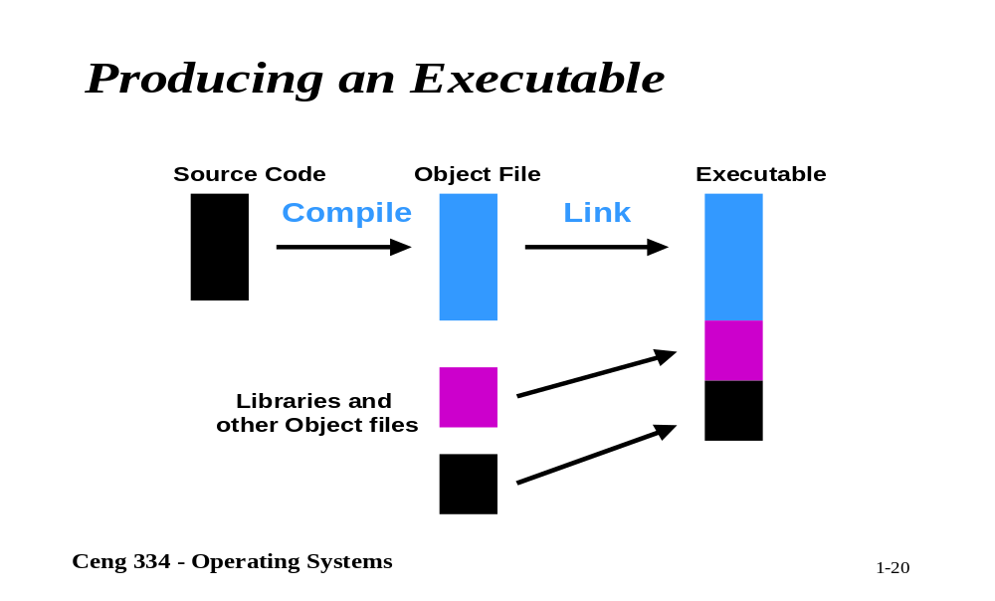
Producing an Executable

Slide 29
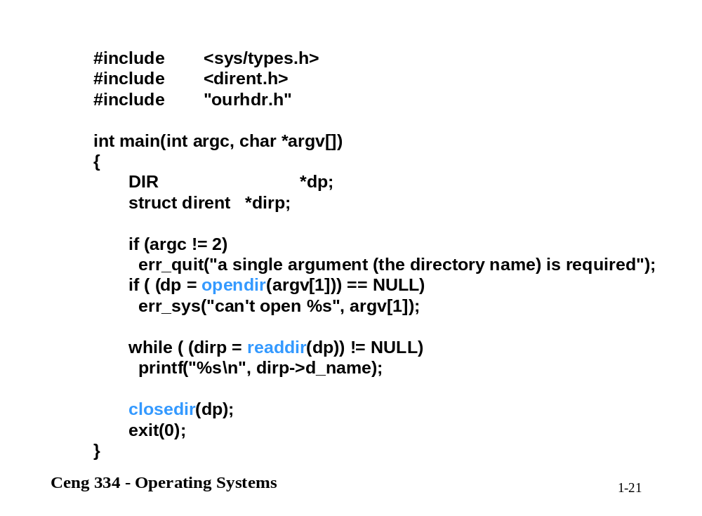

Slide 30
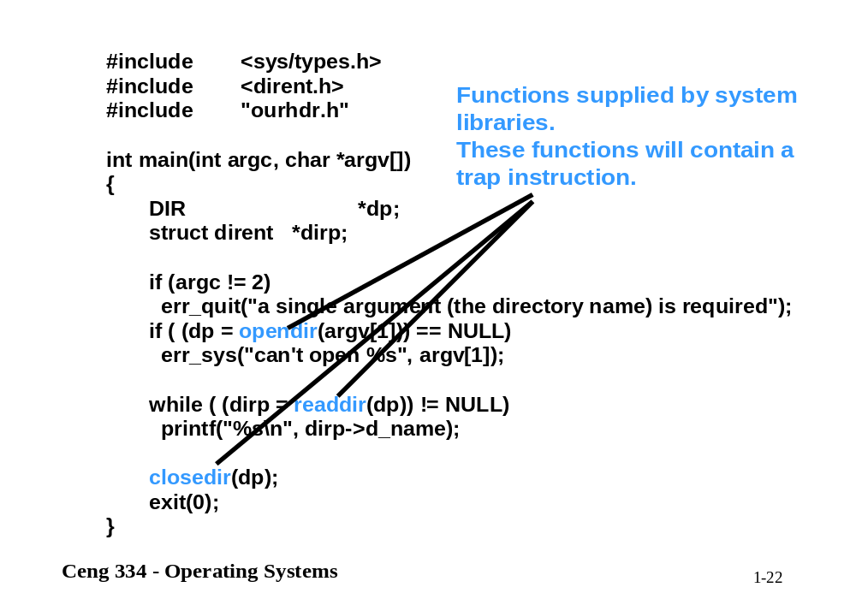

Slide 31
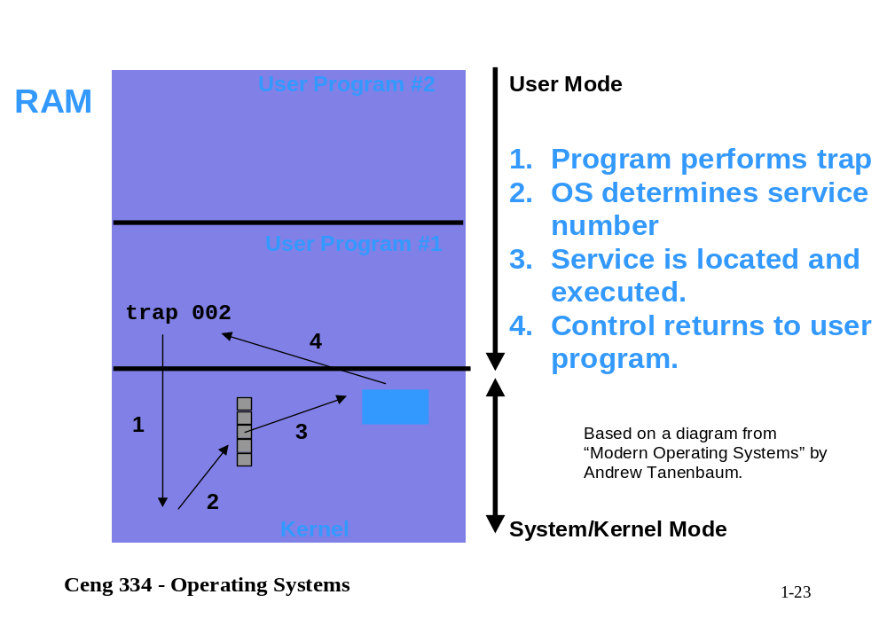

Slide 32
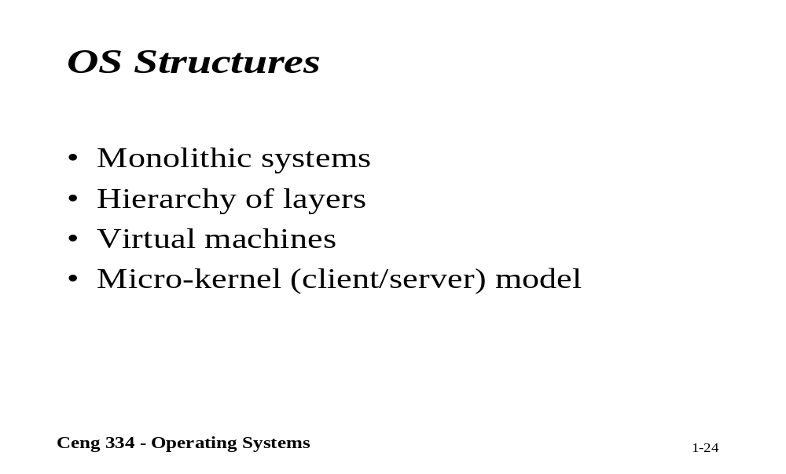
Operating System Structures

Slide 33
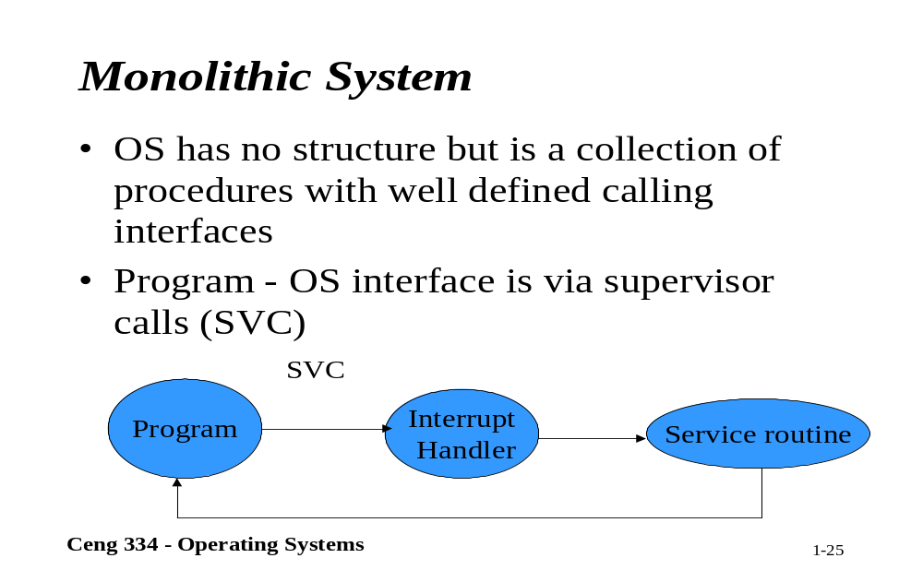
Monolithic System

Slide 34
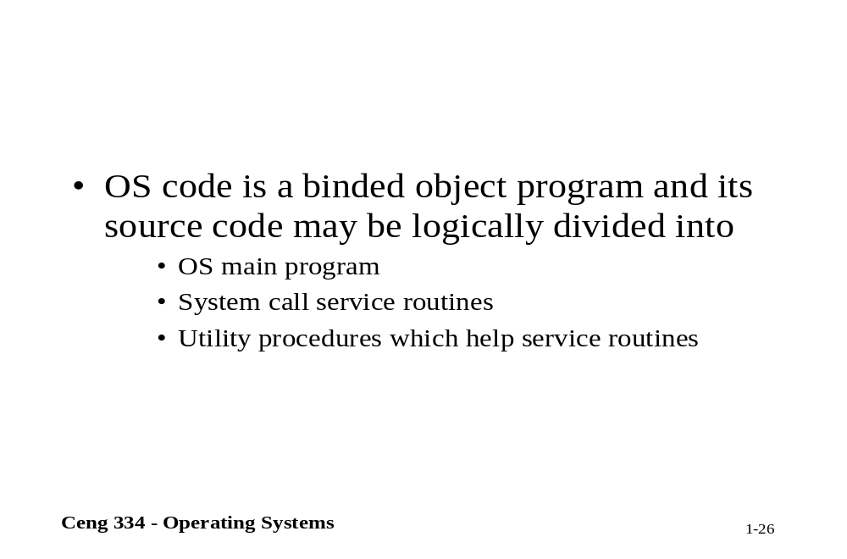

Slide 35
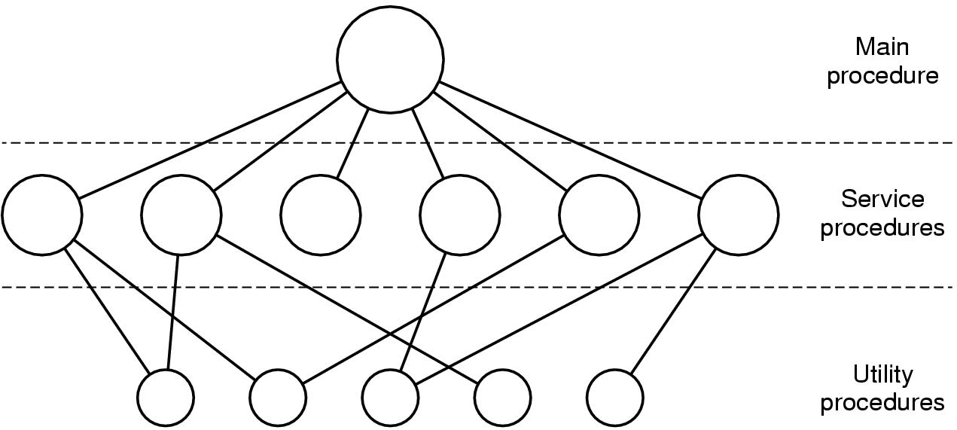
Operating System Structure (1)
Simple structuring model for a monolithic system

Slide 36
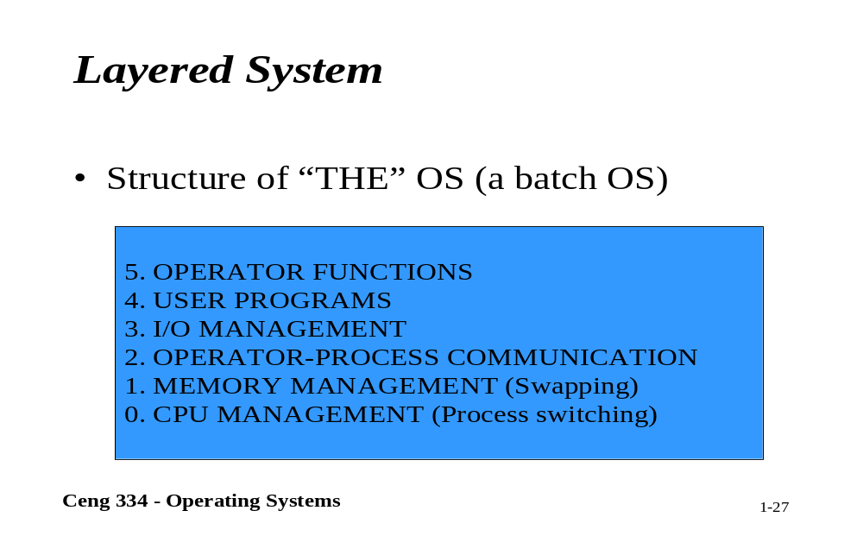
Layered System

Slide 37
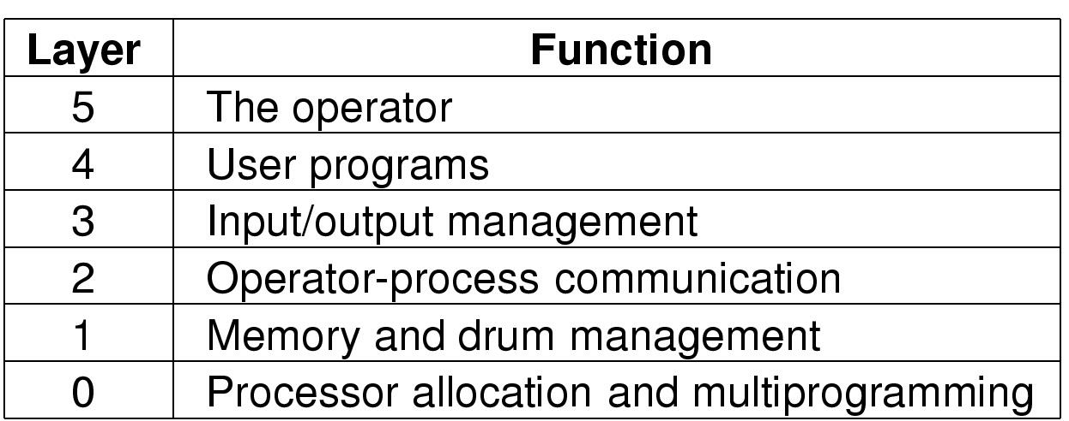
Operating System Structure (2)
Structure of the THE operating system

Slide 38
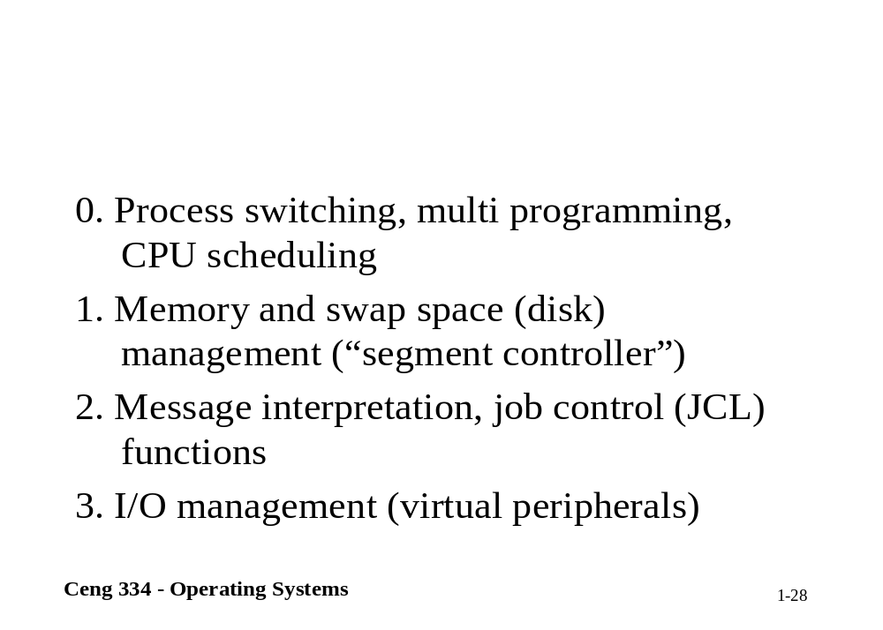

Slide 39
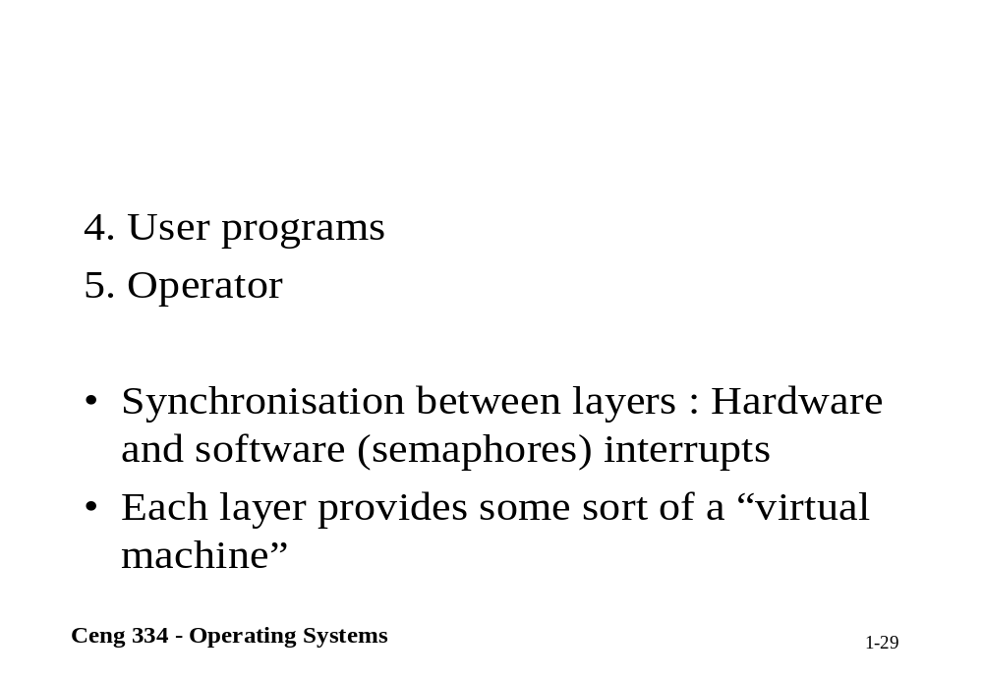

Slide 40
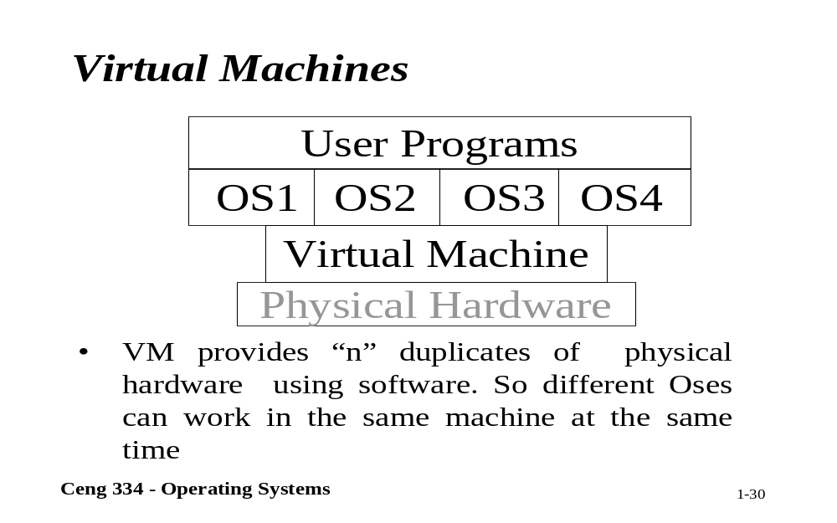
Virtual Machine

Slide 41
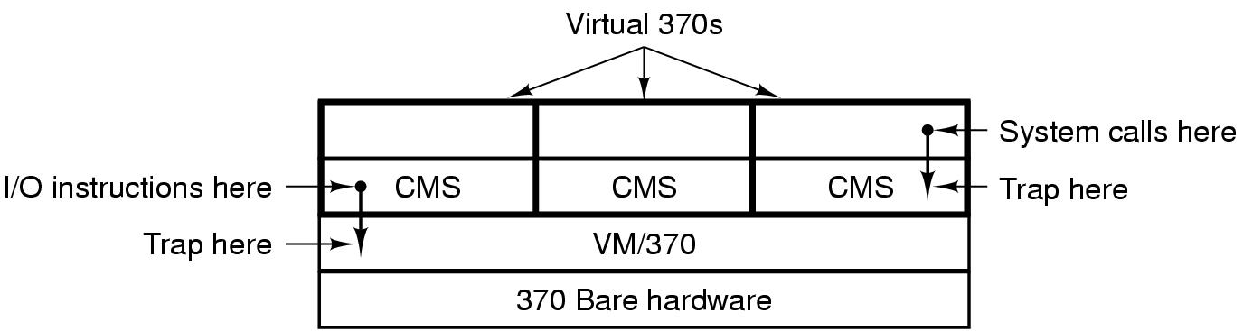
Operating System Structure (3)
Structure of VM/370 with CMS

Slide 42
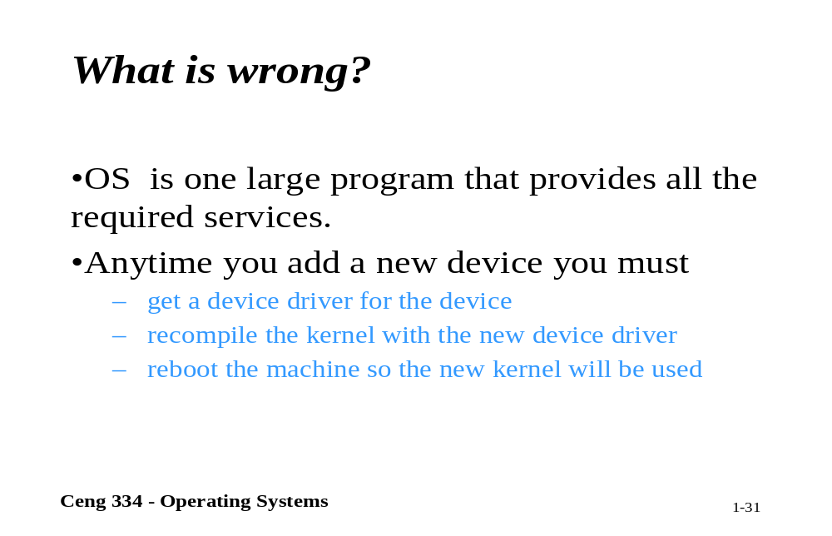
What is wrong

Slide 43
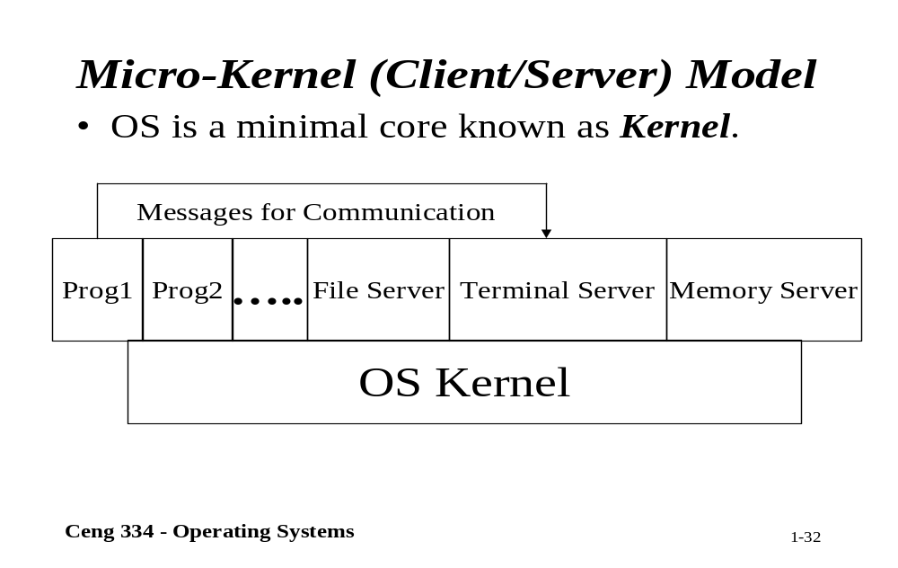
Micro-Kernel Model

Slide 44
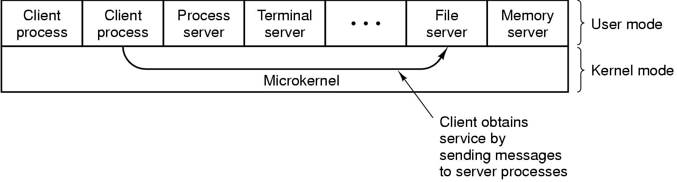
Operating System Structure (4)
The client-server model

Slide 45
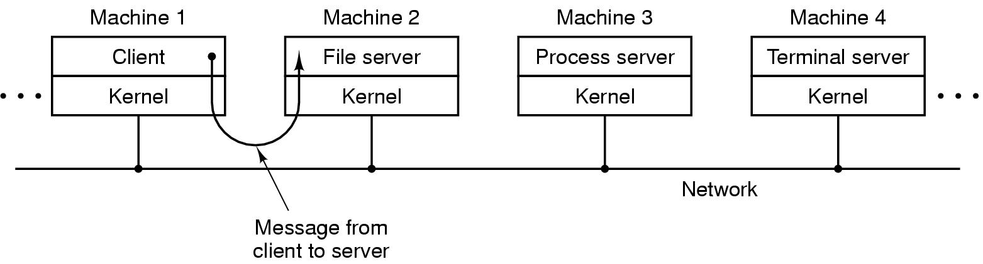
Operating System Structure (5)
The client-server model in a distributed system

Slide 46
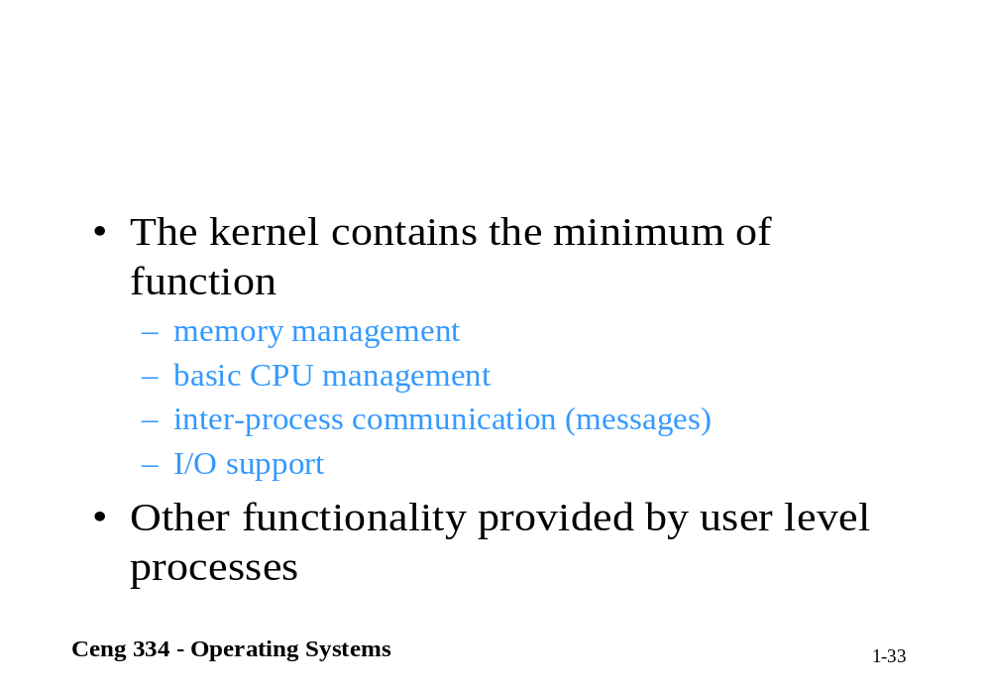

Slide 47
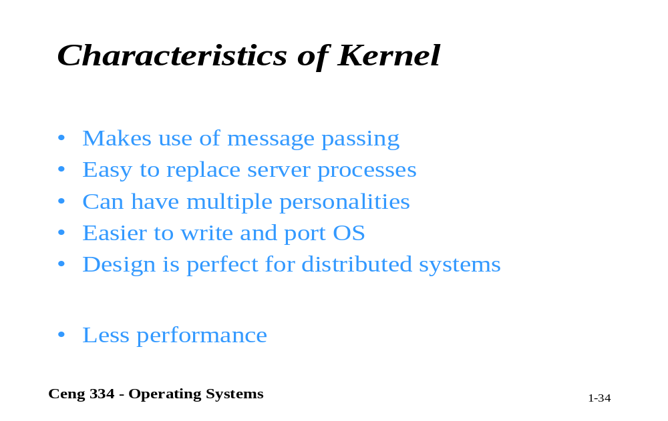
Characteristics of Kernel

Slide 48

Computer Hardware Review (1)
Monitor
Bus
Components of a simple personal computer

Slide 49
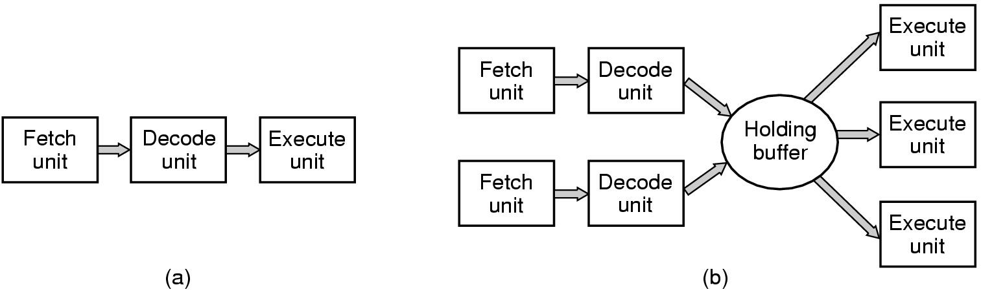
Computer Hardware Review (2)
(a) A three-stage pipeline
(b) A superscalar CPU

Slide 50
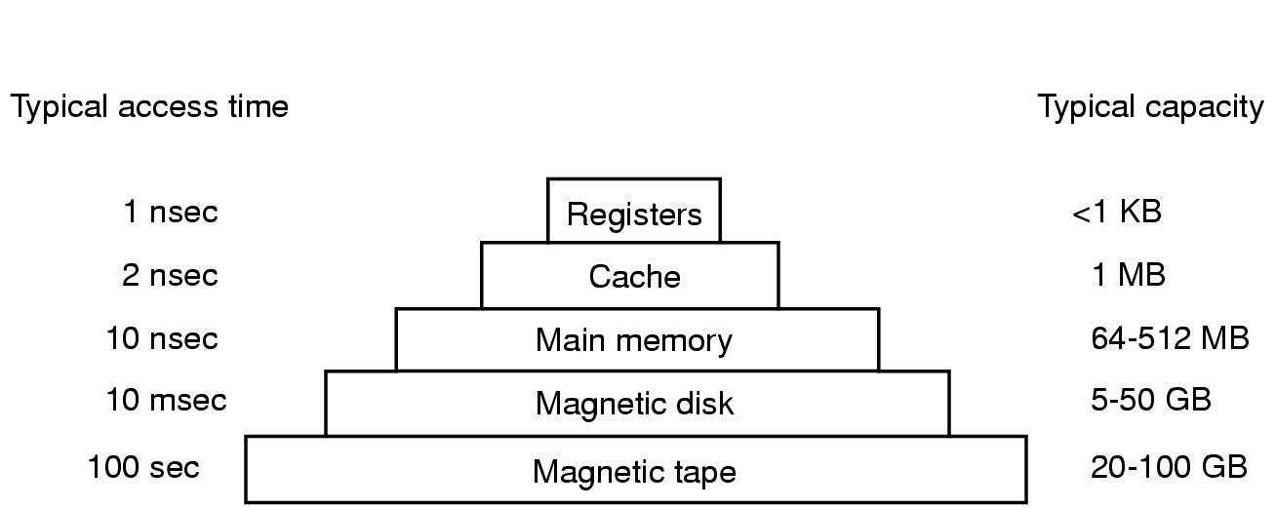
Computer Hardware Review (3)
Typical memory hierarchy
  numbers shown are rough approximations

Slide 51
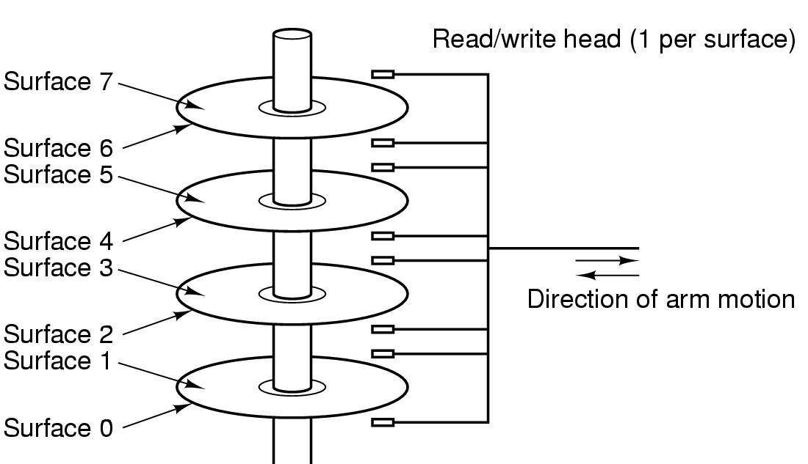
Computer Hardware Review (4)
Structure of a disk drive

Slide 52
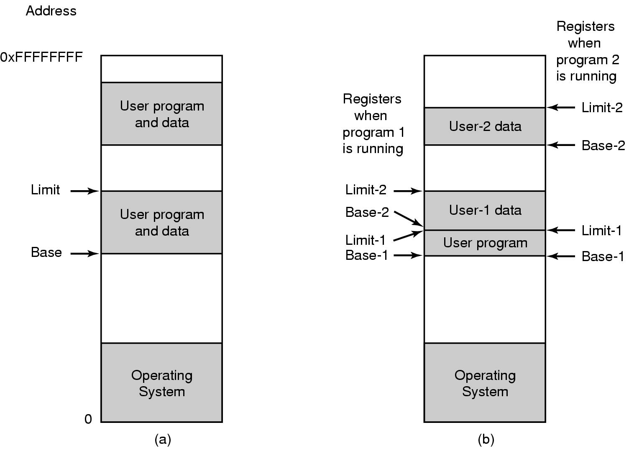
Computer Hardware Review (5)
One base-limit pair and two base-limit pairs

Slide 53
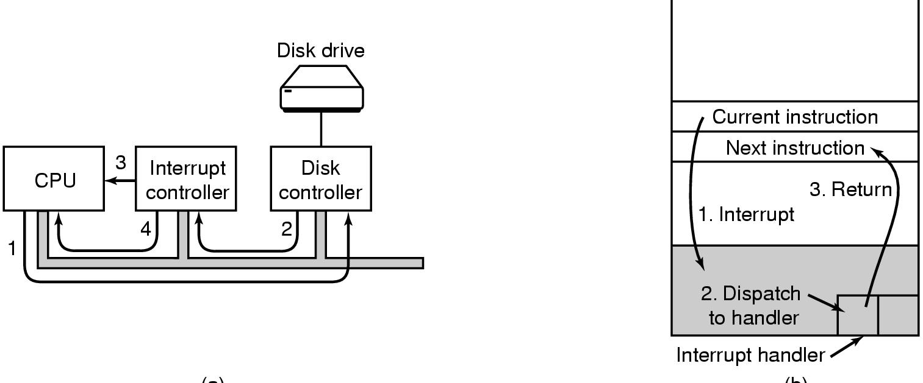
Computer Hardware Review (6)
(a)
(b)
(a) Steps in starting an I/O device and getting interrupt
(b) How the CPU is interrupted

Slide 54

Computer Hardware Review (7)
Structure of a large Pentium system

Slide 55

Operating System Concepts (1)
A process tree
  A created two child processes, B and C
  B created three child processes, D, E, and F

Slide 56
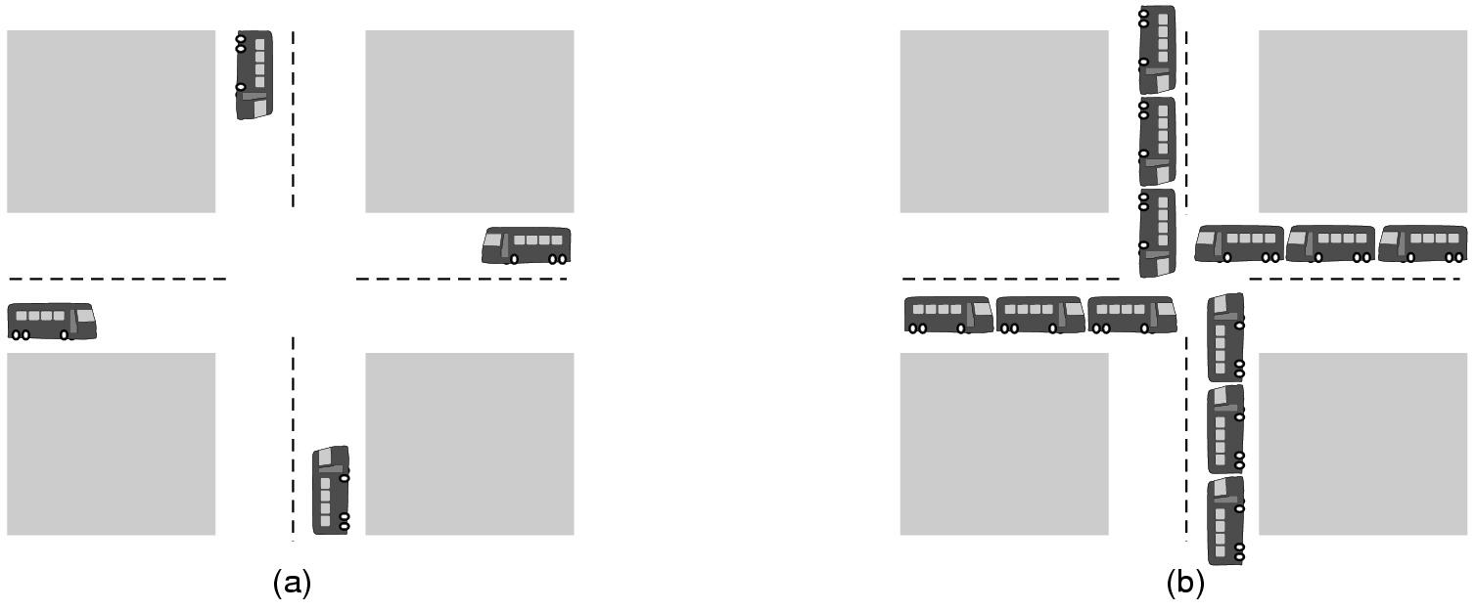
Operating System Concepts (2)
(a) A potential deadlock. (b) an actual deadlock.

Slide 57
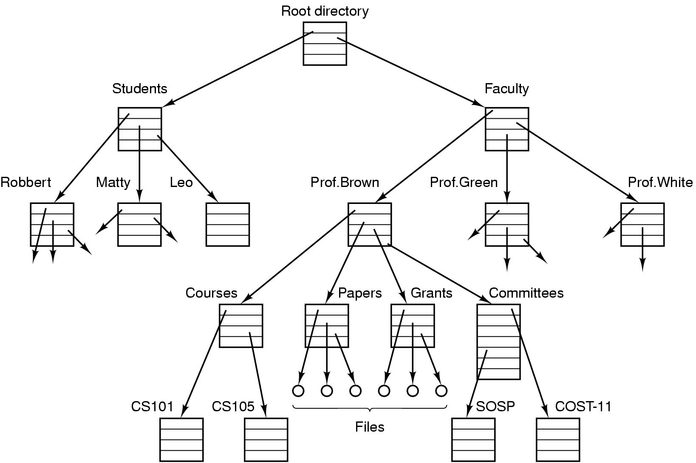
Operating System Concepts (3)
File system for a university department

Slide 58
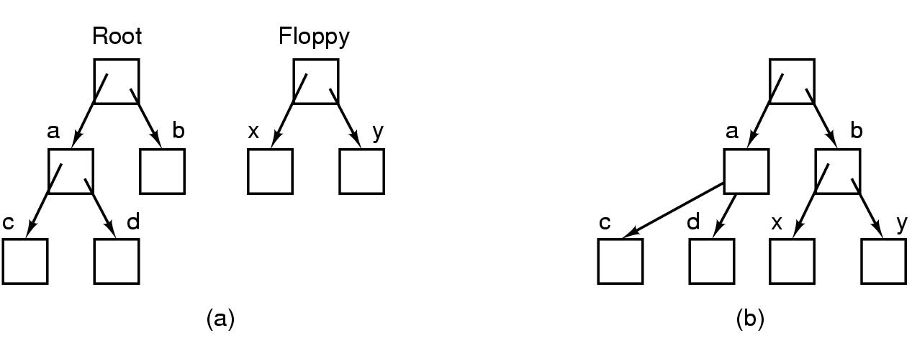
Operating System Concepts (4)
Before mounting,
  files on floppy are inaccessible
After mounting floppy on b,
  files on floppy are part of file hierarchy

Slide 59
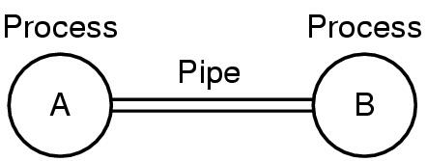
Operating System Concepts (5)
Two processes connected by a pipe

Slide 60
System Calls (1)
A stripped down shell:
while (TRUE) { /* repeat forever */
type_prompt( ); /* display prompt */
read_command (command, parameters) /* input from terminal */
if (fork() != 0) { /* fork off child process */
/* Parent code */
waitpid( -1, &status, 0); /* wait for child to exit */
} else {
/* Child code */
execve (command, parameters, 0); /* execute command */
}
}

Slide 61

System Calls (5)
Some Win32 API calls

Slide 62

Metric Units
The metric prefixes

