Slide 1
Multimedia
Chapter 13
13.1 Introduction to multimedia
13.2 Multimedia files
13.3 Video compression
13.4 Multimedia process scheduling
13.5 Multimedia file system paradigms
13.6 File placement
13.7 Caching
13.8 Disk scheduling for multimedia

Slide 2
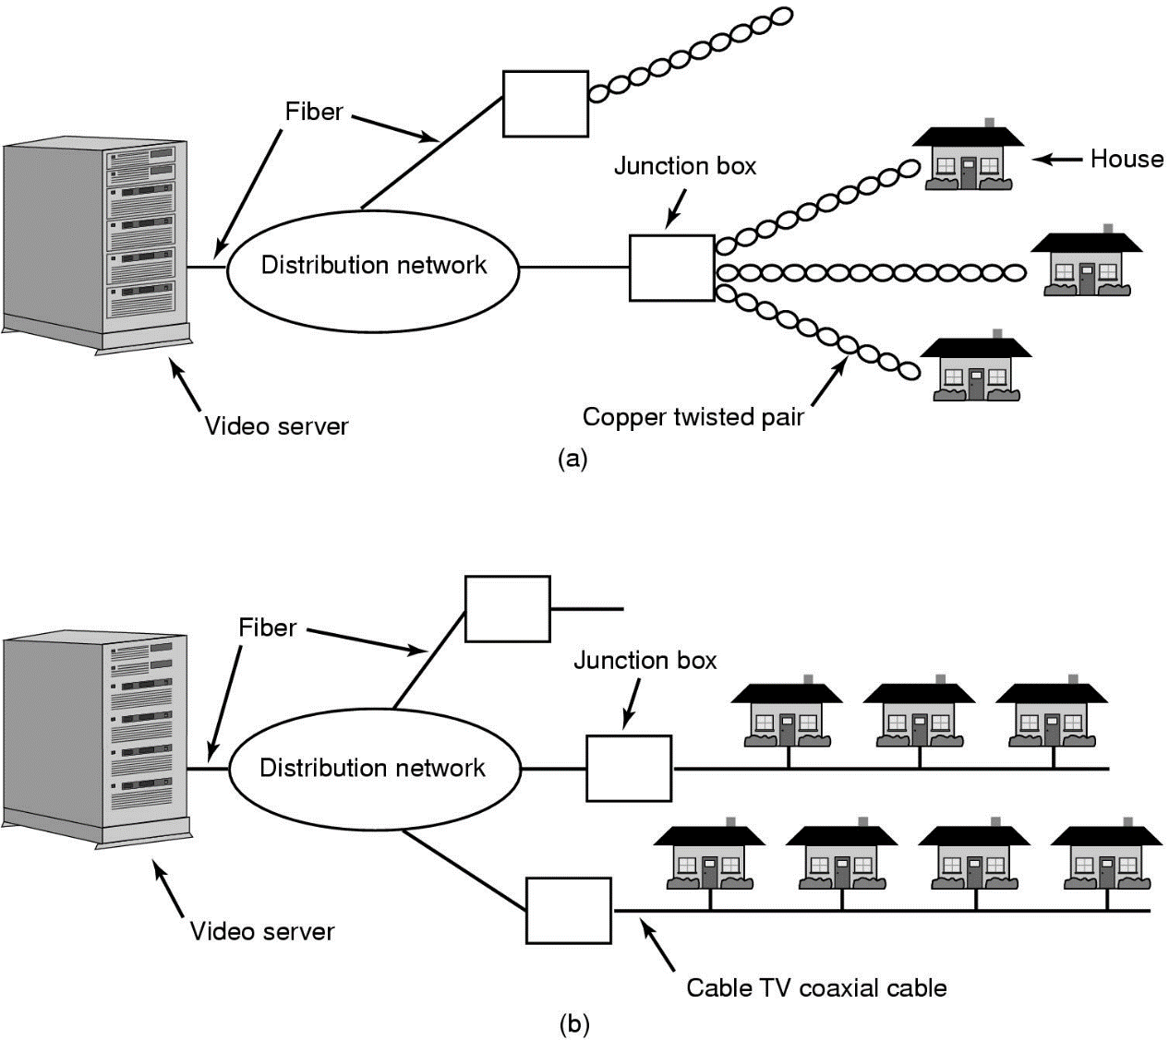
Introduction to Multimedia (1)
Video On Demand: (a) ADSL vs. (b) cable

Slide 3
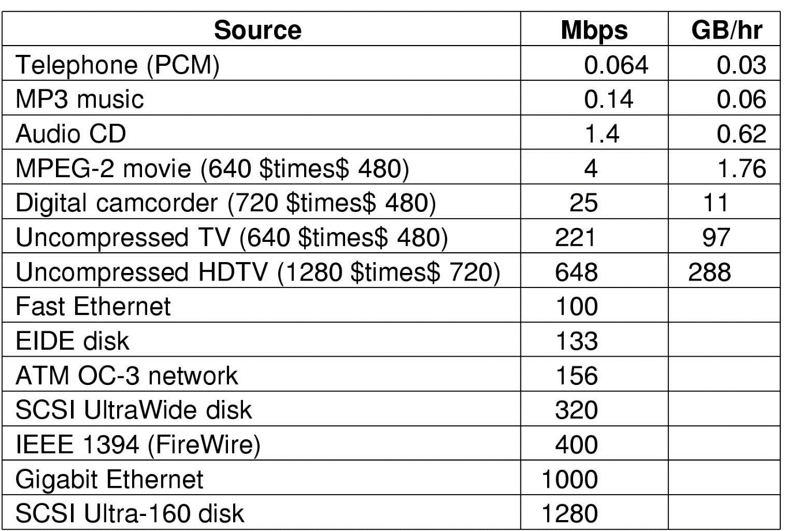
Introduction to Multimedia (2)
Some data rates
  multimedia, high performance I/O devices
Note: 1 Mbps = 10⁶ bits/sec but 1 GB = 2³⁰ bytes

Slide 4
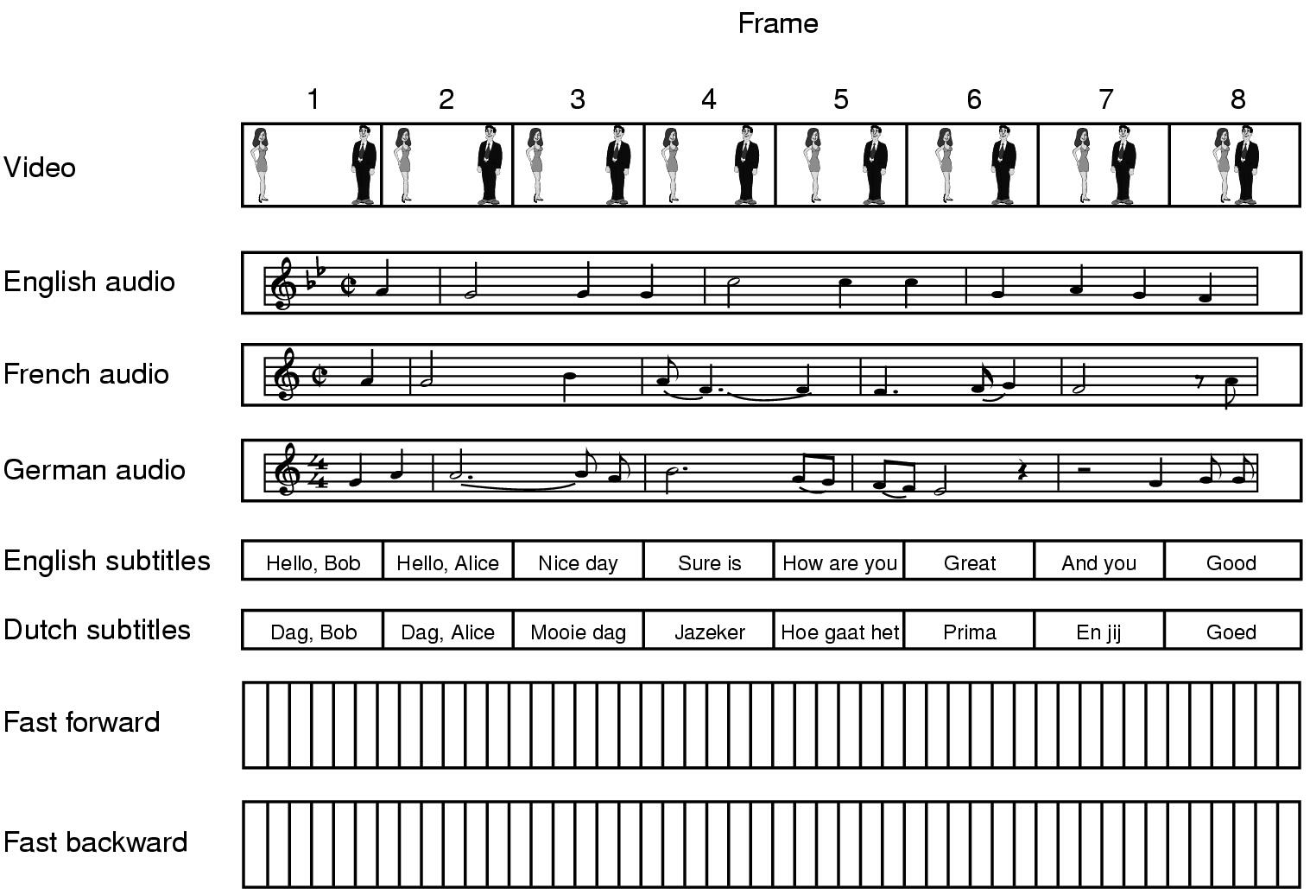
Multimedia Files
A movie may consist of several files

Slide 5
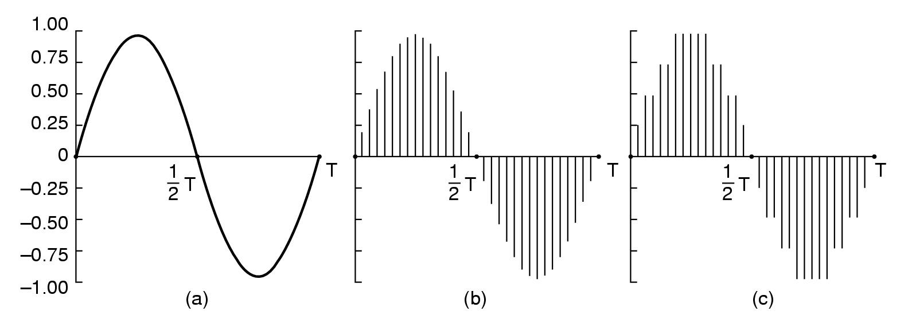
Audio Encoding (1)
Audio Waves Converted to Digital
  electrical voltage input
  binary number as output

Slide 6
Audio Encoding (2)
Error induced by finite sampling
  called quantization noise
Examples of sampled sound
  telephone – pulse code modulation
  audio compact disks

Slide 7
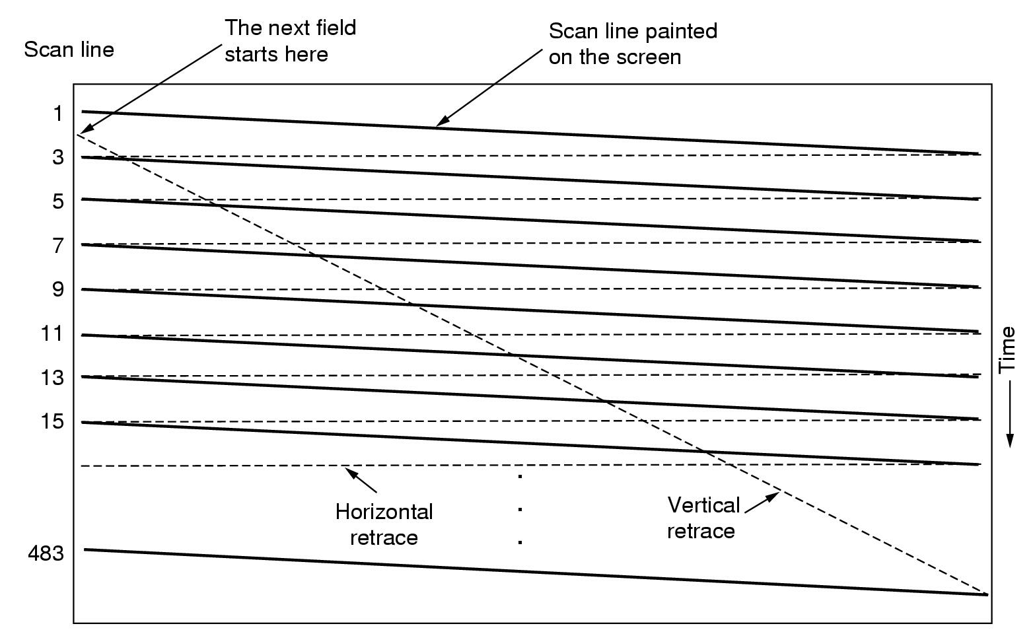
Video Encoding
Scanning Pattern for NTSC Video and Television

Slide 8
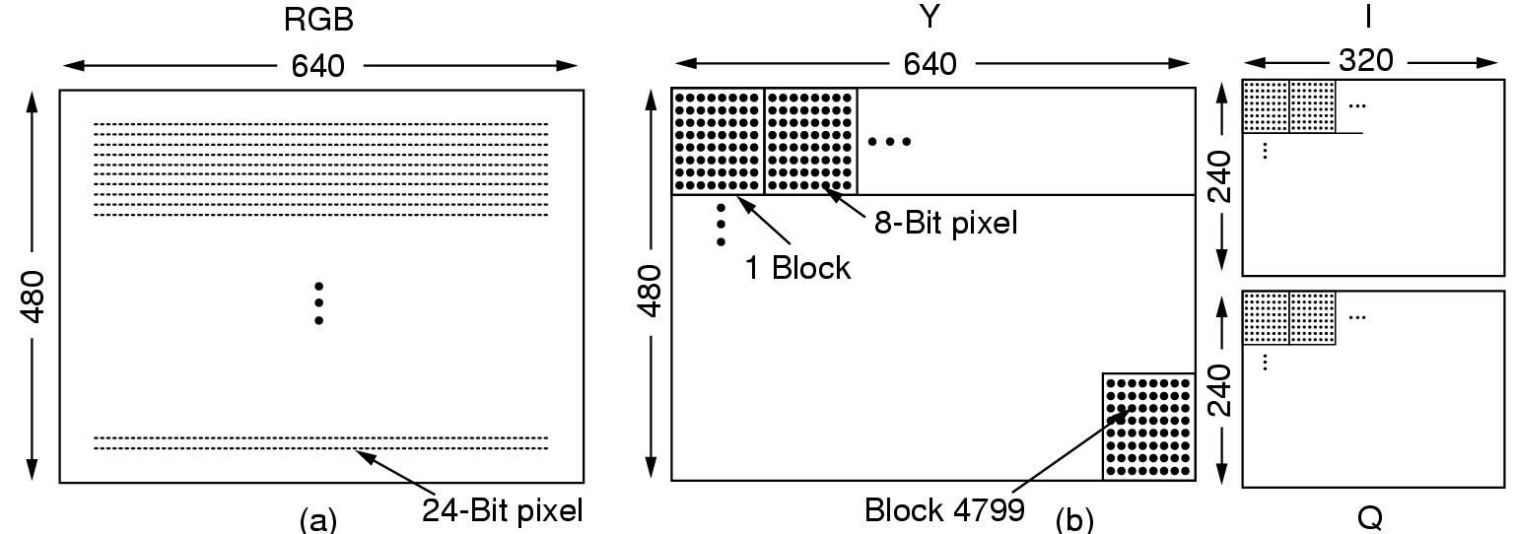
Video Compression
The JPEG Standard (1)
RGB input data and block preparation

Slide 9
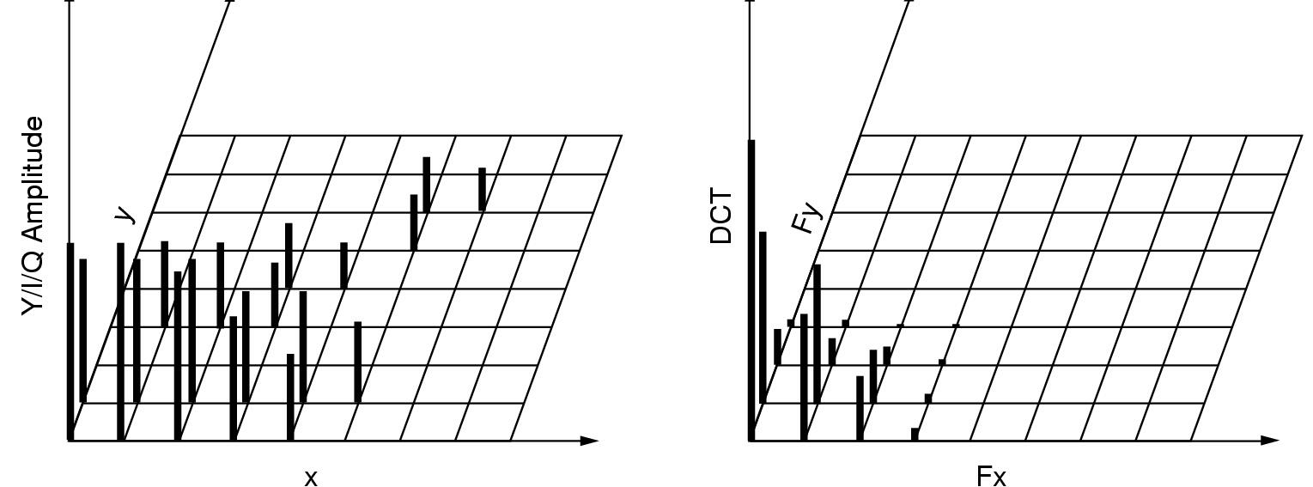
The JPEG Standard (2)
One block of the Y matrix and the DCT coefficients

Slide 10
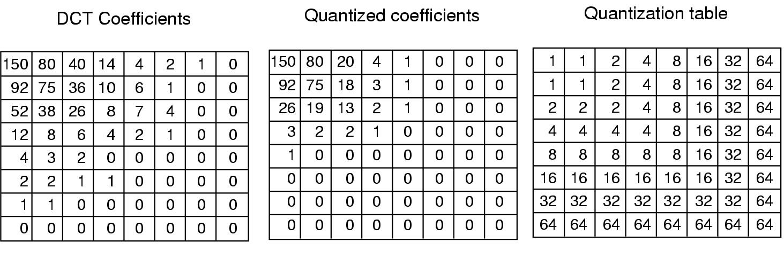
The JPEG Standard (3)
Computation of the quantized DCT coefficients

Slide 11
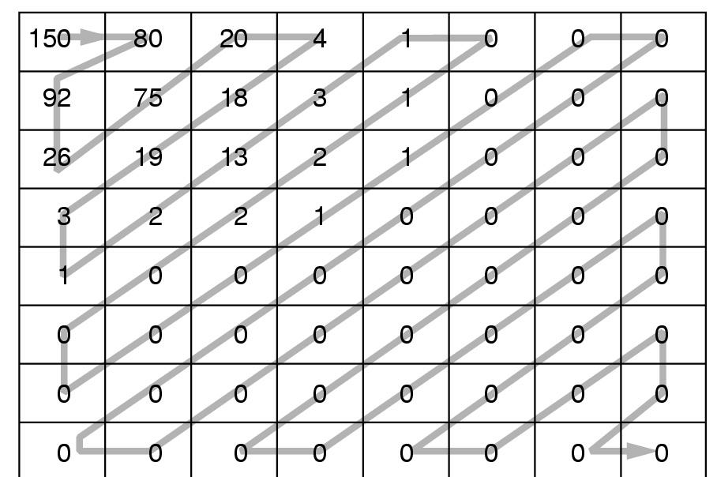
The MPEG Standard (1)
Order of quantized values when transmitted

Slide 12
The MPEG Standard (2)
MPEG-2 has three kinds of frame: I, P, B
Intracoded frames
  Self-contained JPEG-encoded pictures
Predictive frames
  Block-by-block difference with last frame
Bi-directional frames
  Differences with last and next frame

Slide 13
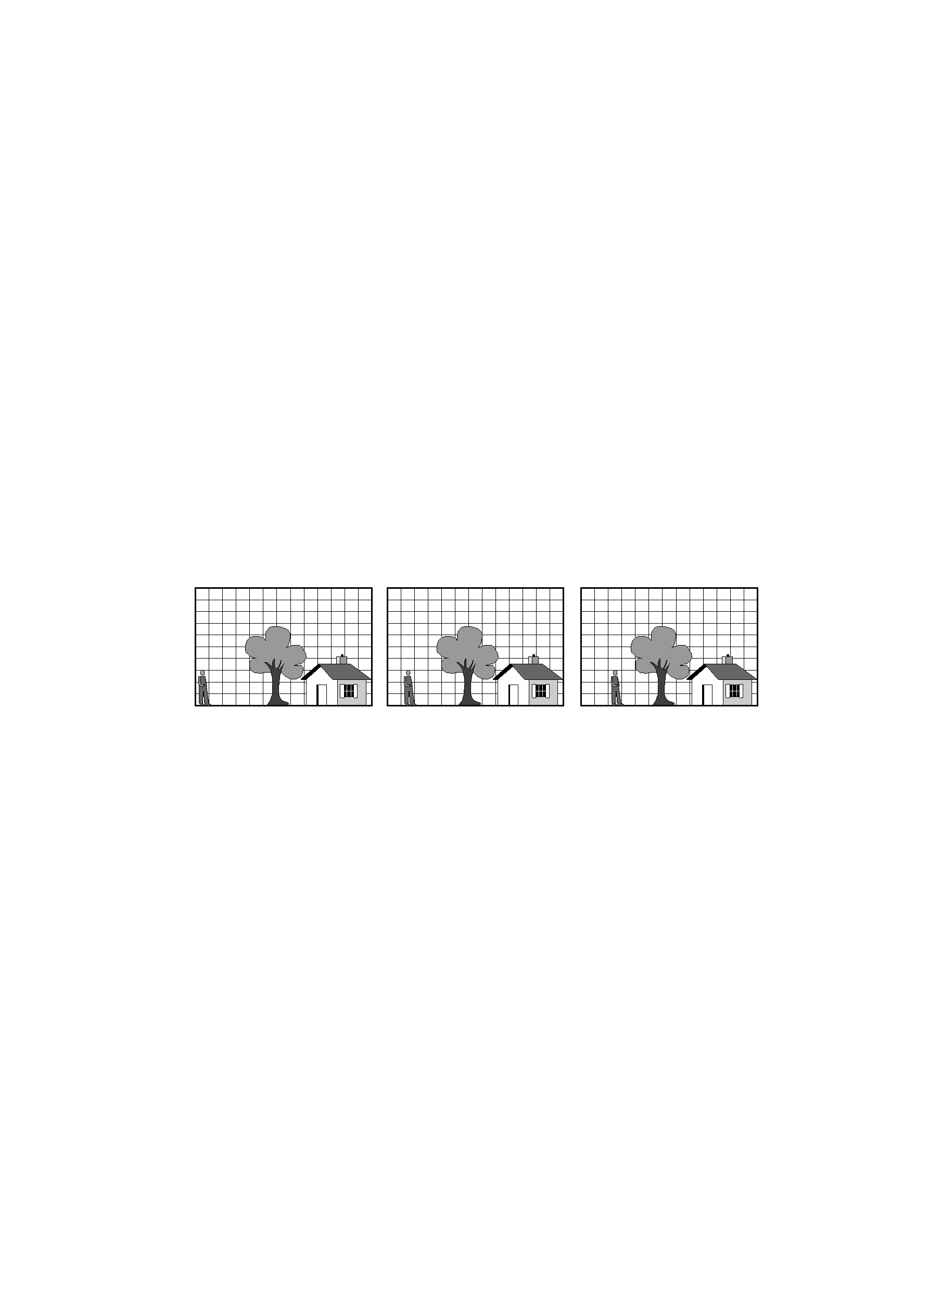
The MPEG Standard (3)
Consecutive Video Frames

Slide 14
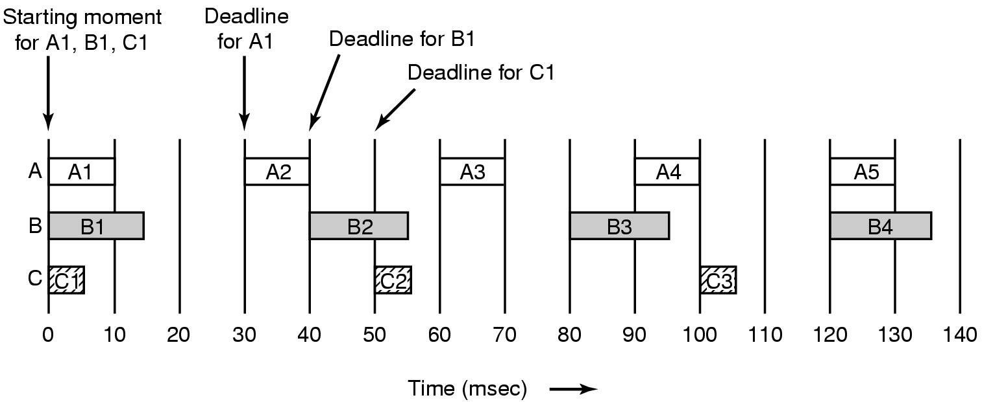
Multimedia Process Scheduling
Periodic processes displaying a movie
Frame rates and processing requirements may be different for each movie

Slide 15
Rate Monotonic Scheduling
Used for processes which meet these conditions
Each periodic process must complete within its period
No process dependent on any other process
Each process needs same CPU time each burst
Any nonperiodic processes have no deadlines
Process preemption occurs instantaneously, no overhead

Slide 16
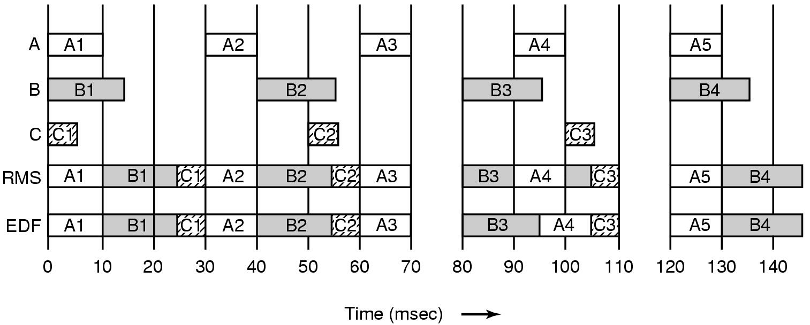
Earliest Deadline First Scheduling (1)
Real Time Scheduling algorithms
  RMS
  EDF

Slide 17
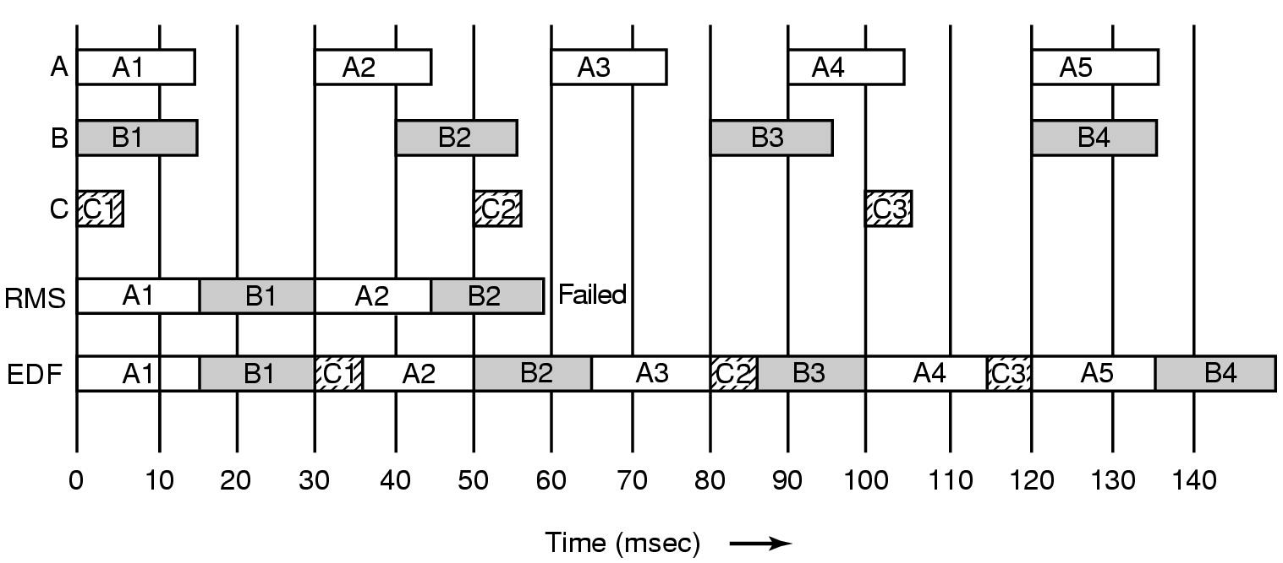
Earliest Deadline First Scheduling (2)
Another example of real-time scheduling with RMS and EDF

Slide 18
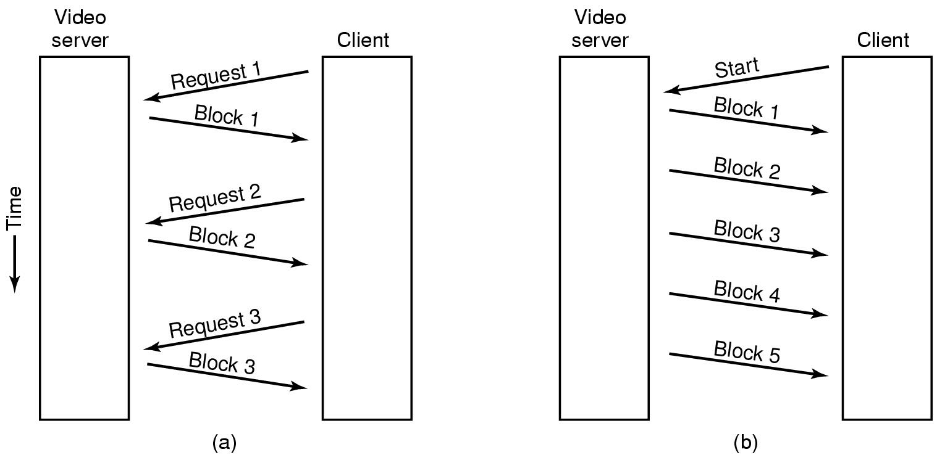
Multimedia File System Paradigms
Pull and Push Servers

Slide 19
VCR Control Functions
Rewind is simple
  set next frame to zero
Fast forward/backward are trickier
  compression makes rapid motion complicated
  special file containg e.g. every 10th frame

Slide 20
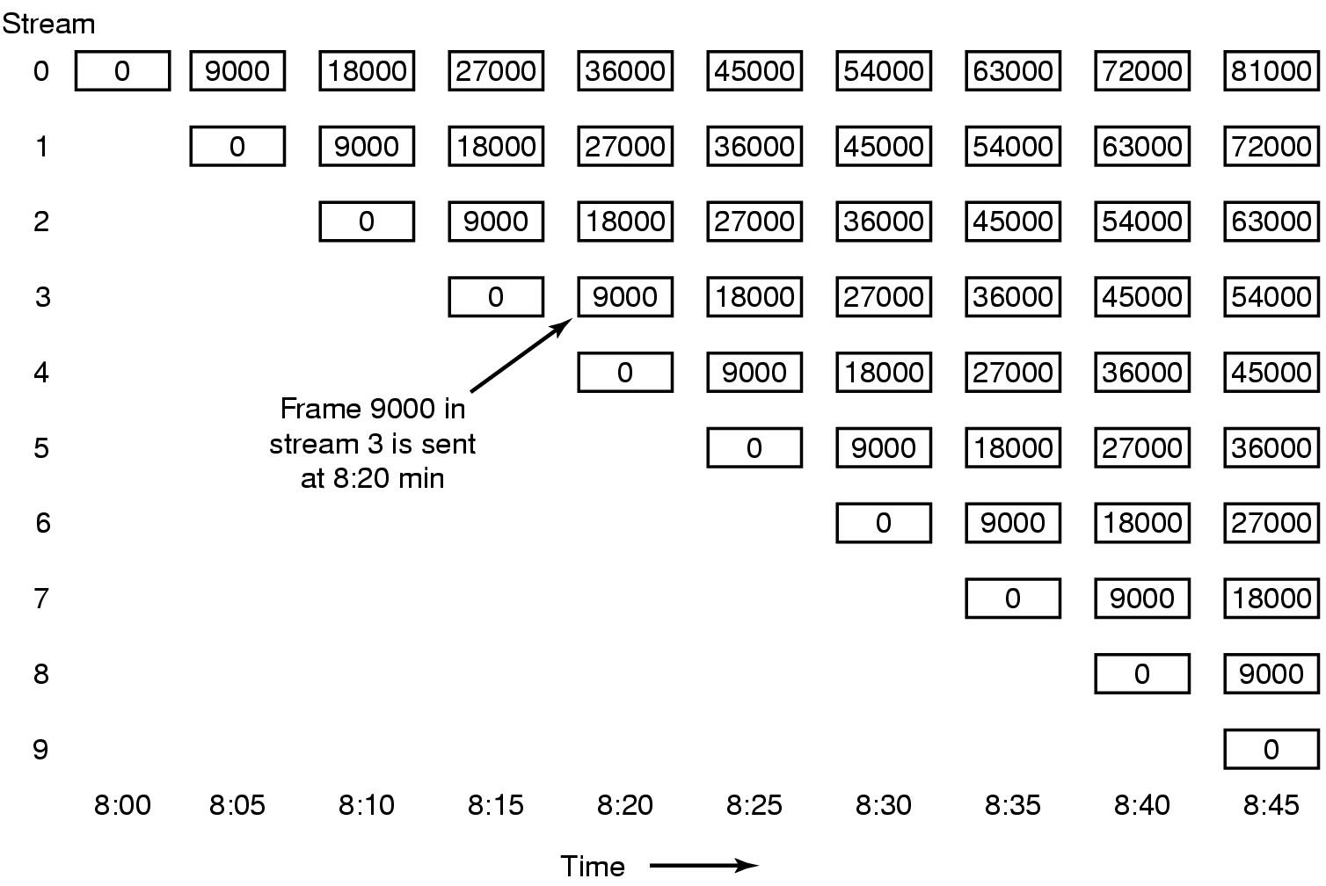
Near Video on Demand
New stream starting at regular intervals

Slide 21
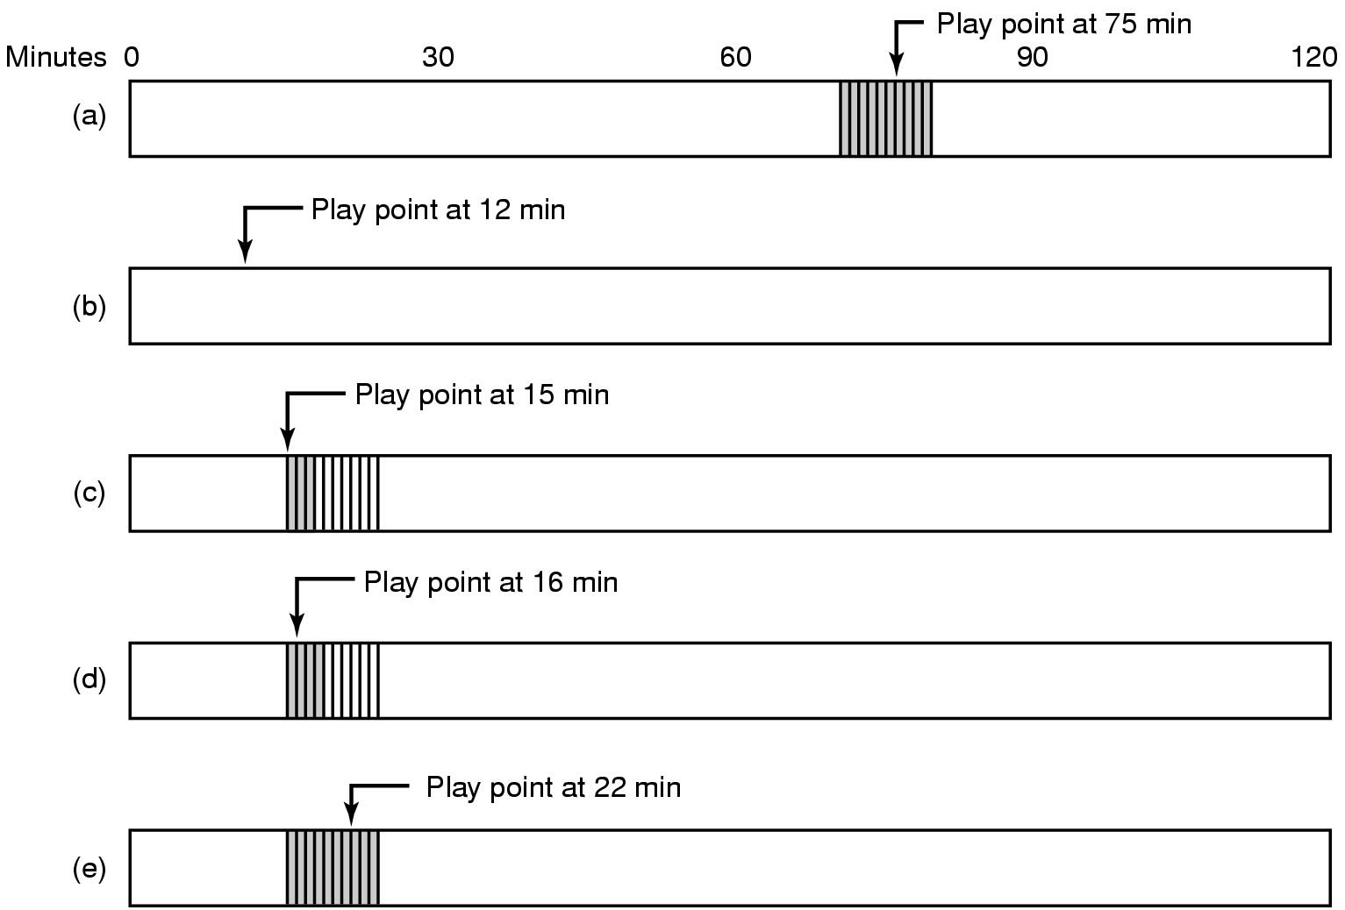
Near Video on Demand with VCR Functions
Buffering for Rewind

Slide 22
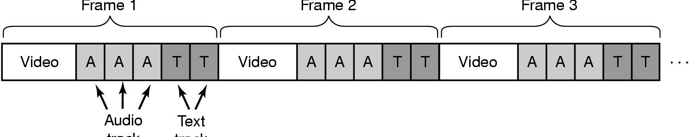
File Placement
Frame 1
Frame 2
Frame 3
Audio
Frame
Text
Frame
Placing a File on a Single Disk
Interleaving
  Video, audio, text in single contiguous file per movie

Slide 23
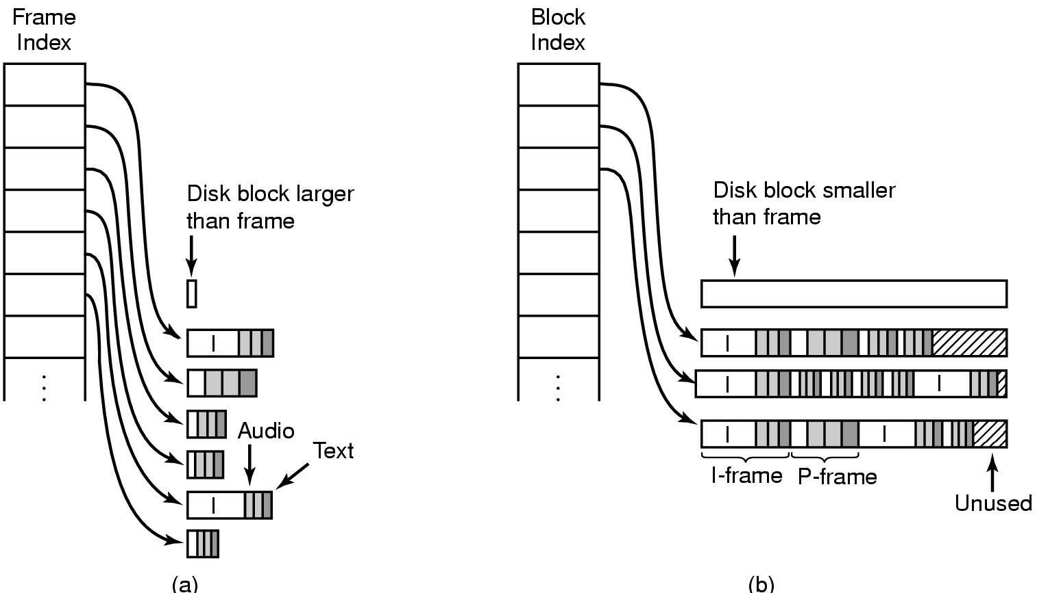
Two Alternative File Organization Strategies (1)
Noncontiguous Movie Storage
  (a) small disk blocks
  (b) large disk blocks

Slide 24
Two Alternative File Organization Strategies (2)
Trade-offs between small, large blocks
Frame index
  heavier RAM usage during movie play
  little disk wastage
Block index (no splitting frames over blocks)
  low RAM usage
  major disk wastage
Block index (splitting frames over blocks allowed)
  low RAM usage
  no disk wastage
  extra seeks

Slide 25
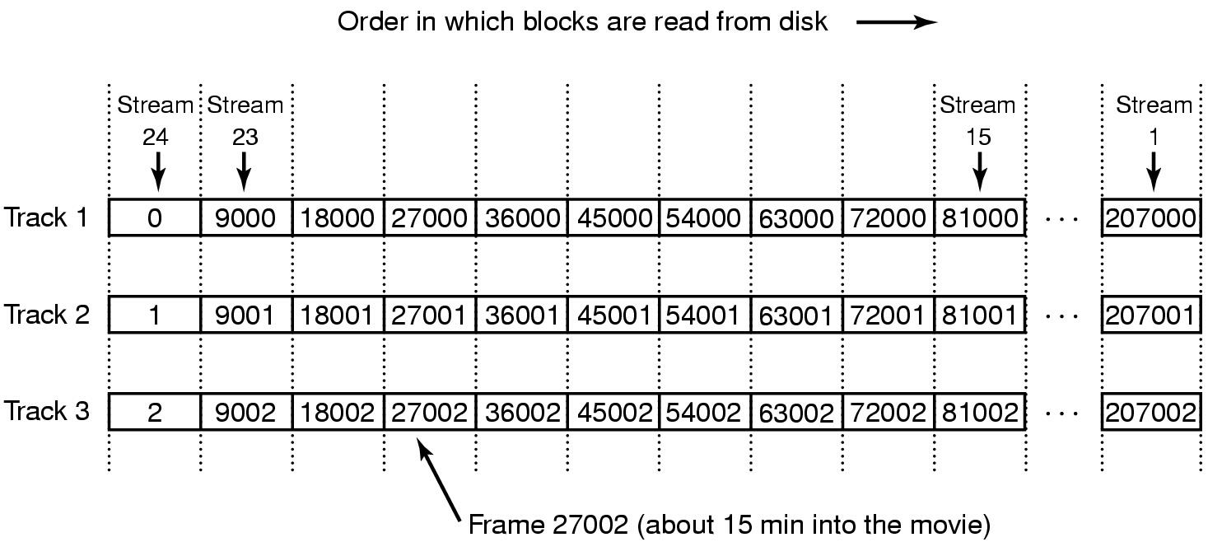
Placing Files for Near Video on Demand
Optimal frame placement for near video on demand

Slide 26
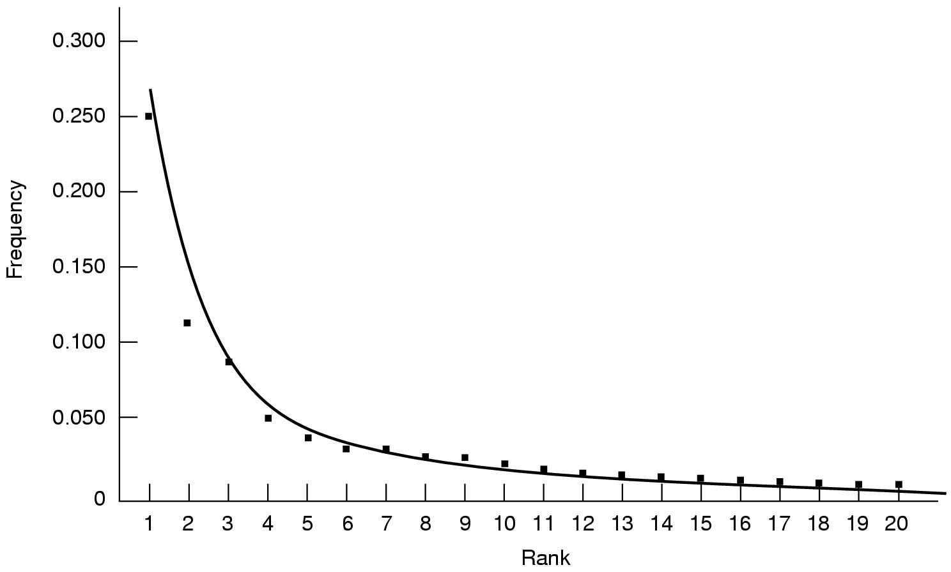
Placing Multiple files on a Single Disk (1)
Zipf's law for N=20
Squares for 20 largest cities in US
  sorted on rank order

Slide 27
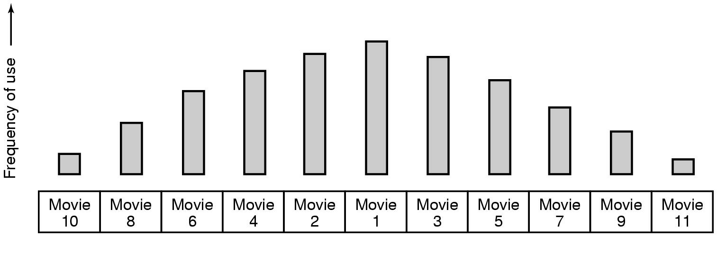
Placing Multiple files on a Single Disk (2)
Organ-pipe distribution of files on server
  most popular movie in middle of disk
  next most popular either on either side, etc.

Slide 28
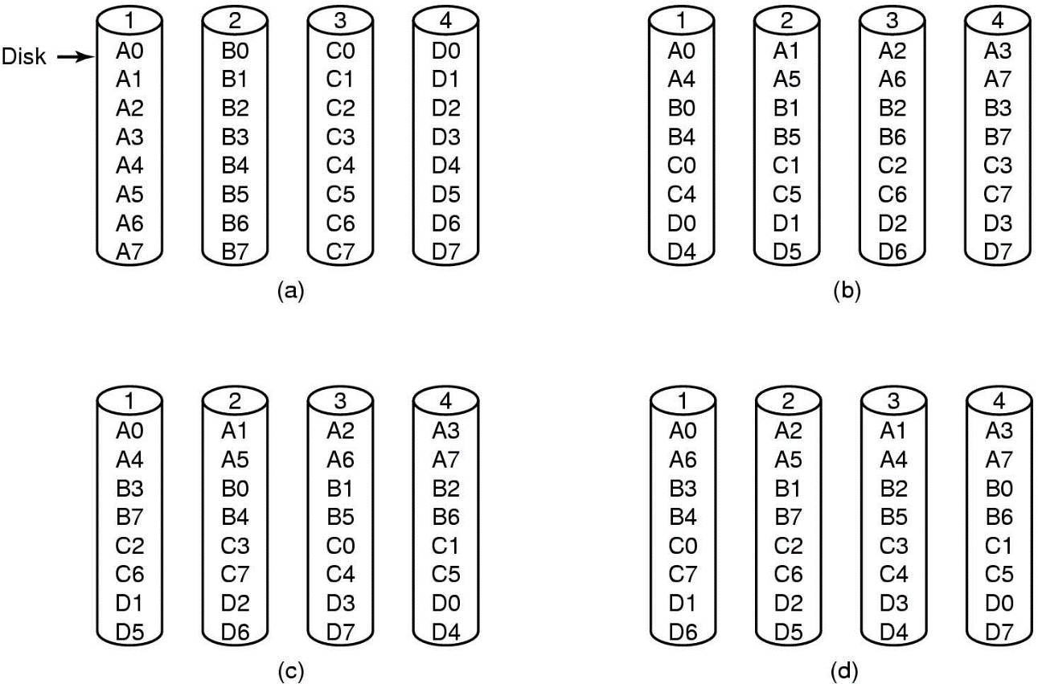
Placing Files on Multiple Disks
Organize multimedia files on multiple disks
(a) No striping
(b) Same striping pattern for all files
(c) Staggered striping
(d) Random striping

Slide 29
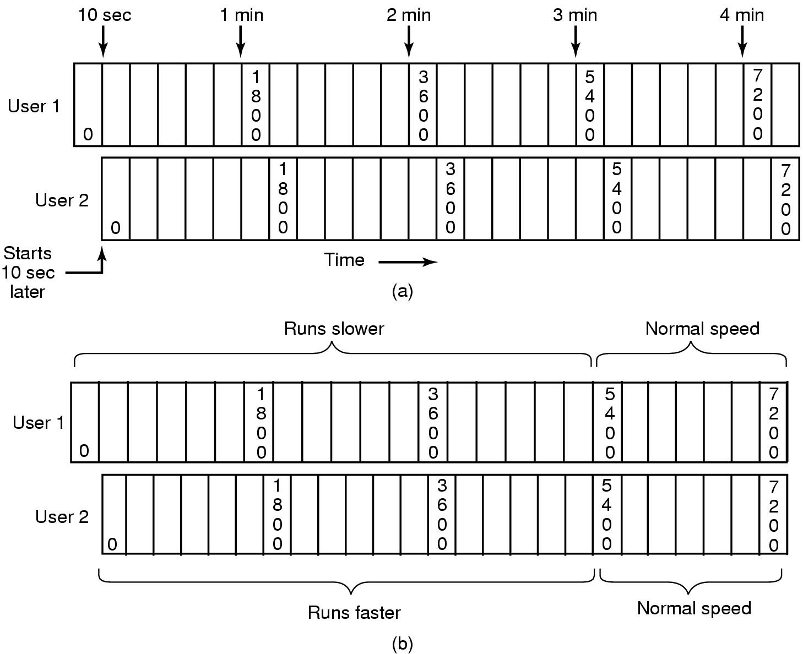
Caching
Block Caching
(a) Two users, same movie 10 sec out of sync
(b) Merging two streams into one

Slide 30
File Caching
Most movies stored on DVD or tape
  copy to disk when needed
  results in large startup time
  keep most popular movies on disk
Can keep first few min. of all movies on disk
  start movie from this while remainder is fetched

Slide 31
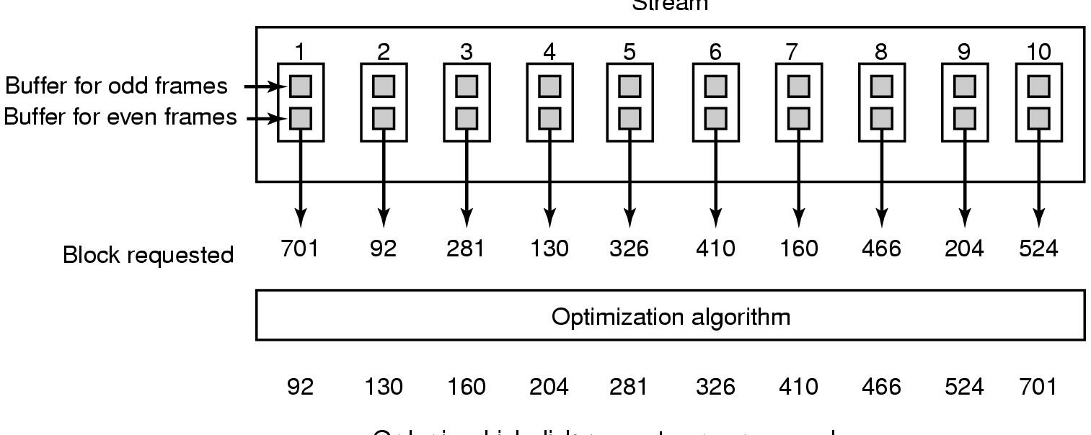
Disk Scheduling for Multimedia
Stream
Order in which disk requests are processed →
Static Disk Scheduling
In one round, each movie asks for one frame

Slide 32
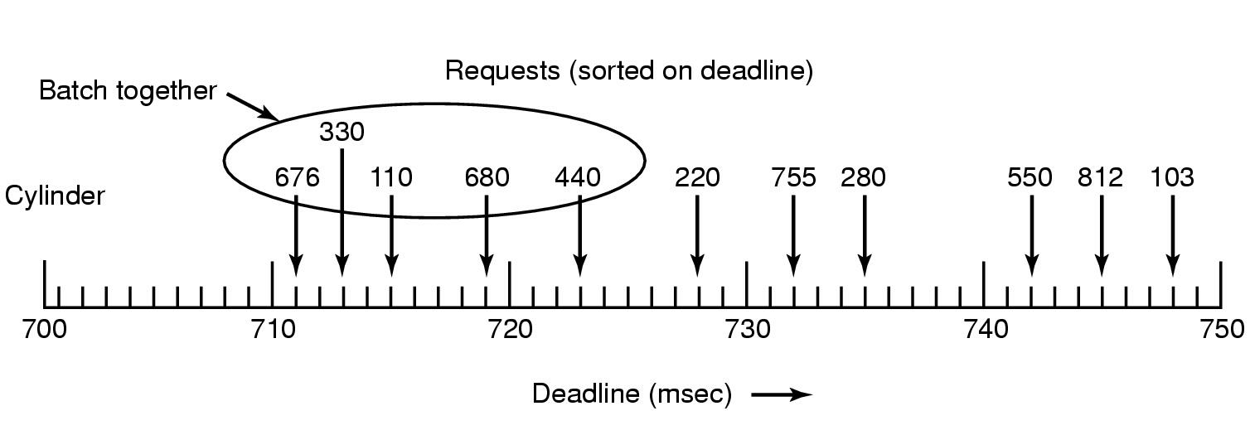
Dynamic Disk Scheduling
Scan-EDF algorithm
  uses deadlines & cylinder numbers for scheduling

