Slide 1
Chapter 2
Processes
1

Slide 2
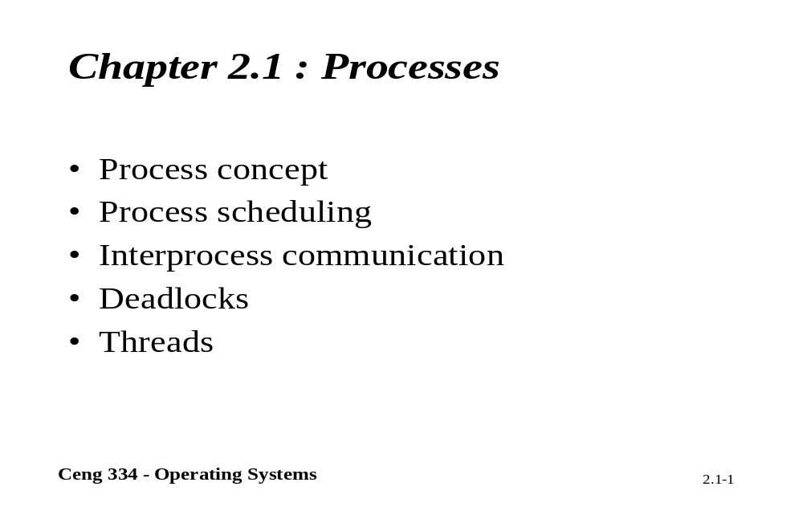
Processes and Others?

Slide 3
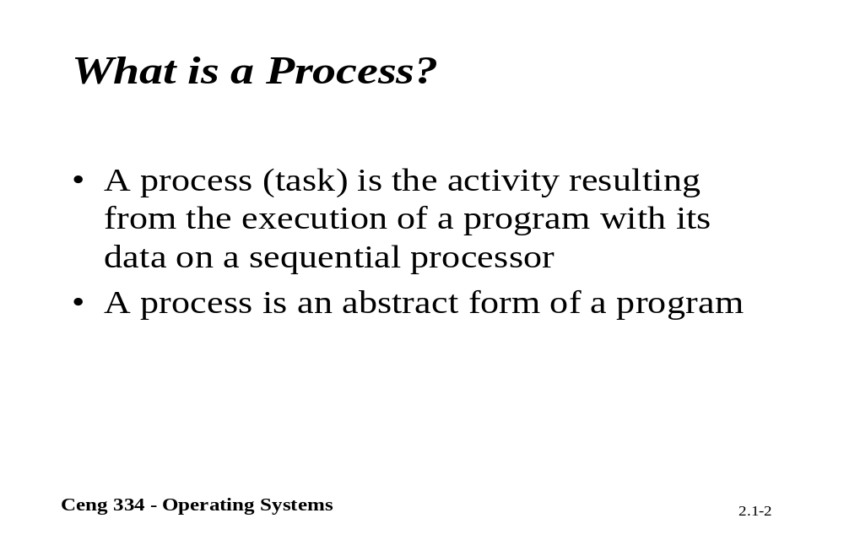
What is a Process?

Slide 4

Processes
The Process Model
Multiprogramming of four programs
Conceptual model of 4 independent, sequential processes
Only one program active at any instant

Slide 5
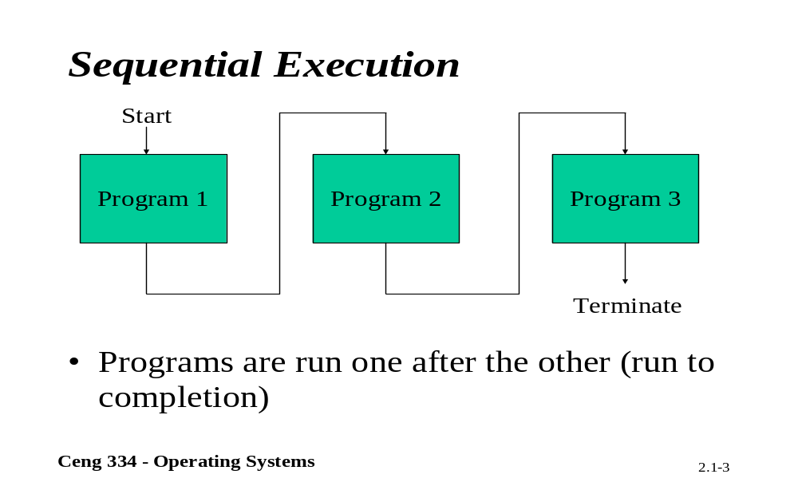
Sequential Execution

Slide 6
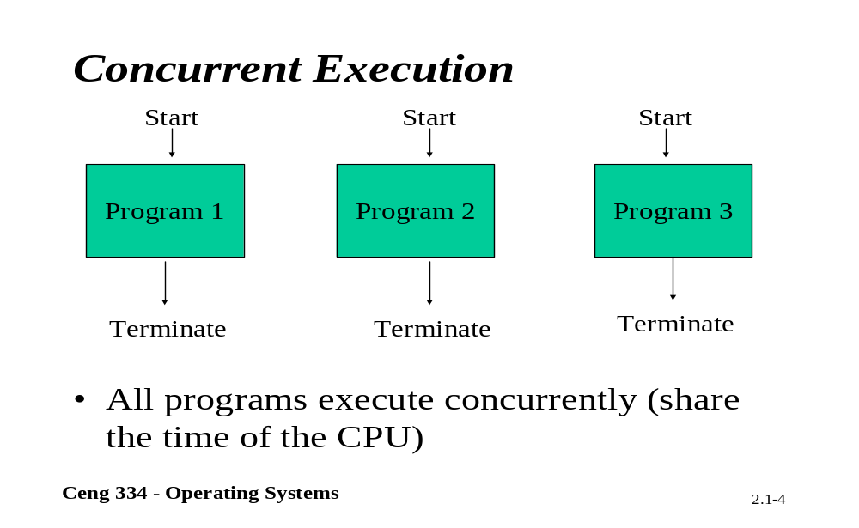
Concurrent Execution

Slide 7
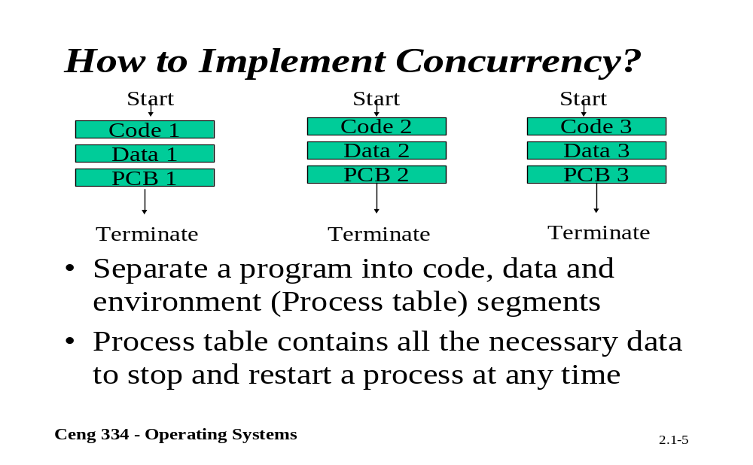
How to implement Concurrency

Slide 8
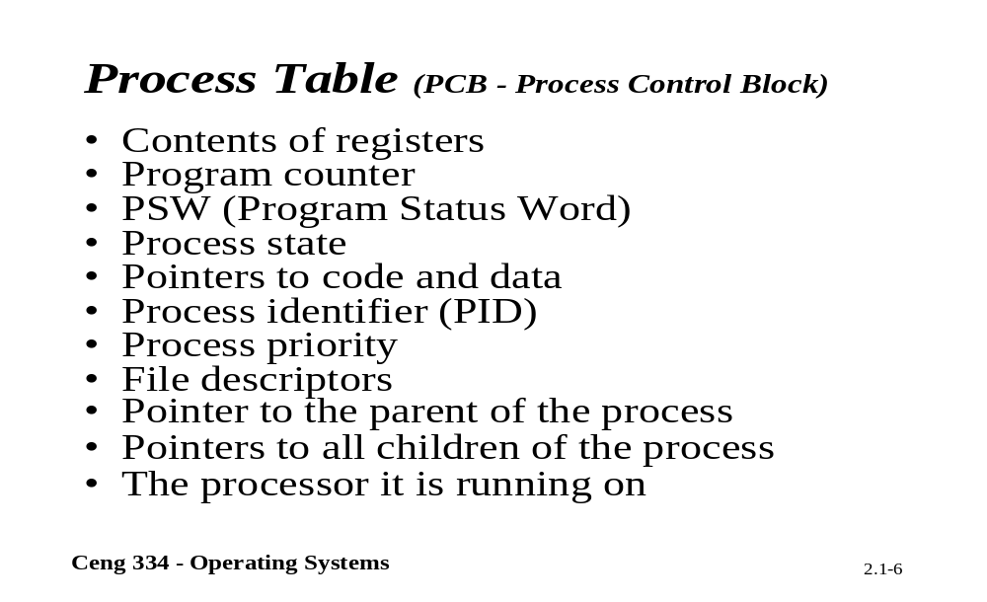
Process Table

Slide 9
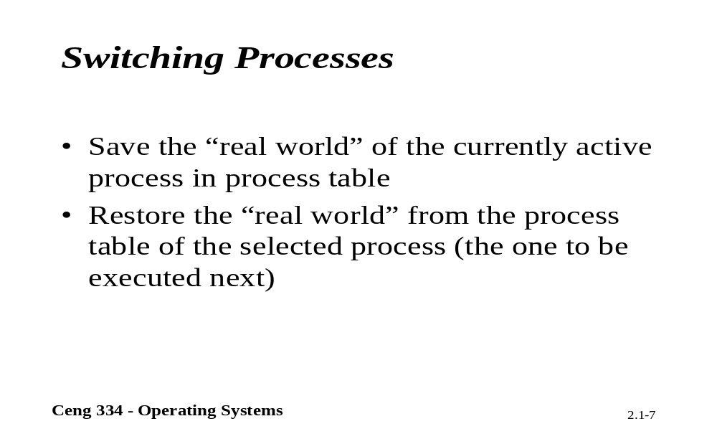
Switching Processes

Slide 10
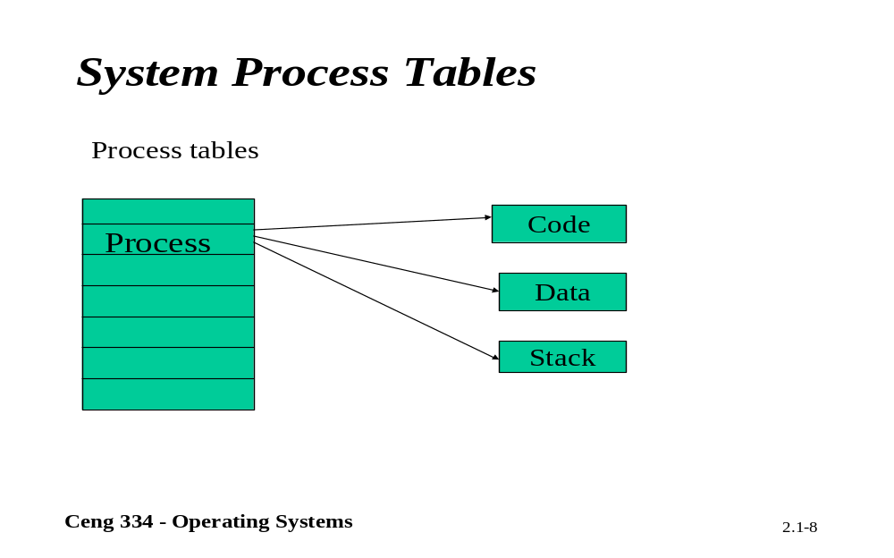
System Process Tables

Slide 11
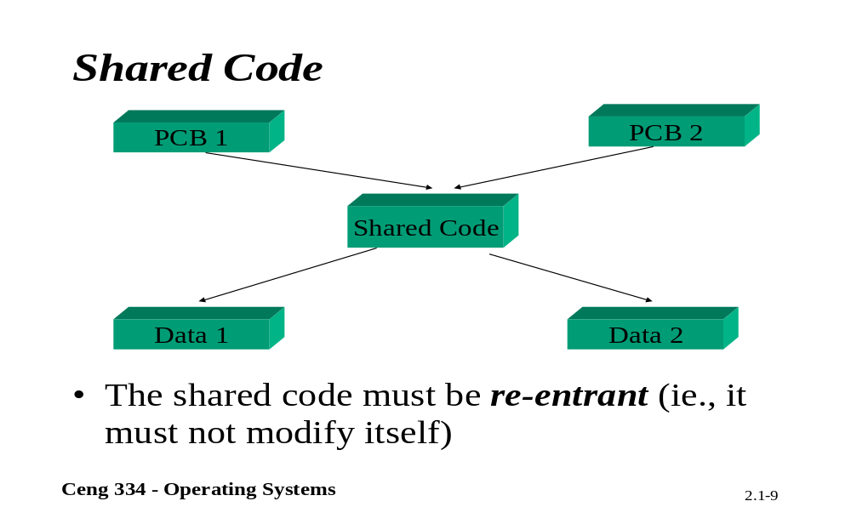
Shared Code

Slide 12
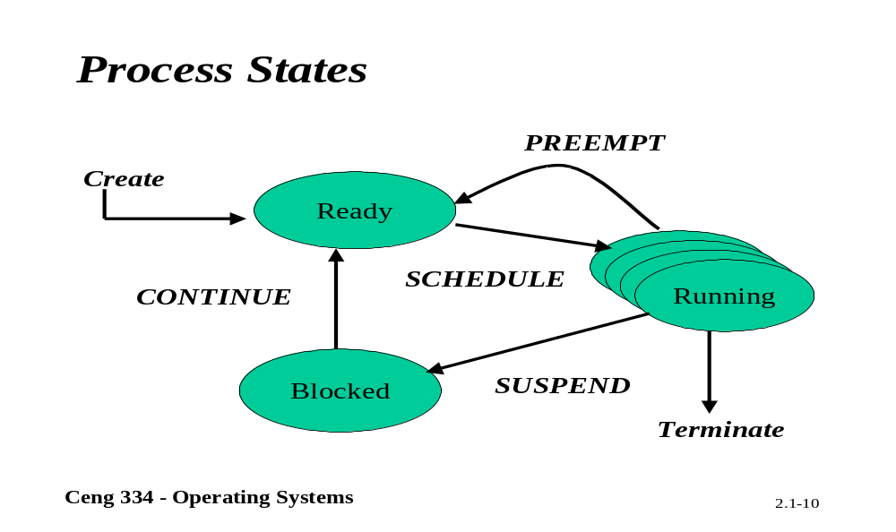
Process States

Slide 13
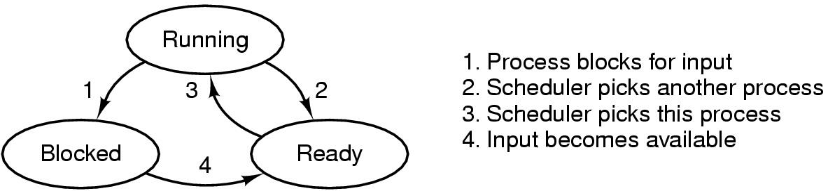
Process States (1)
Possible process states
  running
  blocked
  ready
Transitions between states shown

Slide 14
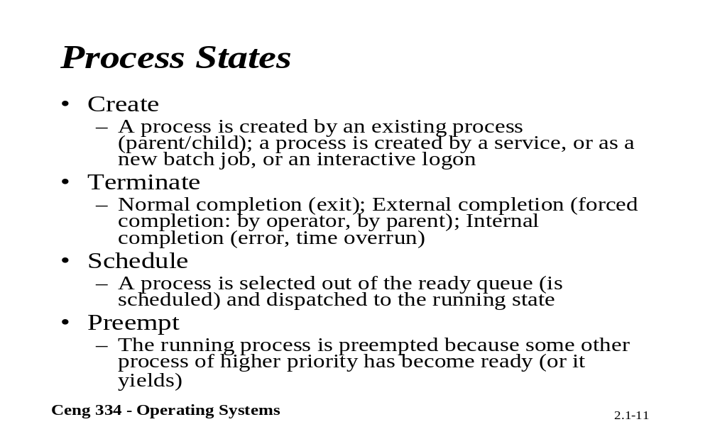
Process States

Slide 15
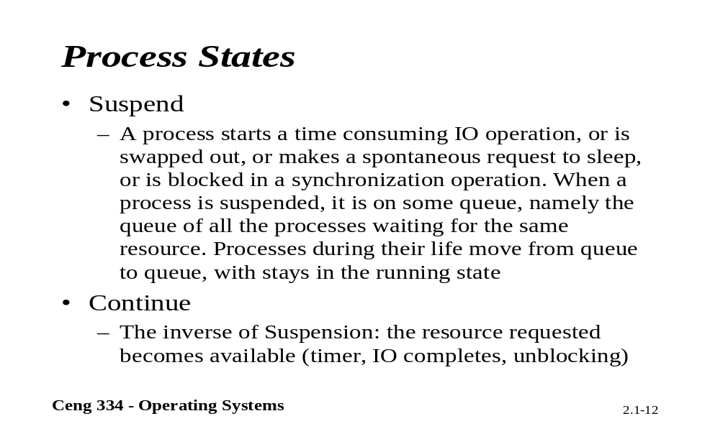
Process States

Slide 16
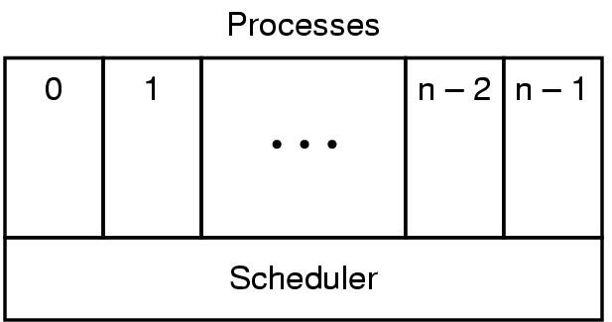
Process States (2)
Lowest layer of process-structured OS
  handles interrupts, scheduling
Above that layer are sequential processes

Slide 17
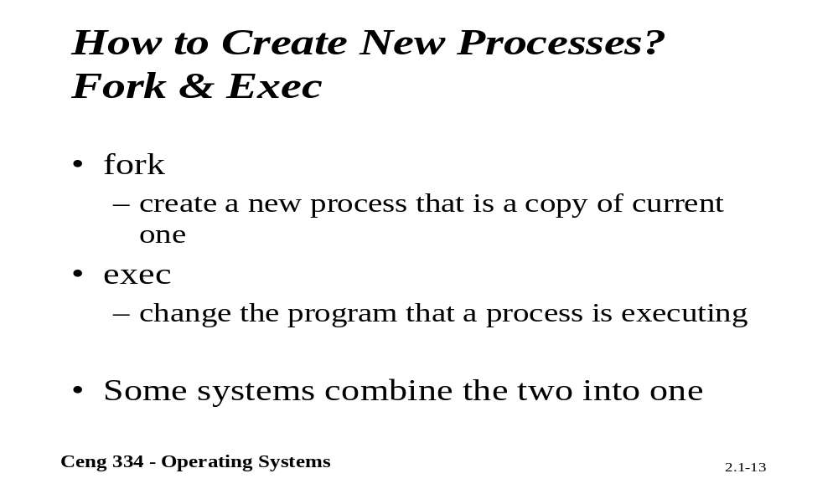
Creating New Process?

Slide 18
Process Creation
Principal events that cause process creation
System initialization
Execution of a process creation system
User request to create a new process
Initiation of a batch job

Slide 19
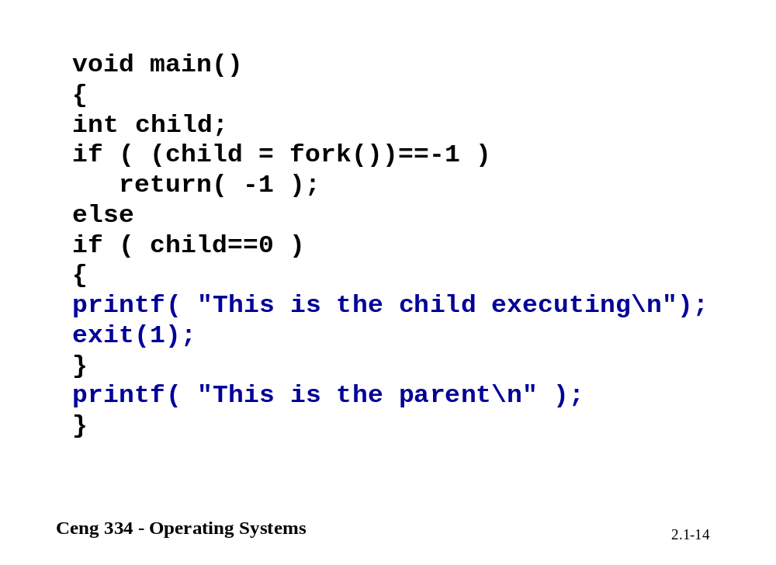

Slide 20
Process Termination
Conditions which terminate processes
Normal exit (voluntary)
Error exit (voluntary)
Fatal error (involuntary)
Killed by another process (involuntary)

Slide 21
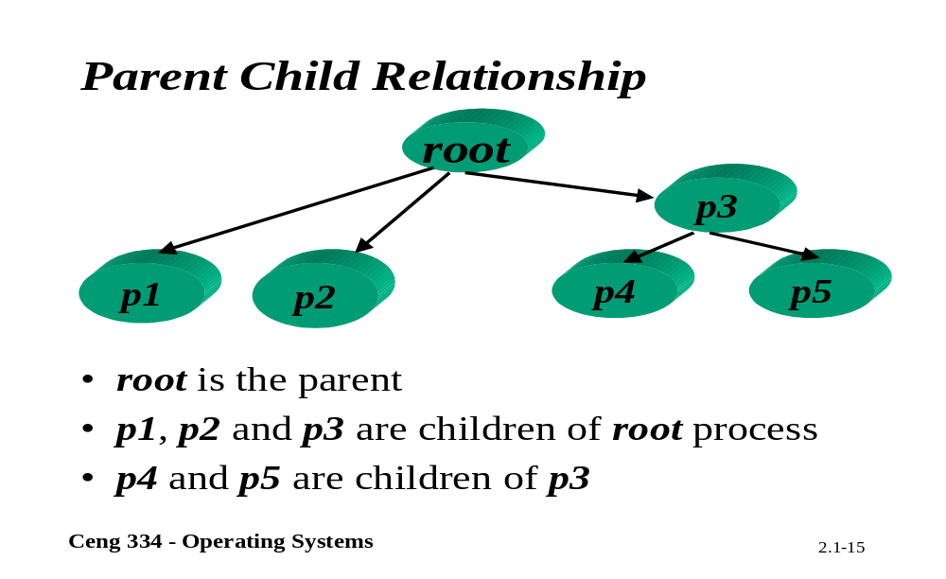
Parent Child Relationship

Slide 22
Process Hierarchies
Parent creates a child process, child processes can create its own process
Forms a hierarchy
  UNIX calls this a "process group"
Windows has no concept of process hierarchy
  all processes are created equal

Slide 23
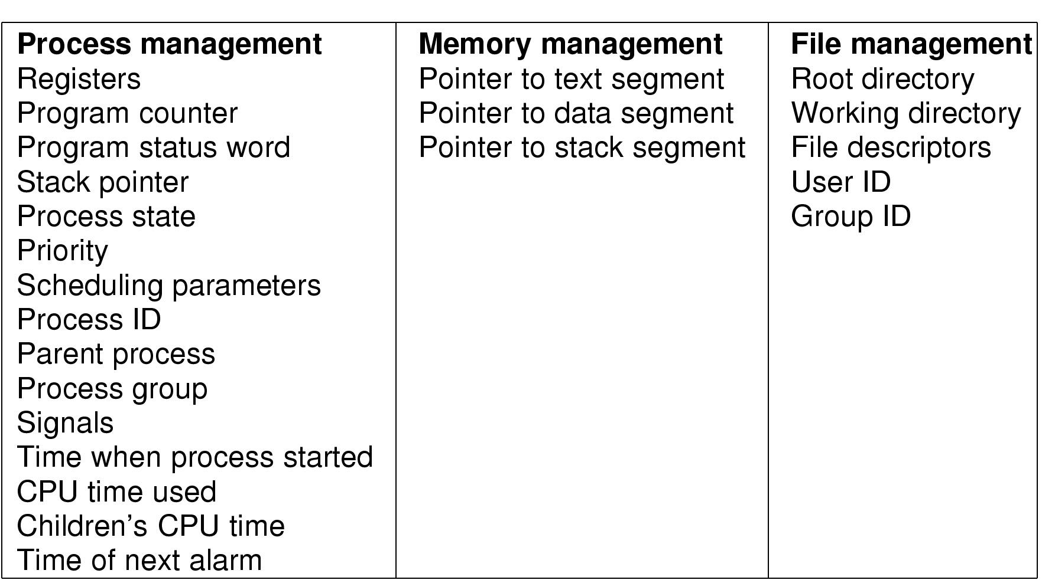
Implementation of Processes (1)
Fields of a process table entry

Slide 24
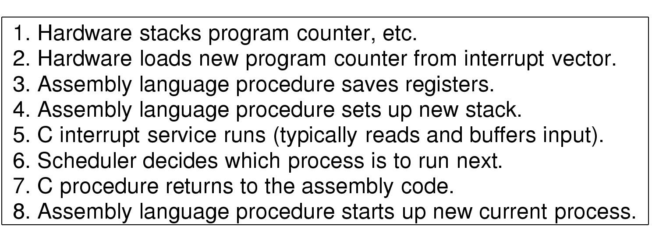
Implementation of Processes (2)
Skeleton of what lowest level of OS does when an interrupt occurs

