Slide 1
Chapter 3
Threads
1

Slide 2
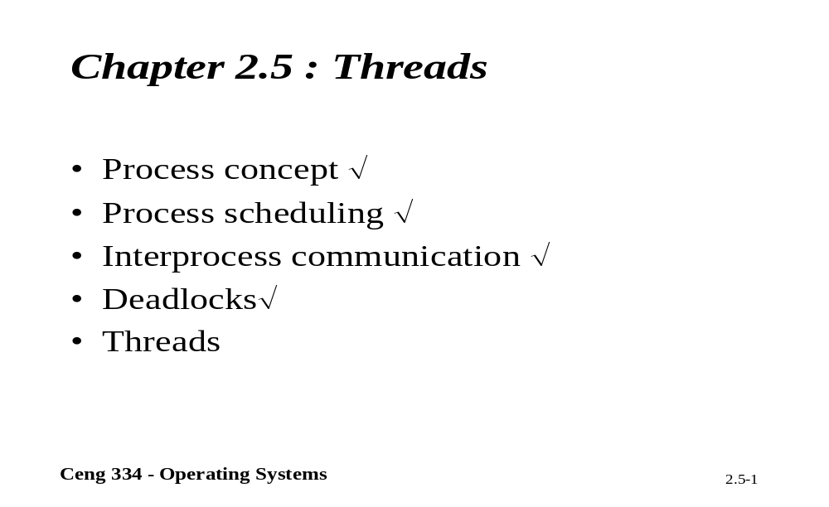
Chapter 2.4: Threads

Slide 3
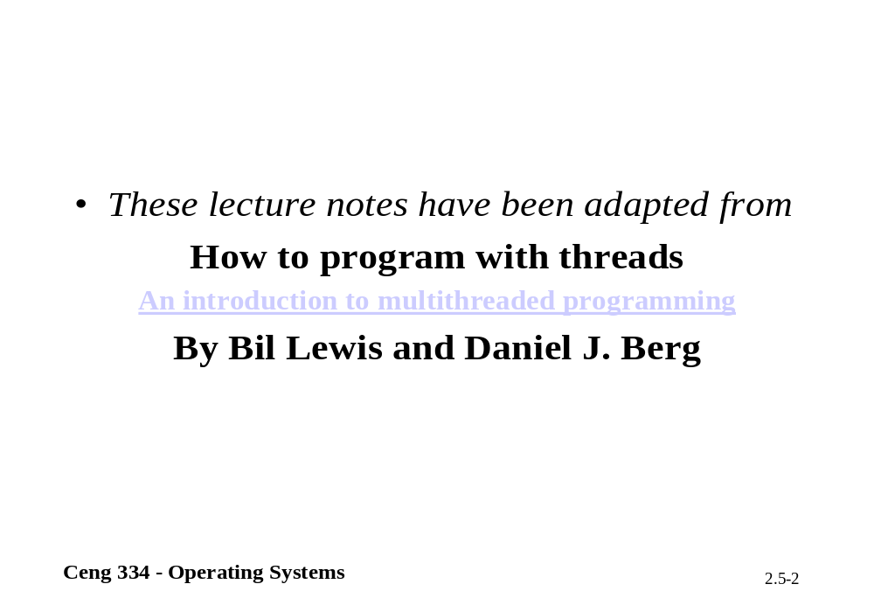

Slide 4
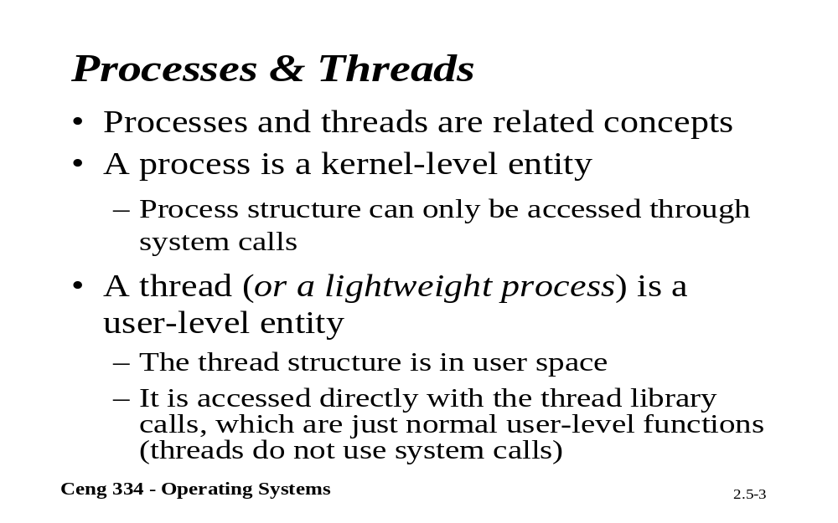
Processes and Threads

Slide 5
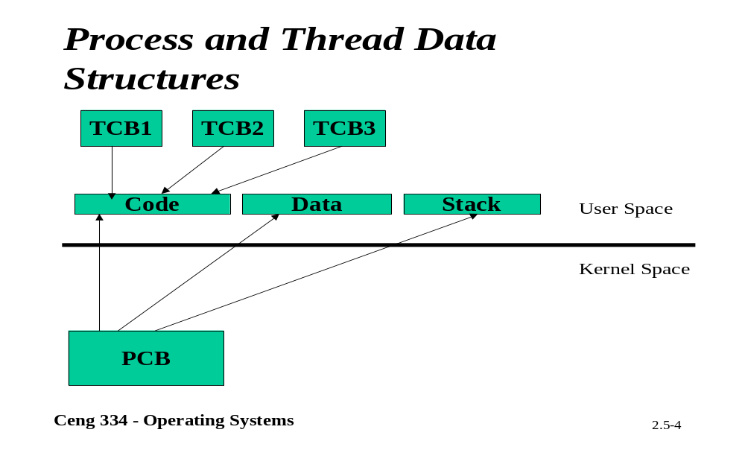
Process-Threads and Data Structures

Slide 6
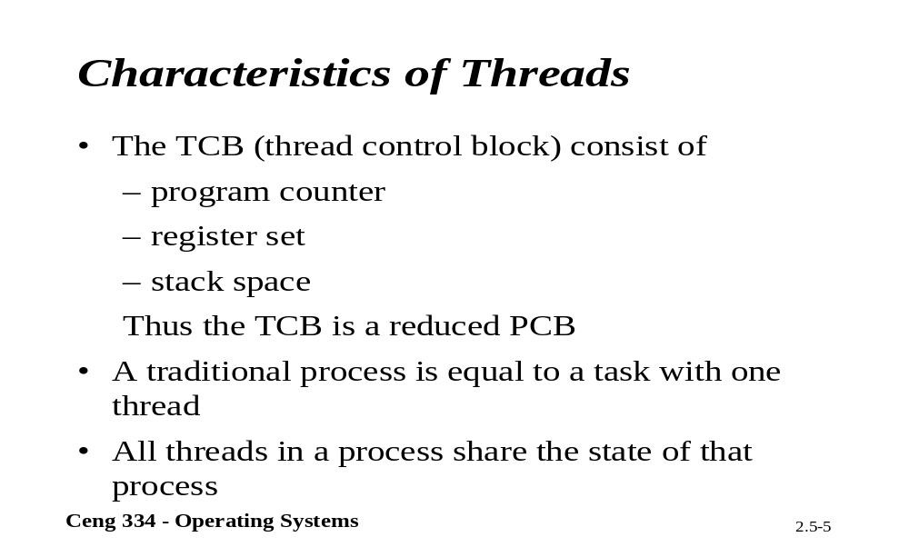
Chracteristics of Threads

Slide 7
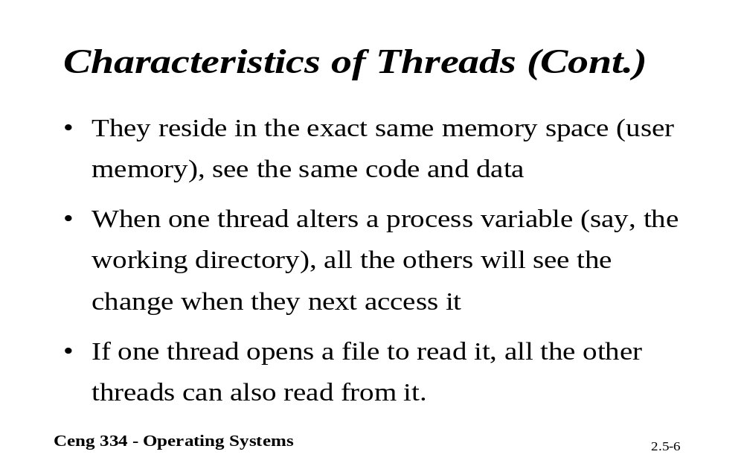
Characteristics of Threads

Slide 8
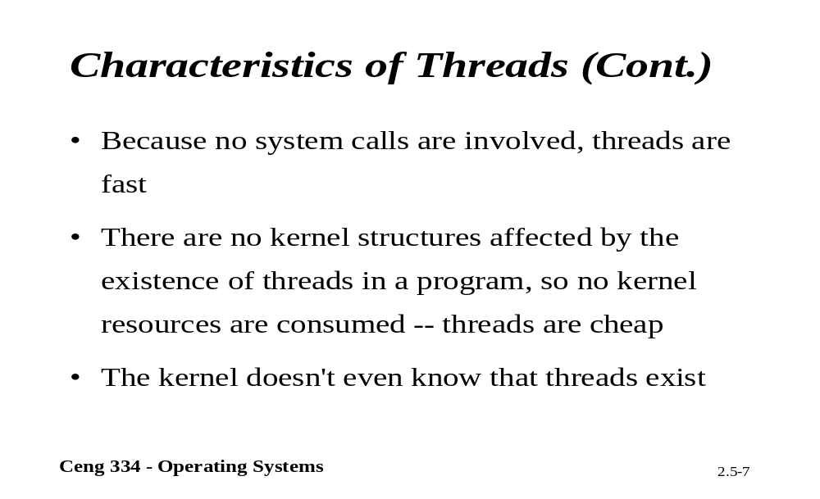
Characteristics of Threads

Slide 9
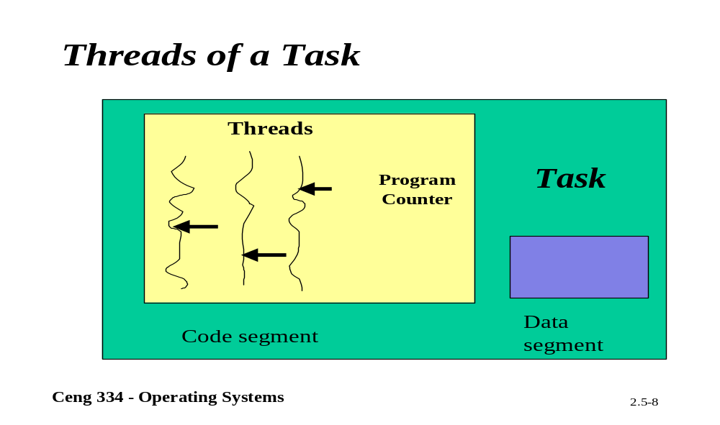
Thredas of a Taks

Slide 10
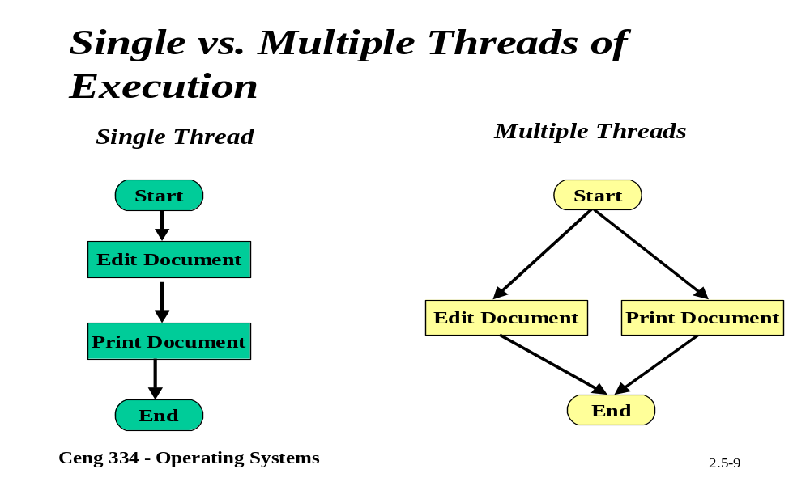
Multiple Threads

Slide 11

Threads
The Thread Model (1)
(a) Three processes each with one thread
(b) One process with three threads

Slide 12
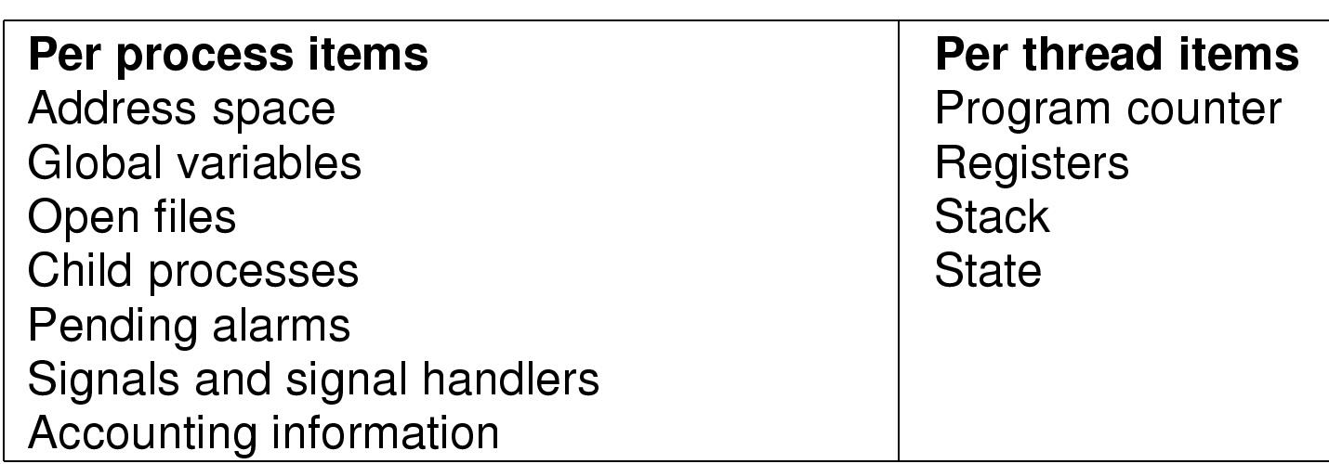
The Thread Model (2)
Items shared by all threads in a process
Items private to each thread

Slide 13

The Thread Model (3)
Each thread has its own stack

Slide 14

Thread Usage (1)
A word processor with three threads

Slide 15

Thread Usage (2)
A multithreaded Web server

Slide 16
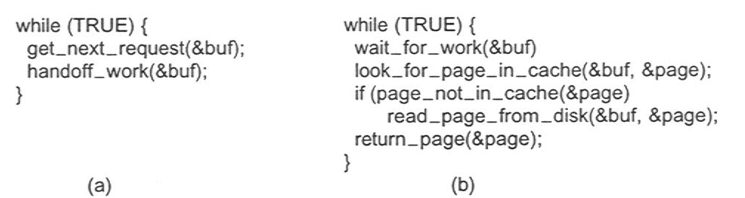
Thread Usage (3)
Rough outline of code for previous slide
  (a) Dispatcher thread
  (b) Worker thread

Slide 17
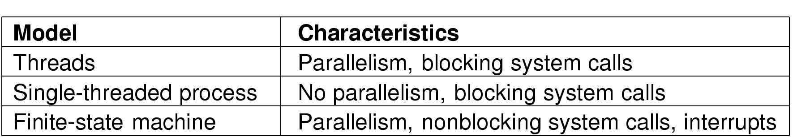
Thread Usage (4)
Three ways to construct a server

Slide 18
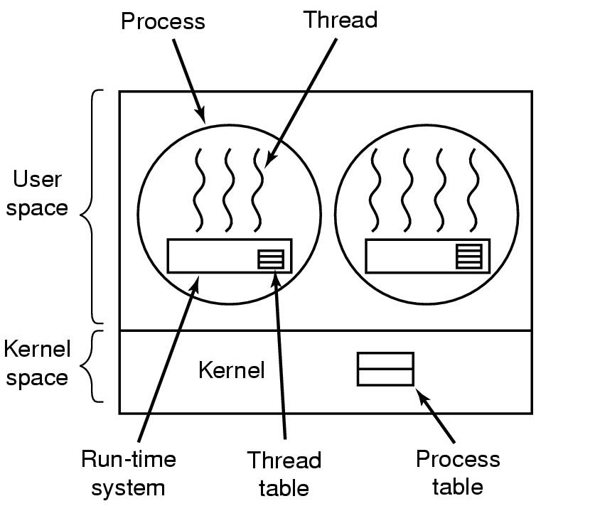
Implementing Threads in User Space
A user-level threads package

Slide 19
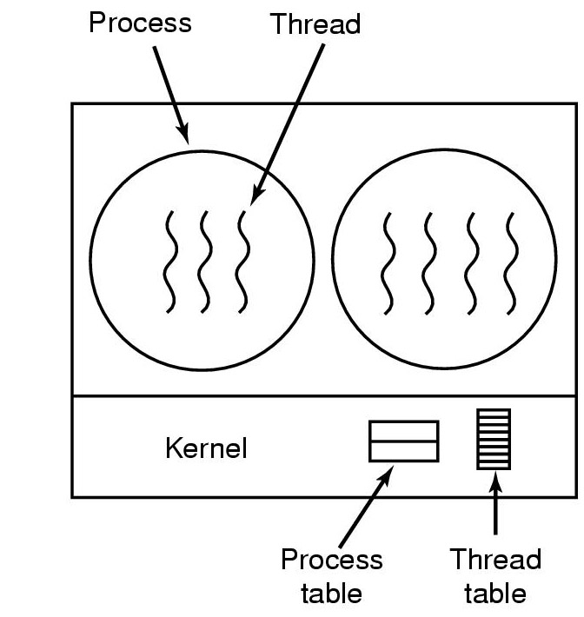
Implementing Threads in the Kernel
A threads package managed by the kernel

Slide 20
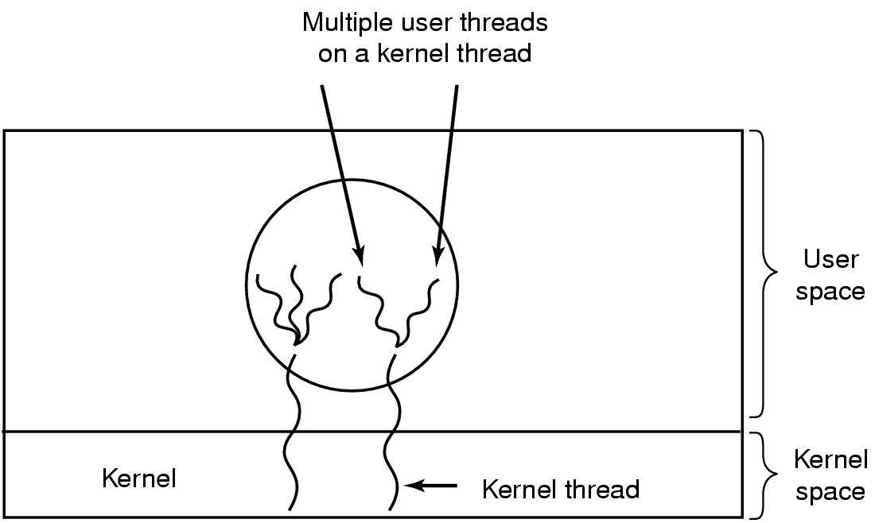
Hybrid Implementations
Multiplexing user-level threads onto kernel- level threads

Slide 21
Scheduler Activations
Goal – mimic functionality of kernel threads
  gain performance of user space threads
Avoids unnecessary user/kernel transitions
Kernel assigns virtual processors to each process
  lets runtime system allocate threads to processors
Problem:
Fundamental reliance on kernel (lower layer)
calling procedures in user space (higher layer)

Slide 22
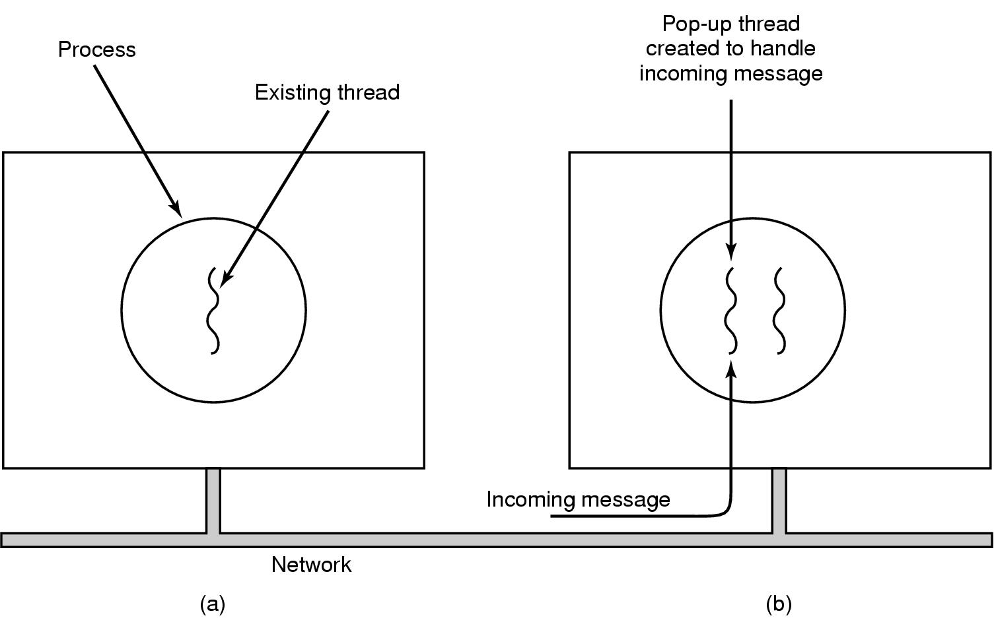
Pop-Up Threads
Creation of a new thread when message arrives
  (a) before message arrives
  (b) after message arrives

Slide 23
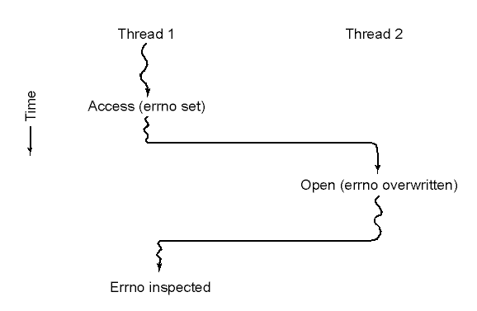
Making Single-Threaded Code Multithreaded (1)
Conflicts between threads over the use of a global variable

Slide 24
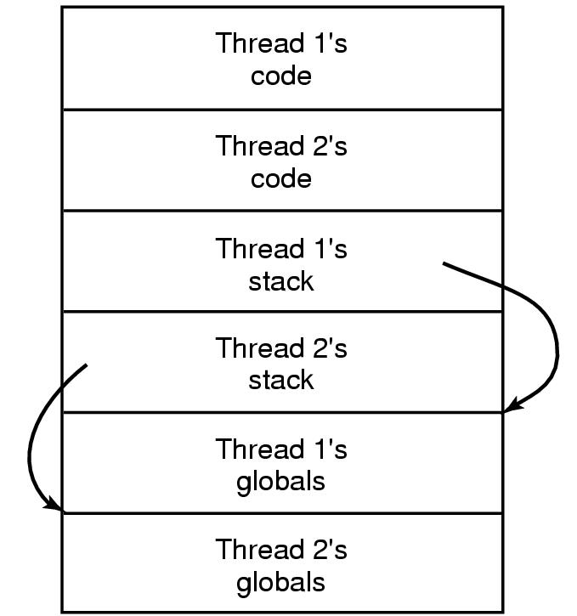
Making Single-Threaded Code Multithreaded (2)
Threads can have private global variables

Slide 25
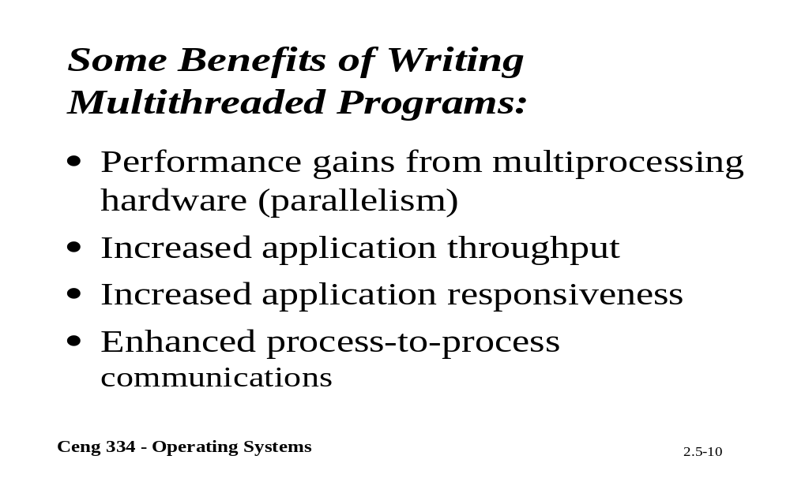
Some Benifits of Multi-Threading

Slide 26
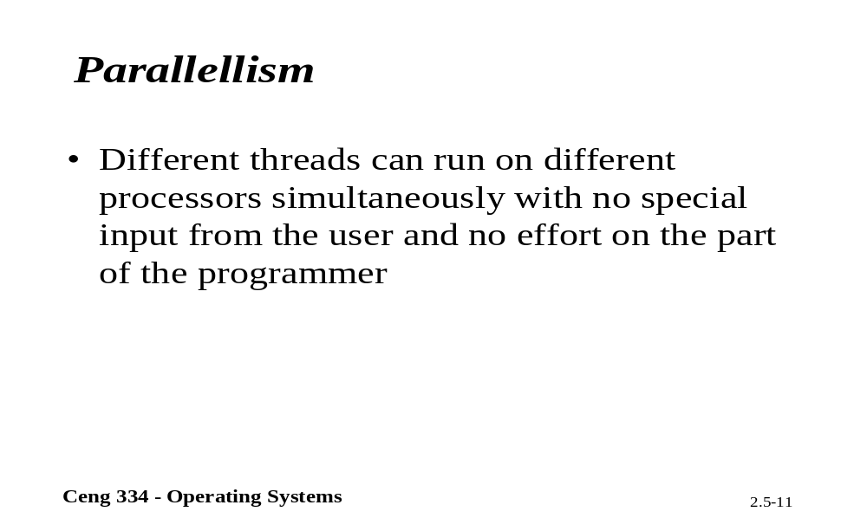
Parallelism

Slide 27
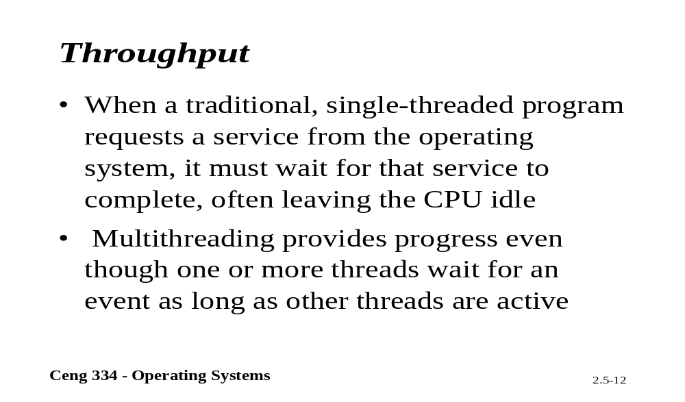
Througput

Slide 28
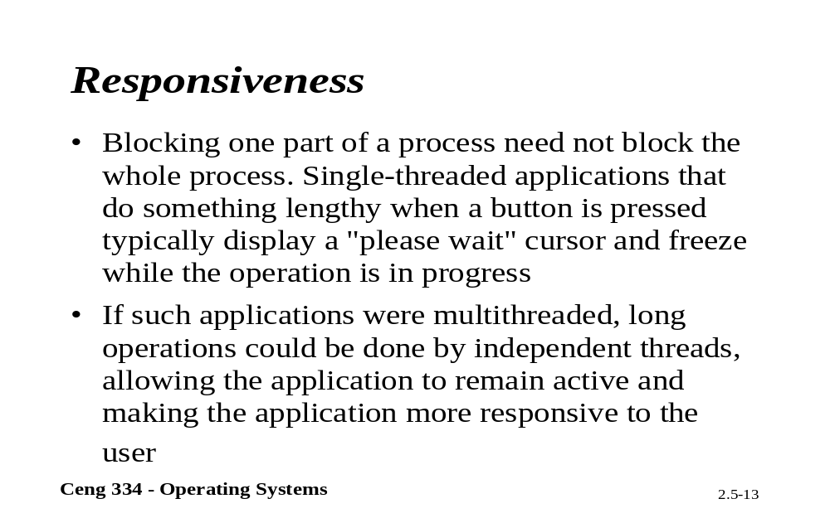
Reponsiveness

Slide 29
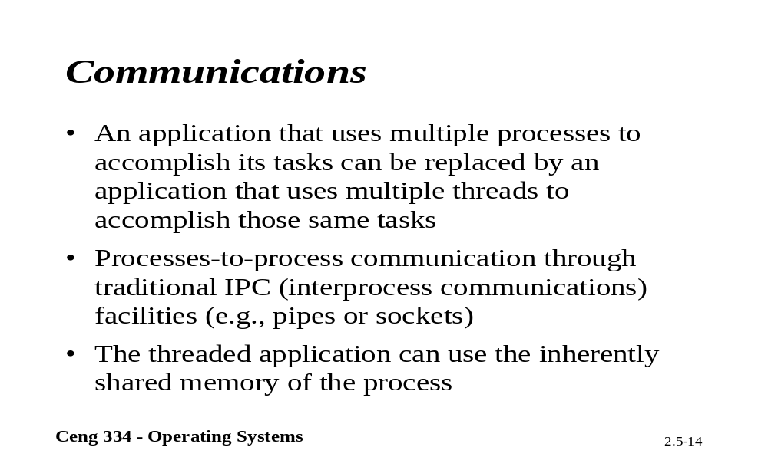
Communication

