Slide 1
Chapter 4
Scheduling
1

Slide 2
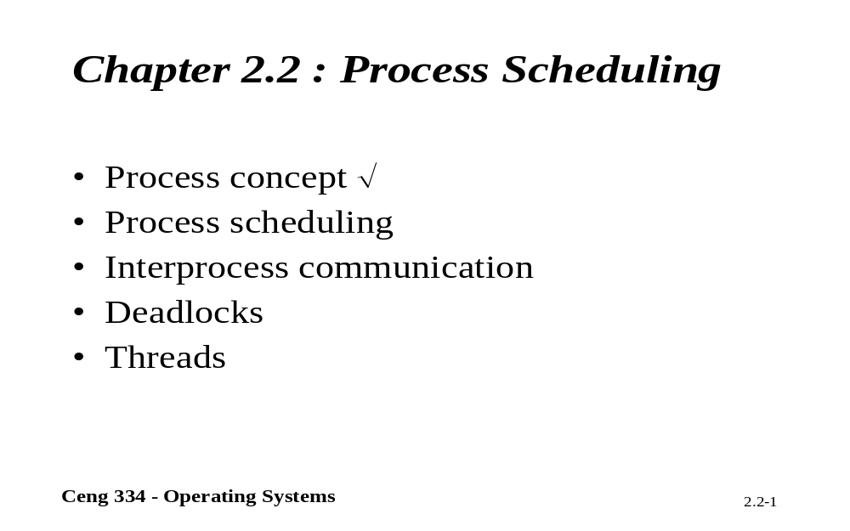
Chapter 2.2: Process Scheduling

Slide 3
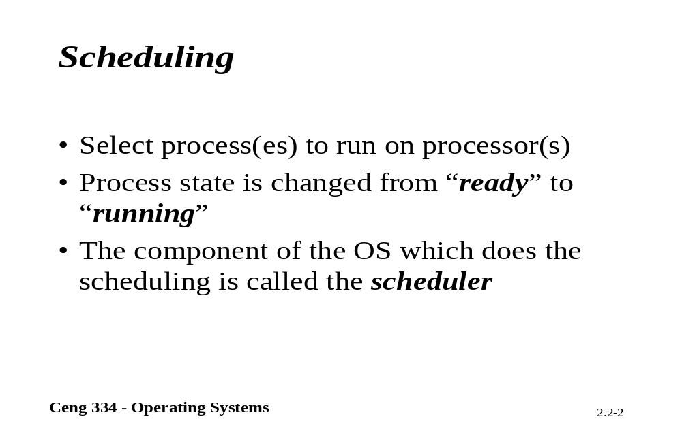
Scheduling

Slide 4

Scheduling
Introduction to Scheduling (1)
Bursts of CPU usage alternate with periods of I/O wait
  a CPU-bound process
  an I/O bound process

Slide 5
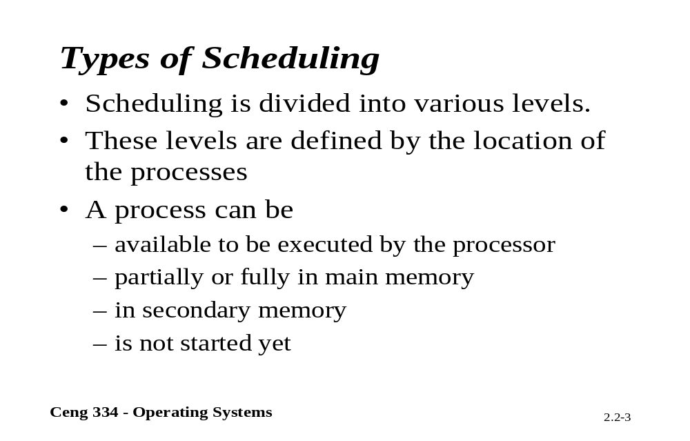
Types of scheduling

Slide 6
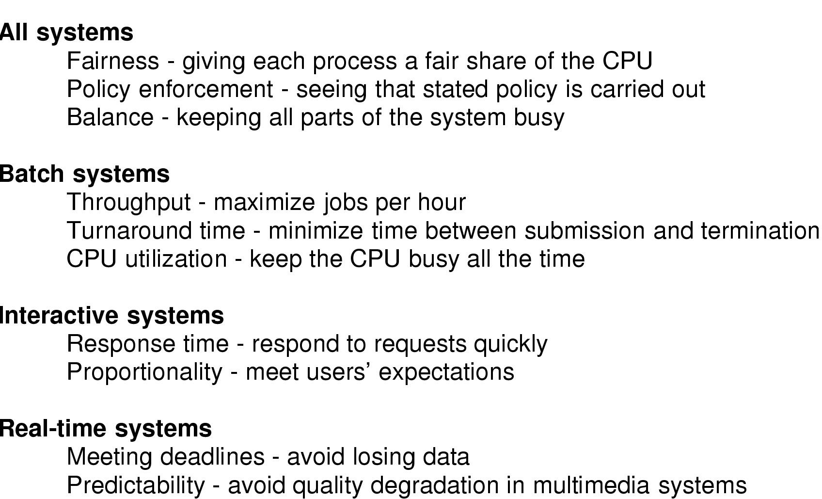
Introduction to Scheduling (2)
Scheduling Algorithm Goals

Slide 7
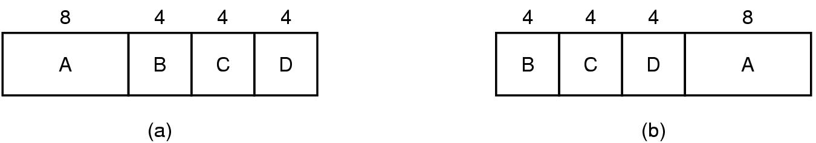
Scheduling in Batch Systems (1)
An example of shortest job first scheduling

Slide 8
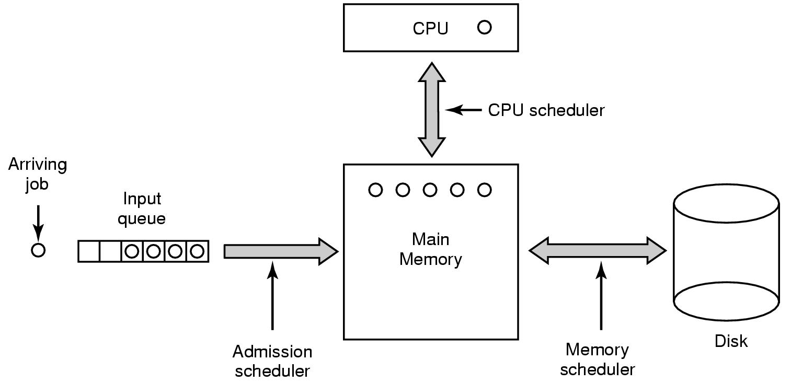
Scheduling in Batch Systems (2)
Three level scheduling

Slide 9
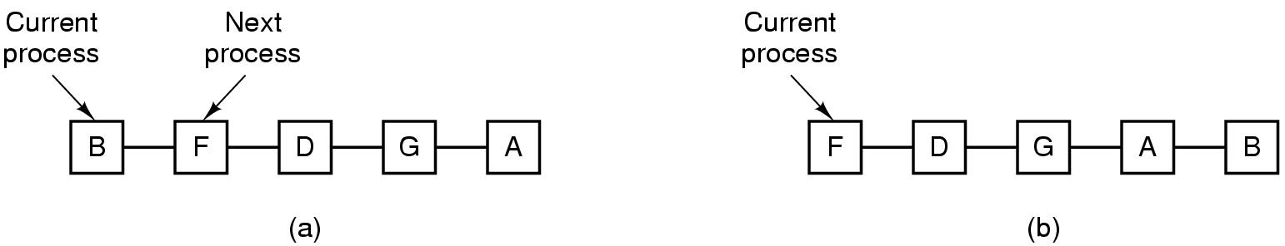
Scheduling in Interactive Systems (1)
Round Robin Scheduling
  list of runnable processes
  list of runnable processes after B uses up its quantum

Slide 10
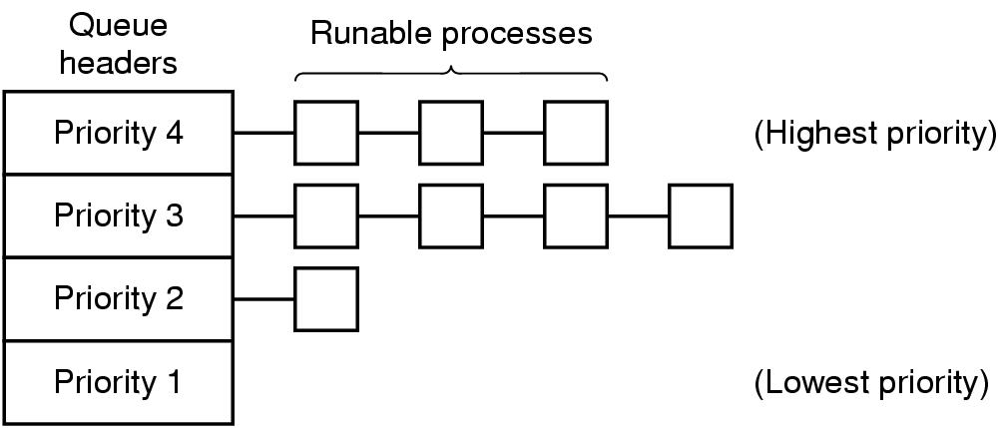
Scheduling in Interactive Systems (2)
A scheduling algorithm with four priority classes

Slide 11
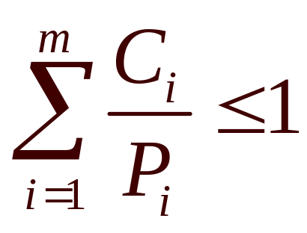
Scheduling in Real-Time Systems
Schedulable real-time system
Given
  m periodic events
  event i occurs within period P_{i} and requires C_{i} seconds
Then the load can only be handled if

Slide 12
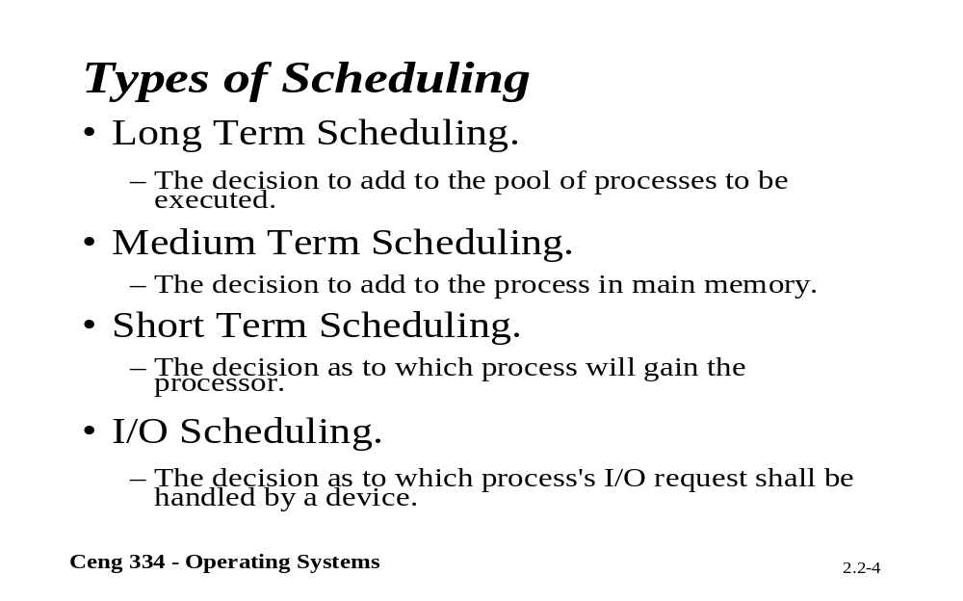
Types of scheduling

Slide 13
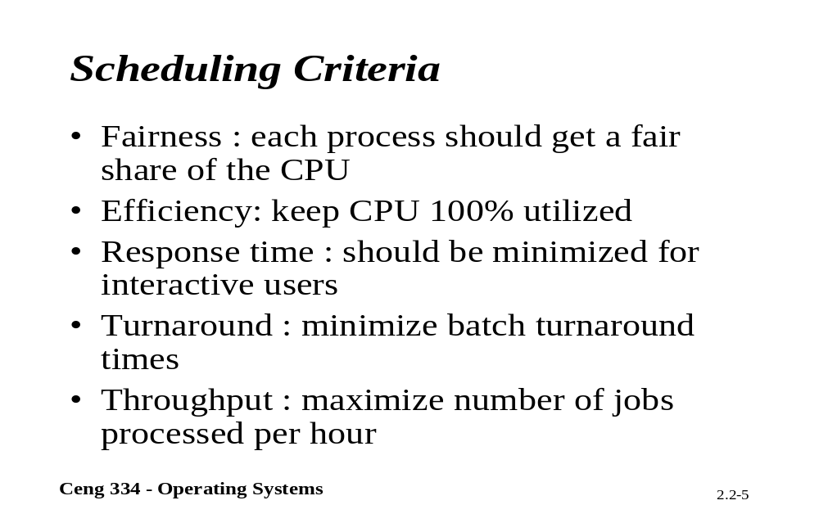
Scheduling Criteria

Slide 14
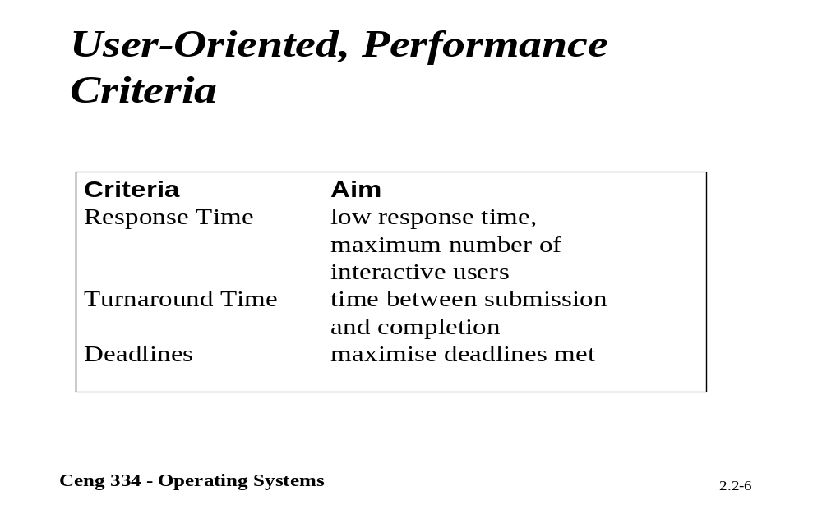
Peformance Criteria

Slide 15
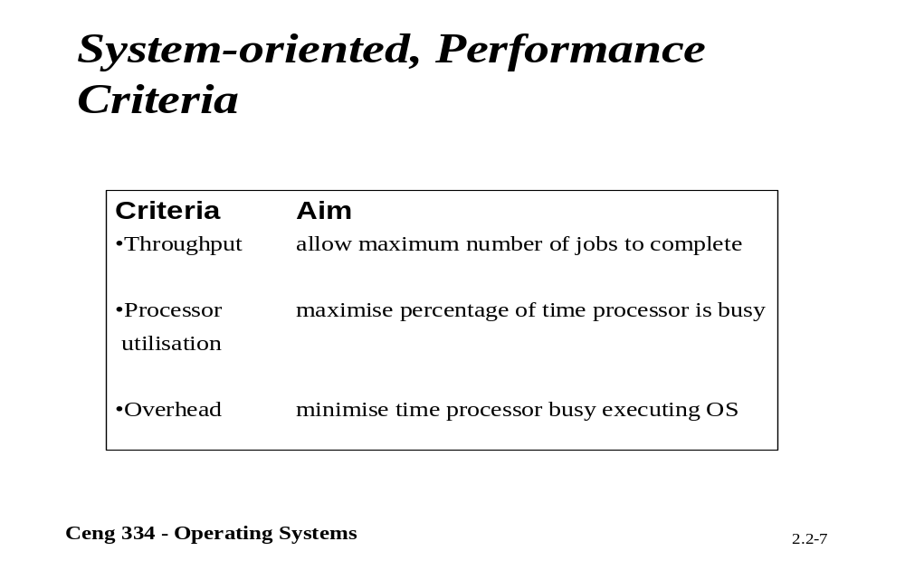
Performance Criteria

Slide 16
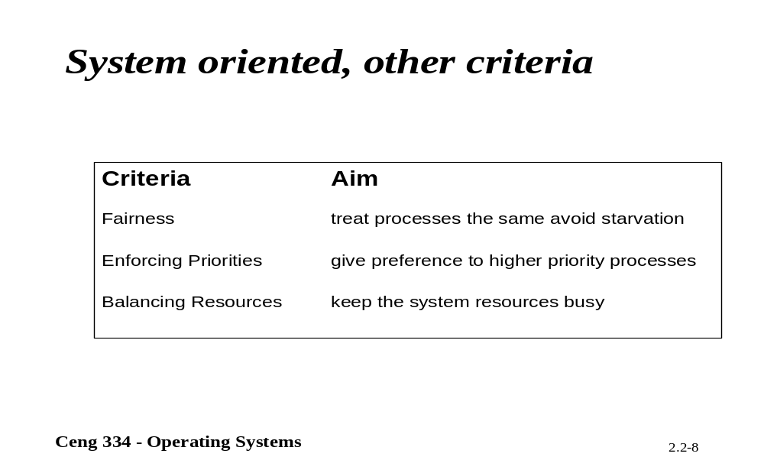
Other criterias

Slide 17
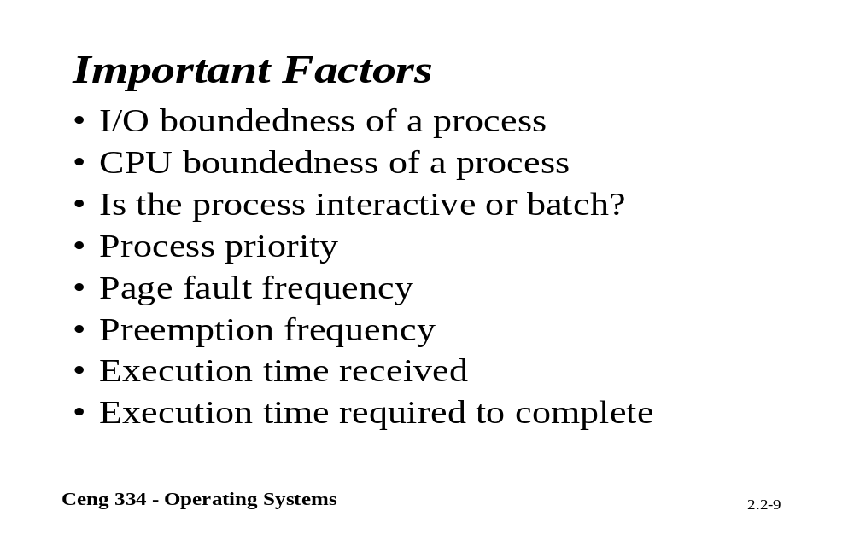
Important Factors

Slide 18
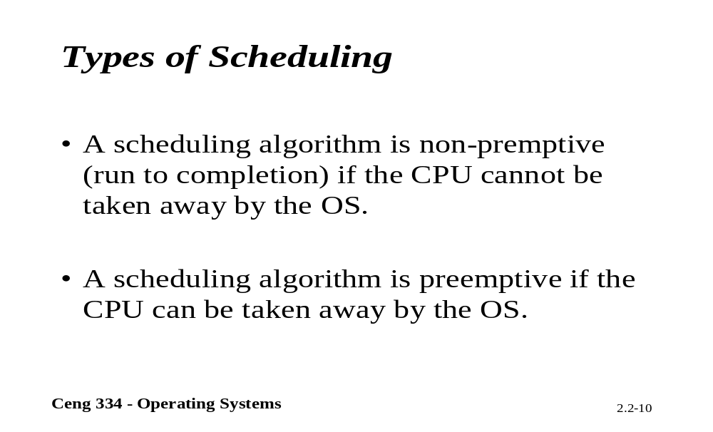
Types of Scheduling

Slide 19
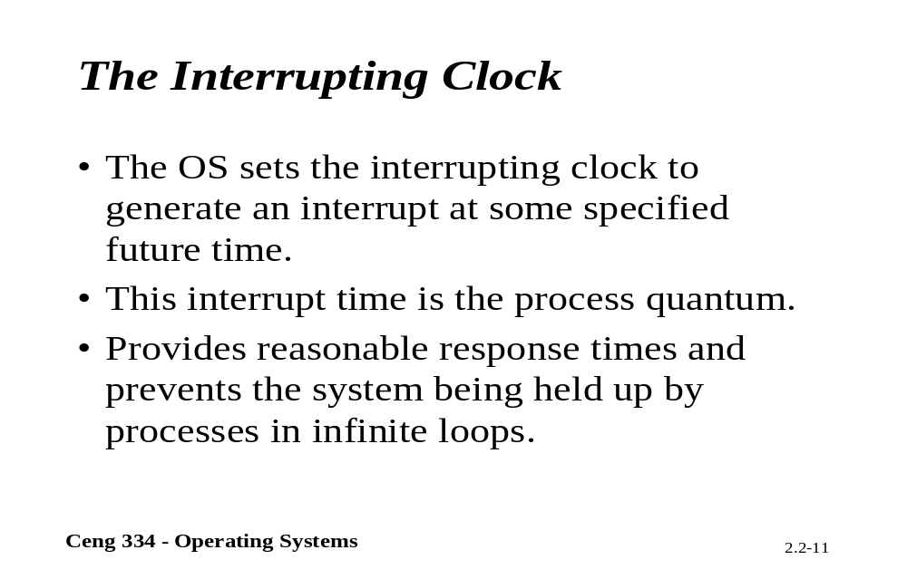
The Interrupting Clock

Slide 20
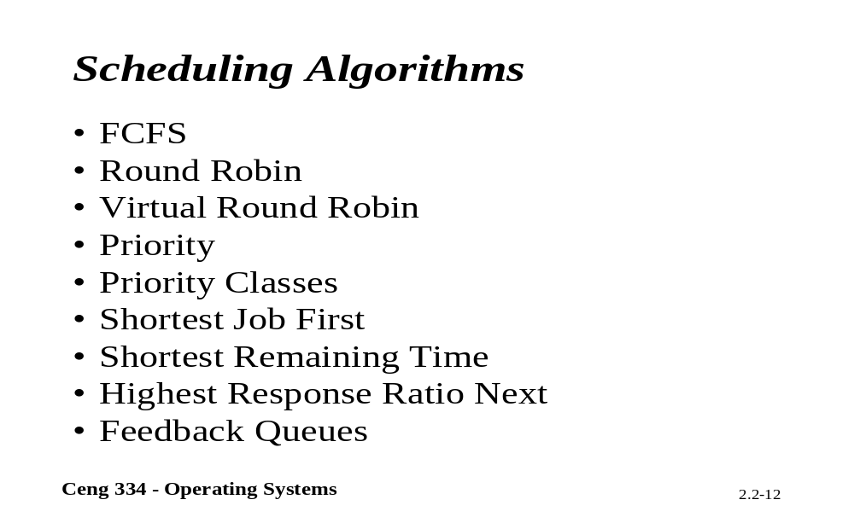
Scheduling Algorithms

Slide 21
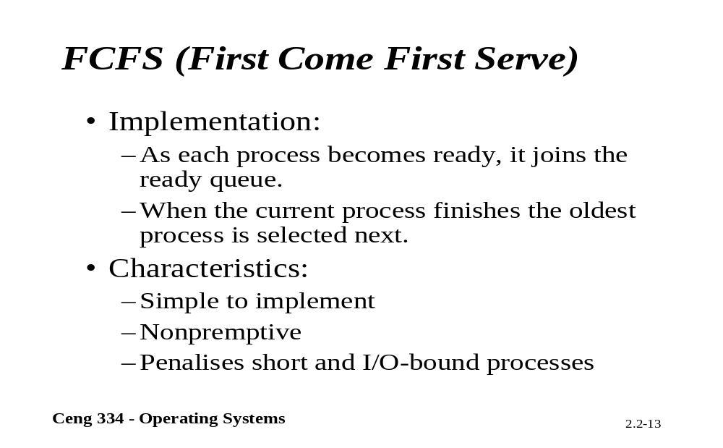
FCFS

Slide 22
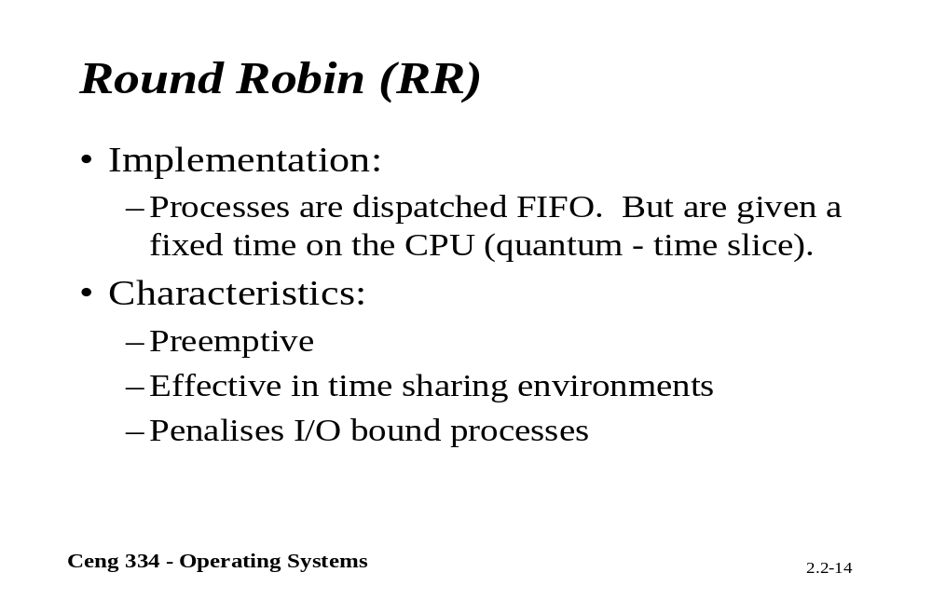
Round Robin

Slide 23
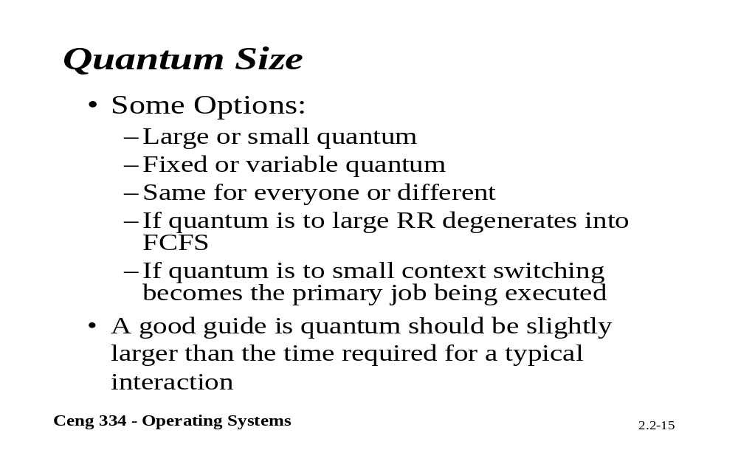
Quantum Size

Slide 24
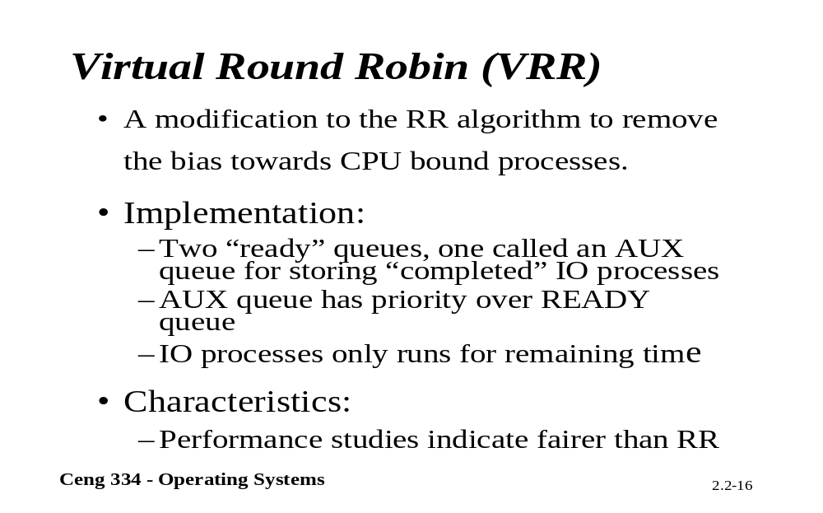
VRR

Slide 25
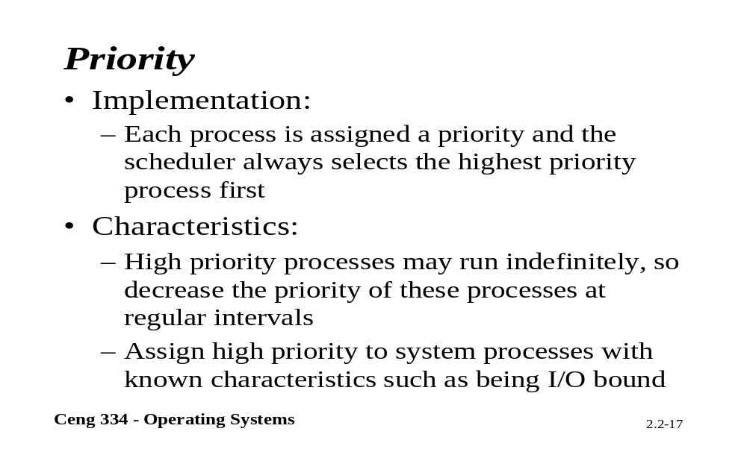
Priority

Slide 26
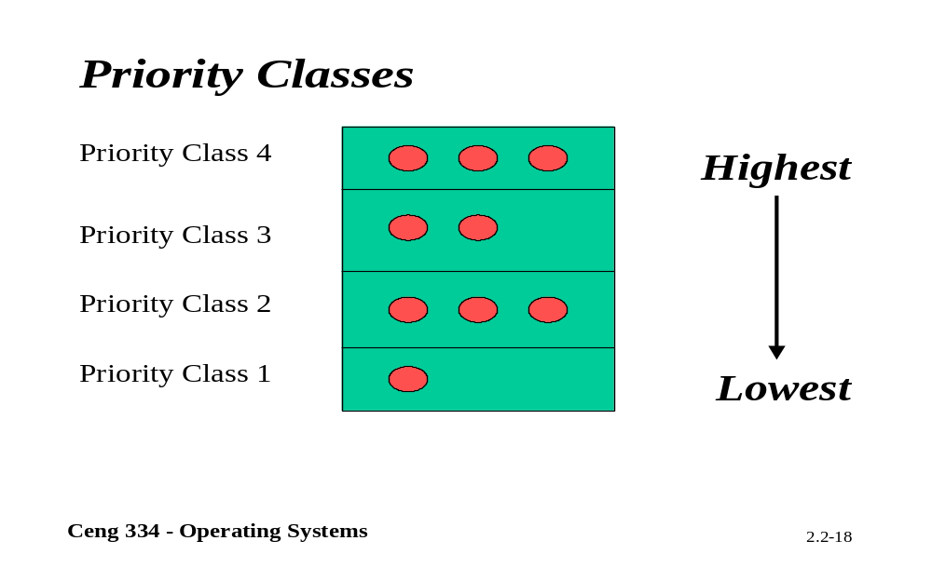
Priority Classes

Slide 27
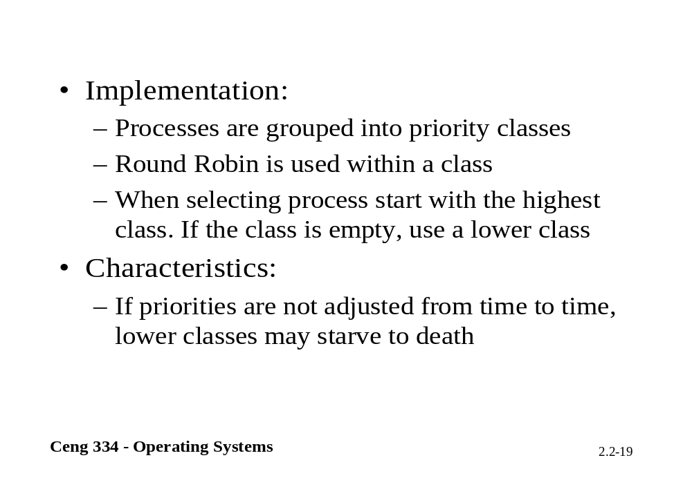

Slide 28
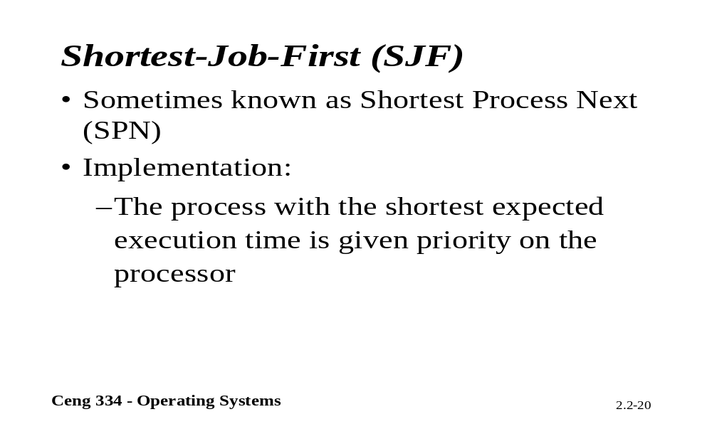
SJF

Slide 29
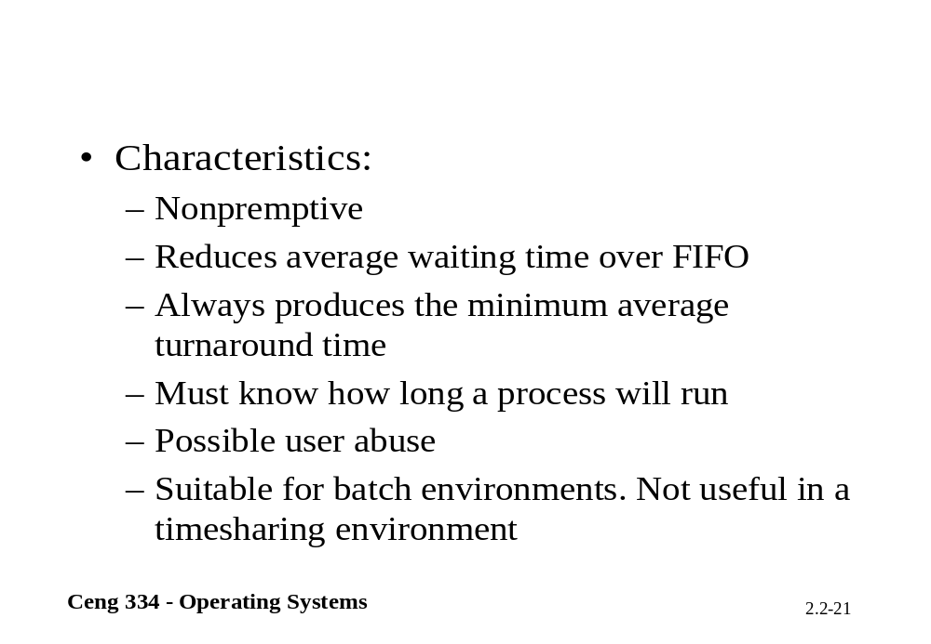

Slide 30
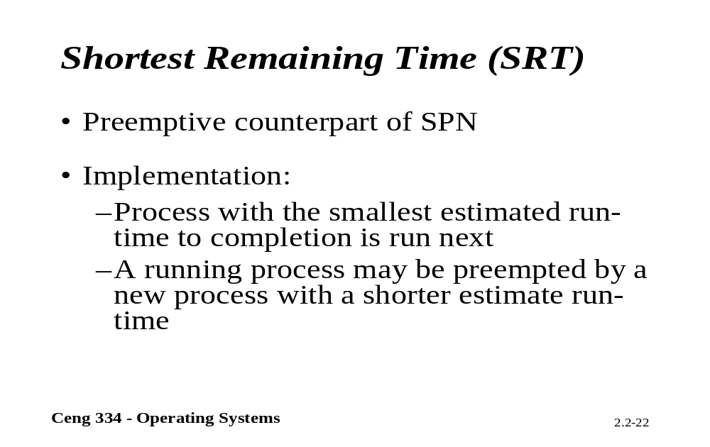
SRT

Slide 31
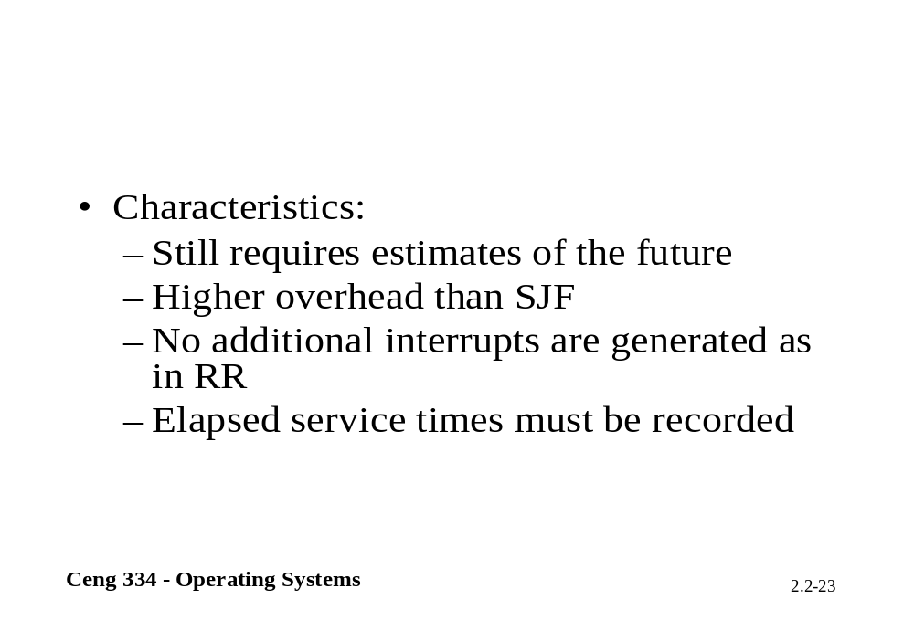

Slide 32
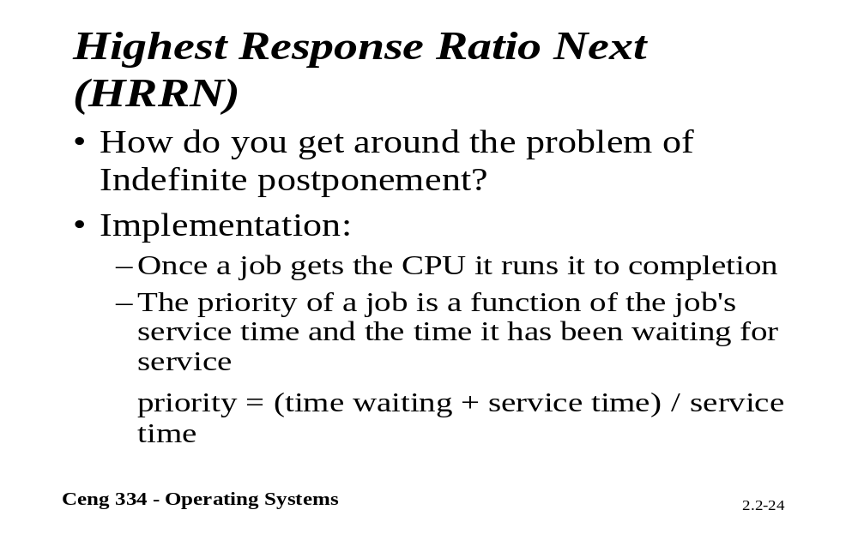
HRRN

Slide 33
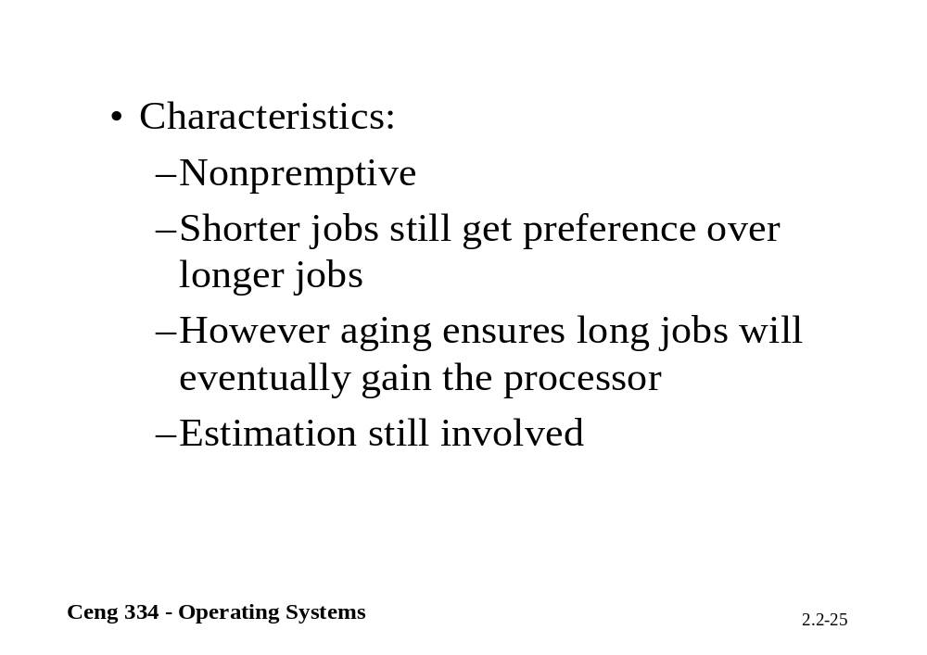

Slide 34
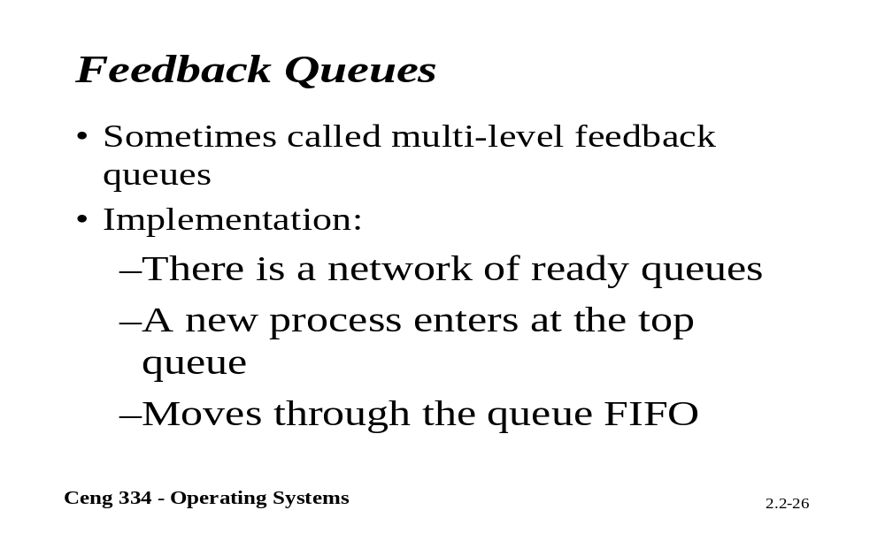
Feedback Queues

Slide 35
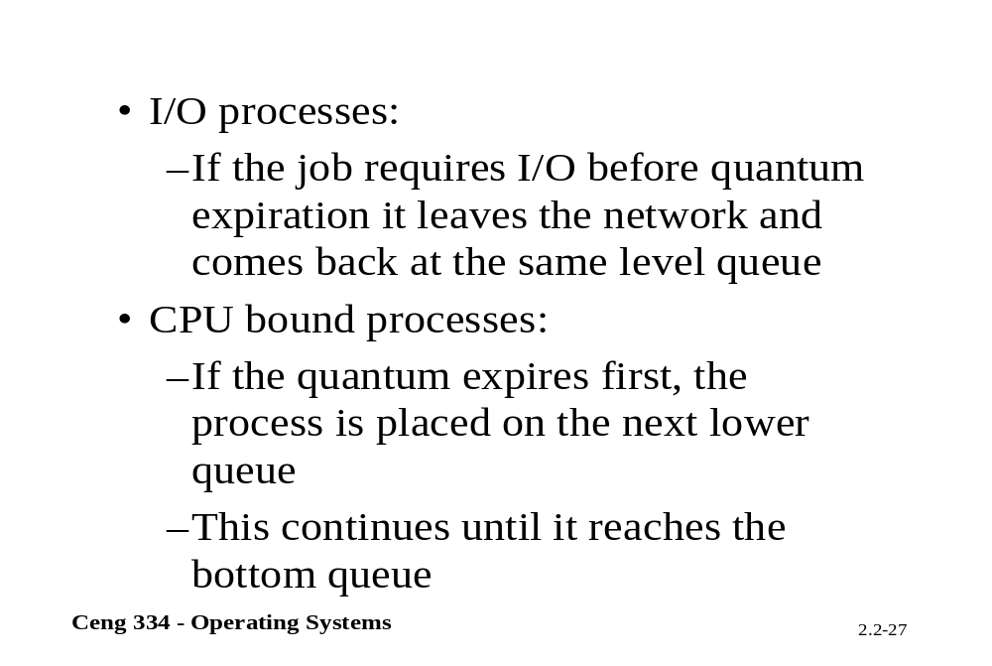

Slide 36
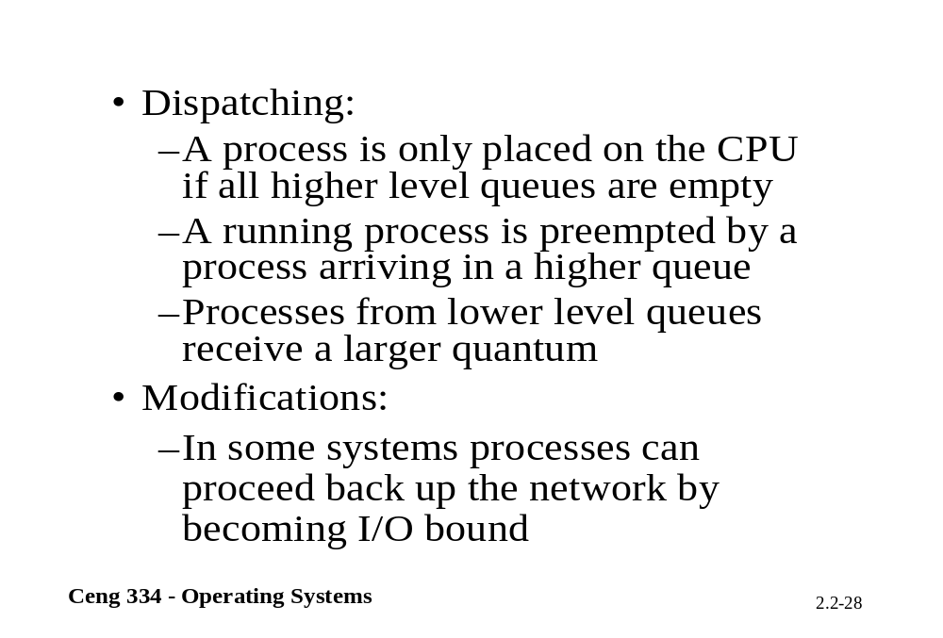

Slide 37
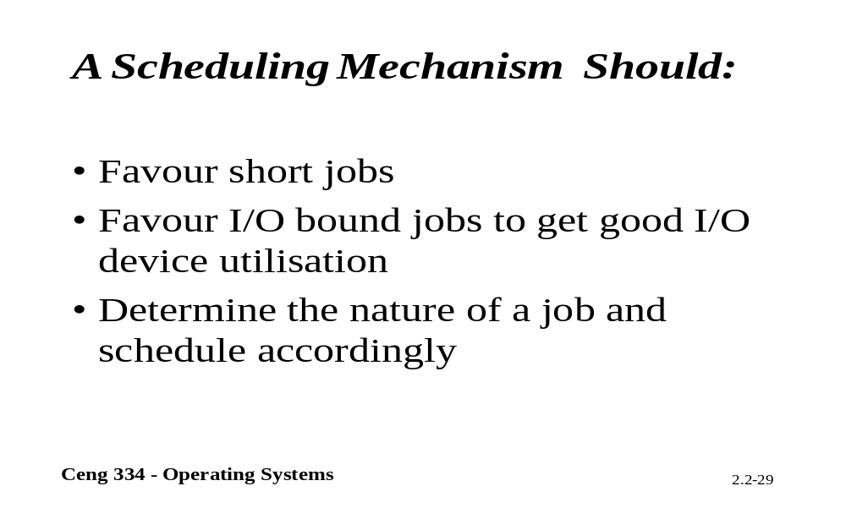
A sheduling mechanism ?

Slide 38
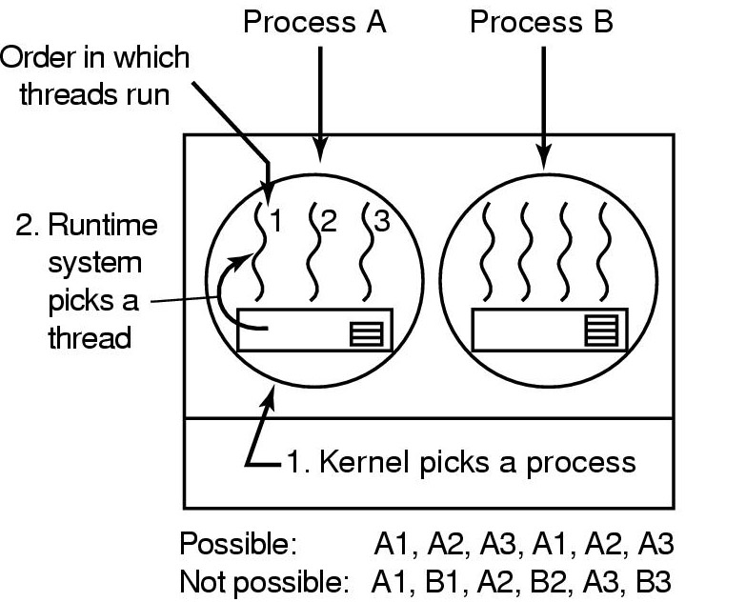
Thread Scheduling (1)
Possible scheduling of user-level threads
50-msec process quantum
threads run 5 msec/CPU burst

Slide 39
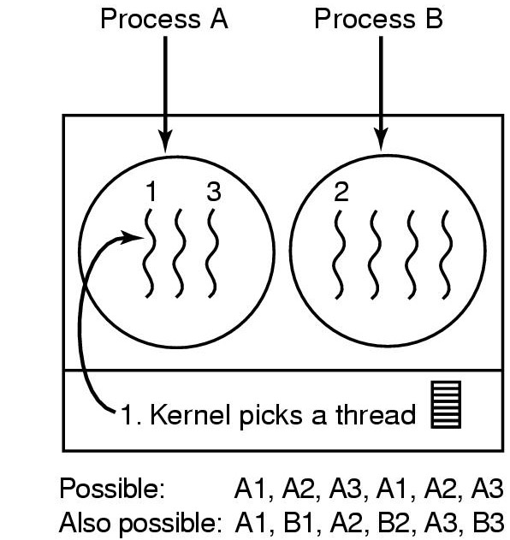
Thread Scheduling (2)
Possible scheduling of kernel-level threads
50-msec process quantum
threads run 5 msec/CPU burst

Slide 40
Policy versus Mechanism
Separate what is allowed to be done with how it is done
  a process knows which of its children threads are important and need priority
Scheduling algorithm parameterized
  mechanism in the kernel
Parameters filled in by user processes
  policy set by user process

