Slide 1
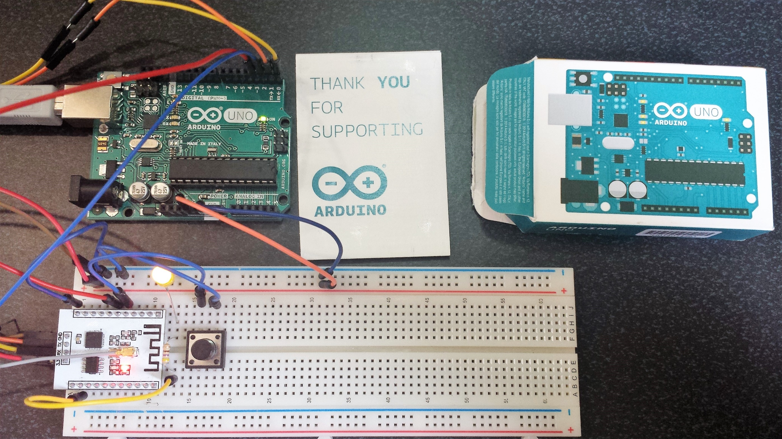

Slide 2
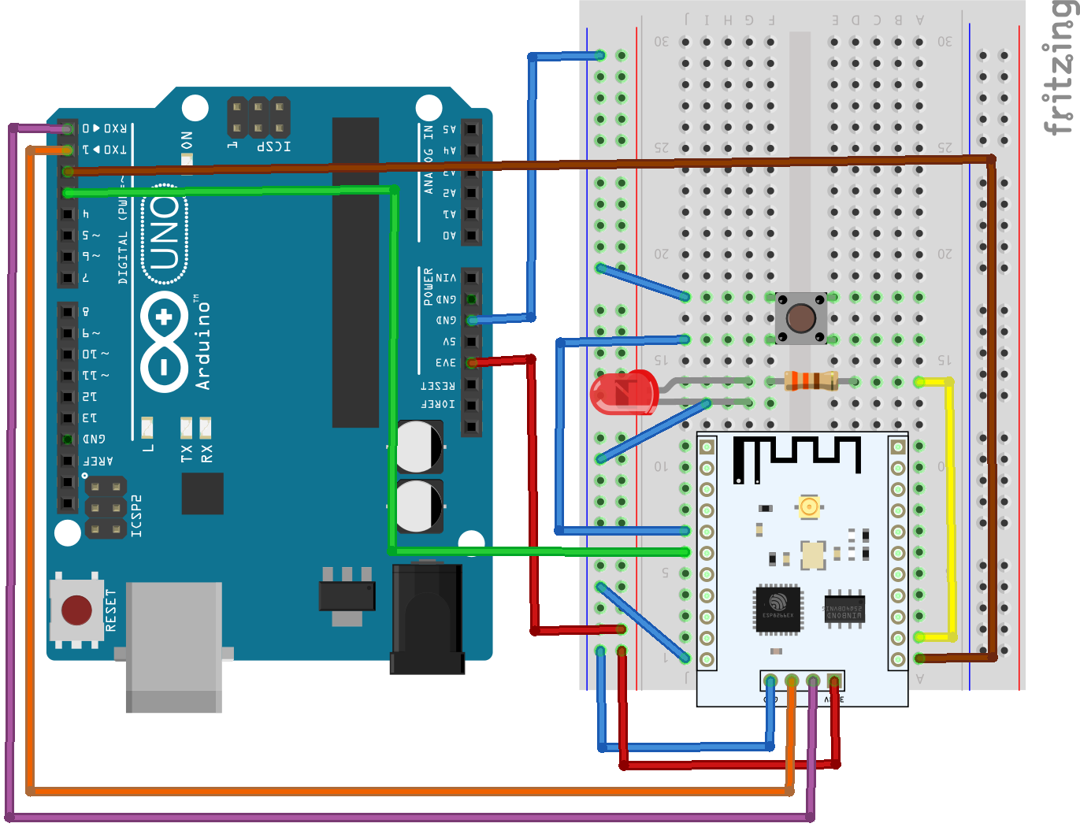
Wire as show and press button (Long push)
The LED goes ON (Important)

Slide 3
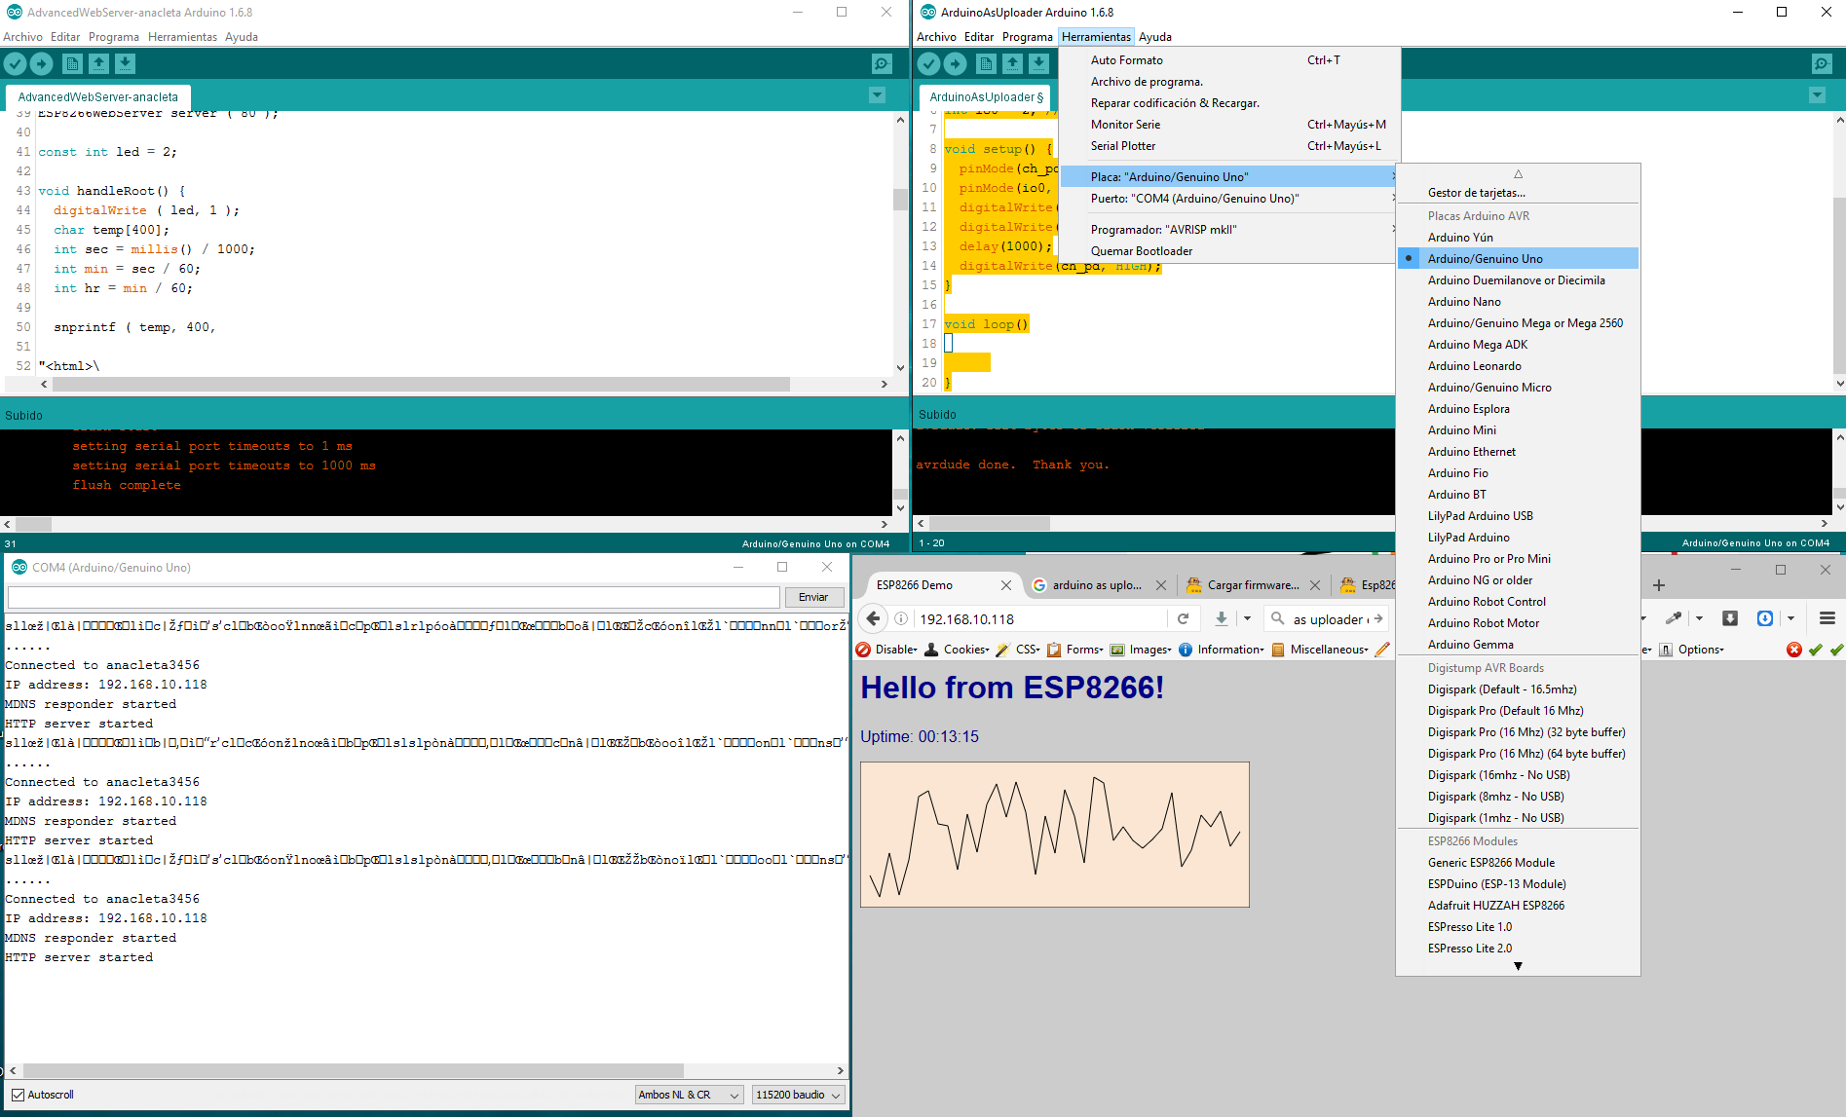
1.-

Slide 4
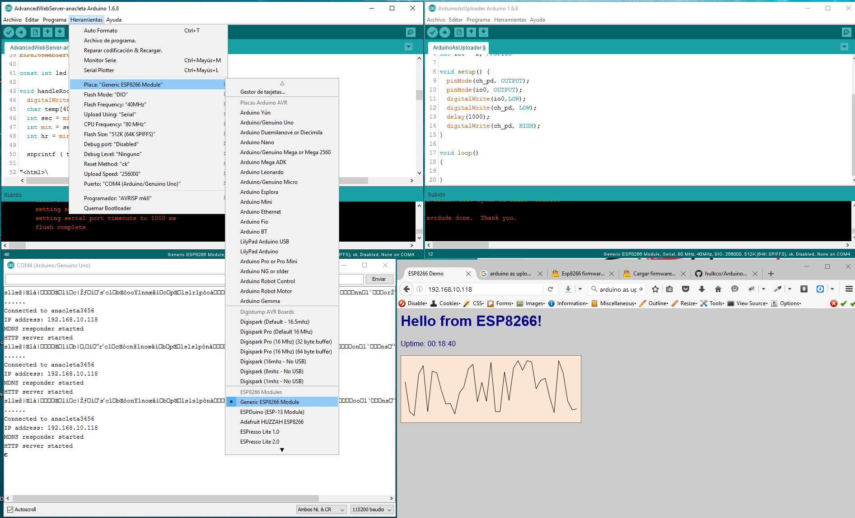
2.-
Go to:
https://github.com/esp8266/Arduino#installing-with-boards-manager

Slide 5
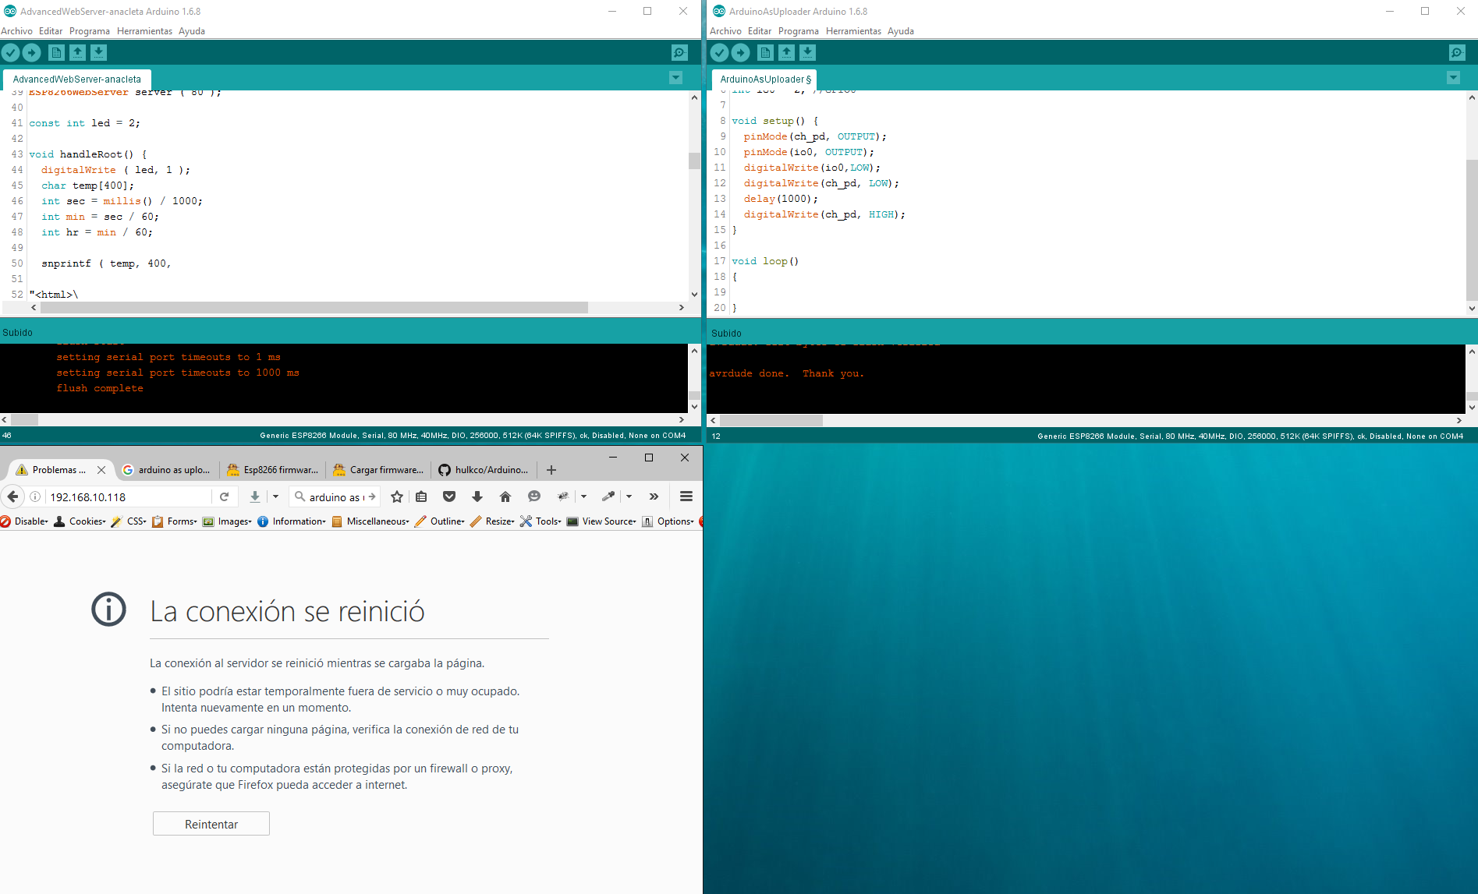
3.-
Close Monitor before upload.

Slide 6
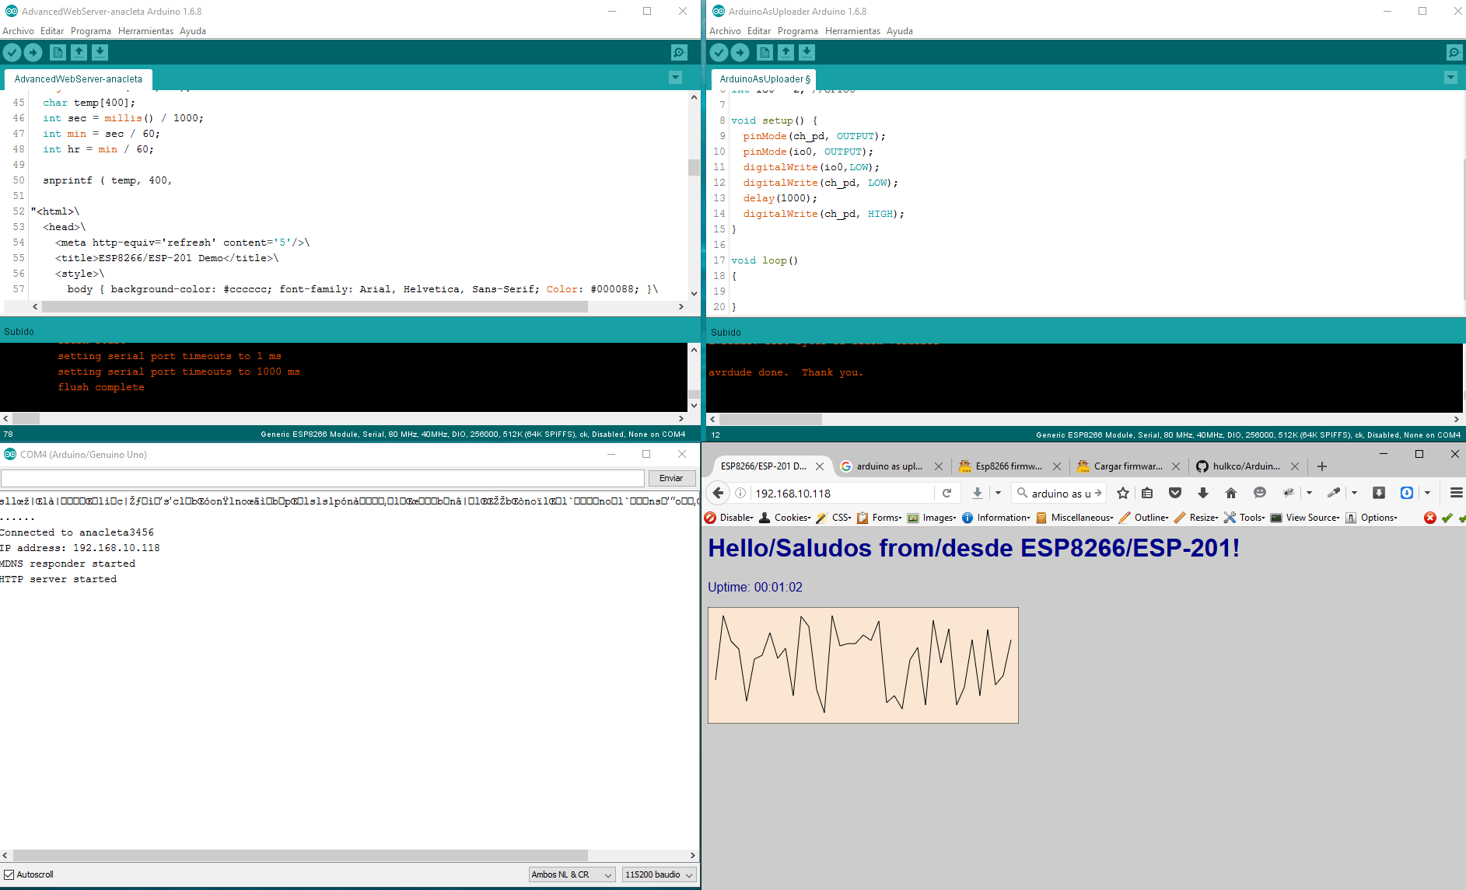
4.-
Open Monitor, copy IP as show,
in your browser, thas all.

