Slide 1

郑大晔校
Notes:
郑大晔校的目标、纪律以及本期课程的计划; 破冰

Slide 2
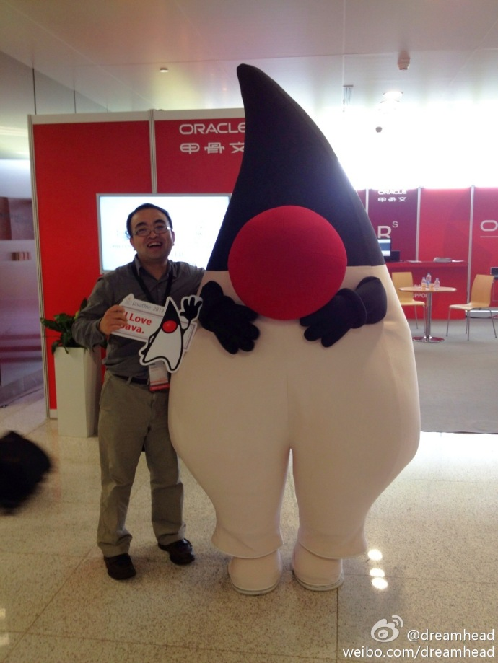
Notes:
Duke’s Choice Awards 2013

Slide 3
Goals / Expectations
Get you well prepared for coming TW work
Reach TW grads baseline
Clarify learning directions
Get you hands dirty of coding
Understand TW work style
Track yourself progress

Slide 4
Ground Rules
Be on time, sign-up each time
Inform the Owner for taking leave in advance
Mobile Phones Off
No Side Conversations
Get back in time after breaks
Participate Actively
Complete homework

Slide 5
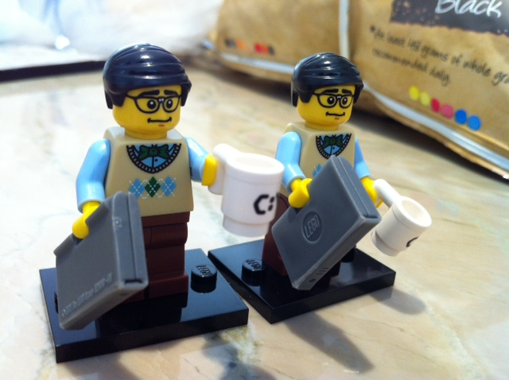
Buddy
Notes:
Review homework
Query for questions, technical, non-technical
Weekly catch-up
Buddy是做什么的？全方位的帮助：举例
怎样更好的“利用”Buddy？积极主动，有事没事骚扰Buddy；有问题第一时间找Buddy；对Buddy提出的建议认可的执行，不认可的告知为什么不认可；etc （再往里面加一些内容）
与Buddy的互动：可以给Buddy提反馈，非常必要。可以反映出跟Buddy沟通的效果，并且更好地帮助Buddy提升。
与Buddy“河蟹”相处需要时间：去年毕业生的经历告诉我们，最开始跟Buddy建立信任需要时间。如果过程当中有任何疑问，可以直接找HR。

Slide 6

Notes:
Safe to provide feedback, ThoughtWorks culture
How to provide feedback.
Pair
Coach
Session
Buddy

Slide 7
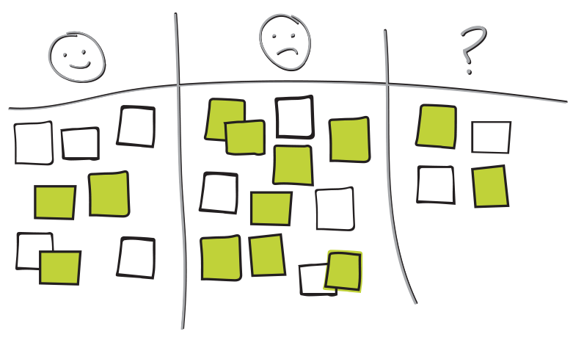
RETROSpective

Slide 8
Agenda: Round 1
13:00 – 13:30 | Ice breaker | Nick
13:30 – 14:00 | Welcome to Night School | Nick
14:00 – 14:10 | Break
14:10 – 15:10 | Session 1 | Honglai
15:10 – 15:20 | Break
15:20 – 16:20 | Session 1 – Con. | Honglai
16:20 – 16:30 | Break
16:30 - 17:00 | Retro | Hongwei

Slide 9


