Slide 1
Distributed Databases
CS347
Lecture 14
May 30, 2001

Slide 2
Topics for the Day
Query processing in distributed databases
  Localization
  Distributed query operators
  Cost-based optimization

Slide 3
Query Processing Steps
Decomposition
  Given SQL query, generate one or more algebraic query trees
Localization
  Rewrite query trees, replacing relations by fragments
Optimization
  Given cost model + one or more localized query trees
  Produce minimum cost query execution plan

Slide 4
Decomposition
Same as in a centralized DBMS
Normalization (usually into relational algebra)
Select A,C
From R Natural Join S
Where (R.B = 1 and S.D = 2) or (R.C > 3 and S.D = 2)
σ (R.B = 1 v R.C > 3) ∧ (S.D = 2)
R S
Conjunctive
normal
form

Slide 5
Decomposition
Redundancy elimination
  (S.A = 1) ∧ (S.A > 5) ⇒ False
  (S.A < 10) ∧ (S.A < 5) ⇒ S.A < 5
Algebraic Rewriting
  Example: pushing conditions down
σcond3
σcond
σcond1
σcond2
S
T
S
T

Slide 6
Localization Steps
Start with query tree
Replace relations by fragments
Push ∪ up & π,σ down (CS245 rules)
Simplify – eliminating unnecessary operations
Note: To denote fragments in query trees
[R: cond]
Relation that fragment belongs to Condition its tuples satisfy

Slide 7
Example 1
σE=3
∪
[R: E<10] [R: E ≥ 10]
σE=3
R
∪
σE=3 σE=3
[R: E<10] [R: E ≥ 10]
σE=3
[R: E<10]

Slide 8
Example 2
A
A
R S
∪
∪
[R: A<5] [R: 5 ≤ A ≤ 10] [R: A>10]
[S: A<5] [S: A ≥ 5]
R1
R2
R3
S1
S2

Slide 9
∪
A
A
A
A
A
A
R1 S1 R1 S2 R2 S1 R2 S2 R3 S1 R3 S2
∪
A
A
A
[R:A<5][S:A<5] [R:5≤A≤10] [S:A≥5] [R:A>10][S:A≥5]

Slide 10
Rules for Horiz. Fragmentation
σ_{C1}[R: C₂] ⇒ [R: C₁ ∧ C₂]
[R: False] ⇒ Ø
[R: C₁] [S: C₂] ⇒ [R S: C₁ ∧ C₂ ∧ R.A = S.A]
In Example 1:
σ_{E=3}[R₂: E ≥ 10] ⇒ [R₂: E=3 ∧ E ≥ 10]
⇒ [R₂: False] ⇒ Ø
In Example 2:
[R: A<5] [S: A ≥ 5]
⇒ [R S: R.A < 5 ∧ S.A ≥ 5 ∧ R.A = S.A]
⇒ [R S: False] ⇒ Ø
A
A
A
A
A

Slide 11
Example 3 – Derived Fragmentation
S’s fragmentation is derived from that of R.
K
R S
K
∪
∪
[R: A<10] [R: A ≥ 10] [S: K=R.K ∧ R.A<10] [S: K=R.K ∧ R.A≥10]
R₁
R₂
S₁
S₂

Slide 12
∪
K
K
K
K
R₁
S₁
R₁
S₂
R₂
S₁
R₂
S₂
∪
K
K
[R: A<10] [S: K=R.K ∧ R.A<10]
[R: A ≥ 10] [S: K=R.K ∧ R.A ≥ 10]

Slide 13
Example 4 – Vertical Fragmentation
Π_{A}
R₁(K,A,B) R₂(K,C,D)
Π_{A}
R
K
Π_{A}
Π_{K,A} Π_{K,A}
R₁(K,A,B) R₂(K,C,D)
Π_{A}
R₁(K,A,B)
K

Slide 14
Rule for Vertical Fragmentation
Given vertical fragmentation of R(A):
R_{i} = Π_{Ai}(R), A_{i} ⊆ A
For any B ⊆ A:
Π_{B} (R) = Π_{B} [ R_{i} | B ∩ A_{i} ≠ Ø]
i

Slide 15
Parallel/Distributed Query Operations
Sort
  Basic sort
  Range-partitioning sort
  Parallel external sort-merge
Join
  Partitioned join
  Asymmetric fragment and replicate join
  General fragment and replicate join
  Semi-join programs
Aggregation and duplicate removal

Slide 16
Parallel/distributed sort
Input: relation R on
  single site/disk
  fragmented/partitioned by sort attribute
  fragmented/partitioned by some other attribute
Output: sorted relation R
  single site/disk
  individual sorted fragments/partitions

Slide 17
Basic sort
Given R(A,…) range partitioned on attribute A, sort R on A
Each fragment is sorted independently
Results shipped elsewhere if necessary
11
7
27
10
17
20
3
22
14
11
3
22
10
14
20
7
27
17

Slide 18
Range partitioning sort
Given R(A,….) located at one or more sites, not fragmented on A, sort R on A
Algorithm: range partition on A and then do basic sort
R_{a}
R₁
Local sort
R_{1s}
a₀
R_{b}
Local sort
Result
R₂
R_{2s}
a₁
Local sort
R_{3s}
R₃

Slide 19
Selecting a partitioning vector
Possible centralized approach using a “coordinator”
  Each site sends statistics about its fragment to coordinator
  Coordinator decides # of sites to use for local sort
  Coordinator computes and distributes partitioning vector
For example,
  Statistics could be (min sort key, max sort key, # of tuples)
  Coordinator tries to choose vector that equally partitions relation

Slide 20
Example
Coordinator receives:
  From site 1: Min 5, Max 9, 10 tuples
  From site 2: Min 7, Max 16, 10 tuples
Assume sort keys distributed uniformly within [min,max] in each fragment
Partition R into two fragments
What is k₀?
5 10 15 20
k₀

Slide 21
Variations
Different kinds of statistics
  Local partitioning vector
  Histogram
Multiple rounds between coordinator and sites
  Sites send statistics
  Coordinator computes and distributes initial vector V
  Sites tell coordinator the number of tuples that fall in each range of V
  Coordinator computes final partitioning vector V_{f}
Site 1
3
4
3
# of tuples
5 6 8 10
local vector

Slide 22
Parallel external sort-merge
Local sort
Compute partition vector
Merge sorted streams at final sites
In order
R₁
R_{a}
Local sort
R_{as}
a₀
Result
R₂
R_{b}
Local sort
R_{bs}
a₁
R₃

Slide 23
Parallel/distributed join
Input: Relations R, S
May or may not be partitioned
Output: R S
Result at one or more sites

Slide 24
Partitioned Join
Join attribute A
Local join
R₁
S₁
R_{a}
S_{a}
R₂
S₂
R_{b}
S_{b}
R₃
S₃
f(A)
Result
f(A)
Note: Works only for equi-joins

Slide 25
Partitioned Join
Same partition function (f) for both relations
f can be range or hash partitioning
Any type of local join (nested-loop, hash, merge, etc.) can be used
Several possible scheduling options. Example:
  partition R; partition S; join
  partition R; build local hash table for R; partition S and join
Good partition function important
  Distribute join load evenly among sites

Slide 26
Asymmetric fragment + replicate join
Join attribute A
Local join
R₁
S
R_{a}
S_{a}
R₂
S
R_{b}
S_{b}
R₃
S
f
union
Partition function
Result
Any partition function f can be used (even round-robin)
Can be used for any kind of join, not just equi-joins

Slide 27
General fragment + replicate join
R₁
R₁
R_{a}
R₂
Replicate m copies
R₂
R_{b}
R_{n}
R_{n}
Partition
S₁
S₁
S_{a}
S₂
Replicate n copies
S₂
S_{b}
S_{m}
S_{m}
Partition

Slide 28
R₁
S₁
R₁
S_{m}
R₂
S₁
R₂
S_{m}
All n x m pairings of
R,S fragments
R_{n}
S₁
R_{n}
S_{m}
Result
Asymmetric F+R join is a special case of general F+R.
Asymmetric F+R is useful when S is small.

Slide 29
Semi-join programs
Used to reduce communication traffic during join processing
R S = (R S) S
= R (S R)
= (R S) (S R)

Slide 30
Example
A
B
A
C
2
a
3
x
S
R
10
b
10
y
25
c
15
z
30
d
25
w
Compute
S (R S)
Π_{A}(S) = [2,10,25,30]
32
x
R S =
10
y
25
w
Using semi-join, communication cost = 4 A + 2 (A + C) + result
Directly joining R and S, communication cost = 4 (A + B) + result

Slide 31
Comparing communication costs
Say R is the smaller of the two relations R and S
(R S) S is cheaper than R S if
size (Π_{A}S) + size (R S) < size (R)
Similar comparisons for other types of semi-joins
Common implementation trick:
  Encode Π_{A}S (or Π_{A}R) as a bit vector
  1 bit per domain of attribute A
0 0 1 1 0 1 0 0 0 0 1 0 1 0 0

Slide 32
n-way joins
To compute R S T
  Semi-join program 1: R’ S’ T
  where R’ = R S & S’ = S T
  Semi-join program 2: R’’ S’ T
  where R’’ = R S’ & S’ = S T
  Several other options
In general, number of options is exponential in the number of relations

Slide 33
Other operations
Duplicate elimination
  Sort first (in parallel), then eliminate duplicates in the result
  Partition tuples (range or hash) and eliminate duplicates locally
Aggregates
  Partition by grouping attributes; compute aggregates locally at each site

Slide 34
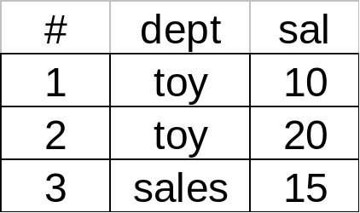
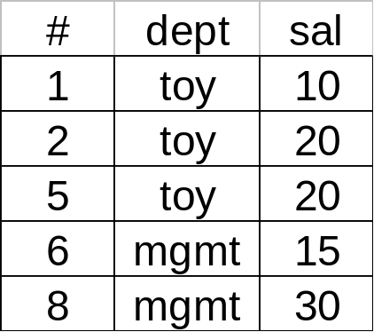
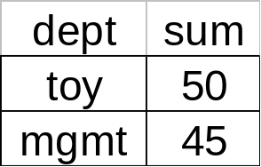
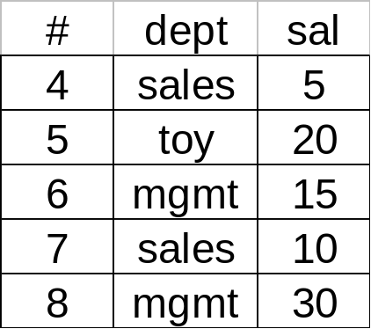
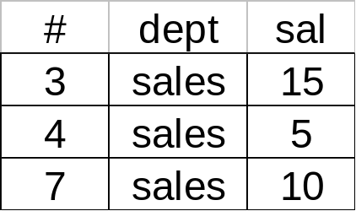
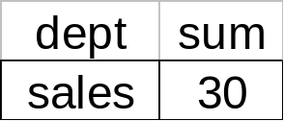
Example
sum
R_{a}
R_{b}
sum
sum(sal) group by dept

Slide 35
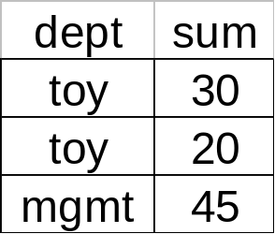
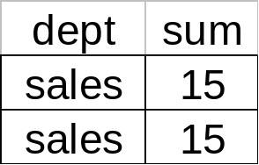
Example
sum
sum
R_{a}
R_{b}
sum
sum
Does this work for all kinds of aggregates?
Aggregate during partitioning to reduce communication cost

Slide 36
Query Optimization
Generate query execution plans (QEPs)
Estimate cost of each QEP ($,time,…)
Choose minimum cost QEP
What’s different for distributed DB?
  New strategies for some operations (semi-join, range-partitioning sort,…)
  Many ways to assign and schedule processors
  Some factors besides number of IO’s in the cost model

Slide 37
Cost estimation
In centralized systems - estimate sizes of intermediate relations
For distributed systems
  Transmission cost/time may dominate
  Account for parallelism
  Data distribution and result re-assembly cost/time
Work at site
T1
Work at site
T2
answer
Plan B
Plan A
50 IOs
70 IOs
100 IOs
20 IOs

Slide 38
Optimization in distributed DBs
Two levels of optimization
Global optimization
  Given localized query and cost function
  Output optimized (min. cost) QEP that includes relational and communication operations on fragments
Local optimization
  At each site involved in query execution
  Portion of the QEP at a given site optimized using techniques from centralized DB systems

Slide 39
Search strategies
Exhaustive (with pruning)
Hill climbing (greedy)
Query separation

Slide 40
Exhaustive with Pruning
A fixed set of techniques for each relational operator
Search space = “all” possible QEPs with this set of techniques
Prune search space using heuristics
Choose minimum cost QEP from rest of search space

Slide 41
|R|>|S|>|T|
Example
A
B
R
S
T
R S T
R S R×T S R S T T S T×R
(S R) T (T S) R
2
1
2
1
Ship S to R
Semi-join
Ship T to S
Semi-join
1
Prune because cross-product not necessary
Prune because larger relation first
2

Slide 42
Hill Climbing
2
Initial plan
1
x
Begin with initial feasible QEP
At each step, generate a set S of new QEPs by applying ‘transformations’ to current QEP
Evaluate cost of each QEP in S
Stop if no improvement is possible
Otherwise, replace current QEP by the minimum cost QEP from S and iterate

Slide 43
Example
Goal: minimize communication cost
Initial plan: send all relations to one site
To site 1: cost=20+30+40= 90
To site 2: cost=10+30+40= 80
To site 3: cost=10+20+40= 70
To site 4: cost=10+20+30= 60
Transformation: send a relation to its neighbor
R S T V
R
S
T
V
A
B
C
Rel. Site # of tuples
R 1 10 S 2 20 T 3 30 V 4 40

Slide 44
Local search
Initial feasible plan
P0: R (1 → 4); S (2 → 4); T (3 → 4)
Compute join at site 4
Assume following sizes: R S ⇒ 20
S T ⇒ 5
T V ⇒ 1

Slide 45
No change
4
20
R S
cost = 30
10
1
2
cost = 30
R
4
10
20
R
S
4
cost = 40
1
2
S R
20
1
20
2
S
Worse

Slide 46
Improvement
4
T S
cost = 35
5
cost = 50
2
30
3
T
4
S
T
20
30
4
cost = 25
2
3
S T
5
2
20
3
S
Improvement

Slide 47
Next iteration
P1: S (2 → 3); R (1 → 4); α (3 → 4)
where α = S T
Compute answer at site 4
Now apply same transformation to R and α
4
α R
1
α
3
4
R
α
4
1
3
R α
1
3
R

Slide 48
Resources
Ozsu and Valduriez. “Principles of Distributed Database Systems” – Chapters 7, 8, and 9.

